Slide 1
Stat 414 – Day 9
Three-level models (4.9)

Slide 2
Plan for today
Project proposals submitted in PolyLearn
Review Exam 1
Intraclass correlation and effective sample size
Three-level random intercepts models
Due Friday
New version of last exam question

Slide 3
Exam 1
Average: .825 (55 pts), high = 48.5
Solutions online
Reminders
Interpreting intercept: also consider “group effect = 0”
Standard errors…

Slide 4
Standard errors
p. 4 of handout

Slide 5
Examples
Group randomized trials
Power: necessary sample size could be much larger
Observational data
$\frac{4σ^{2}}{kn}(1+\left(n−1\right)ICC$)

Slide 6
Last Time: Netherlands Language Test
If ignore school to school variation
With random school effects
This slope is 3SE from first slope!
This intercept SE is twice as large

Slide 7
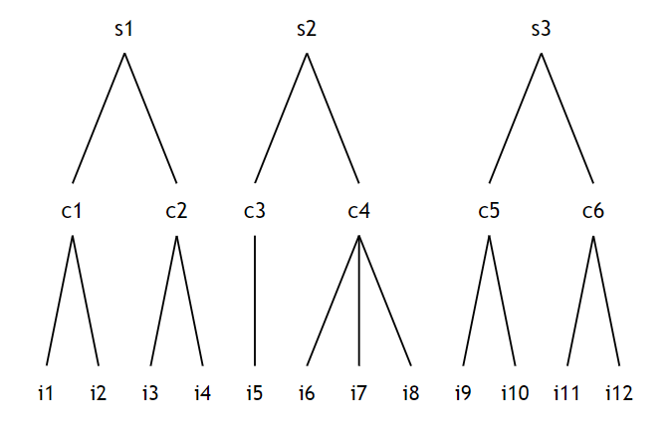
Three-level model

Slide 8
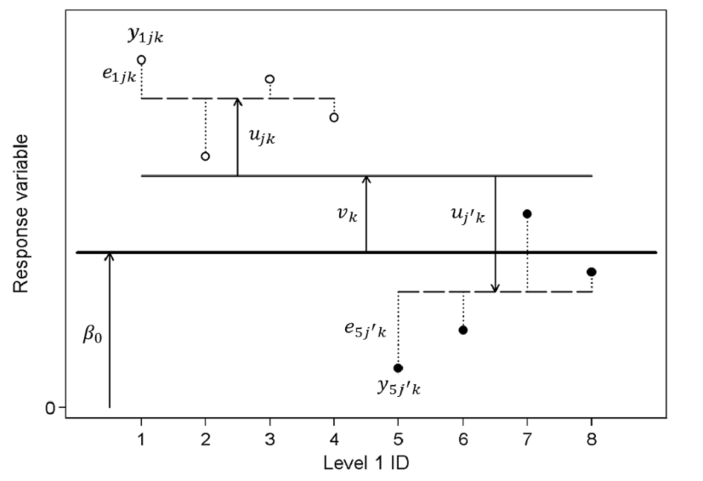
Three-level model

Slide 9
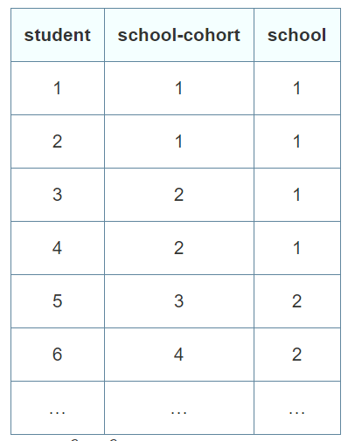
Covariances…
class
Divide by total variance to get correlations
1 2 3 4 5 6
1
2
3
4
5
6

Slide 10
Possible conclusions
Students from the same class are significantly more alike than students from different classes.
Similarly, students taught in the same school are significantly more homogenous than students taught in different school-cohorts.
A multilevel approach preferred over a single-level approach and over carrying out either of the potential two-level analyses of these data.

Slide 11
How compare models?
Model with no random effects?
Model with only Level 2 random effects?
Model with only Level 3 random effects?

