Slide 1
Stat 414 – Day 5
Random effects

Slide 2
Last Time
Likelihood ratio tests
For “nested models” can compare the likelihoods of the models (with and without terms)
χ² = -2(L_{reduced} – L_{full}) ∼ χ² df = number of parameters set equal to zero in Ho

Slide 3
Likelihood ratio test
Intuitively, when the likelihood for the larger model is much greater than it is for the reduced model, we have evidence that the larger model is more closely aligned with the observed data. This isn’t really a fair comparison on the face of it. We need to account for the fact that more parameters were estimated and used for the larger model.
That is accomplished by taking into account the degrees of freedom for the χ2 distribution. The expected value of the χ2 distribution is its degrees of freedom. Thus when the difference in the number of parameters is large, the test statistic will need to be much larger to convince us that it is not simply chance variation with two identical models.

Slide 4
Last Time
Likelihood ratio tests
For “nested models” can compare the likelihoods of the models (with and without terms)
χ² = -2(L_{reduced} – L_{full}) ∼ χ² df = number of parameters set equal to zero in Ho
But provides a biased estimator of σ²
${\hat{σ}}_{MLE}=SSE/n$
E(σ_{MLE}²) = (n – p – 1)/n σ² < σ²
OLS divide by (n – p – 1)
REML, maximize a likelihood not depending on β’s

Slide 5
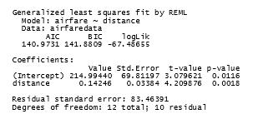
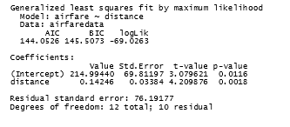
Restricted Maximum Likelihood Est.
With gls can ask for ML or REML estimation
$SE\left({\hat{β}}_{1}\right)=\hat{σ}/{(s}_{x}\sqrt{n−1})$
= 83.46/(743*sqrt(11))
= 0.03387

Slide 6
REML vs. ML
To compare fixed effects in models with the same random structure,
Use REML standard errors for t/F tests
Use ML for nested LRTests
(Variable selection)
To compare models with different random structures (same fixed component)
Can use either (REML)
For final model estimates
Use REML
Notes:
Use REML standard errors for t-tests and F-tests of fixed effects

Slide 7
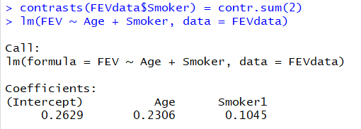
Indicator vs. Effect Coding

Slide 8
Day 5 handout
Work with partner
Practice R commands

Slide 9
To Do
Submit HW 2
Read Ch. 3

