Slide 1
Stat 414 – Day 17
Logistic regression
Cross-level hierarchies

Slide 2
Logistics
HW 7 due Friday
No in person office hours the rest of this week
Submit Project 3?
Initial models
Time to work on projects Week 10
Final project report due Dec. 9
No final presentation
See “project assignment” in PolyLearn for details
Final exam Dec. 10 (10:10-1pm)

Slide 3
Project advice
Tell a story with the data
Clearly identify primary variables (e.g., RV)
Don’t just list numbers
Don’t assume audience is familiar with your data
Use graphs to help tell your story
How the graphs and the model agree
Concern vs. interesting feature
Model vs. data
Start simple (impress with visuals, quality)
Why multilevel, structure of the data, assumptions (audience)
Null model, ICC
Be ready to justify choices
Keep audience’s interest
Notes:
Don’t start sentences with numbers, significant digits, tables

Slide 4
Project advice
Graphs of models
Features of “final model”
Includes important EVs (research question, covariates)
Potential interactions have been investigated
Variables are centered where can enhance interpretation
Unnecessary terms have been removed
Checked validity using residual plots
Defensible/context

Slide 5
Leftovers
Typically only worry about random slopes at lower levels
Typically cross higher level variables with lower level variables with random slopes

Slide 6
Logistic Regression
When you have a categorical (binary) response, transform the response (counts or 0/1 values) with logit transformation (log-odds)
Log-odds-hat = …..
Slopes: multiplicative change in odds
Intercept: back-transform to predicted probability (odds/(1+odds))

Slide 7
Multilevel Logistic Regression
Y­_{ij} = $π_{j}+ε_{ij}$
but Var($ε_{ij})=π_{j}\left(1−π_{j}\right)$ (weird residuals)
Some software will allow a “scale factor” (overdispersion)
Random intercepts
$log\left[{π_{j}}/{(1−π_{j})}\right]= β_{0}+ u_{0j}$ $where u_{oj} \sim N(0, τ_{0}^{2})$
$τ_{0}^{2}$ represents the community to community variation in intercepts
Assuming probability doesn’t vary within community…
Notes:
Underdispersion implies misspecification of model (e.g., omission of interactions)
Overdispersion can occur if omit important random effects/ level, small group sizes

Slide 8
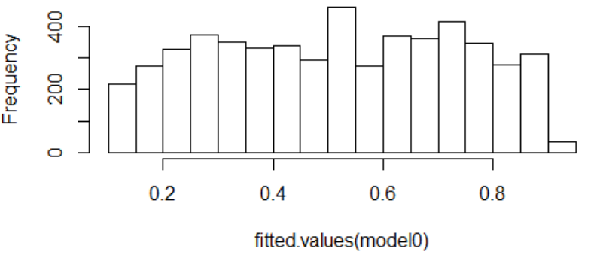
Example 2
Lots of variation in the sample proportions across communities
Statistically significant chi-square test
Random intercepts model
e.¹⁴⁸
(1 + e.¹⁴⁸)
=.537
Notes:
exp($β$₀)/(1 + exp($β$₀)) is the population average probability
Could use scale factor: 3.29s

Slide 9
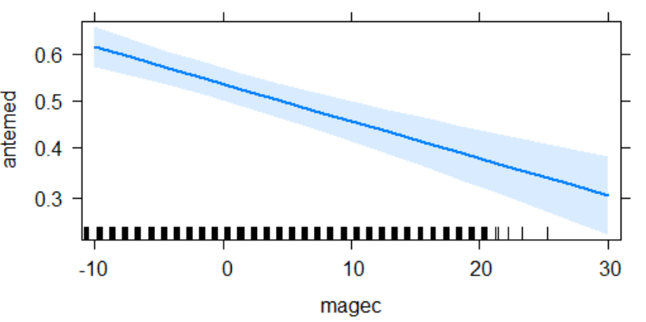
Include mom’s age
Allows probability to change within community
mage = 23.6 years
pred prob = e^{.145}/(1+ e^{.145}) = .536

Slide 10
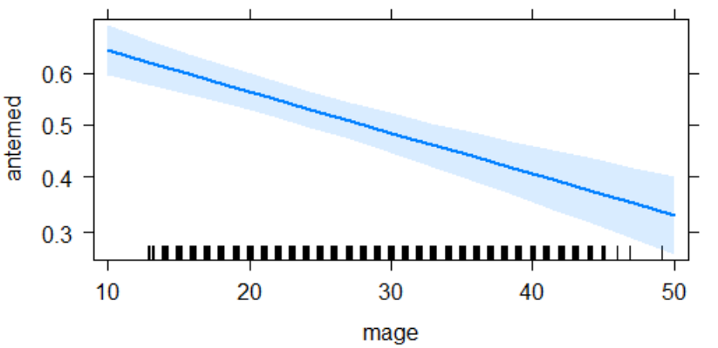
Predicted probability
40-year-old
Predicted log odds = .1446 - .03236(40-23.6) = -.386
Predicted odds = exp(-.386) = .6797
Predicted probability = .6797/1.6797 = .404
In the average community

Slide 11
Predicted probability
33-year-old
Predicted log odds = .1446 - .03236(33-23.6) = -.1596
Predicted probability = .8525/1.8525 = .460
In community 1:
Predicted log odds = .1446 - .03236(33-23.6)-.084 = -.244
Predicted probability = .439

Slide 12
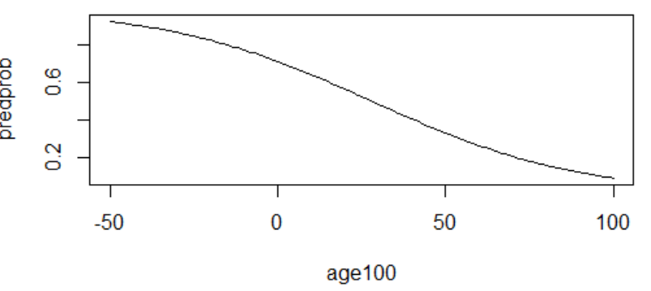
If don’t center
Centered
Uncentered
Each additional year in age, decreases the predicted odds of prenatal care by exp(-.032) = .968 => 3.2%
Over 40 years: .27 or 72%
Age 10: 1.79 (prob = .64)
Age 50: .49 (prob = .32)
Mom’s age = 23.6: exp(.909 - .03236(23.6))/(1 + exp(.909 - .03236(23.6))
= .536

Slide 13
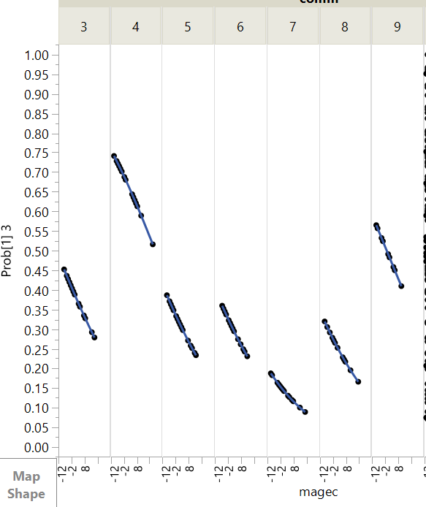

Slide 14
Including mom’s age, random slopes
Level 1: $log(\frac{π_{ij}}{(1−π_{ij})})=β_{0j}+β_{1j}∗(mage)_{ij}$ Level 2: $β_{0j}=β_{00}+u_{0j}$ $β_{1j}=β_{10}+u_{1j}$
$$u_{0j}∼N(0,σ_{u0}^{2}) \\ u_{1j}∼N(0,σ_{u1}^{2}) \\ cov(σ_{u0}^{2},σ_{u1}^{2})=τ_{01}^{2}$$

Slide 15
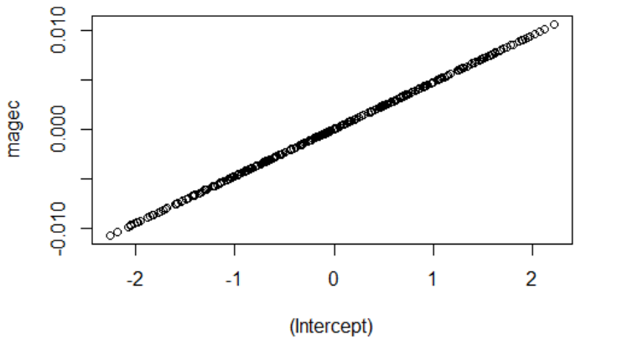
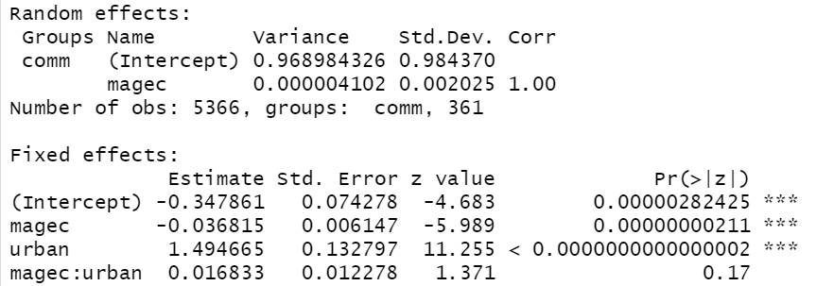
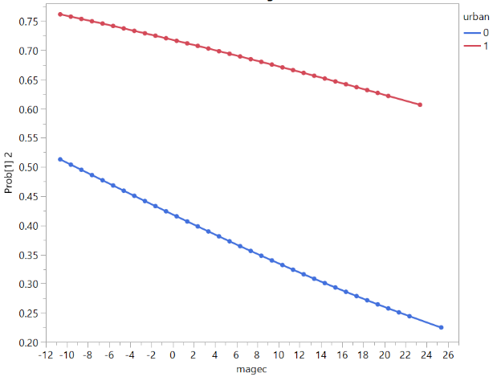
Including urban
Communities with higher intercepts
tend to have a larger change with mom’s age
With random slopes?
Random slopes doesn’t make sense (level 2 variable) but can look at interaction with mom’s age (esp if keep mom’s age random)
Notes:
The correlation of one says we can perfectly predict the slope from the intercept. This could be from the variation in the slopes being so small, that once we know the intercept, we know the community?)

Slide 16
Interaction mage and urban

Slide 17
Example 3: What did we learn?
All individual level variables are significant except unemployment, which only has an effect at the country level. For education of divorce, both negative, between-country regression coefficients are stronger than the within-country coefficients. But remember unstandardized coefficients and country averages have much less variability than individual variables.

Slide 18
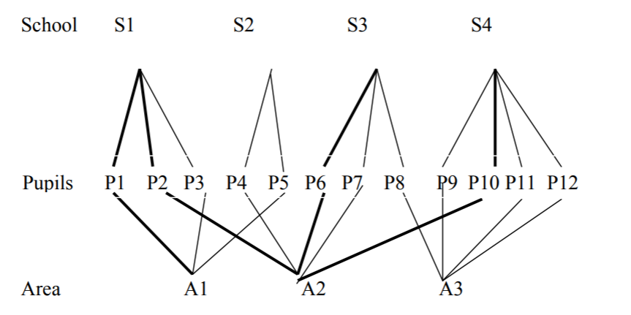
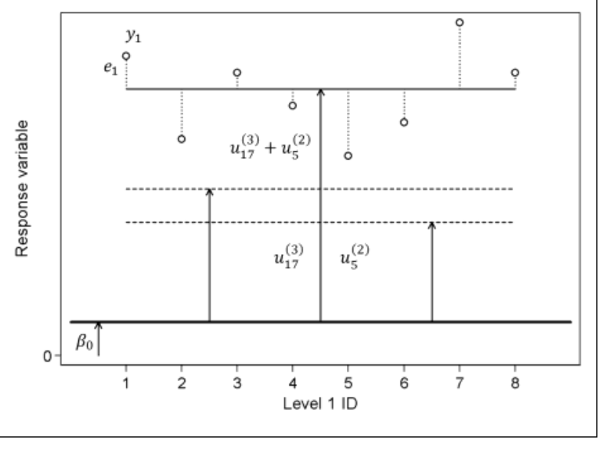
Cross-classified

Slide 19
What do we learn?
The average attainment score for male 16 year olds with an average verbal reasoning score that attended an average primary and secondary school is 5.557, and we see much more variation in this average male 16 year old score depending on what primary school they attended compared to the secondary school they attended (standard deviation for random intercepts: 0.531 vs. 0.134).
Overall, for students who attended the average primary and secondary school, females tend to score 0.111 points higher than males on average, after adjusting for their verbal reasoning scores (statistically insignificant: t-value = 1.55) and, after adjusting for sex, there is an associated 2.114 point increase on average in a student’s attainment score for every 1 point increase in their verbal reasoning score (highly statistically significant: t-value = 50.19).
There is about the same amount of variation in the “effect” that verbal reasoning score has on attainment score depending on the primary school attended and depending on the secondary school attended standard deviation for random slopes: 0.062 vs. 0.080). And for both the primary school level and secondary school level, the changes in the verbal reasoning slope is fairly small.

Slide 20
Fixed vs. Random (higher level units or lower level variable)
hospital
ethnicity
Level
Variable
Categorical variables whose categories have no special meaning
Ahead of time, no real predictions of how compare
Would make sense to be the observational unit in a regression model (agg.)
Large number of categories
Willing to assume drawn from some distribution
Categorical variable and specific categories have distinct meanings
Might predict different results in advance
Ordinal or continuous variable
Wouldn’t really make sense to be the unit of analysis

Slide 21
