Slide 1
Stat 414 – Day 15
Relaxing Exchangability

Slide 2
Logistics
HW 5/6 graded and returned
Scores updated in PolyLearn
Lowest HW score dropped
One more HW next week (logistic)
Second project progress report…
Review material posted
Review Q&A

Slide 3
HW 5 key ideas
Using Level 2 variables to explain variation in intercepts, slopes (two-stage analysis)
Level 1 (e.g., within school, person) vs. Level 2 variation (e.g., between schools, person)
Summarize model
Fixed effects (e.g., type of audience, interactions) and Random effects

Slide 4
HW 6 key ideas
Variability explained by time trend
Residuals = Unexplained variation about the time trend
Evaluation of linearity of time trend
Adding a level 2 variable
Does it explain variation in intercepts
Variable becomes part of the intercept
Does it explain variation in slopes
With interaction, variable becomes part of slope coefficient
How impact charter effect
Change in coefficient, interaction?
Interpreting all of the parameters

Slide 5
Last Time – “Longitudinal” data
Repeat observations on same “individual”
Missing values aren’t really a problem
Wide vs. Long format
Include time as Level 1 variable
Time-dependent (Level 1) and Time-invariant variables (Level 2 and higher)
Assumption: Linear trend
Nonlinear trend
Quadratic (vs. random slopes)
Piecewise linear

Slide 6
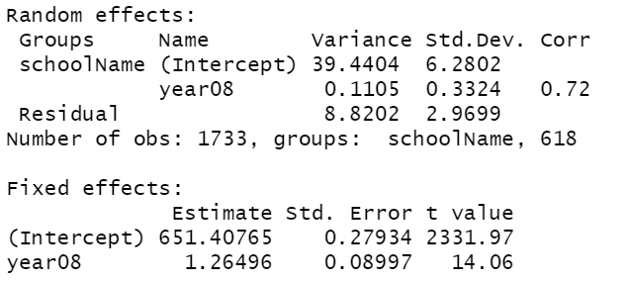
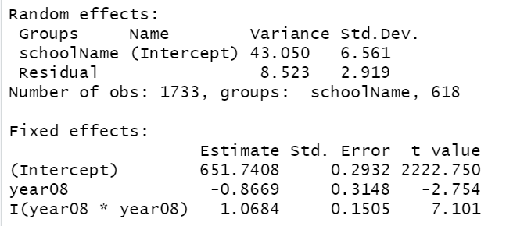
Linear model
6 parameters
Quadratic but only
random intercepts
5 parameters

Slide 7
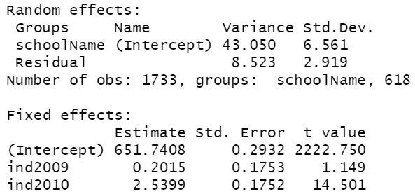
Piecewise linear
$Y_{ij}=β_{0}+u_{i}+β_{1}year0809+β_{2}year0910+ε_{ij}$

Slide 8
