Slide 1
Stat 414 – Day 13
Diagnostics

Slide 2
Logistics
Guest speaker on Thursday
Submit at least one question for speaker by 8am
Email
HW credit
HW 6 due Friday
No Thur/Fri office hour this week
Wednesday office hour moving 9-10
Submit second project progress report
Review material posted this weekend
Review Q&A

Slide 3
Last Time
Adding contextual variables to Level 2
Including “group means”
Within group vs. Between group equations
Adding Level 2 variable can explain variation in intercepts; Adding cross-level interaction can explain variation in slopes
Try to use “theory” to determine fixed vs. random slope
Desire to include Level 2 variables, interactions
Can restrict covariances to zero to reduce number of parameters

Slide 4
Checking the model assumptions
Linearity with Level 1 and Level 2 variables
Normality and constant variance with error terms (Level 1 and Level 2)
Residuals
Independence of errors
If not met:
Heteroscedasticity vs. Random slopes vs. Nonlinear effect

Slide 5
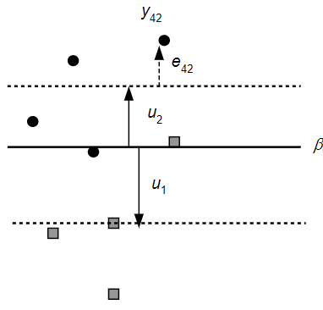
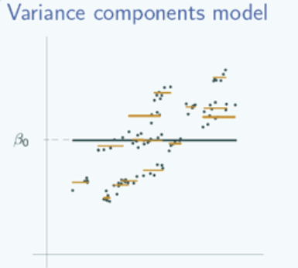
Marginal vs. Conditional residuals
Conditional = relative to group mean/line
Level 2 residuals = u_{j}
Marginal = relative to overall mean/line

Slide 6
Checking the model assumptions
For each level there is a set of residuals and a residual analysis can be executed
Level 1 residuals
1st check linearity with Level 1/2 variables
Plot residuals against X, smoother
Then check equal variance: should really use squared standardized residuals
Against X (Ch. 8)
Against clusters (Bartlett, Levene)
Normal probability plot

Slide 7
Checking the model assumptions
Level 2 residuals (after)
Plot vs. Level 2 variables for linearity
Normal probability plot (standardized)
Squared standardized vs. Level 2 EV
Check for outliers
If problems, could signal
Misspecification of fixed effects
Model assumptions about random effect distributions are inappropriate

Slide 8
Example 2
Base your prediction on that subject’s BDI
What was subject 1’s actual cigarette usage at time = 1?
What is the residual?
What are the random effects for this subject?
How does this change your prediction?
What is the residual?

Slide 9
Residuals
Marginal residuals
Should be mean zero but might vary by group
May not have equal variance
Good for checking fixed effects
Conditional residuals
Should be random and equal variance
Good for checking normality, outliers
Random effect residuals
Not mean zero, may not be equal variance
Good for checking normality, outliers

Slide 10
Influence

Slide 11
This week
HW 5
How to knit
Performance to performance variation
Project proposals
Office hours
Today 1-2
Tomorrow econference 8:30-9:30, conf call 9:30-12

Slide 12
Last Time
Grand mean centering
Affects interpretation of intercept
With random slopes, affects variation of intercept, as well as slope/intercept covariance
Group mean centering
“Centering within context”
Affects the slope (total effect vs. within effect)

Slide 13
Last Time
Have removed some school level variation
Grand-mean centering vs. Group-mean centering (e.g., PctFamily in county)
Fixed coefficient: Slopes and intercepts similar to each other but intercepts very different from raw data
Random coefficient: fixed slope component will differ with group-mean centering
Notes:
Same predicted values, residuals, deviance

Slide 14
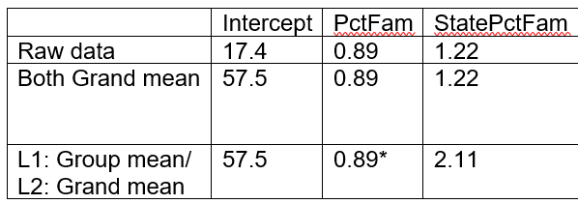
Special Case: Adding group mean as Level 2 variable
Level 2 variable raw or grand-mean centered: intercept differs, slopes won’t change too much, unless Level 1 variable group-mean centered; Level 2 slopes have different interpretations

Slide 15
Within vs. Between Groups
Group mean centering (Level 1)
PctBush = 57.5 + .89(PctFamily-$\overline{x_{j}})+2.11\overline{x_{j}}$
.89 is county-level (within state) effect
2.11 is between state effect
Represents state effect and state composition
Use if care about: Relative size of X vs. mean X effects; primarily the Level 2 effect
Grand mean centering (Level 1)
PctBush = 57.5 + .89(PctFamily-$\overline{x})+1.22\overline{x_{j}}$
.89 is county-level (within state) effect
1.22 is additional “contextual” effect at state level (between – within) after adjusting for county (two counties with same PctFamily but located in two different states)

Slide 16
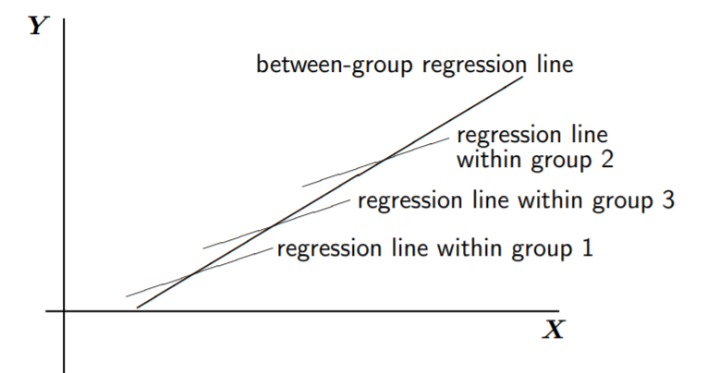
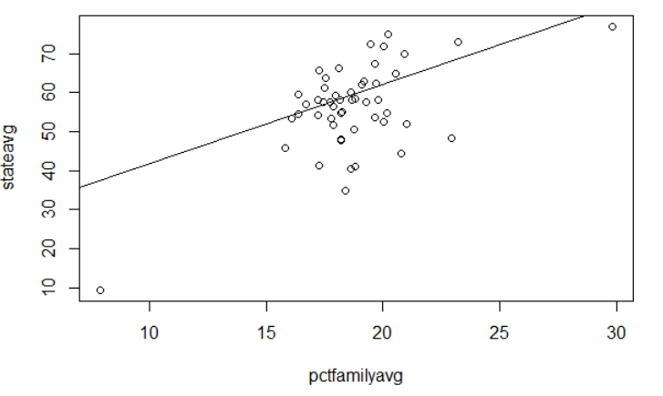
Within vs. Between Groups
Within groups
Between groups (regressing group means of PctBush on group means of PctFamily)
familymeans = aggregate(bushdata$PctFamily, list(bushdata$state_po), mean)
bushmeans = aggregate(bushdata$PctBush, list(bushdata$state_po), mean)
summary(lm(bushmeans$x ~ familymeans$x))

Slide 17
Within vs. Between Groups
Without random slopes, these “fits” are the same
But do differ with random slopes (p. 88)

Slide 18
Last Time
“it is clear that centering, whether with grand means or with group means, should always be used in multilevel regression”
Grand-mean centering is simpler and more common
Group-mean centering separates the individual and group effects, focuses on contextual (Level 2) effects

Slide 19
Day 10, Example 3
langPOST in different classes (schools)
verbal__IQ was centered
But then some observations remove
With new dataset, computed group means
Grand mean centered

Slide 20
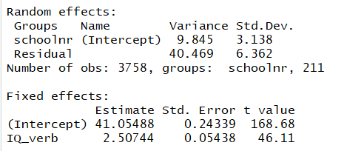
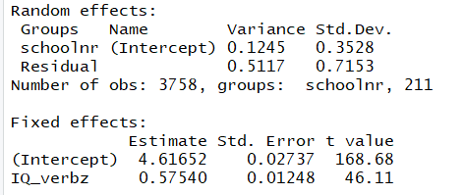
Table 4.2 with “centered” IQ
Table 4.2 with “standardized” IQ and lang

Slide 21
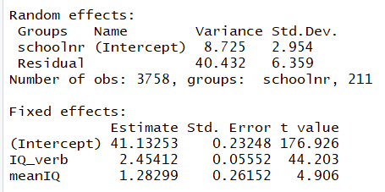
Table 4.2 with “centered” IQ
Table 4.4 including IQ and mean IQ
$$langPOST=β_{0j}+β_{1}IQ_verb$$
$$β_{0j}=β_{00}+β_{2}meanIQ_{j}+u_{oj}$$
School level variance goes down

Slide 22
Example 3
(a) Slope of within groups equation?
2.45 (“effect” of increase in student IQ)
(b) Additional contribution?
Grand-mean centered: 1.28 (given student IQ, but school IQ one unit higher)
t = 4.906
(c) group-mean centered: 3.74
Change in school mean langPOST if increase school mean IQ by one (vs. 3.67)

Slide 23
Example 3
(f) Allow IQ_verb to have random slopes…

Slide 24
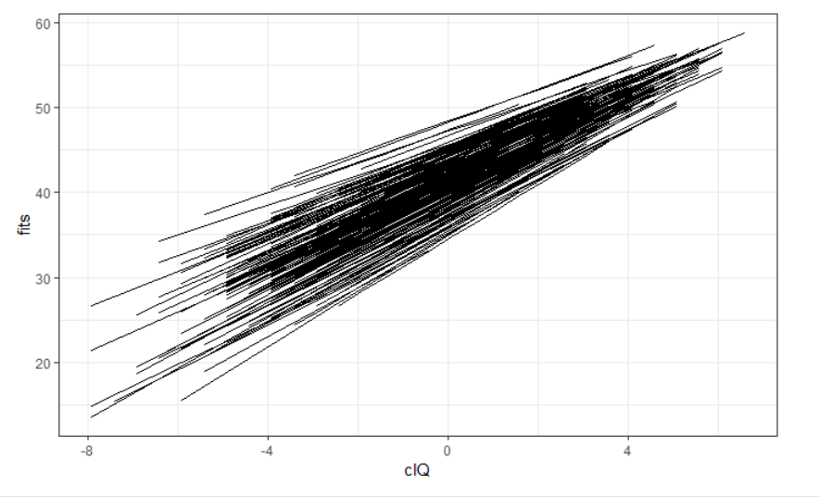
Example 3
Slope/Intercept correlation
Negative…
Schools with large intercepts (avg lang for students with average IQ in school with average IQ) have smaller slopes (within class IQ effect) but still stay “ahead” of schools with lower intercepts, for this range of IQ scores

Slide 25
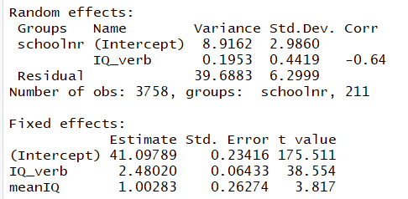
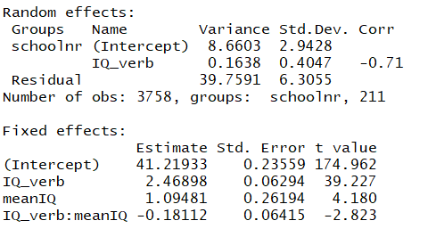
Allowing for random slope
Table 4.4 including IQ * mean IQ
$$langPOST=β_{0j}+β_{1j}IQ_verb$$
$$β_{0j}=β_{00}+β_{2}meanIQ_{j}+u_{oj}$$
$$β_{1j}=β_{10}+β_{3}meanIQ_{j}+u_{1j}$$
Notes:
Interpret 2.47: effect of IQ_verb when meanIQ in class is zero (overall mean)
Interpret 1.09: effect of meanIQ when IQ_verb = 0 (at the mean = student with average IQ)
.195 to .163
Can include cross-level interaction even if don’t have random slopes

Slide 26
SES…

Slide 27
p. 87
In cases where the explanation of the random effects works extremely well, one may end up with models with no random effects at level two… random intercepts, slope have zero variance.. Omitted.. The resulting model may be analyzed just as well with OLS regression analysis… within group dependence has been fully explained by the available explanatory variables/interactions (no more dependence in the residuals)

Slide 28
Note
Have already discussed 5.4 and 5.5, Ch. 6

Slide 30
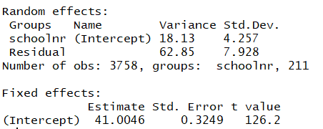
Null model
Table 4.2 with “centered” IQ
ICC = 0.224
Residual ICC = 0.196

