Slide 1
Stat 414 – Day 10
Random slopes (5.1)

Slide 2
This week
HW 5
How to knit
Performance to performance variation
Project proposals
Office hours
Today 1-2
Tomorrow econference 8:30-9:30, conf call 9:30-12

Slide 3
Last Time
Grand mean centering
Affects interpretation of intercept
With random slopes, affects variation of intercept, as well as slope/intercept covariance
Group mean centering
“Centering within context”
Affects the slope (total effect vs. within effect)

Slide 4
Last Time
Have removed some school level variation
Grand-mean centering vs. Group-mean centering (e.g., PctFamily in county)
Fixed coefficient: Slopes and intercepts similar to each other but intercepts very different from raw data
Random coefficient: fixed slope component will differ with group-mean centering
Notes:
Same predicted values, residuals, deviance

Slide 5
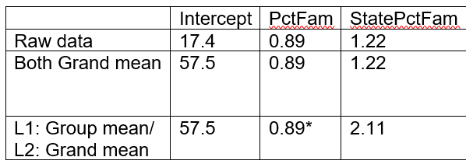
Special Case: Adding group mean as Level 2 variable
Level 2 variable raw or grand-mean centered: intercept differs, slopes won’t change too much, unless Level 1 variable group-mean centered; Level 2 slopes have different interpretations

Slide 6
Within vs. Between Groups
Group mean centering (Level 1)
PctBush = 57.5 + .89(PctFamily-$\overline{x_{j}})+2.11\overline{x_{j}}$
.89 is county-level (within state) effect
2.11 is between state effect
Represents state effect and state composition
Use if care about: Relative size of X vs. mean X effects; primarily the Level 2 effect
Grand mean centering (Level 1)
PctBush = 57.5 + .89(PctFamily-$\overline{x})+1.22\overline{x_{j}}$
.89 is county-level (within state) effect
1.22 is additional “contextual” effect at state level (between – within) after adjusting for county (two counties with same PctFamily but located in two different states)

Slide 7
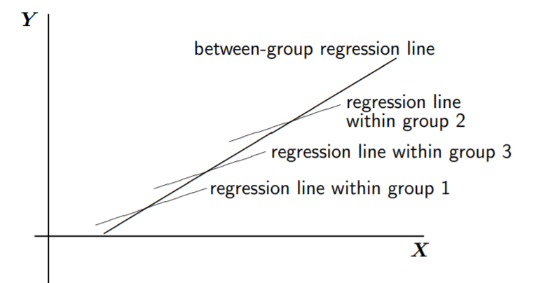
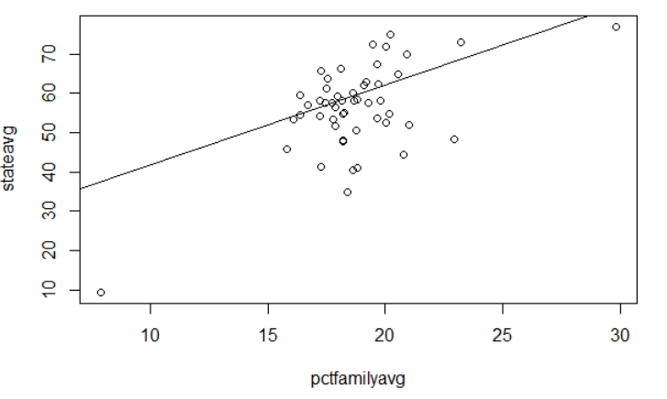
Within vs. Between Groups
Within groups
Between groups (regressing group means of PctBush on group means of PctFamily)
familymeans = aggregate(bushdata$PctFamily, list(bushdata$state_po), mean)
bushmeans = aggregate(bushdata$PctBush, list(bushdata$state_po), mean)
summary(lm(bushmeans$x ~ familymeans$x))

Slide 8
Within vs. Between Groups
Without random slopes, these “fits” are the same
But do differ with random slopes (p. 88)

Slide 9
Last Time
“it is clear that centering, whether with grand means or with group means, should always be used in multilevel regression”
Grand-mean centering is simpler and more common
Group-mean centering separates the individual and group effects, focuses on contextual (Level 2) effects

Slide 10
Day 10, Example 3
langPOST in different classes (schools)
verbal__IQ was centered
But then some observations remove
With new dataset, computed group means
Grand mean centered

Slide 11
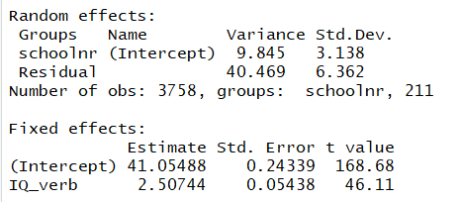
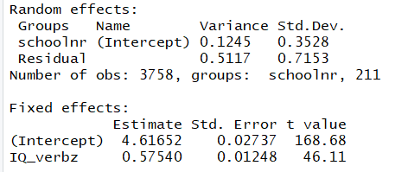
Table 4.2 with “centered” IQ
Table 4.2 with “standardized” IQ and lang

Slide 12
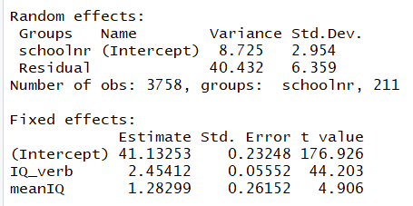
Table 4.2 with “centered” IQ
Table 4.4 including IQ and mean IQ
$$langPOST=β_{0j}+β_{1}IQ_verb$$
$$β_{0j}=β_{00}+β_{2}meanIQ_{j}+u_{oj}$$
School level variance goes down

Slide 13
Example 3
(a) Slope of within groups equation?
2.45 (“effect” of increase in student IQ)
(b) Additional contribution?
Grand-mean centered: 1.28 (given student IQ, but school IQ one unit higher)
t = 4.906
(c) group-mean centered: 3.74
Change in school mean langPOST if increase school mean IQ by one (vs. 3.67)

Slide 14
Example 3
(f) Allow IQ_verb to have random slopes…

Slide 15
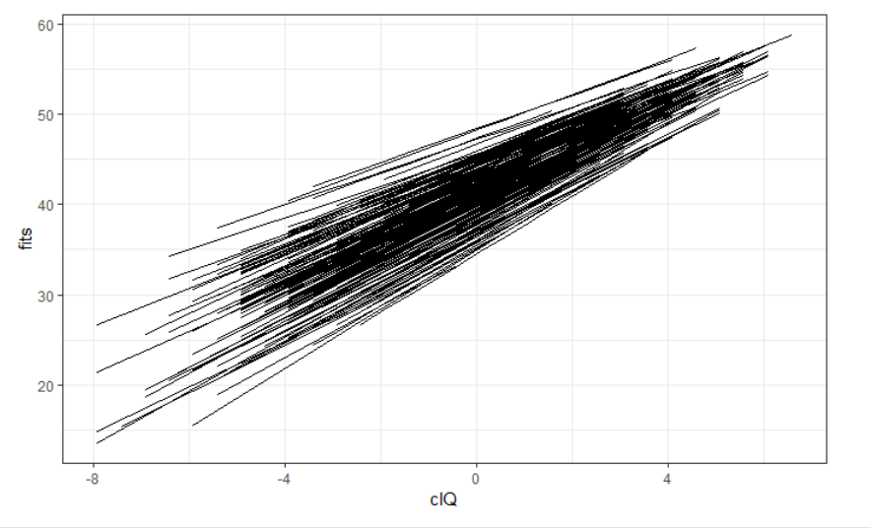
Example 3
Slope/Intercept correlation
Negative…
Schools with large intercepts (avg lang for students with average IQ in school with average IQ) have smaller slopes (within class IQ effect) but still stay “ahead” of schools with lower intercepts, for this range of IQ scores

Slide 16
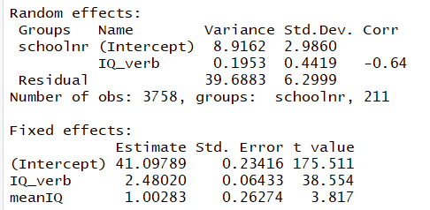
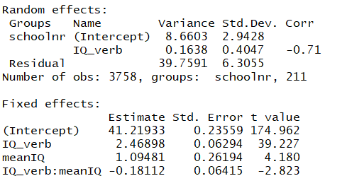
Allowing for random slope
Table 4.4 including IQ * mean IQ
$$langPOST=β_{0j}+β_{1j}IQ_verb$$
$$β_{0j}=β_{00}+β_{2}meanIQ_{j}+u_{oj}$$
$$β_{1j}=β_{10}+β_{3}meanIQ_{j}+u_{1j}$$
Notes:
Interpret 2.47: effect of IQ_verb when meanIQ in class is zero (overall mean)
Interpret 1.09: effect of meanIQ when IQ_verb = 0 (at the mean = student with average IQ)
.195 to .163
Can include cross-level interaction even if don’t have random slopes

Slide 17
SES…

Slide 18
p. 87
In cases where the explanation of the random effects works extremely well, one may end up with models with no random effects at level two… random intercepts, slope have zero variance.. Omitted.. The resulting model may be analyzed just as well with OLS regression analysis… within group dependence has been fully explained by the available explanatory variables/interactions (no more dependence in the residuals)

Slide 19
Note
Have already discussed 5.4 and 5.5, Ch. 6

Slide 21
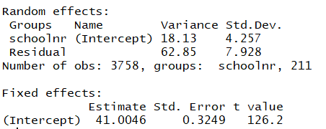
Null model
Table 4.2 with “centered” IQ
ICC = 0.224
Residual ICC = 0.196

