Slide 1
Stat 414 – Day 10
Random slopes (5.1)

Slide 2
Office hours this week
Office hours this week
Today at 1 (can interrupt call)
Wednesday 10-11
Thursday 1-2
HW 4
Level 1: counties
Descriptive: ICC, graph, AIC
Inferential: CI, traditional F-test, LRT
Project proposals
Observations not independent?
Level 2 units are random sample?

Slide 3
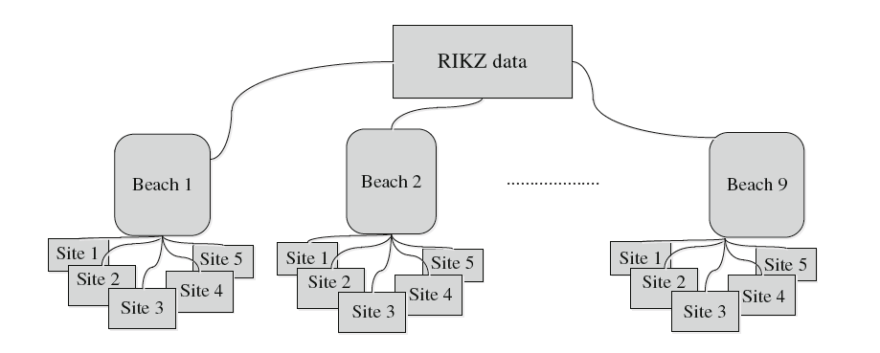
Recall the RIKZ data
Species richness
NAP = height of sampling station relative to mean tidal level

Slide 4
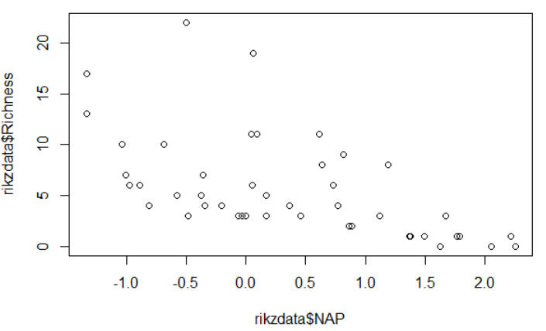
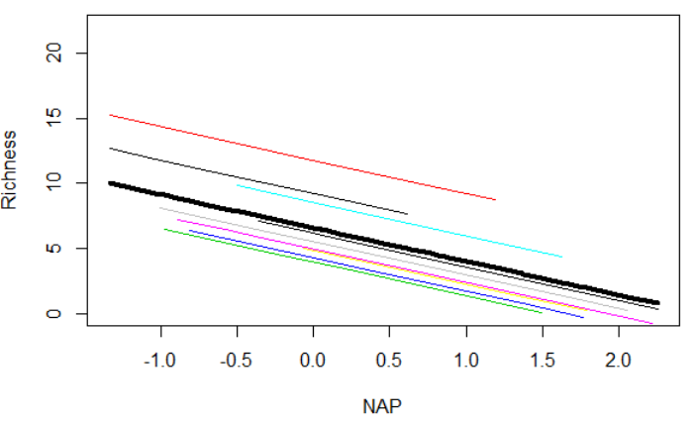
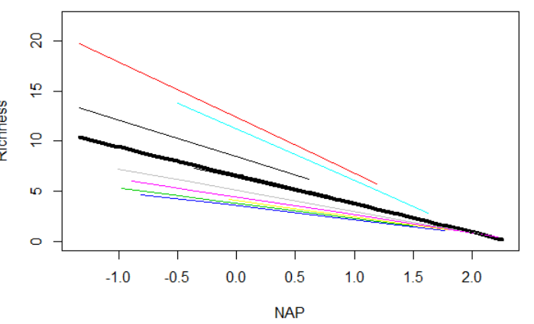
Last Time: Random Slopes of level 1 variables
Saw an association between richness and NAP
To get good standard errors, we “adjusted” by beach
But maybe the slopes (association between NAP and Richness) varies by beach as well

Slide 5
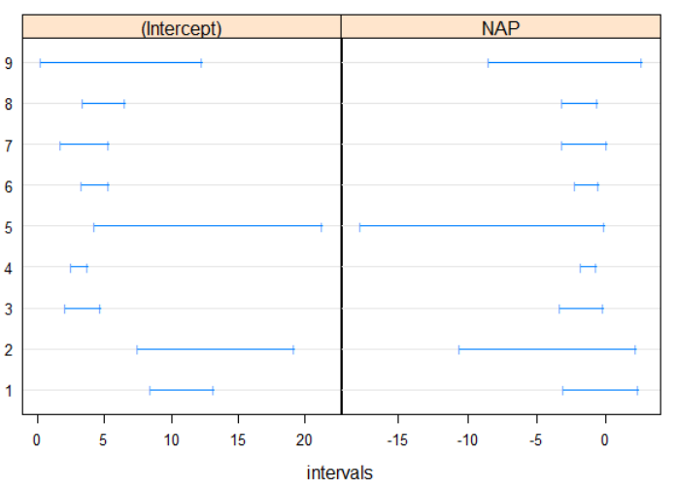
Last Time: Random Slopes
Model: $Y_{ij}=β_{00}+u_{0j}+\left(β_{10}+u_{1j}\right)x_{ij}+ ε_{ij}$
Two new parameters: $τ_{1}^{2}$ and $τ_{01}$
${\hat{τ}}_{01}:−0.99$, beaches with larger intercepts tended to have small (more negative) slopes, larger “impact” of NAP on richness
Var(Y­_{ij}) = $τ_{0}^{2}+2τ_{01}x_{ij}+τ_{1}^{2}x_{ij}^{2}+σ^{2}$
Heterogeneity!
Cov(Y_{aj}, Y_{bj}) : $τ_{0}^{2}+τ_{01}\left(x_{aj}+x_{bj}\right)+ τ_{1}^{2}(x_{aj}x_{bj})$

Slide 6
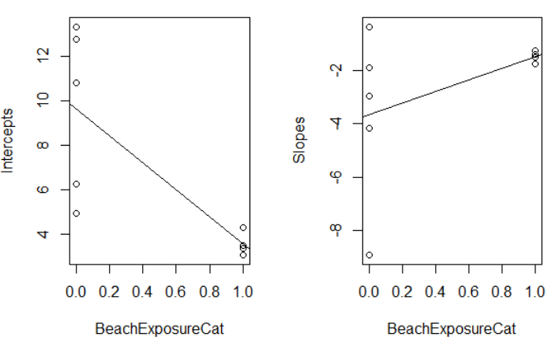
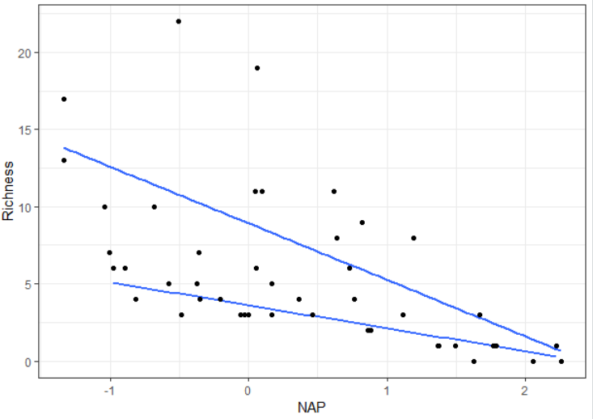
Last Time: Random Slopes
Beaches with more “exposure” tend to have smaller intercept and flatter slope with NAP

Slide 7
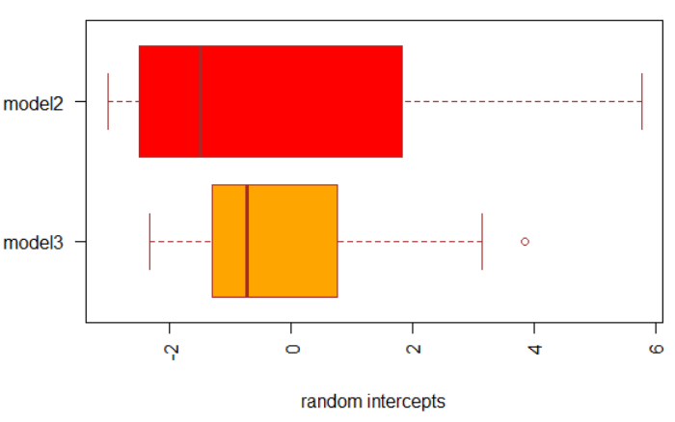
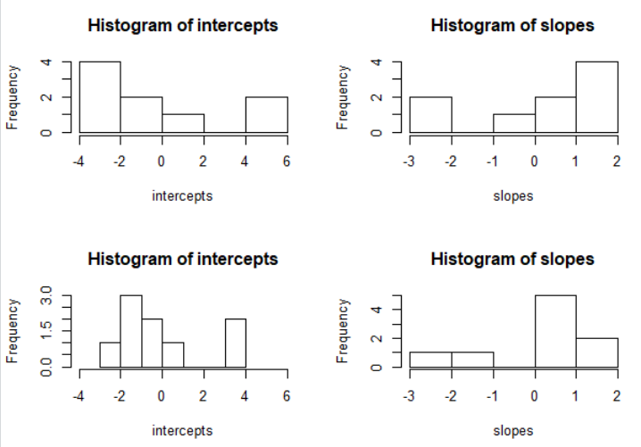
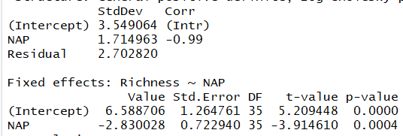
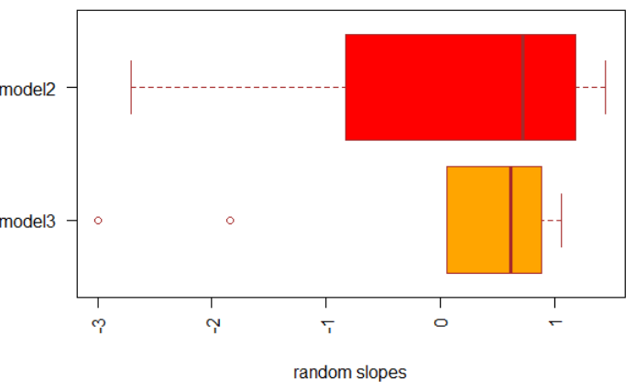
Last Time: Random slopes
Can we use Level 2 variables to explain some of the beach-to-beach variation in intercepts or slopes?
Level 2 equations
$β_{oj}=β_{00}+β_{01}z+u_{0j}$
$β_{1j}=β_{10}+β_{11}z+u_{1j}$

Slide 8
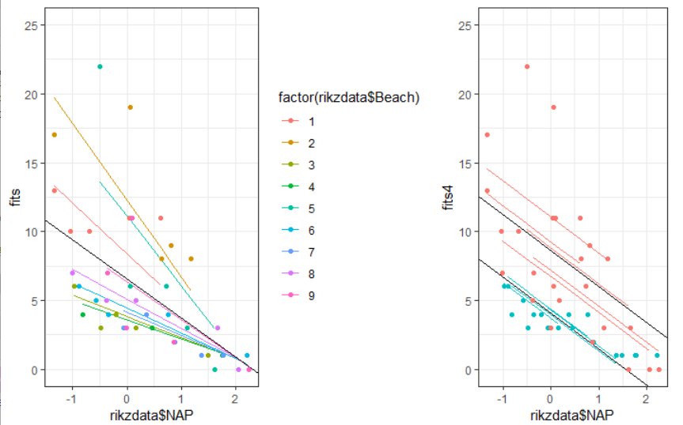
Compare model 2 to model 4

Slide 9
Example 2
Random slopes for gevocab

Slide 10
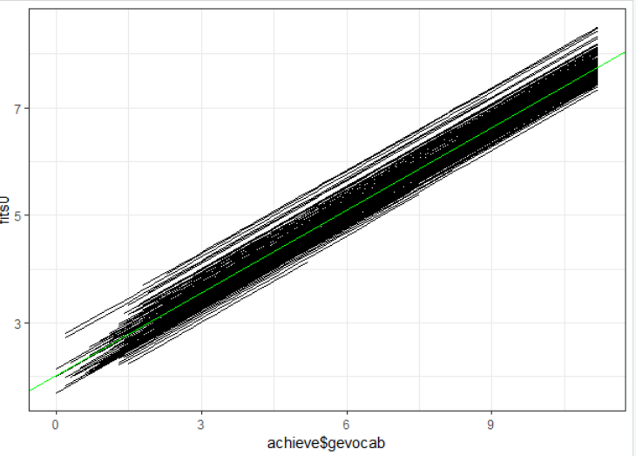
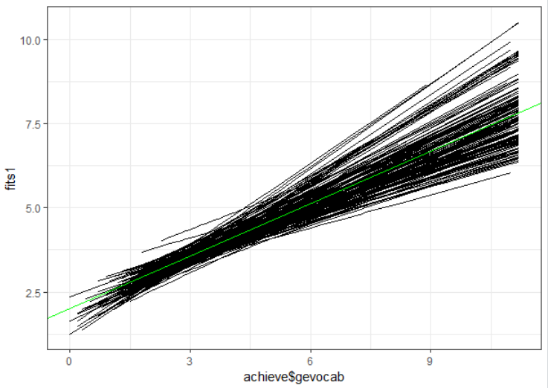
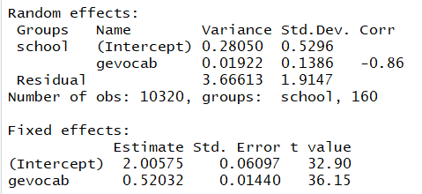
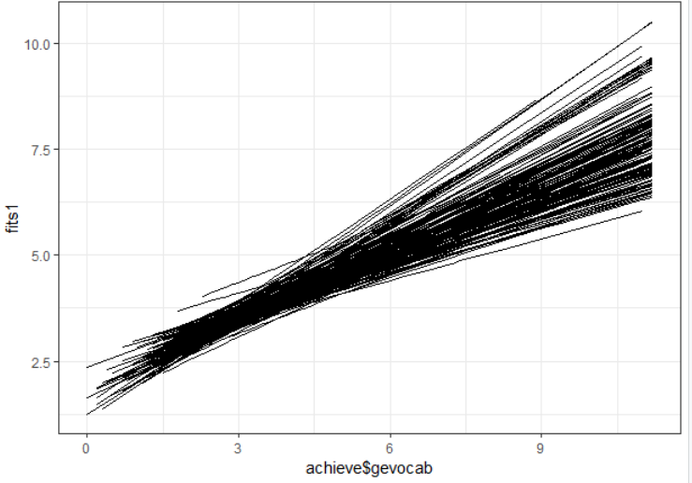
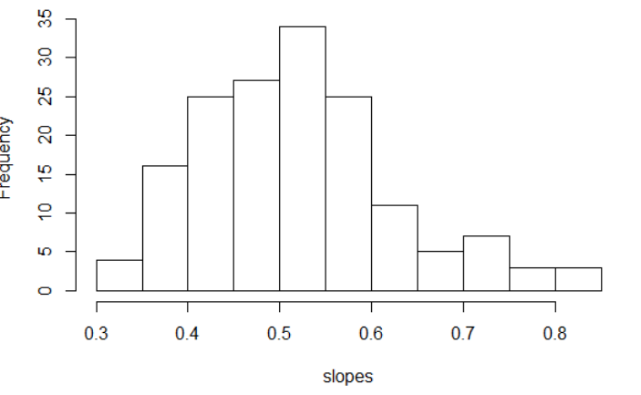
Example 2
95% of slopes between
(.52 – 2(.1386), .52 + 2(.1386))
= (.24, .80)
Notes:
Fairly big spread, largest slope is more than 3 times the size of the smallest slope

Slide 11
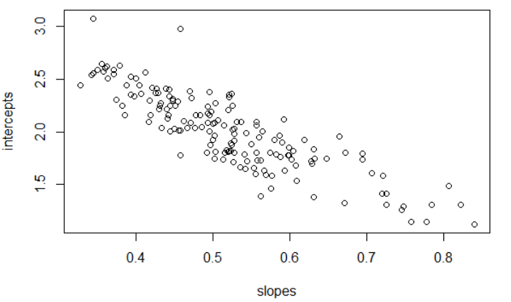
Slope/Intercept correlation
-0.86
Schools with large intercepts, at x = 0, tend to have smaller slopes
If avg reading score higher than average, gevocab has less of an impact
Notes:
Classes with a higher intercept with have a lower within-class effect of gevocab (smallest positive slope). Thus, the higher intercept tends to be achieved by higher language scores of the less intelligent, than by higher scores of the more intelligent. (p. 79)

Slide 12
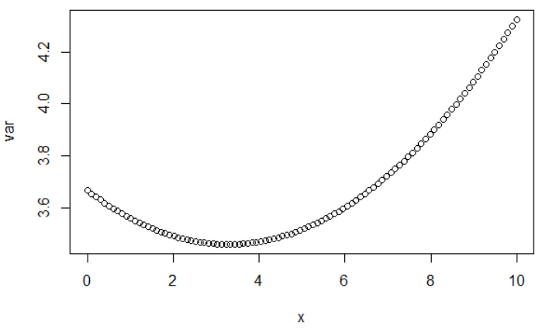
Heterogeneity - quadratic
V(Y_{ij}) = .53+ 2*(-.86*.53*.14)x+ .02 x² + 3.666
min = (.86)(.53)(.14)/.02 = 3.3
Notes:
See online practice questions

Slide 13
Keep in mind
Variance in intercepts, slope, covariance changes with x
Doesn’t make sense to compute ICC (within school correlation) with random slopes
Can focus on level 1 random errors for “variance explained” calculate
Can use fixed slopes to compute R²

Slide 14
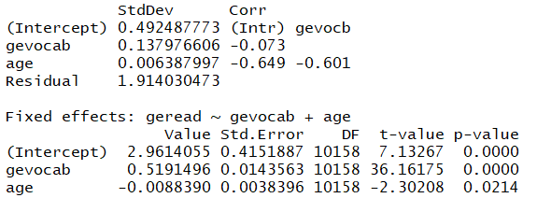
Adding age to the model
summary(lme(geread ~ gevocab + age ,random = ~gevocab + age | school, data = achieve))
More school-to-school variation in gevocab slopes (effect of gevocab) than in age slopes
Negative association…

Slide 15
