Slide 1
Stat 414 – Day 10
Random slopes (5.1)

Slide 2
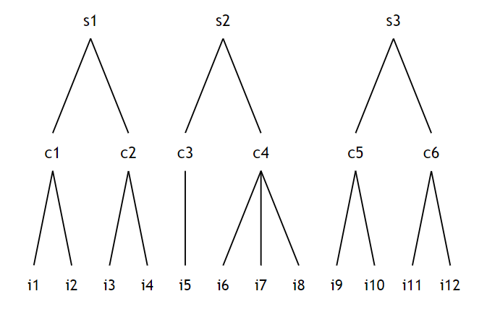
Last Time
Standard errors
Three level models

Slide 3
Last Time
With gevocab plus celnrol, cenroll
With gevocab, cenroll interaction

Slide 4
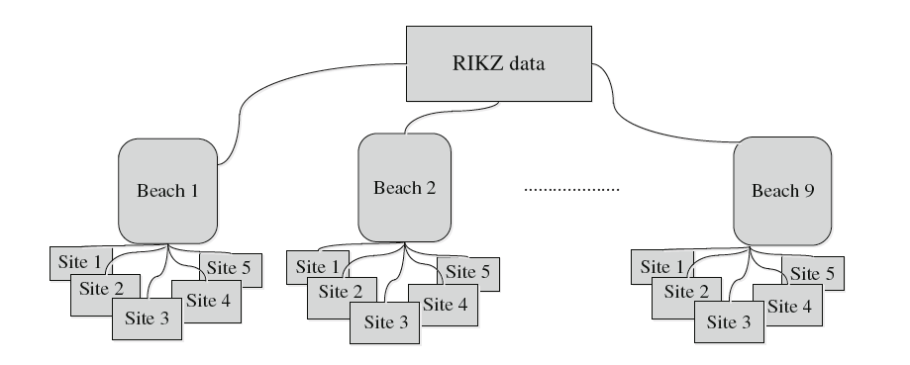
Recall the RIKZ data
Species richness
NAP = height of sampling station relative to mean tidal level

Slide 5
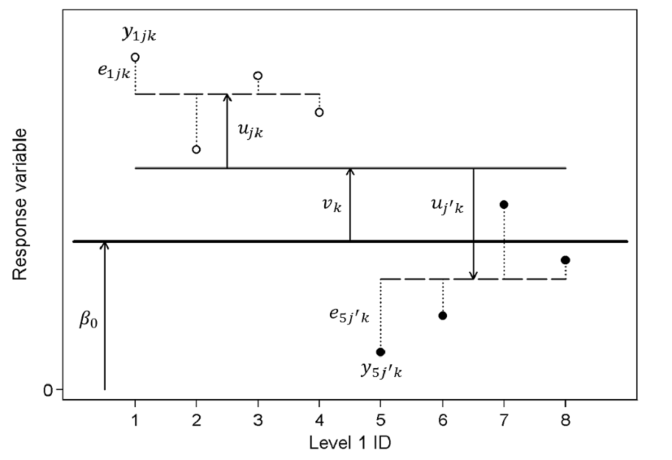
Three-level model

