Slide 1
Stat 301 – Day 29
Two-sample t-procedures

Slide 2
Announcements
Project 2

Slide 3
Last Time – Chapter 4
Want to compare two groups on a quantitative response
Same graphs (just make sure on same scale) and numerical summaries (shape, center, variability)
Stacked vs. Unstacked
Independent random samples
Choice of statistic: difference in sample means
Simulated taking samples from two populations (eastern conference and western conference), looked at difference in sample means

Slide 4
Central Limit Theorem for
Theory:
If sampling from infinite, normally distributed population, the distribution of the difference in sample means will be normally distributed with mean μ₁-μ₂ and standard deviation $\sqrt{σ_{1}^{2}/n_{1} +σ_{2}^{2}/n_{2} }$
Practice:
Distribution of difference in sample means is approximately normal as long as both populations are approximately normal or sample sizes are large (Both at least 20? Same shape?) and populations are much larger than sample sizes

Slide 5
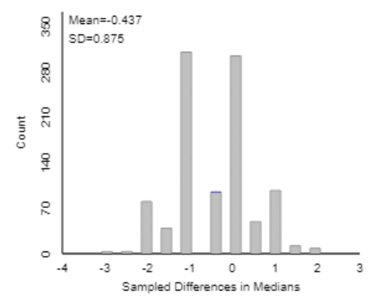
Doesn’t work with other statistics!
Difference in medians?

Slide 6
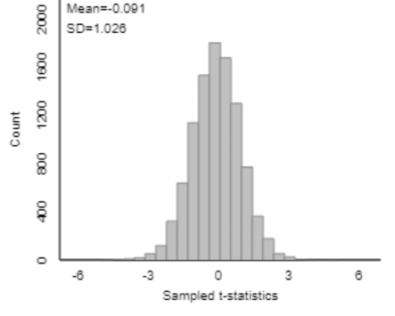
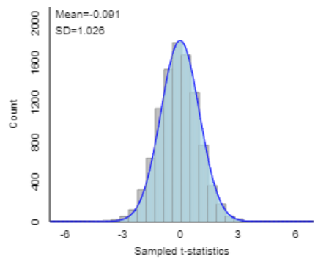
Furthermore
If use standard error: $\sqrt{s_{1}^{2}/n_{1} +s_{2}^{2}/n_{2} }$, then distribution of standardized statistic
$$t=({\overline{x}}_{1}−{\overline{x}}_{2}−δ_{0})/\sqrt{s_{1}^{2}/n_{1} +s_{2}^{2}/n_{2} }$$
is well-modeled by a t distribution
The appropriate degrees of freedom are a little complicated, but we’ll let the computer deal with that

Slide 7
Example
Researchers Holdgate et al. (2016) studied walking behavior of elephants in North American zoos to see whether there is a difference in average distance traveled by African and Asian elephants. They put GPS loggers on 33 randomly selected African elephants and 23 randomly selected Asian elephants and measured the distance (in kilometers) the elephants walked per day.

Slide 8
Technology Options (p. 264-5)
Theory-based Inference applet
Summary data
Raw data (stacked vs. unstacked)
R
iscamtwosamplet
t.test(y ~ x, alt = “”, var.equal = FALSE)
JMP
Journal: Hypothesis Test for Two Means
Fit Y by X, t Test

Slide 9
To Do – for Monday
Submit project 2
Start HW 7
Quiz 25

