Slide 1
Stat 301 – Day 26
Relative risk

Slide 2
Announcements

Slide 3
Last Time: Two random samples
Wanted to test/make confidence interval for two population proportions
Simulation: Model the random sampling of proportions from two populations with same π
Normal approximation?
If sample sizes are large enough (HW: cont. corr.)
Confidence interval for difference in population proportions
Pooled or Unpooled
Theory-based inference applet, JMP, R

Slide 4
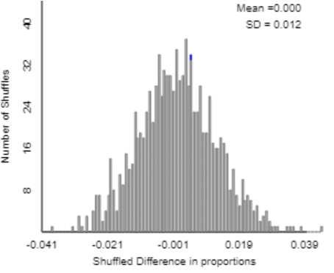
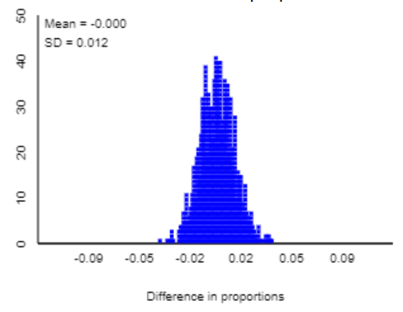
Approximating the standard deviation
Random sampling
Random assignment

Slide 5
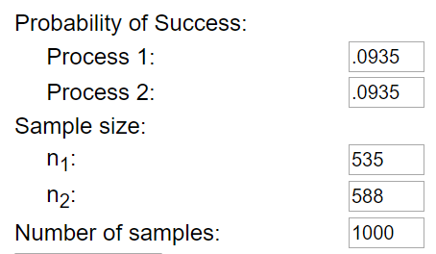
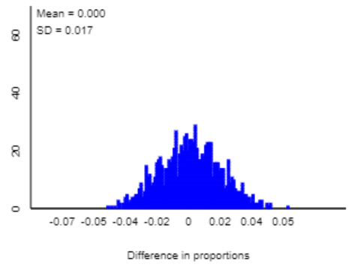
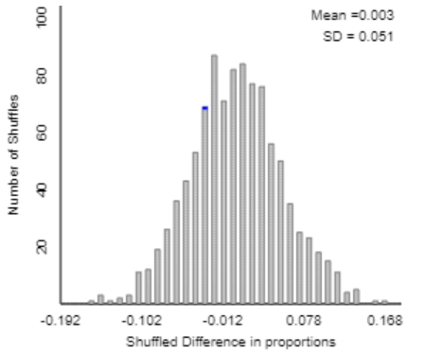
Approximating the standard deviation
Random sampling
Random assignment

Slide 6
Two-sample z-test
Same in both situations
Technically more appropriate for random sampling
How estimate standard deviation can make a difference
Quiz 22
I vs. we

Slide 7
Quiz 22
Using the Theory-Based inference applet, we generated a p-value of 0.0172. Because this p-value is less than 0.05, it is statistically significant. In addition, we were 95% confident that the population proportion of teens with hearing loss is higher now by 0.0015 to 0.0467 than it was then. We are willing to generalize these results to all American teenagers because they used random sampling for our study. However, because they did not use random assignment in our study, we are not willing to conclude that the change in the prevalence of hearing loss is due to the increased use of ear buds among teenagers between 1994 and 2006.

Slide 8
Quiz 22
Since the p-value is less than 0.05, we have convincing evidence to reject the null hypothesis in favor of the alternative hypothesis that the probability of having hearing loss is greater in a teen from 2005 than a teen from 1988. We are willing to generalize this conclusion to all American teens. We are 95% confidence that teens from 2006 have a 0.0015 to 0.0467 higher probability of having hearing loss than teens from 1988. No, there could be other confounding variables, and this study was an observational study. We cannot make any cause and effect conclusions.

Slide 9
Quiz 22
We cannot use these results to conclude that the hearing loss is due to increased use of ear buds because there was no random assignment on whether each subject used ear buds, and there may be many other factors such as likelihood to go to concerts that have changed between these two time periods.

Slide 10
Investigation 3.9 (p. 224)

Slide 11
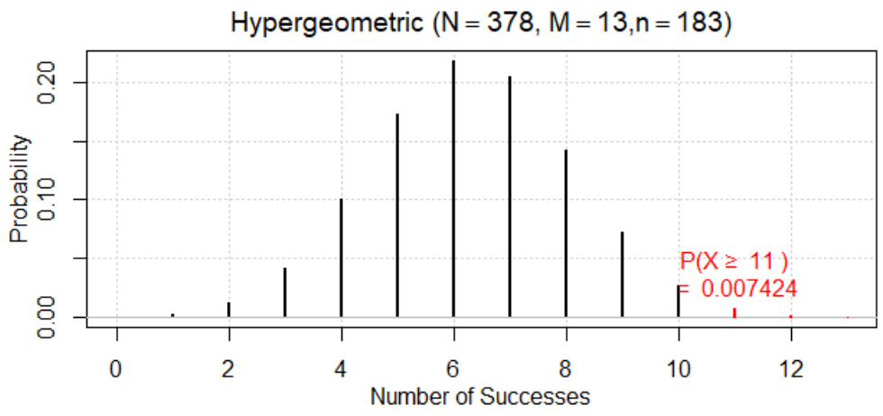
Investigation 3.9
Statistic: 11/183 – 2/195 = 0.04985
Let X represent the number developing peanut allergy in the avoidance treatment
Strong evidence that the observed difference in the sample proportions did not arise from the random assignment process alone

Slide 12
Relative risk
Definition: Relative risk is the ratio of the conditional proportions
Often set up to be larger than one
RR = (Allergy avoidance)/(Allergy consumption) = .060/.010≈ 6.00 (5.86)
Interpretation: Those who avoided peanuts were 6 times more likely to develop an allergy
Percentage change = (5.86 – 1) × 100% = 486%
But now that we’ve changed the statistic?!

Slide 13
Simulation!
The p-value is identical!!
Confidence interval?
estimate + z*× standard error
Need a normal distribution
Need to know the standard deviation of the statistic

Slide 14
Theory-based
Take the (natural) log of the skewed right distribution to scale to a normal distribution
$$SE\left(\ln\left(\frac{{\hat{p}}_{avoid}}{{\hat{p}}_{consume}}\right)=\sqrt{\frac{1}{11}−\frac{1}{183}+\frac{1}{2}−\frac{1}{195}}\right)$$
$$≈0.762$$
If assume the null is true…
$$SE\left(\ln\left(\frac{{\hat{p}}_{avoid}}{{\hat{p}}_{consume}}\right)=\sqrt{\frac{1}{6}−\frac{1}{183}+\frac{1}{7}−\frac{1}{195}}\right)$$
$$≈0.547$$

Slide 15
Confidence interval for π₁/π₂
ln(5.86) + 1.96(0.762)
1.768 + 1.4935
(.275, 3.262)
But that’s for log relative risk
exp(0.275) = 1.32
exp(3.262) = 26.10
We are 95% confident that the “risk” of peanut allergy is 1.32 to 26.10 times larger if avoid rather than consume (6g/week) for all UK infants age 4-11 months similar to the ones in the study

Slide 16
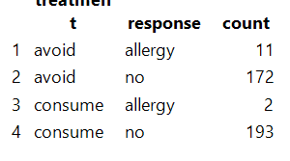
JMP

Slide 17
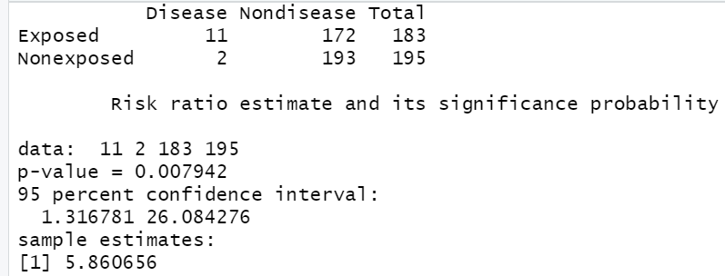
R
riskratio(11, 2, 183, 195, conf.level=0.95, p.calc.by.independence=TRUE)

Slide 18
R
riskratio(11, 2, 183, 195, conf.level=0.95, p.calc.by.independence=TRUE)

Slide 19
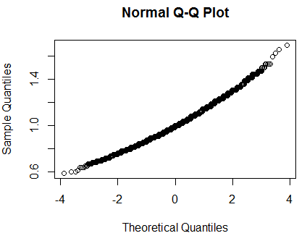
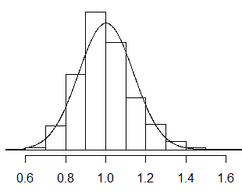
Confidence interval
Null distribution of relative risks: Centered at 1 but not the most normal looking distribution

Slide 20
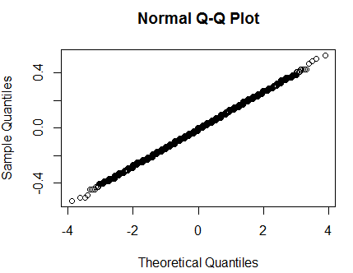
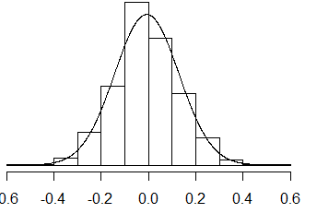
Take the natural log
Will produce a normal distribution, mean 0, preserves ordering of values
But now need a standard deviation…

Slide 21
To Do – for Monday
Office hour tonight: 8:45-9:45pm
Examples 3.1, 3.2, Chapter 3 Summary
Practice problems
Review handout posted this weekend
Post review questions/sample questions in PolyLearn (Ch. 2-3)
Optional Review Session Monday night
6:30-8pm, 10-126

