Slide 1

Assessing Student Learning about Statistical Inference
Beth Chance – Cal Poly, San Luis Obispo, USA
John Holcomb – Cleveland State University, USA
Allan Rossman – Cal Poly, San Luis Obispo, USA
George Cobb – Mt. Holyoke College, USA
Notes:
Thursday 11:00-12:30

Slide 2
Background
Many students leave an introductory statistics course without a deep understanding of the statistical process/inference
NSF grant to develop a randomization-based curriculum focused on conceptual understanding of statistical inference (Holcomb et al., 2010, Fri 14:00-16:00)
  Estimating p-values through simulations under the null model
  Example: Dolphin Study

Slide 3

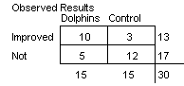
Dolphin Study
Antonioli and Reveley (2005)
Are depression patients who swim with dolphins more likely to show substantial improvement in their symptoms?

Slide 4
Parallel Goal
Assess student understanding of p-value, statistical inference, statistical process
  Identify student intuitions
  Effectiveness of learning activity, curriculum
  Evaluate long-term retention
Outline
  Example items under development
  Sample results
  Lessons learned

Slide 5
Assessment Items
1. Existing Questions
  CAOS = Comprehensive Assessment of Outcomes in a first Statistics course (delMas, Garfield, Ooms, & Chance, 2007)
  RPASS (Lane-Getaz, 2010 Proceedings)
2. Additional Questions
  a. Understanding components of learning activity
  b. Conceptual multiple choice questions
  c. Open-ended p-value interpretation
  d. Extension questions

Slide 6
1. Existing Items – CAOS Post-test
CAOS 4 = 40 multiple choice questions
  5 questions emphasizing significance, p-value interpretation, simulation
  Normative results from 1470 undergraduates
  Comparison of more traditional courses vs. randomization based courses
    Hope College (Fall 07 n=198, Fall 09 n=202)
      Tintle, Vanderstoep, Holmes, Quisenberry, & Swanson (submitted)
    Cal Poly (Spring 10 n=69, Fall 09/Winter 10 n=101)
Notes:
Some simulation but not to the same degree in spring Cal Poly course

Slide 7
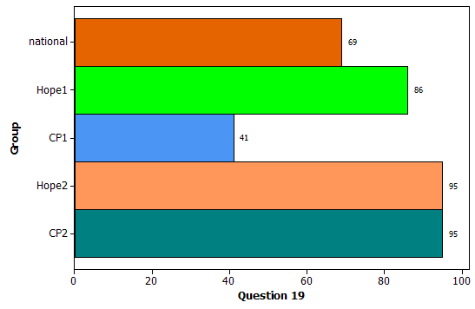
1. Existing Items – CAOS Post-test
19. Statistically significant results correspond to small p-values
  Traditional (National/Hope/CP): 69/86/41%
  Randomization (Hope/CP): 95%/95%

Slide 8
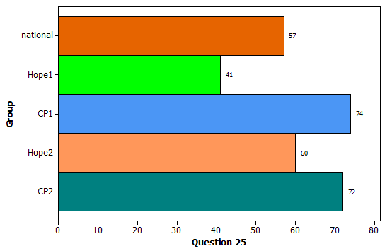
1. Existing Items – CAOS Post-test
25. Recognize valid p-value interpretation
  Traditional (National/Hope/CP): 57/41/74%
  Randomization (Hope/CP): 60/72%

Slide 9
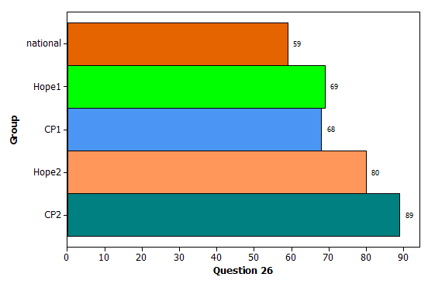
1. Existing Items – CAOS Post-test
26. p-value as probability of Ho - Invalid
  Traditional (National/Hope/CP): 59/69/68%
  Randomization (Hope/CP): 80%/89%

Slide 10
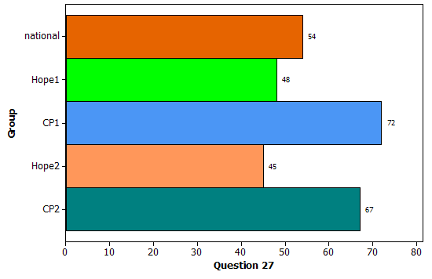
1. Existing Items – CAOS Post-test
27. p-value as probability of Ha – Invalid
  Traditional (National/Hope/CP): 54/48/72%
  Randomization (Hope/CP): 45/67%

Slide 11
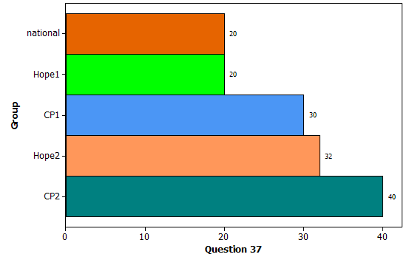
1. Existing Items – CAOS Post-test
37. Recognize a simulation approach to evaluate significance (simulate with no preference vs. repeating the experiment)
  Traditional (National/Hope/CP): 20/20/30%
  Randomization (Hope/CP): 32%/40%

Slide 12
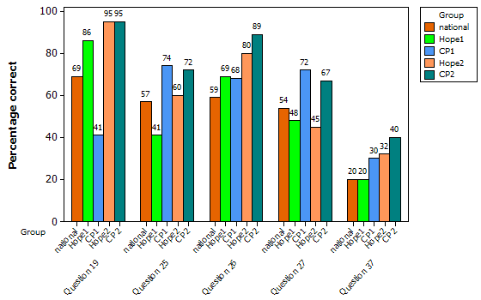

Slide 13
2a. Do students understand the simulation activities?
a) What do the cards represent?
b) What did shuffling and dealing the cards represent?
c) What kind of people did the face cards represent?
d) What implicit assumption about the two groups did the shuffling of the cards represent?
e) What observational units were represented by the dots in the dotplot?
f) Why did we count the number of repetitions with 10 or more?
Notes:
First 3, high 80%

Slide 14
2a. Do students understand the simulation activities (first module)?
d) What implicit assumption about the two groups did the shuffling represent?
e) What observational units were represented by the dots in the dotplot?
f) Why did we count the number of repetitions with 10 or more?
No treatment effect (20%)
Random assignment (63%)
Repetitions (2%)
Variable (55%) or outcome (31%)
Link to observed data (22%)
Decision making
Notes:
Variable – number that imporve; Outcome = successes, e.g., those that improved
Several (11/49, 22%) related the value of 10 to the observed data or as a way to judge the extremeness of this value (7/49, 14%) with 9 of 49 respondents (18%) specifying the desire to judge the extremeness of the observed results. Other answers revolved around decision making (“to prove/disprove the null,” “to calculate the p-value,” setting up a benchmark to compare to) or had an idea of looking at the extreme results without clearly referring back to the observed results.

Slide 15
2b. Conceptual Multiple Choice Questions
Goals:
  Ease of administration and grading, with informative distractors
  Jargon free
  Formative or summative evaluation (including pre/post test)
  Focus on interpretation of significance, drawing conclusions in context, effect of sample size, treatment effect

Slide 16
2b. Conceptual Multiple Choice Questions
Example: You want to investigate a claim that women are more likely than men to dream in color. You take a random sample of men and a random sample of women (in your community) and ask whether they dream in color.
(Optional) Note: A “statistically significant” difference provides convincing evidence (e.g., small p-value) of a difference between men and women

Slide 17
2b. Conceptual Multiple Choice Questions
1) What conclusion draw if not statistically significant?
2) What conclusion draw if statistically significant?
3) What if not significant but really believe is a difference?
6) Two studies with different differences in sample proportions, which more evidence?
7) Two studies with different sample sizes, which more evidence?
Notes:
.62 .82 .88 .62 .36 .78 .82
.69 .69 .60 .65 .40 .80 .66
.57 .74 .71 .77 .60 .77 .77
1 Percent 2 Percent 3 Percent 4 Percent 5 Percent 6 Percent 7 Percent
a 30.00 a 11.43 a 25.71 a 7.14 a 30.43 a 79.71 a 71.43
b 62.86 b 71.43 b 8.57 b 21.43 b 50.72 c 20.29 b 7.14
c 7.14 c 17.14 c 65.71 c 71.43 c 18.84 c 21.43
Alpha = .492

Slide 18
2b. Conceptual Multiple Choice Questions
4) If the difference in the proportions (who dream in color) between the two groups does turn out to be statistically significant, which of the following is a possible explanation for this result?
8% a) Men and women do not differ on this issue but there is a small chance that random sampling alone led to the difference we observed between the two groups.
30% b) Men and women differ on this issue.
62% c) Either (a) or (b) are possible explanations for this result.

Slide 19
2b. Conceptual Multiple Choice Questions
5) Reconsider the previous question. Now think about not possible explanations but plausible explanations. Which is the more plausible explanation for the result?
28% a) Men and women do not differ on this issue but there is a small chance that random sampling alone led to the difference we observed between the two groups.
36% b) Men and women differ on this issue.
36% c) They are equally plausible explanations.

Slide 20
2c. Components of p-value Interpretation
All subjects in an experiment were told to imagine they have moved to a new state and applied for a driver’s license.
(a) Use the Two-way Table Simulation applet to approximate the p-value for determining whether there is evidence that a higher proportion are willing to be donors when the default option is to be a donor. Report the approximate p-value.
(b) Provide an interpretation of the p-value you calculated in the context of this study.
Optional hint: What is it the probability of?
 | Default not donor | Default donor | Total
Became donor | 25 | 40 | 65
Did not become donor | 25 | 15 | 40
Total | 50 | 55 | 105

Slide 21
2c. Components of p-value Interpretation
What components of interpretation do students (voluntarily) mention? How changes over time?
  Probability of observed data
  Tail probability
  Based on random sampling or assignment
  Under the null hypothesis

Slide 22
Rubric
 | Essentially correct (E) | Partially correct (P) | Incorrect (I)
Probability of data | of observed data (with context and numerical value) | of “these values” (no numerical values) but seems to be of data at hand | unclear event
Tail probability | give correct direction | gives wrong direction or unclear direction (“or more extreme”) but still a tail probability | no indication of tail
Based on randomness | by random assignment or random sampling | something is repeated or source of randomness is not clear, e.g. “by chance” | no randomness specified
Under null hypothesis | assuming no difference or assuming specific parameter values | assuming randomness is only explanation but no context given (e.g., “by chance alone”) | no specification of a condition

Slide 23
Example (first exam)
Being that the default is to be a donor or not did have an effect on the subjects, it is not just by random chance. [IIPP – focused on conclusion]
So the observed data in this study would be surprising to have happened by random chance alone. [P⁺IPP]
If this study was redone, only a proportion of .029 times would the data be as extreme or more extreme as the study. [PPPI]

Slide 24
Example
In every 500 sets, 3 showed the [group A] would have the same values, or be as extreme as, the original observed value… chance that our original observed results will be repeated. [EPPP]
If the subjects were going to be donate, regardless of which condition they were in, it shows how often would the random assignment process lead to such a large difference in the conditional proportions. [EIEE]

Slide 25
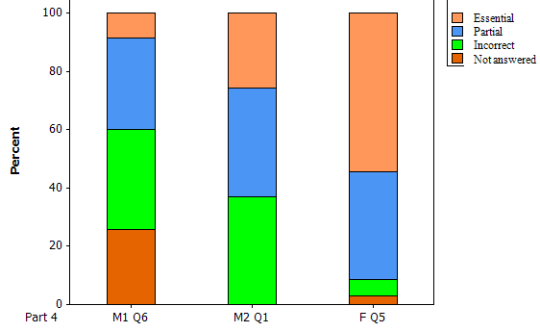
Observations (over 3 exams)
Often, students only talk about the conclusion will draw from p-value (evaluation vs. interp)
Many students quickly get to “result wouldn’t happen by chance alone”
Initially, most often missed component is the conditional nature of the probability (under null hypothesis) but greatest improvement
Continue to struggle with
  Specifying a tail probability
  Specifying specific source of randomness

Slide 26
Compromise?
We have said the p-value can often be interpreted as “the probability you would get results at least this extreme by chance alone.” Explain what is meant by each underlined phrase in this context.
Probability:
Results at least this extreme:
Chance:
Alone:
Notes:
Largest difference was on getting credit for the probability part?

Slide 27
2d. Extension Questions
Applying concepts to new study
  Describe how to carry out simulation using a deck of cards…
  What is the “null model”?
Novel scenarios
  Apply lessons learned in comparing two groups to discuss how would assess significance among three groups
  Matched pairs design

Slide 28

Example – 2009 AP Statistics Exam
A consumer organization would like a method for measuring the skewness of the data. One possible statistic for measuring skewness is the ratio mean/median….
  Calculate statistic for sample data…
  Draw conclusion from simulated data …

Slide 29
Conclusion
Highlighting student difficulties
  Deeply understanding why we perform the simulations under the null model
  Differentiating between sample data and simulated data under null model
  Understanding our expectation in clarity and thoroughness of written response
More work to be done in refining items and in
  Linking randomization process across activities, scenarios (random sampling vs. random assignment)
  Using assessments to build understanding
Notes:
“good start”
Giving them the components each time

Slide 30
Thank you!
Assessment items:
  Chance, Holcomb, Rossman, and Cobb (2010, Proceedings)
  http://statweb.calpoly.edu/csi/ (advisors page)
Instructional modules, development process:
  Holcomb, Chance, Rossman, Tietjen, and Cobb (2010, Proceedings)
  Session 8D, Friday 14:00-16:00
This project has been supported by the National Science Foundation, DUE/CCLI #0633349

Slide 31
Example
In 1977, the U.S. government sued the City of Hazelwood, a suburb of St. Louis, on the grounds that it discriminated against African Americans in its hiring of school teachers (Finkelstein and Levin, 1990). The statistical evidence introduced noted that of the 405 teachers hired in 1972 and 1973 (the years following the passage of the Civil Rights Act), only 15 had been African American. But according to 1970 census figures, 15.4% of teachers employed in St. Louis County that year were African American. Suppose we find the p-value is less than .0001. Provide a one-sentence interpretation of this p-value in this context.
Optional: What is it the probability of?

Slide 32
This is the probability of observing 15 hired African-Americans out of a random sample of 405 teachers if 15.4% of teachers are African-American. (EIEE)
There is a small probability, close to 0, that by randomization we would get fewer than 15 African-American teachers hired. (EEPI)

Slide 33
Component 1: Probability of observed data

Slide 34
Component 2: Tail Probability

Slide 35
Component 3: Randomization

Slide 36
Component 4: Under null hypothesis

