Slide 1
Stat 414 – Day 2
Estimating linear regression models

Slide 2
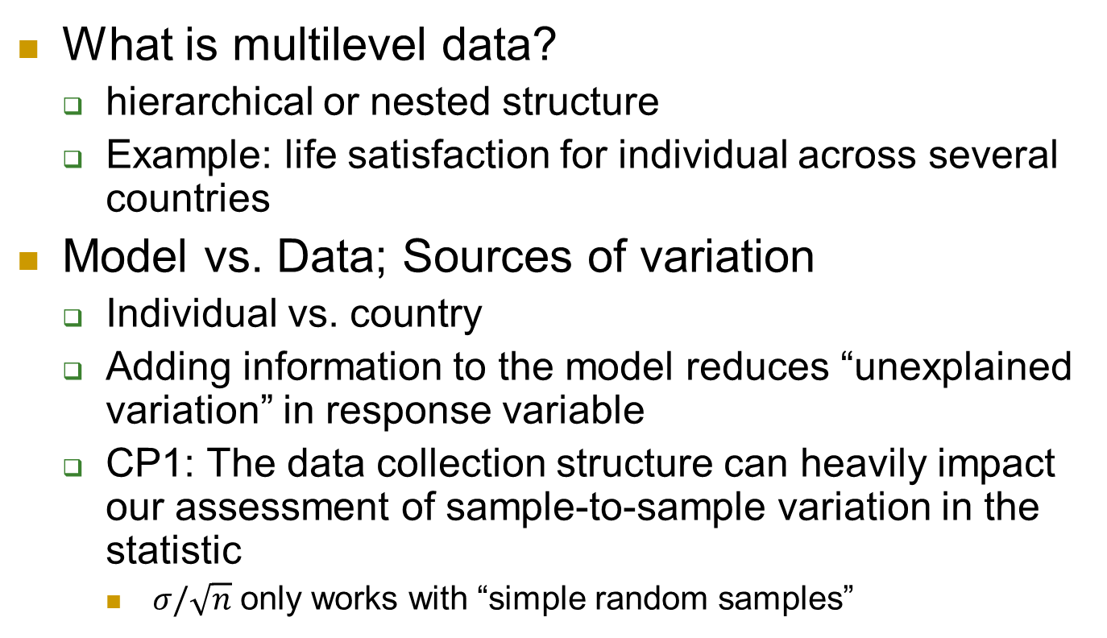
Last Time
university
class
student
student
class
student
What is multilevel data?
  hierarchical or nested structure
  Example: life satisfaction for individual across several countries
Model vs. Data; Sources of variation
  Individual vs. country
  Adding information to the model reduces “unexplained variation” in response variable
  CP1: The data collection structure can heavily impact our assessment of sample-to-sample variation in the statistic
    $σ/\sqrt{n}$ only works with “simple random samples”

Slide 3
Quiz 1
Given some level 1 units: Identify potential level 2 units, and level 1 and level 2 variables

Slide 4
Linear Regression Models…
When can I use a linear model?
How do I measure the strength of the linear association?
How do I find a line?
How do I interpret the model?
How do I assess the fit of the model?
When am I allowed to use causal language?
When am I allowed to use the p-values? Confidence intervals?

Slide 5
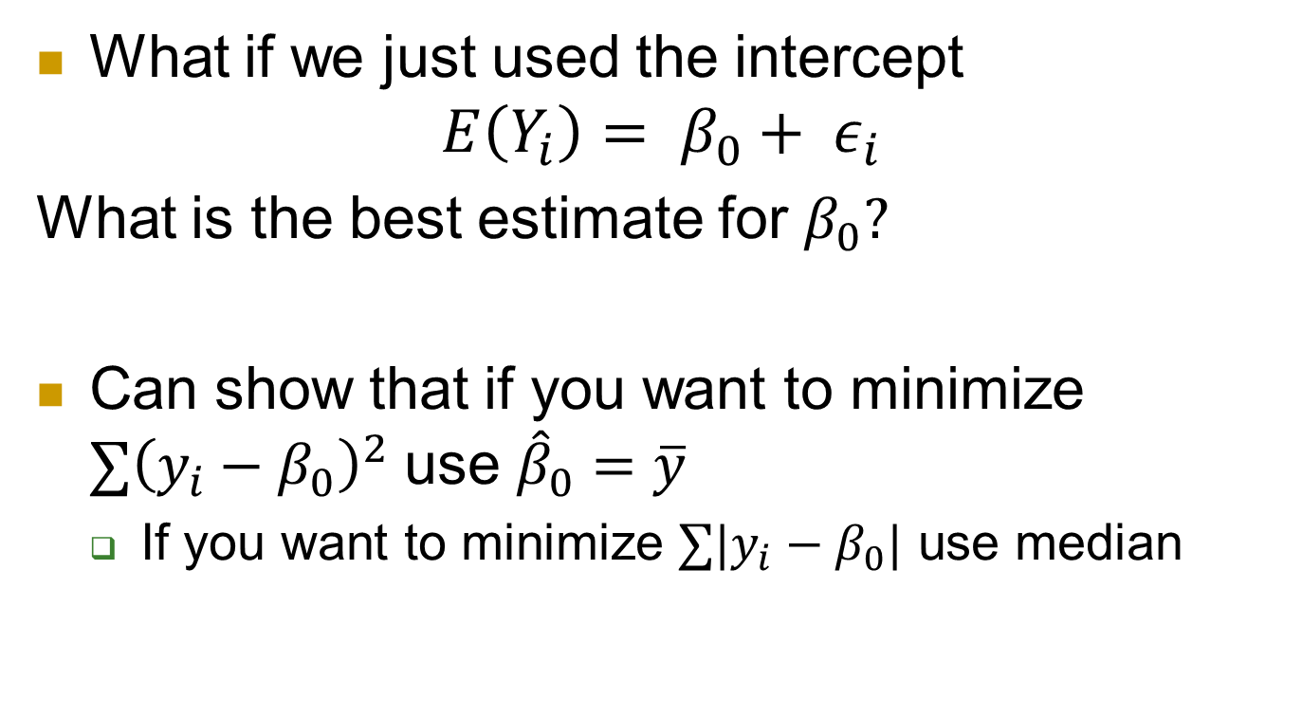
Last Time: Predicting airfares
What if we just used the intercept
$$E\left(Y_{i}\right)= β_{0}+ ε_{i}$$
What is the best estimate for $β_{0}?$
Can show that if you want to minimize $∑{\left(y_{i}−β_{0}\right)}^{2}$ use ${\hat{β}}_{0}=\overline{y}$
  If you want to minimize $∑|y_{i}−β_{0}|$ use median

Slide 6
Applet demo

Slide 7
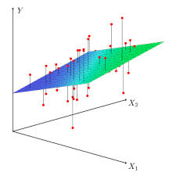
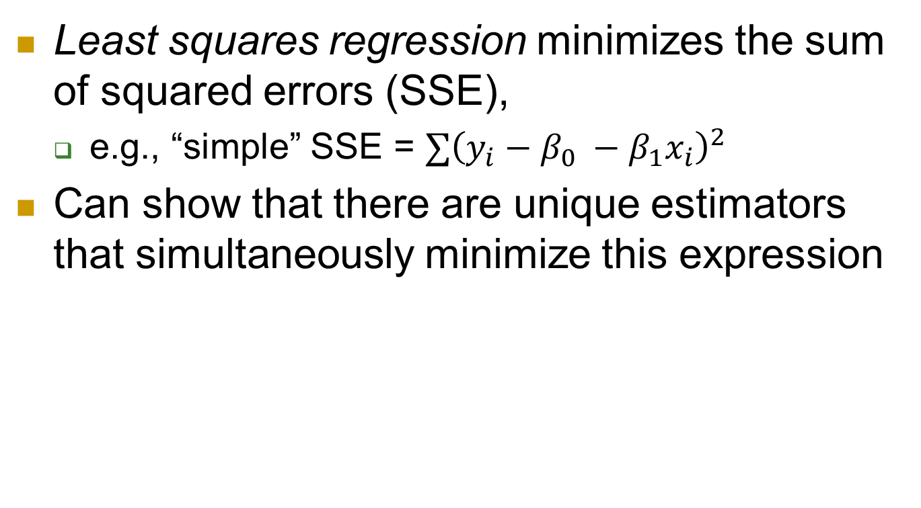
Estimating a linear model
Least squares regression minimizes the sum of squared errors (SSE),
  e.g., “simple” SSE = $∑{\left(y_{i}−β_{0} −β_{1}x_{i}\right)}^{2}$
Can show that there are unique estimators that simultaneously minimize this expression

Slide 8
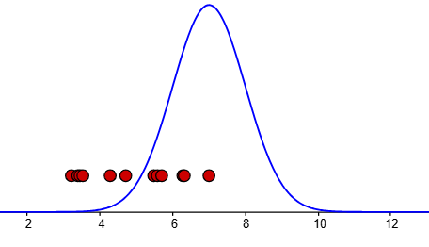
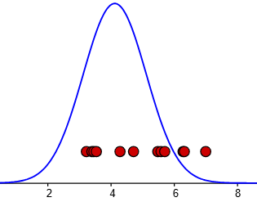
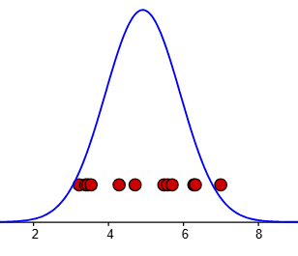
Alternatively
Rather than minimizing the sum of squared errors, we want to maximize the “likelihood” of seeing our data
Airfare data (red dots) vs. likelihood function (blue curve):

Slide 9
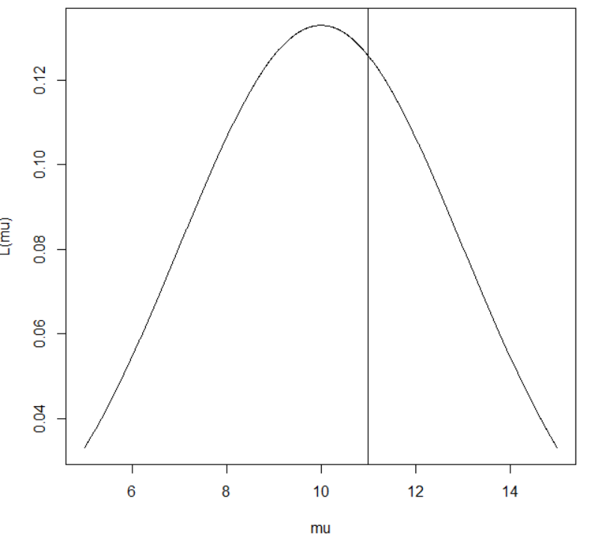

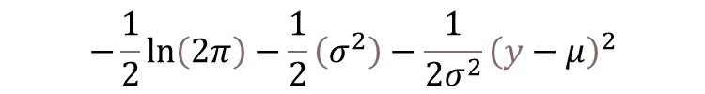
Another approach
Using a normal distribution as likelihood function
How solve for the best value of the mean?
$$L\left(μ,σ;y\right)=\frac{1}{σ\sqrt{2π}}e^{\left(\frac{−{\left(y−μ\right)}^{2}}{2σ^{2}}\right)}$$
Log-likelihood
$$−\frac{1}{2}\ln\left(2π\right)−\frac{1}{2}\left(σ^{2}\right)−\frac{1}{2σ^{2}}{\left(y−μ\right)}^{2}$$

Slide 10
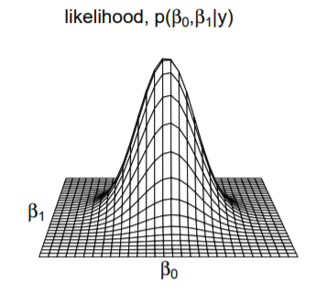
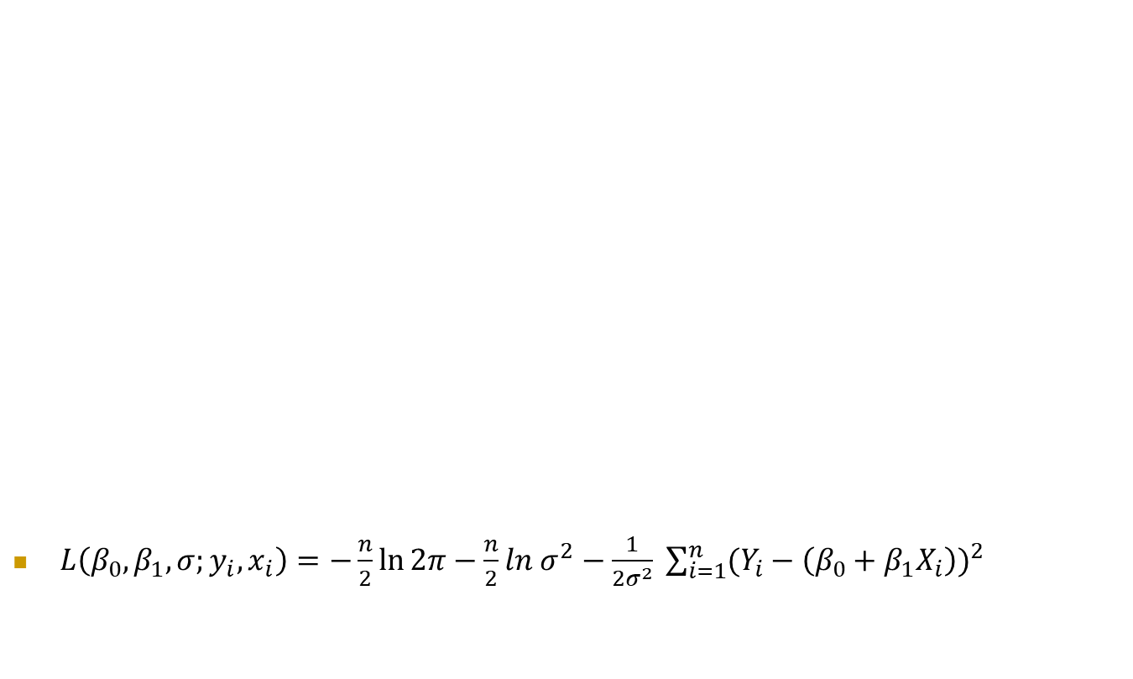
Last Time: MLEs
$L\left(β_{0},β_{1},σ;y_{i}, x_{i}\right)=−\frac{n}{2}\ln{2π−\frac{n}{2}ln{ σ}^{2}−\frac{1}{2σ^{2}} \sum_{i=1}^{n}{(Y_{i}−{\left(β_{0}+β_{1}X_{i}\right))}^{2}} }$
Want to find the estimates to maximize this function

Slide 11
Let’s do it

Slide 12
To Do by Friday
Day 2 Quiz
Computer problem 2 (submit just this part as word or pdf)
Continue HW 1 (due midnight Sunday)

