Slide 1
Stat 414 – Day 19
Final review

Slide 2
Next
Will send out some post-presentation comments soon
Things to fix up on final project reports
HW 8 solutions posted
Optional Quiz solutions available?
video for Day 16 (also explanations in these slides)
Final exam Dec. 8, 7:10am
Aiming for 120 points
Review session Sunday?
Final exam discussion board/Discord

Slide 3
Format of final exam
2 pages of notes
Recommendation: Formulas, Translations (e.g., substantial vs. significant; independence vs. interaction)
No computer
Coverage
Since midterm, but using everything
Mostly interpreting output
Useful and Not useful output supplied
Important to know what you are basing your statements on
Explain big ideas to non statistician
Interplay between data/model/visualization
Answering specific research questions
Consequences of model assumptions/What if questions

Slide 4
Most recent material
Random slopes
Allows modeling of unequal variances
Cross-level interactions can explain variation in slopes
Crossed-effects (aka imperfect hierarchies)
Uncorrelated but can still explore interaction
Logistic models
Longitudinal models (“growth curves”)
Piecewise linear, quadratic models
AR(1) = alternative correlation structure
Applications/Extensions
Meta-analysis
GEE/Sandwich estimators (robust standard errors)
Choosing model to match research question

Slide 5
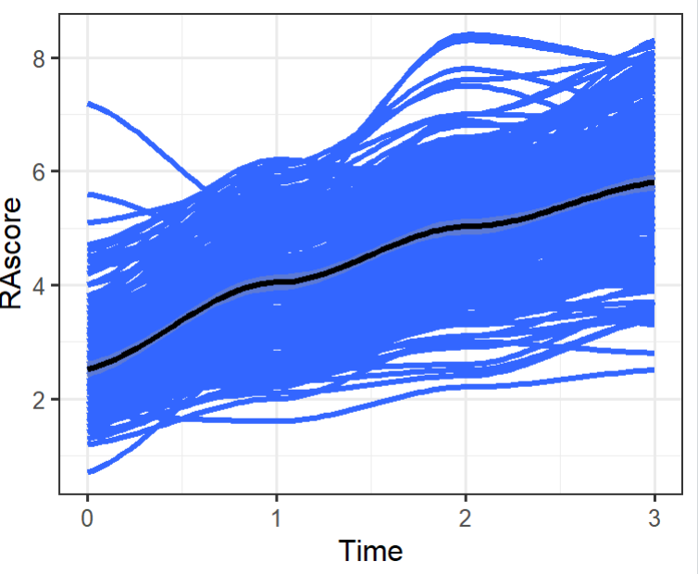
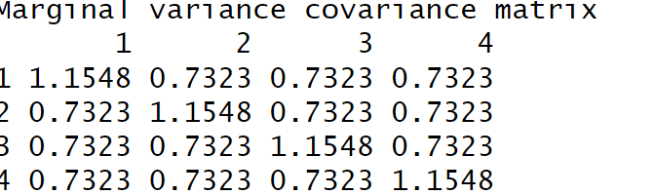
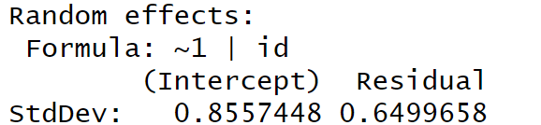

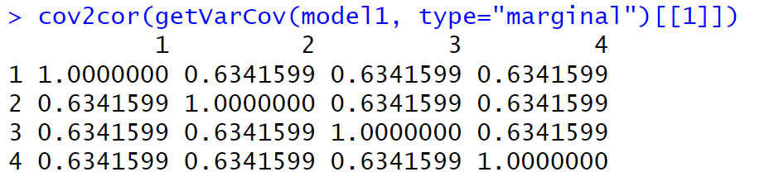
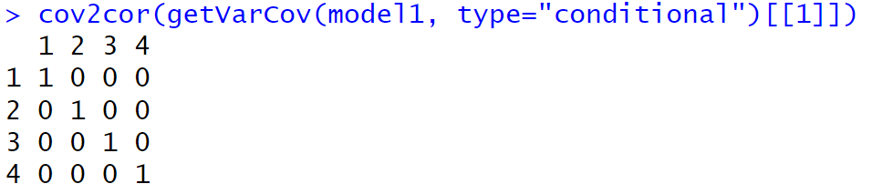

Data (y) vs. Errors ($ε$)
summary(model1 <- lme(RAscore ~ Time, random = ~1 | id))
Random intercepts partition the unexplained variability into within group and between group
Random intercepts “induce” an identical correlation between pairs of responses in the same cluster
(assuming independence of errors within cluster)

Slide 6
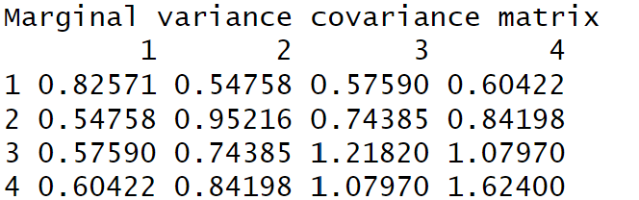
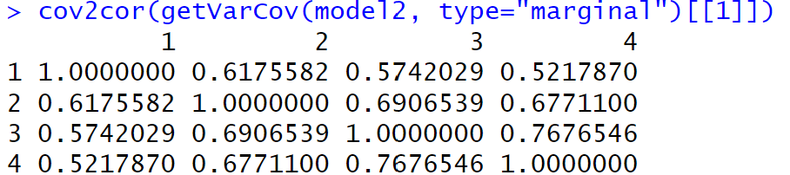
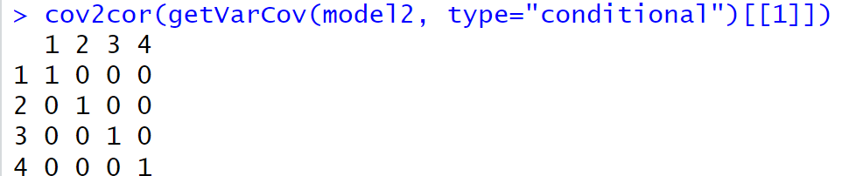
Data (y) vs. Errors ($ε$)
model2 = lme(RAscore ~ Time, random = ~Time|id)
Random slopes allows us to model unequal variability in the responses
Also get unequal correlations, but do they match the observed data?
Still have uncorrelated residuals within each group

Slide 7
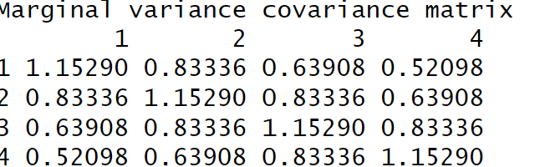
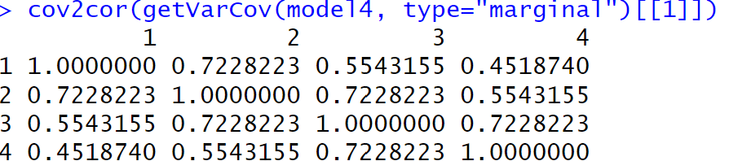
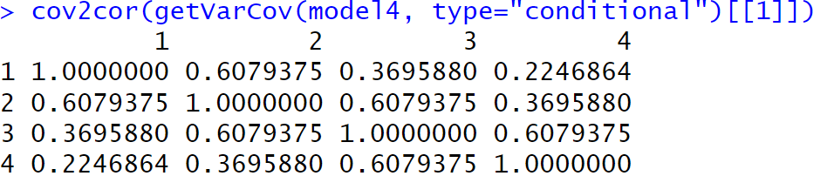

Data (y) vs. Errors ($ε$)
model4 = lme(fixed = RAscore ~ Time, random = ~1| id, correlation = corAR1())
AR(1) model on the residuals
Equal variances
Decay in correlations of pairs of responses
Correlated “within person” residuals (one parameter)

Slide 8
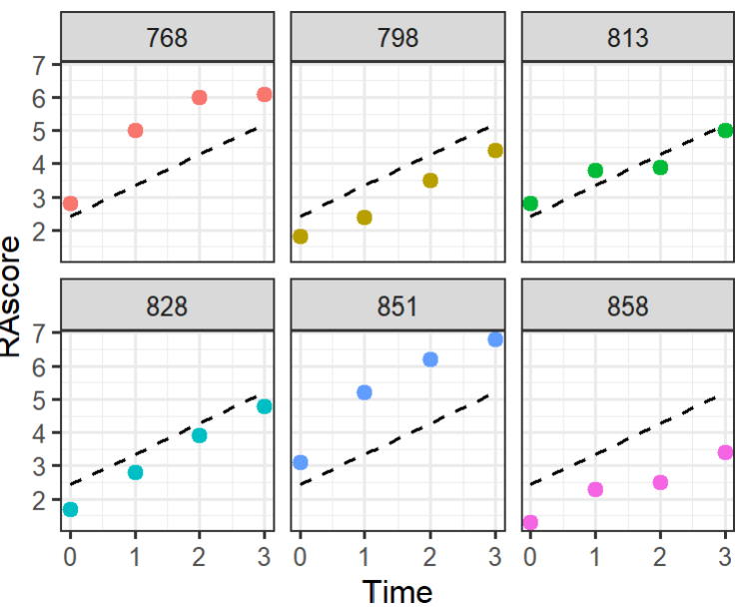
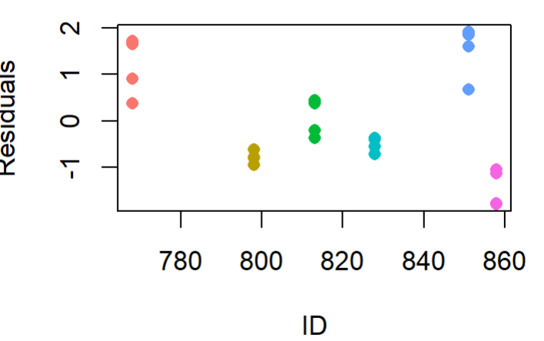
What do we mean by correlated residuals?

Slide 9
Random vs. Fixed
With OLS, the coefficient of x represents the effect of x averaged across all individuals, ignoring any clustering in the data
Standard errors are likely too small
To adjust for correlation within clusters, include the cluster variable in the model
Fixed effect: controls for all observed and unobserved possible confounders at Level 2
Controls for differences across clusters
Can adjust SEs for heterogeneity, autocorrelation
Or treat as random…

Slide 10
Fixed vs. Random (higher level units or lower level variable)
hospital
ethnicity
Level
Variable
Categorical variables whose categories have no special meaning
Ahead of time, no real predictions of how compare
Would make sense to be the observational unit in a regression model (aggregating)
Large number of categories
Willing to assume drawn from some distribution
Categorical variable and specific categories have distinct meanings
Might predict different results in advance
Ordinal or continuous variable
Wouldn’t really make sense to be the unit of analysis
Notes:
Region

Slide 11
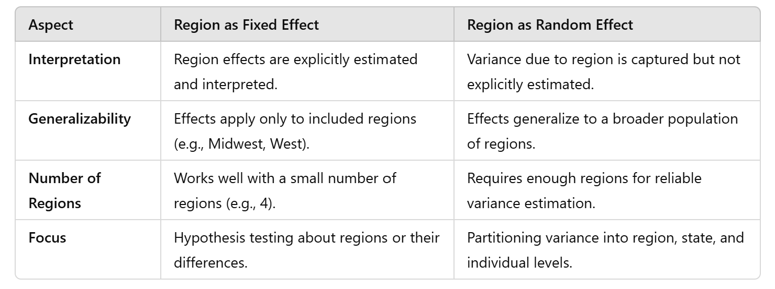
What about Region?
Research Question:
If your focus is on how regions differ, treat region as a fixed effect.
If your focus is on partitioning variance or accounting for regional clustering, treat region as a random effect.
Number of Regions:
A small number of regions (e.g., 4) is better handled as a fixed effect because random-effects estimation requires more levels for stability.
Model Complexity:
Adding a random effect for regions increases model complexity, which may not be justified with only a few regions.
Generalization:
If regions represent a fixed and exhaustive set (e.g., all US regions), fixed effects are more appropriate.
If regions represent a random sample of possible groupings, random effects are more appropriate.
Notes:
Research Question:
If your focus is on how regions differ, treat region as a fixed effect.
If your focus is on partitioning variance or accounting for regional clustering, treat region as a random effect.
Number of Regions:
A small number of regions (e.g., 4) is better handled as a fixed effect because random-effects estimation requires more levels for stability.
Model Complexity:
Adding a random effect for regions increases model complexity, which may not be justified with only a few regions.
Generalization:
If regions represent a fixed and exhaustive set (e.g., all US regions), fixed effects are more appropriate.
If regions represent a random sample of possible groupings, random effects are more appropriate.

Slide 12
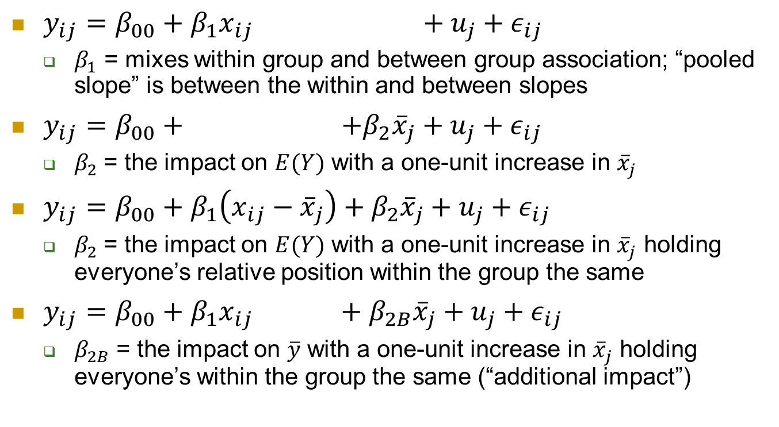
Within-Between Model
$y_{ij}=β_{00}+β_{1}x_{ij} +u_{j}+ε_{ij}$
$β_{1}$ = mixes within group and between group association; “pooled slope” is between the within and between slopes
$y_{ij}=β_{00}+ +β_{2}{\overline{x}}_{j}+u_{j}+ε_{ij}$
$β_{2}$= the impact on $E(Y)$ with a one-unit increase in ${\overline{x}}_{j}$
$y_{ij}=β_{00}+β_{1}\left(x_{ij}−{\overline{x}}_{j}\right)+β_{2}{\overline{x}}_{j}+u_{j}+ε_{ij}$
$β_{2}$= the impact on $E(Y)$ with a one-unit increase in ${\overline{x}}_{j}$ holding everyone’s relative position within the group the same
$y_{ij}=β_{00}+β_{1}x_{ij} +β_{2B}{\overline{x}}_{j}+u_{j}+ε_{ij}$
$β_{2B}$= the impact on $\overline{y}$ with a one-unit increase in ${\overline{x}}_{j}$ holding everyone’s within the group the same (“additional impact”)

Slide 13
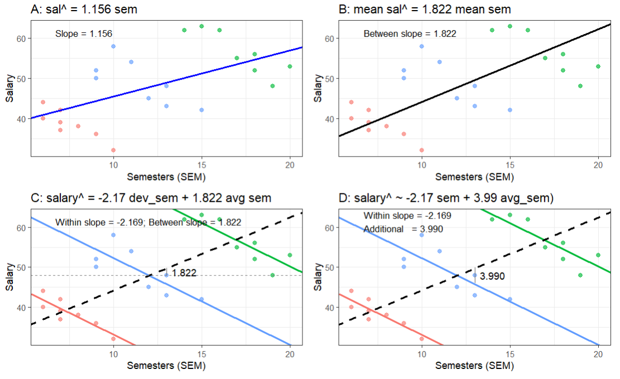


Remember our salary data…
$$β_{2}$$
$$β_{2B}$$
-2.17 + 3.99 = 1.822

Slide 14
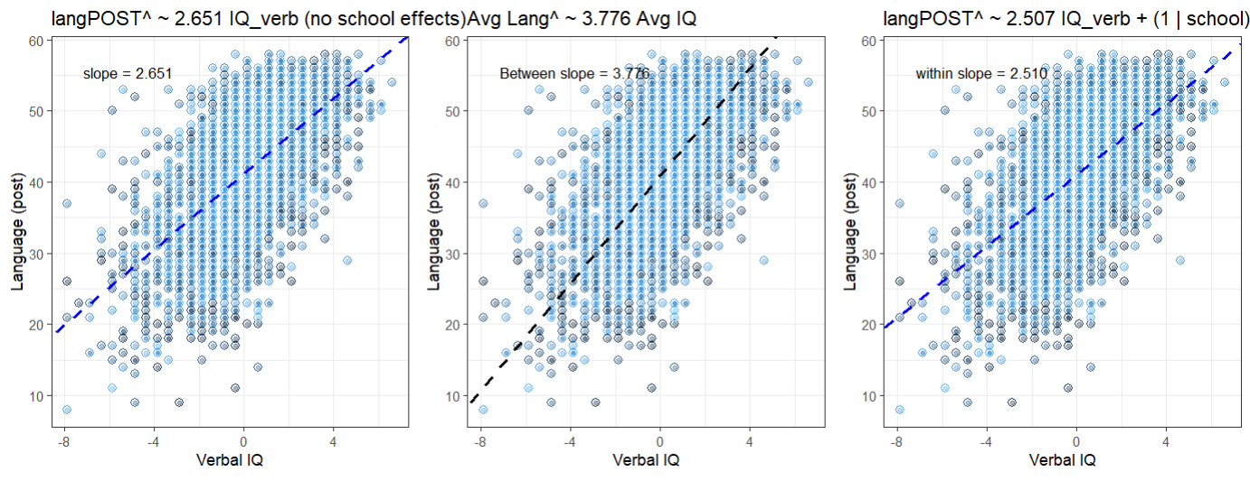
Remember our langPOST data
Without adjusting for school looks like overall slope is larger than actual “within school” slope

Slide 15
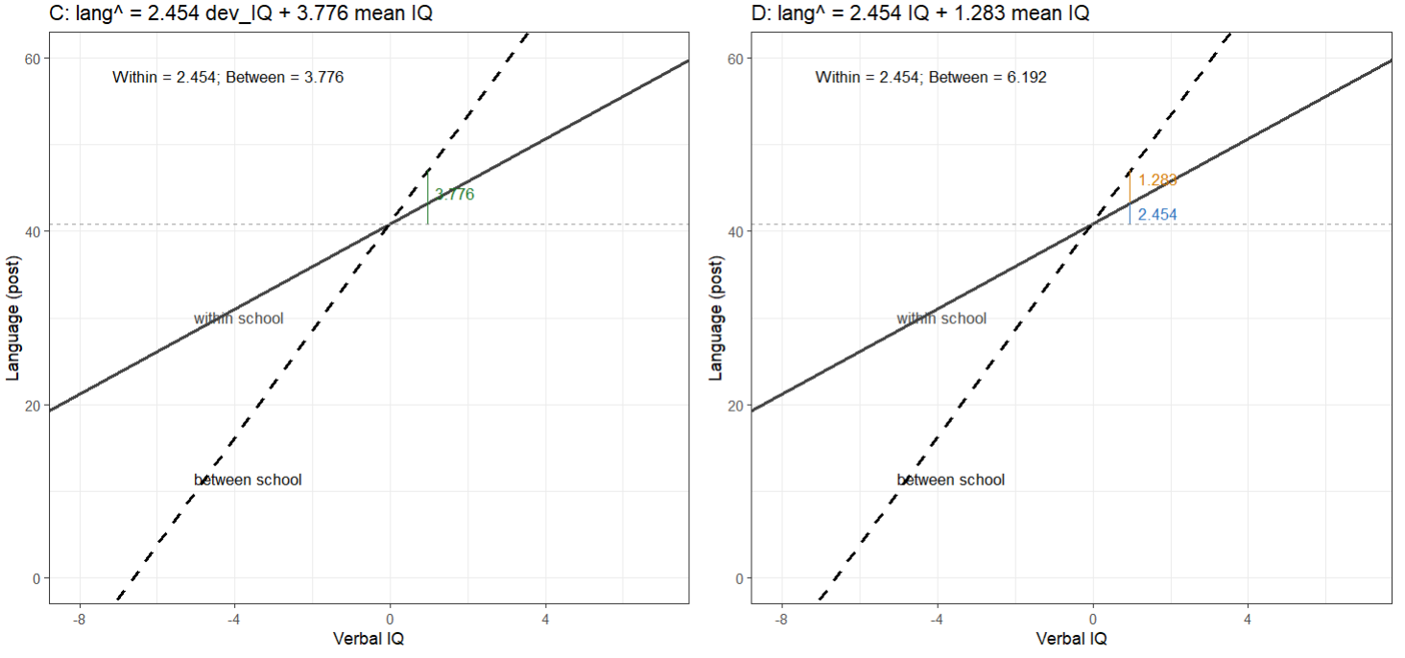

Using ($IQ_{ij} −{\overline{IQ}}_{j}$) vs IQ$ij$
Between group slope
Additional effect

Slide 16
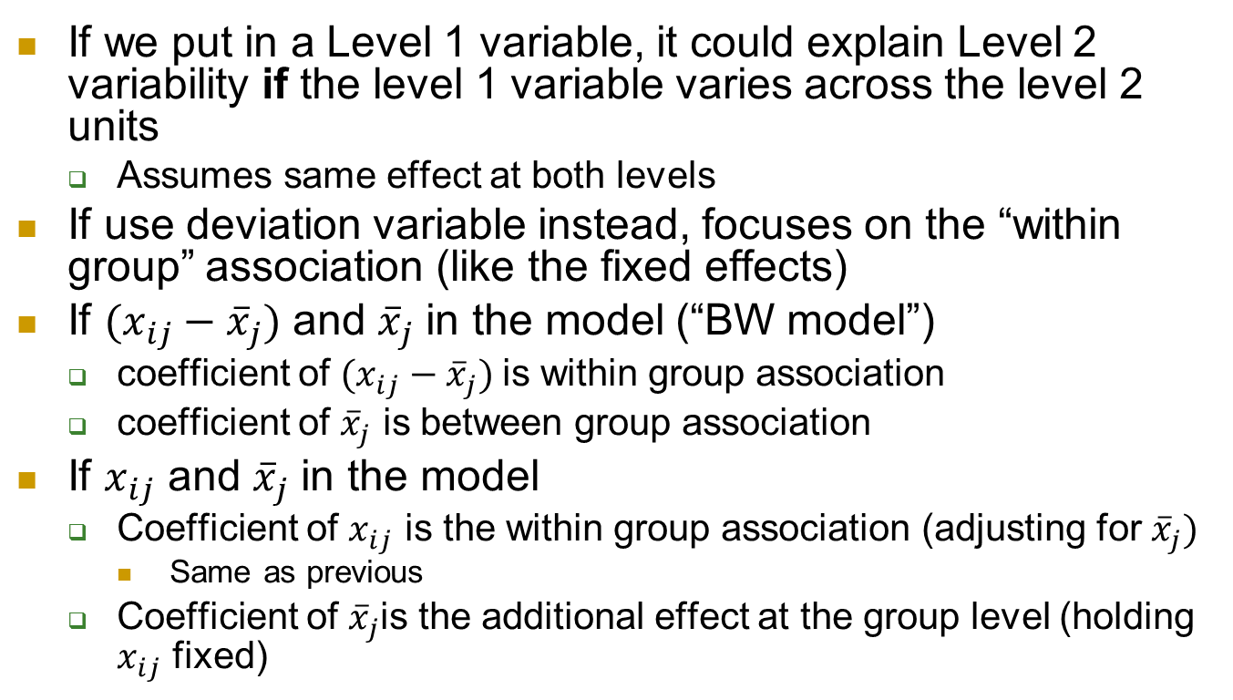
Group mean centering
If we put in a Level 1 variable, it could explain Level 2 variability if the level 1 variable varies across the level 2 units
Assumes same effect at both levels
If use deviation variable instead, focuses on the “within group” association (like the fixed effects)
If $(x_{ij}−{\overline{x}}_{j})$ and ${\overline{x}}_{j}$ in the model (“BW model”)
coefficient of $(x_{ij}−{\overline{x}}_{j})$is within group association
coefficient of ${\overline{x}}_{j}$ is between group association
If $x_{ij}$ and ${\overline{x}}_{j}$ in the model
Coefficient of $x_{ij}$ is the within group association (adjusting for ${\overline{x}}_{j})$
Same as previous
Coefficient of ${\overline{x}}_{j}$is the additional effect at the group level (holding $x_{ij}$ fixed)

Slide 17
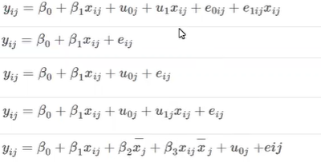
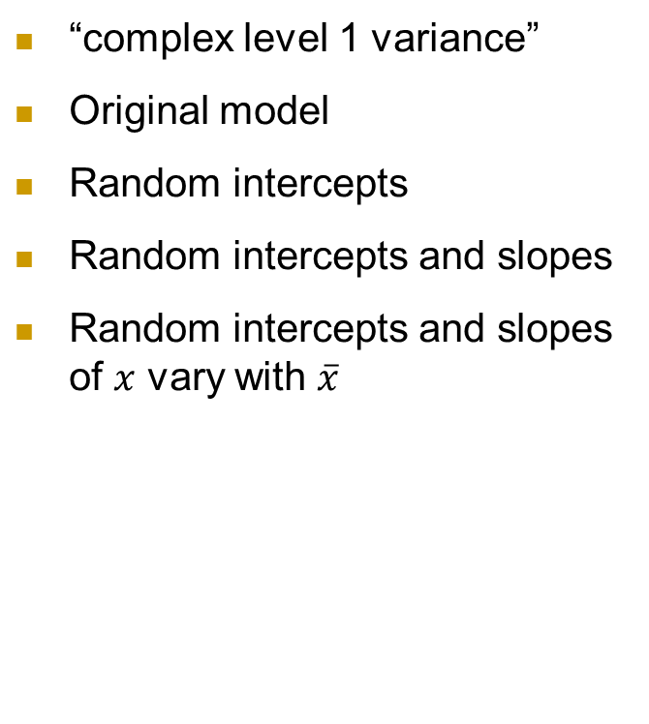
Optional Quiz 16
“complex level 1 variance”
Original model
Random intercepts
Random intercepts and slopes
Random intercepts and slopes of $x$ vary with $\overline{x}$
Notes:
Quiz 27
https://www.rossmanchance.com/chance/stat414F22/lectures/GMT20201023-060334_Beth-Chanc_1920x1080.mp4

Slide 18

Optional Quiz 16 (2)
In a study of school effects on students’ progress, does the strength of the relationship between prior attainment and subsequent performance vary across schools?
x = prior attainment, y = subsequent performance
Random slopes on prior attainment

Slide 19
Optional Quiz 16 (3)
Are there contextual (area level) effects of income on an individual’s health that operate over and above any effect of individual income?
Want average income in the model (with group mean centering income)
Do any contextual (area) effects of income differ for poor individuals and better-off individuals
Want interaction between individual income and group level income

Slide 20

Optional Quiz 16 (4)
Do mean fertility levels differ across regions (adjusting for age effects)?
Fertility is the response variable, region is the level 2 unit, age is a level 1 variable
Want random intercepts with age in the model

Slide 21

Optional Quiz 16 (5)
Do mean fertility levels differ across regions (adjusting for age effects)?
Are regional differences in fertility more apparent among older women than among younger women?
Regional differences ⇒ random intercepts
Effect of region varies by age ⇔ Effect of age varies by region
Random slopes on age, allows the variability in average fertility (lines) to depend on age

Slide 22
Optional Quiz 16 (6)
Do mean fertility levels differ across regions (adjusting for age effects)?
Are regional differences in fertility more apparent among older women than among younger women?
Does variation between women in their fertility depend on age?
Allow within region variability to depend on age
Notes:
Discussion recording Links to an external site.Passcode: C?*Lf!u6 Recording 2!!!

Slide 23
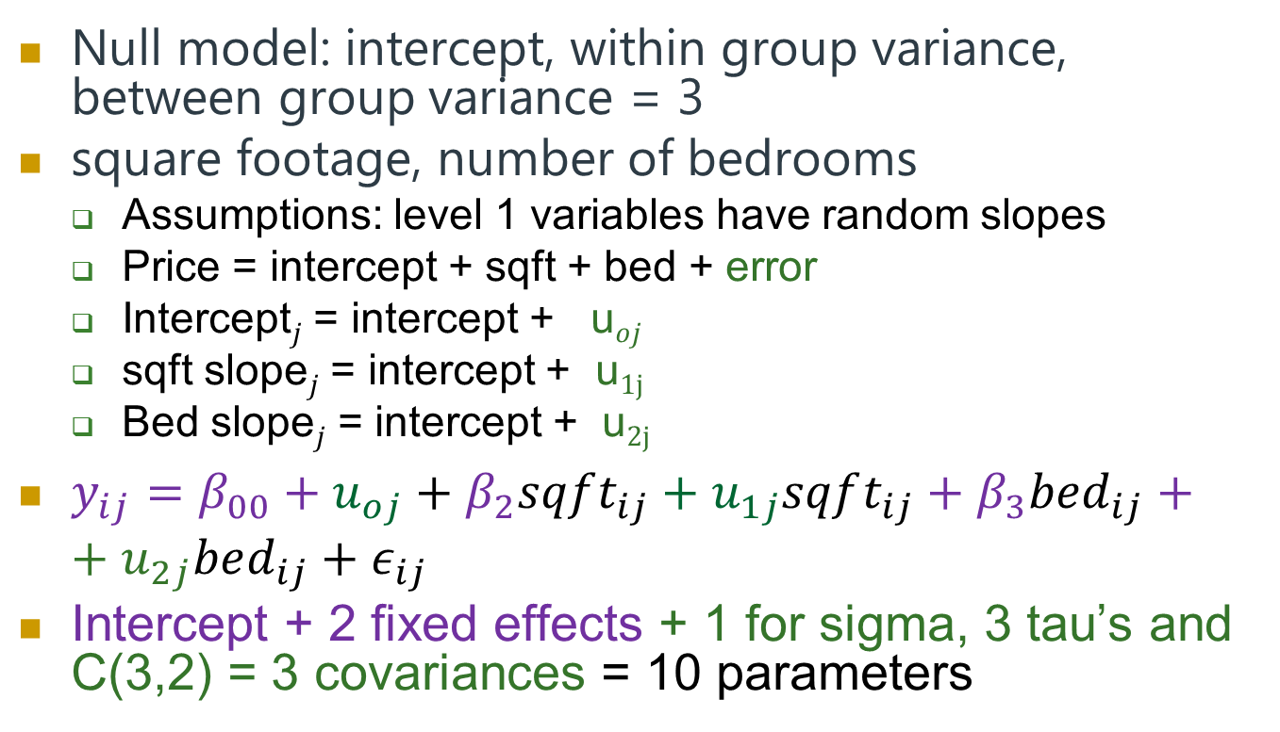
Optional Quiz 17
Null model: intercept, within group variance, between group variance = 3
square footage, number of bedrooms
Assumptions: level 1 variables have random slopes
Price = intercept + sqft + bed + error
Intercept$j$ = intercept + u$oj$
sqft slope$j$ = intercept + u$1j$
Bed slope$j$ = intercept + u$2j$
$y_{ij}=β_{00}+u_{oj}+β_{2}sqft_{ij}+u_{1j}sqft_{ij}+β_{3}bed_{ij}++u_{2j}bed_{ij}+ε_{ij}$
Intercept + 2 fixed effects + 1 for sigma, 3 tau’s and C(3,2) = 3 covariances = 10 parameters
Notes:
3, 10,

Slide 24
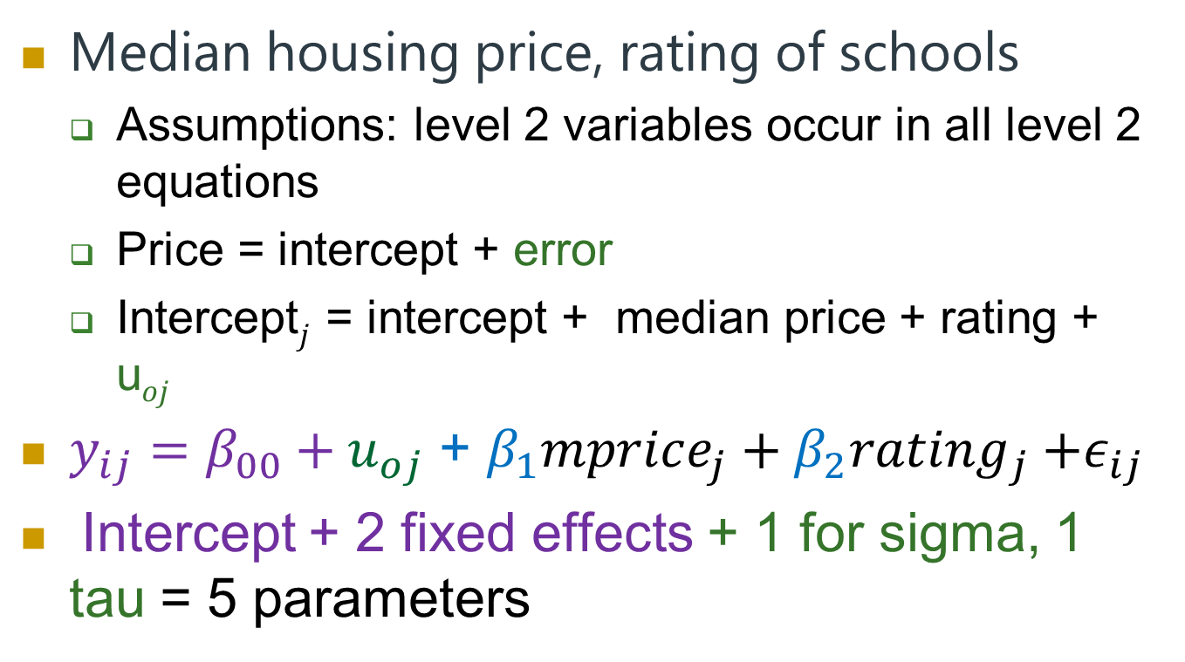
Optional Quiz 17 (2)
Median housing price, rating of schools
Assumptions: level 2 variables occur in all level 2 equations
Price = intercept + error
Intercept$j$ = intercept + median price + rating + u$oj$
$y_{ij}=β_{00}+u_{oj}$ + $β_{1}mprice_{j}+β_{2}rating_{j}$ $+ε_{ij}$
Intercept + 2 fixed effects + 1 for sigma, 1 tau = 5 parameters
Notes:
3, 10,

Slide 25
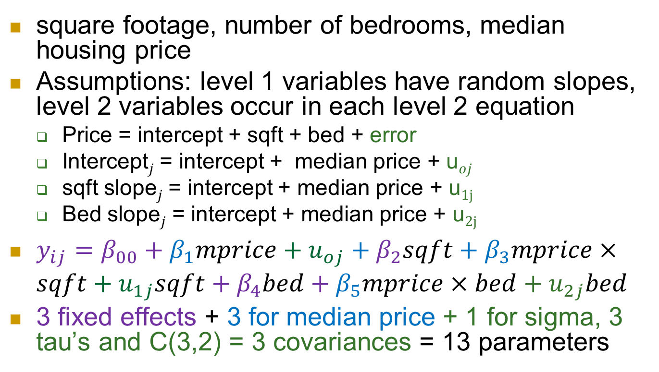
Optional Quiz 17 (3)
square footage, number of bedrooms, median housing price
Assumptions: level 1 variables have random slopes, level 2 variables occur in each level 2 equation
Price = intercept + sqft + bed + error
Intercept$j$ = intercept + median price + u$oj$
sqft slope$j$ = intercept + median price + u$1j$
Bed slope$j$ = intercept + median price + u$2j$
$y_{ij}=β_{00}+β_{1}mprice+u_{oj}+β_{2}sqft+β_{3}mprice×sqft+u_{1j}sqft+β_{4}bed+β_{5}mprice×bed+u_{2j}bed$
3 fixed effects + 3 for median price + 1 for sigma, 3 tau’s and C(3,2) = 3 covariances = 13 parameters
Notes:
3, 10, 5, 13

Slide 26
Optional Quiz 17 (4)
Model 1: lmer(geread~gevocab+gender + (gevocab | class) + (-1 + gender|class), data=achieve)
Intercept + gevocab slope + gender slope + 3 (intercept var, slope var, covar) + 1 (slope var) + sigma = 8

Slide 27
Case Study highlights
Graphing Level 1 data vs. aggregating to Level 2 data
e.g., mean(na), head(mpqnem, 1)
Performances nested within musicians
About 18% of the variation in na is at the musician level
Level 1 variables include audience
Large ensemble or not
Leve 2 variables include instrument
Orchestral or not

Slide 28
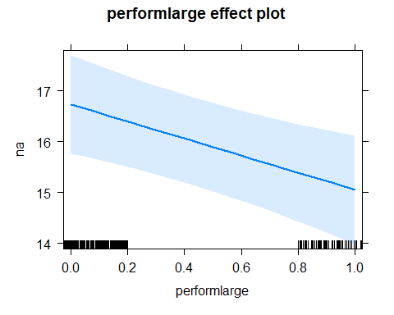
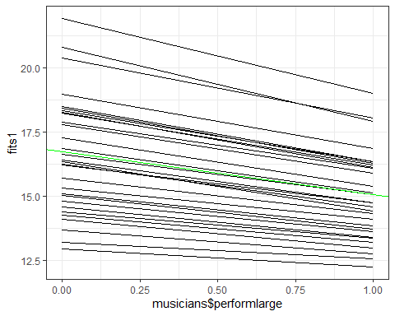
Large performance?
Keep in mind, really comparing 2 means…

Slide 29
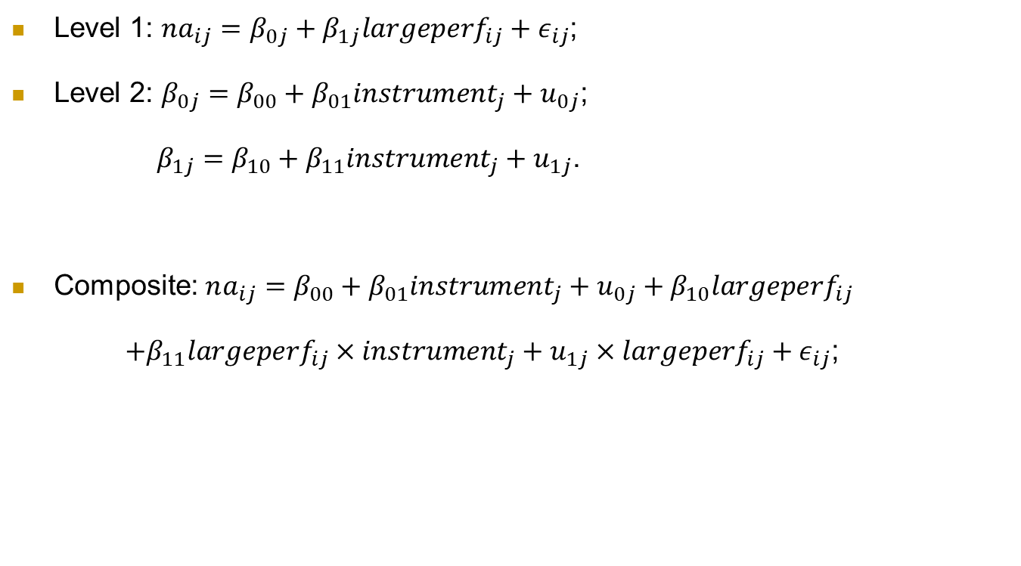
Orchestral instrument?
Level 1: $na_{ij}=β_{0j}+β_{1j}largeperf_{ij}+ε_{ij}$;
Level 2: $β_{0j}=β_{00}+β_{01}instrument_{j}+u_{0j}$;
$β_{1j}=β_{10}+β_{11}instrument_{j}+u_{1j}$.
Composite: $na_{ij}=β_{00}+β_{01}instrument_{j}+u_{0j}+β_{10}largeperf_{ij}$
$+β_{11}largeperf_{ij}×instrument_{j}+u_{1j}×largeperf_{ij}+ε_{ij}$;

Slide 30
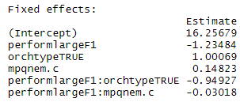
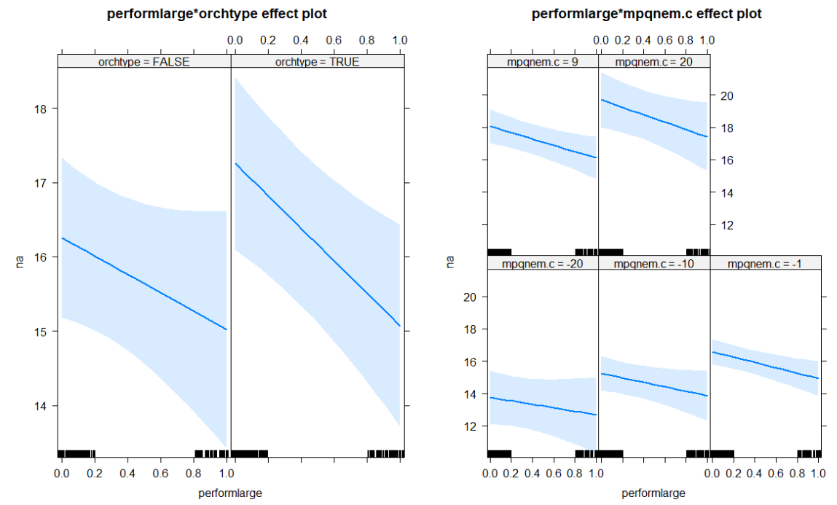
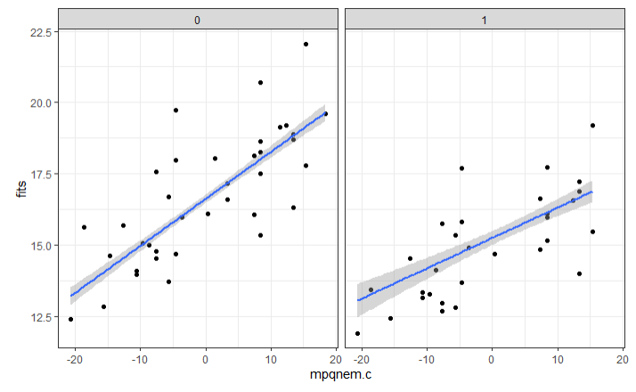
Case Study highlights (2)
Interactions

Slide 31
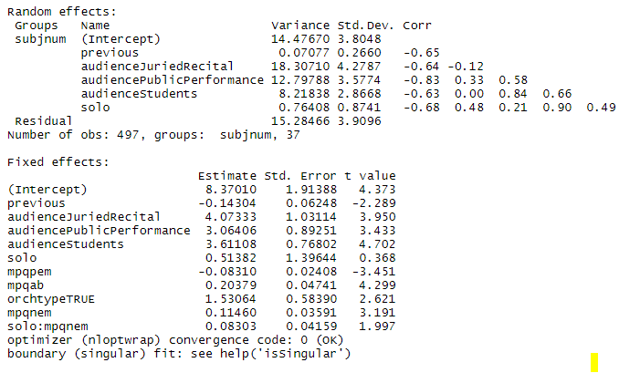
Case Study highlights (3)
Don’t get too carried away

Slide 32
Case Study highlights (4)
Fancy output options

Slide 33
Office hours this week
Today 2-3 (plus)
Thursday 12-1, plus
Friday afternoon zoom?
Saturday?
Sunday?

