Slide 1
Stat 414 – Day 18
Modelling

Slide 2
Logistics
Grades updated in Canvas?
Presentations Wednesday
  See Canvas for order
  Send visuals in advance
  5 min!
Final exam Dec. 8, 7:10am
  Aiming for 100-120 points
  Review session Sunday night?
  Final exam discussion board/Discord

Slide 3
Project advice
Tell a story with the data
  Clearly identify primary variables (e.g., RV)
  Don’t just list numbers
Don’t assume audience is familiar with your data
Use graphs to help tell your story
  How the graphs and the model agree
  Concern vs. interesting feature
  Model vs. data
Start simple (impress with visuals, quality)
  Why multilevel, structure of the data, assumptions (audience)
  Null model, ICC
  Be ready to justify choices
  Keep audience’s interest
Notes:
Don’t start sentences with numbers, significant digits, tables

Slide 4
Project advice
Graphs of models
  plot(ggeffects::ggpredict(model.income, terms=c("income", "COUNTRY [sample=9]"), type="random"))
Features of “final model”
  Includes important EVs (research question, covariates)
  Potential interactions have been investigated
  Variables are centered where can enhance interpretation
  Unnecessary terms have been removed
  Checked validity using residual plots
  Defensible/context

Slide 5
Project advice
Comparing models
performance::compare_performance(m1,m2, metrics = c("BIC", “AIC"), bf = FALSE)
texreg::screenreg(list(m1, m2), digits = 3, single.row = TRUE, stars = 0, custom.model.names=c(“m1", “m2"))
stargazer
Warning messages
```{r, echo=FALSE}
```{r message=FALSE}
knitr::opts_chunk$set(warning = FALSE, message = FALSE)

Slide 6
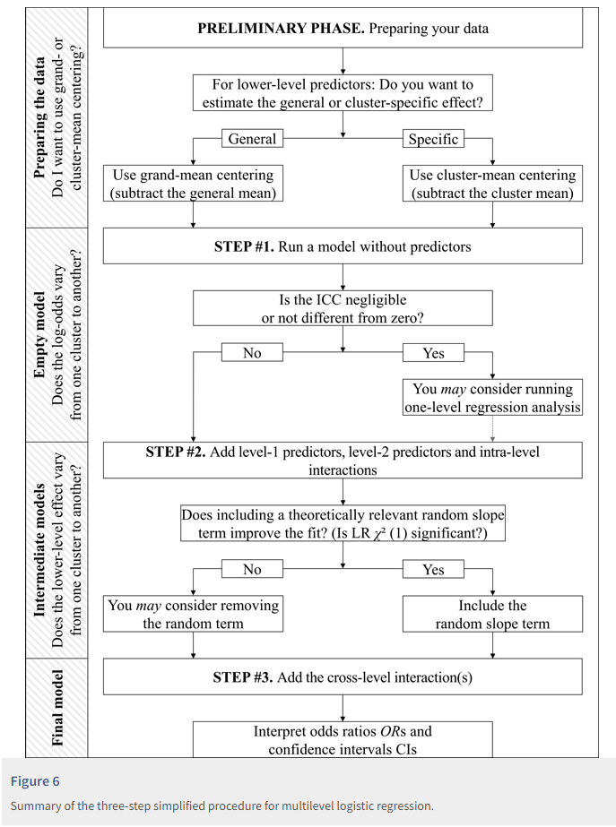
Notes:
https://rips-irsp.com/articles/10.5334/irsp.90#ill-show-you-a-three-step-simplified-procedure-for-multilevel-logistic-regression

Slide 7
Most recent material
Crossed-effects
Logistic models
Longitudinal models (“growth curves”)
Three-level models

Slide 8
Key ideas
Variability explained by time trend
  Level 1 residuals = Unexplained variation about the time trend
  Evaluation of linearity of time trend
  Exchangeability means no “pattern” to the time points
Adding a Level 2 variable
  Does it explain variation in intercepts
    Variable becomes part of the intercept
  Does it explain variation in slopes
    With interaction, variable becomes part of slope coefficient

Slide 9
Leftovers
We saw with the moms and prenatal care, adding fixed effects often eliminates the need for random effects (is why some recommend doing them first)
When analyzing significance of fixed effects, can often look at both t(z) and LRT
  Usually give similar results, if not LRT might be more trustworthy (robust to model assumptions)
Partitioning variation (in one model) vs. variation explained (comparing models)

Slide 10
Fixed vs. Random (higher level units or lower level variable)
hospital
ethnicity
Level
Variable
Categorical variables whose categories have no special meaning
Ahead of time, no real predictions of how compare
Would make sense to be the observational unit in a regression model (aggregating)
Large number of categories
Willing to assume drawn from some distribution
Categorical variable and specific categories have distinct meanings
Might predict different results in advance
Ordinal or continuous variable
Wouldn’t really make sense to be the unit of analysis

Slide 11
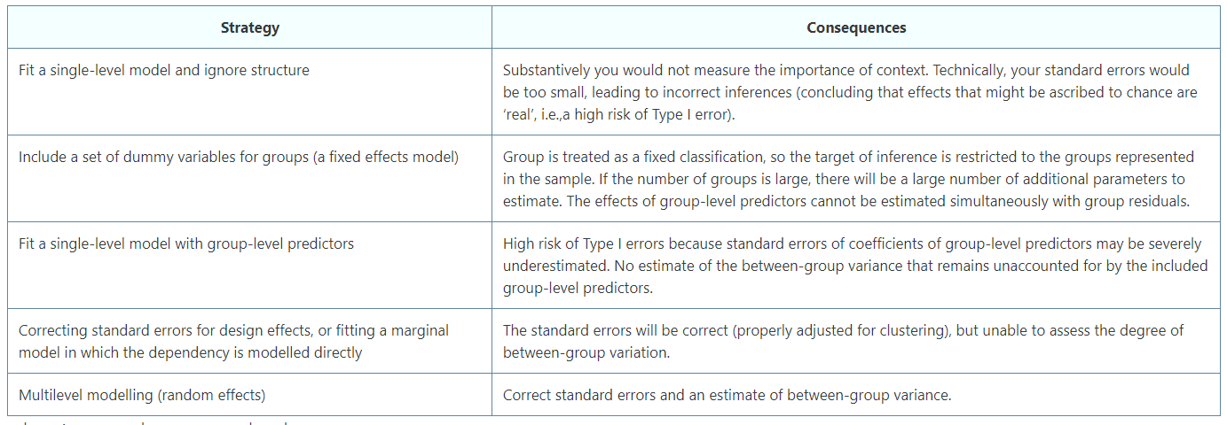
Modeling choices

Slide 12
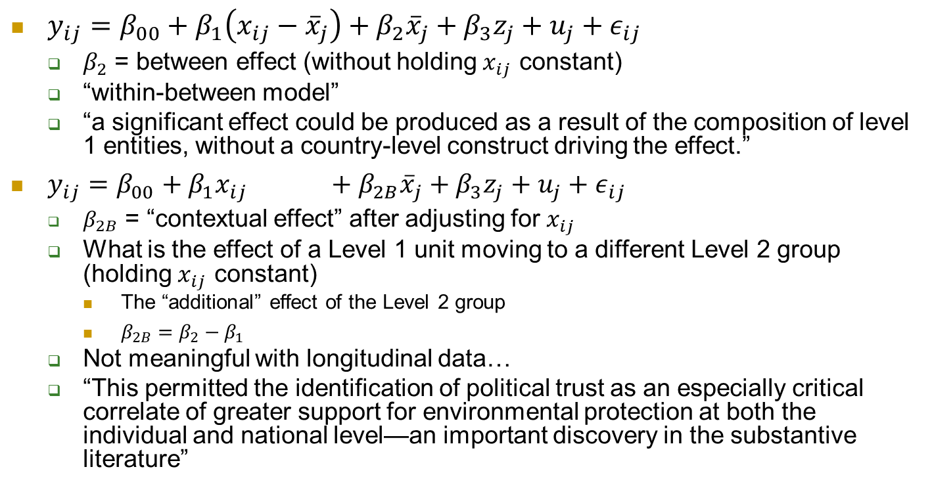
Separating between vs. within
$y_{ij}=β_{00}+β_{1}\left(x_{ij}−{\overline{x}}_{j}\right)+β_{2}{\overline{x}}_{j}+β_{3}z_{j}+u_{j}+ε_{ij}$
  $β_{2}$ = between effect (without holding $x_{ij}$ constant)
  “within-between model”
  “a significant effect could be produced as a result of the composition of level 1 entities, without a country-level construct driving the effect.”
$y_{ij}=β_{00}+β_{1}x_{ij} +β_{2B}{\overline{x}}_{j}+β_{3}z_{j}+u_{j}+ε_{ij}$
  $β_{2B}$ = “contextual effect” after adjusting for $x_{ij}$
  What is the effect of a Level 1 unit moving to a different Level 2 group (holding $x_{ij}$ constant)
    The “additional” effect of the Level 2 group
    $β_{2B}=β_{2}−β_{1}$
  Not meaningful with longitudinal data…
  “This permitted the identification of political trust as an especially critical correlate of greater support for environmental protection at both the individual and national level—an important discovery in the substantive literature”

Slide 13
Example
NLSY dataset looking at student’s antisocial behavior at 3 different times points.
Time varying variables include self-esteem and poverty status of family. Time invariant variables include child’s age at start of study, mom’s age at birth etc.
Treating child as fixed effects= adjusts for being that child (observed + unobserved) vs. being a child like that…

Slide 14
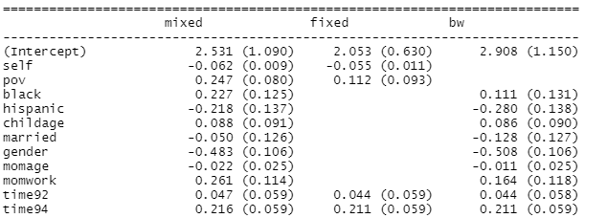

Separating between/within
A change in poverty (0.247) vs. being a family in poverty (.616)
(e.g. for an effect of income: the effect of being unusually well paid, such as after receiving a non-regular bonus or a pay rise) is different from the cross-sectional effect (being well paid on average, over the course of the period of observation).

