Slide 1
Stat 414 – Day 17
Recap: Longitudinal models, Three-level models

Slide 2
Updates
Project feedback
Much will be solved by including visuals
See also assignment about presentations
See new documents in Canvas
HW 8 due date

Slide 3
Last time: Longitudinal data cont.
Variability explained by time trend
Level 1 residuals = Unexplained variation about the time trend
Evaluation of linearity of time trend
Random slopes allows unequal variances, correlations
Exchangeability means no “pattern” to the time points
Can also model remaining time trend in residuals (e.g., AR(1))
Adding a Level 2 variable
Does it explain variation in intercepts
Variable becomes part of the intercept
Does it explain variation in slopes
With interaction, variable becomes part of slope coefficient Include time, with random intercepts and random slopes (growth trajectory)

Slide 4
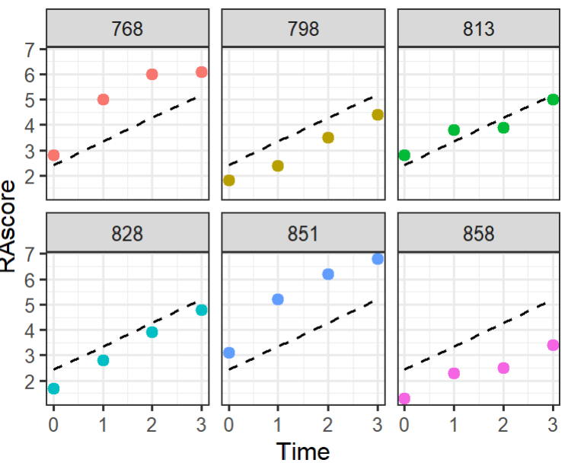
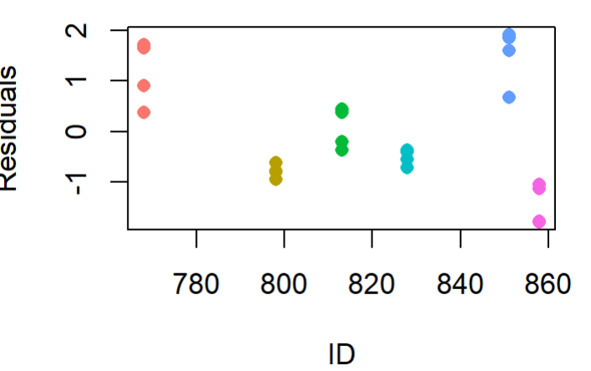
What do we mean by correlated level 1 residuals?

Slide 5
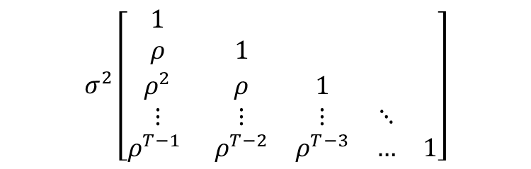
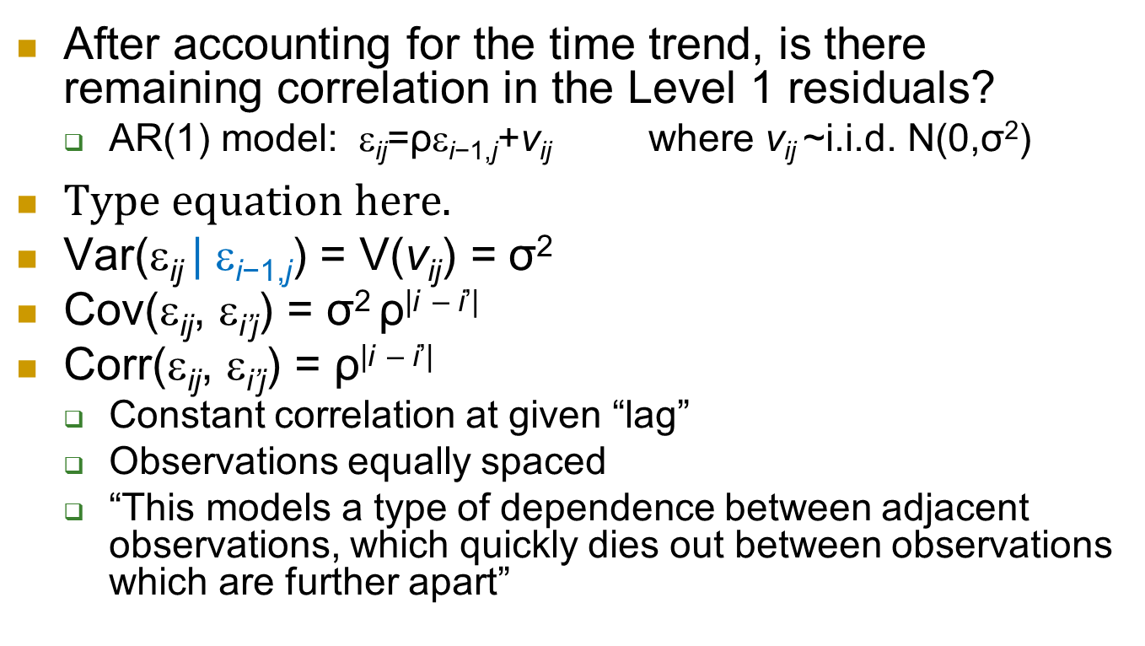
Autoregressive (Level 1) residuals
After accounting for the time trend, is there remaining correlation in the Level 1 residuals?
AR(1) model: ε_{ij}=ρε_{i−1,j}+ν_{ij} where ν_{ij} ~i.i.d. N(0,σ²)
Var(ε_{ij} | ε_{i−1,j}) = V(v_{ij}) = σ²
Cov(ε_{ij}, ε_{i’j}) = σ² ρ^{|i} ^{– i’|}
Corr(ε_{ij}, ε_{i’j}) = ρ^{|i} ^{– i’|}
Constant correlation at given “lag”
Observations equally spaced
“This models a type of dependence between adjacent observations, which quickly dies out between observations which are further apart”
$$σ^{2}\left[\begin{matrix}1 & & & & \\ ρ & 1 & & & \\ ρ^{2} & ρ & 1 & & \\ ⋮ & ⋮ & ⋮ & ⋱ & \\ ρ^{T−1} & ρ^{T−2} & ρ^{T−3} & … & 1\end{matrix}\right]$$

Slide 6
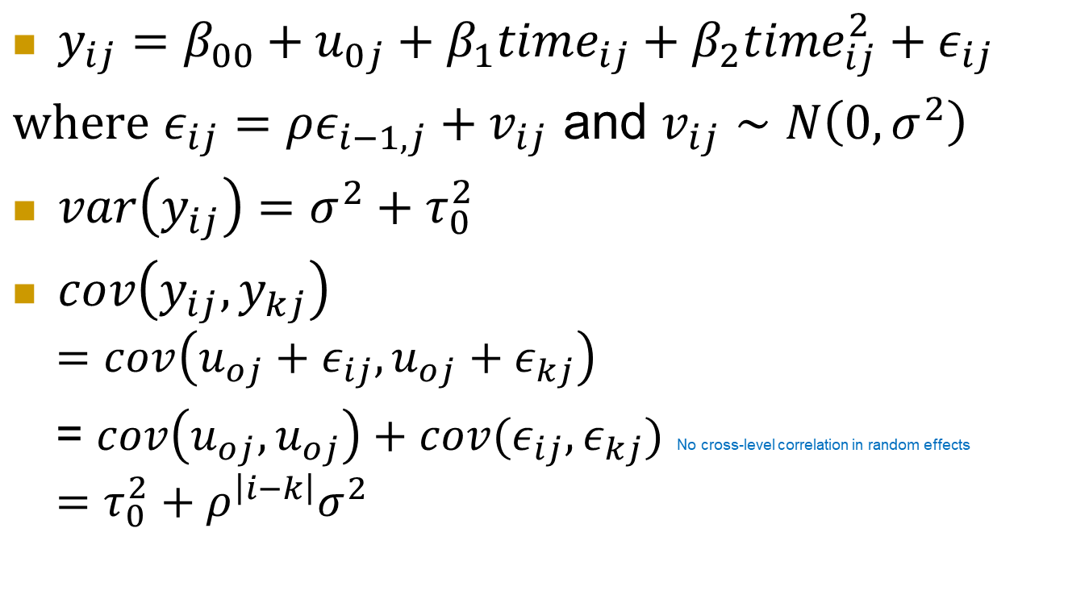
AR(1) model
$y_{ij}=β_{00}+u_{0j}+β_{1}time_{ij}+β_{2}time_{ij}^{2}+ε_{ij}$
$where$ $ε_{ij}=ρε_{i−1,j}+v_{ij}$ and $v_{ij}∼N\left(0, σ^{2}\right)$
$var\left(y_{ij}\right)=σ^{2}+τ_{0}^{2}$
$cov\left(y_{ij}, y_{kj}\right)$
$$=cov\left(u_{oj}+ε_{ij}, u_{oj}+ε_{kj}\right)$$
= $cov\left(u_{oj}, u_{oj}\right)+cov(ε_{ij}, ε_{kj})$ No cross-level correlation in random effects
$$=τ_{0}^{2}+ρ^{\left|i−k\right|}σ^{2}$$

Slide 7
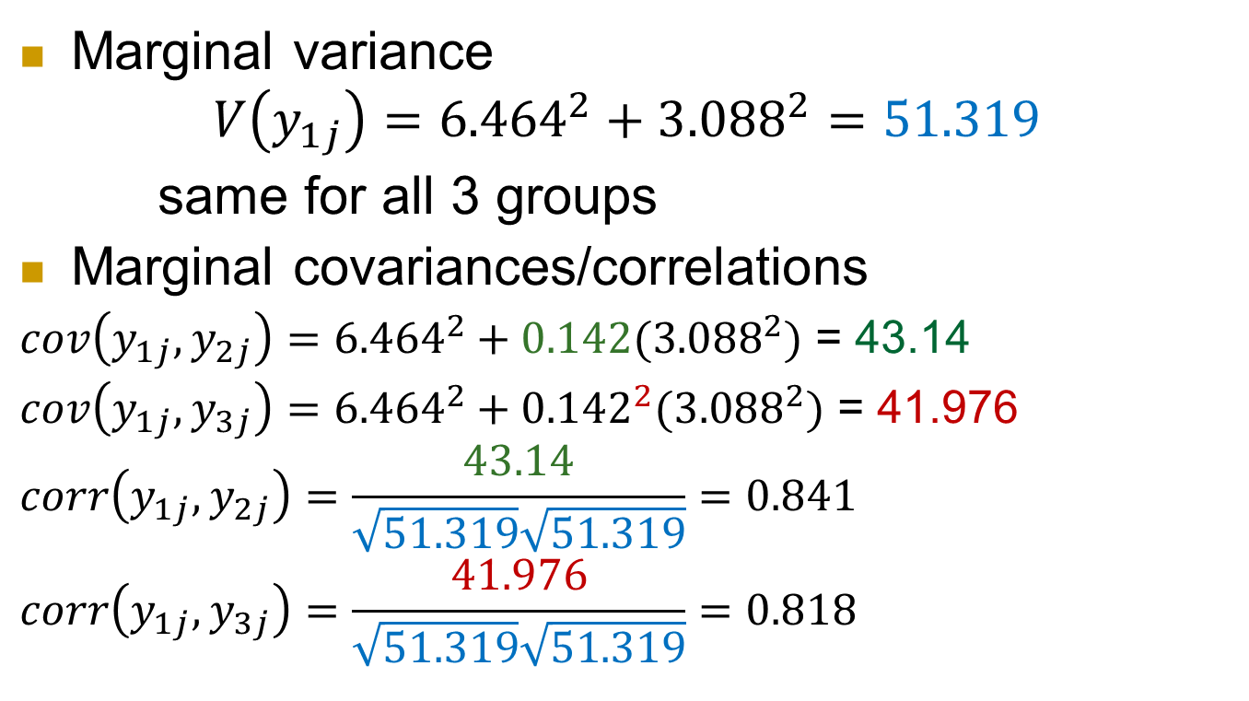
Fitted model CP16
## Marginal variance covariance
time=1 time=2 time=3
## 1 51.318 43.137 41.976 time=1
## 2 43.137 51.318 43.137 time=2
## 3 41.976 43.137 51.318 time=3
Marginal variance
$$V\left(y_{1j}\right)={6.464}^{2}+{3.088}^{2}=51.319$$
same for all 3 groups
Marginal covariances/correlations
$cov\left(y_{1j}, y_{2j}\right)={6.464}^{2}+0.142({3.088}^{2})$ = 43.14
$cov\left(y_{1j}, y_{3j}\right)={6.464}^{2}+{0.142}^{2}({3.088}^{2})$ = 41.976
$$corr\left(y_{1j}, y_{2j}\right)=\frac{43.14}{\sqrt{51.319}\sqrt{51.319}}=0.841$$
$$corr\left(y_{1j}, y_{3j}\right)=\frac{41.976}{\sqrt{51.319}\sqrt{51.319}}=0.818$$

Slide 8
Notes
“The extent to which time dependence can be modeled by random slopes, or rather by autocorrelated residuals, or a combination of both, depends on the phenomenon being modeled. This issue usually will be decided empirically.”

Slide 9
From Roback and Legler (2019)
… as is often true in multilevel models, the choice of covariance matrix does not greatly affect estimates of fixed effects. The choice of covariance structure could potentially impact the standard errors of fixed effects, and thus the associated test statistics… In fact, the standard model typically works very well. So is it worth the time and effort to accurately model the covariance structure? If primary interest is in inference regarding fixed effects, and if the standard errors for the fixed effects appear robust to choice of covariance structure, then extensive time spent modeling the covariance structure is not advised. However, if researchers are interested in predicted random effects and estimated variance components in addition to estimated fixed effects, then choice of covariance structure can make a big difference. For instance, if researchers are interested in drawing conclusions about particular schools rather than charter schools in general, they may more carefully model the covariance structure in this study.

Slide 10
Repeated measures ANOVA
Repeated measures ANOVA is traditionally one of the most common methods for analysis of change. However, when it is used with longitudinal data, the assumptions upon which repeated measures rests may be too restrictive. In particular the assumption of sphericity (assuming equal variances of outcome variable differences) may be unreasonable given that variability can change considerably as time passes. On the other hand, analyzing longitudinal data from a multilevel modeling perspective does not require the assumption of sphericity. In addition, it also provides flexibility in model definition, thus allowing for information about the anticipated effects of time on error variability to be included in the model design. Finally, multilevel models can easily incorporate predictors from each of the data levels, thereby allowing for more complex data structures. In the context of longitudinal data, this means that it is possible to incorporate measurement occasion (level 1), individual (level 2), and cluster (level 3) characteristics. … On the other hand, in the context of repeated measures ANOVA or MANOVA, incorporating these various levels of the data would be much more difficult. Thus, the use of multilevel modeling in this context not only has the benefits listed above pertaining specifically to longitudinal analysis, but it brings the added capability of simultaneous analysis of multiple levels of influence.

Slide 11
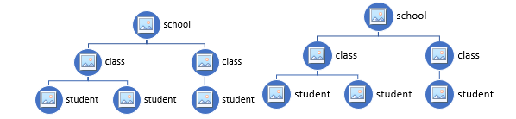
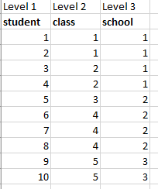
Three-level models
School identifier is constant within each class (classes are nested within schools)

Slide 12
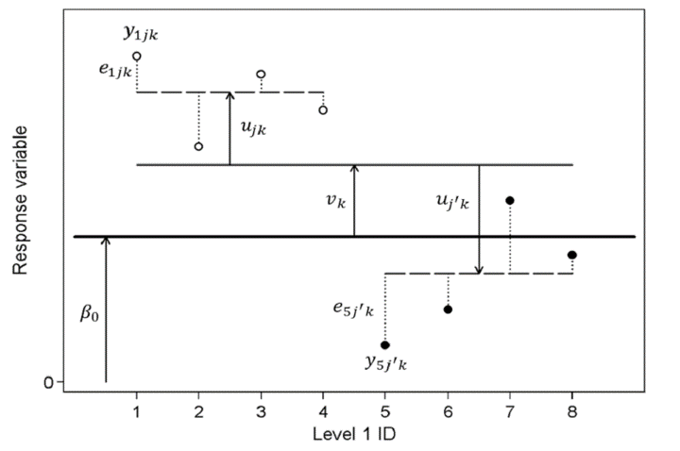
Three-level model
ϵ_{ijk} represents the deviation in the student’s score around the class mean, u_{jk} represents the deviation in class average around the school mean, and v_{k} is the school effect.

Slide 13
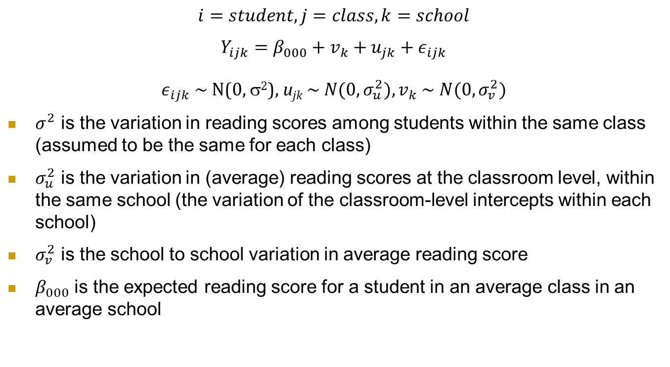
Three-level model cont
$$i=student,j=class,k=school$$
$$Y_{ijk}=β_{000}+v_{k}+u_{jk}+ε_{ijk}$$
$ε_{ijk}$ ~ N(0, σ²), u­_{jk} ~ $N(0,σ_{u}^{2}),v_{k}$ ~ $N(0,σ_{v}^{2})$
$σ^{2}$ is the variation in reading scores among students within the same class (assumed to be the same for each class)
$σ_{u}^{2}$ is the variation in (average) reading scores at the classroom level, within the same school (the variation of the classroom-level intercepts within each school)
$σ_{v}^{2}$ is the school to school variation in average reading score
$β_{000}$ is the expected reading score for a student in an average class in an average school

Slide 14
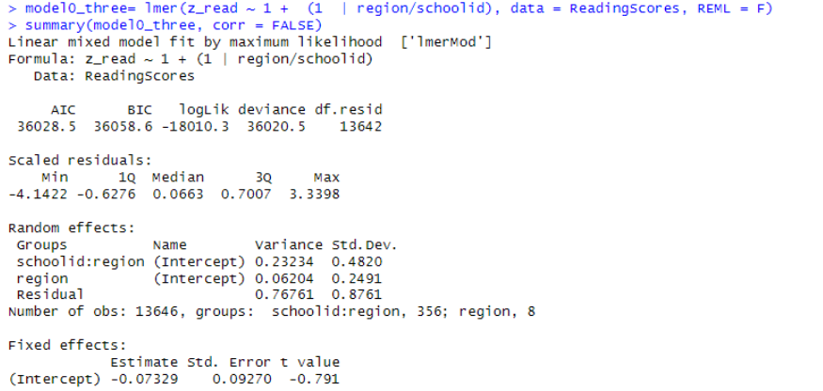
Day 16 quiz
Total variance = .232 + .062 + .768 = 1.06
Variance partitioning coefficients (VPCs)
.232/1.06 ⇒ 22%
.062/1.06 ⇒ 5.8%
.768/1.06 ⇒ 72%
> performance::icc(mode0three, by_group=TRUE)
# ICC by Group
Group | ICC
-----------------------
schoolid:region | 0.219
region | 0.058

Slide 15
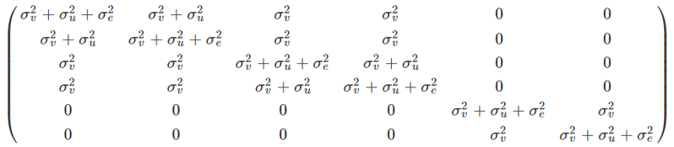
ICC for Three-level model
Students 1 and 2 in same class and school
Students 1 and 3 in same school
Students 1 and 5 share nothing

Slide 16
Question 5
“The female random slope variance is 0.021 which shows that between schools the effect of being female on standardized reading scores is not the same (otherwise this variance would be 0), so there is some differences in the gender gap in reading performance among the schools, even after accounting for parental occupation score, school size, and school to school plus region to region variability.”

Slide 17
Case study
See qmd file

Slide 18
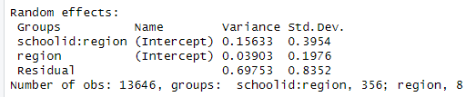
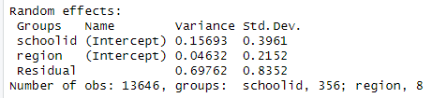
3-level models (i)
lmer(z_read ~ cen_pos + female + cen_size + (1 | region/schoolid)
lmer(z_read ~ cen_pos + female + cen_size + (1 | region) + (1 | schoolid)

Slide 19
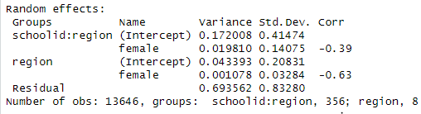

3-level models
lmer(z_read ~ cen_pos + female + cen_size + (1 + female | region/schoolid)
lmer(z_read ~ cen_pos + female + cen_size + (1 + female | schoolid) + (1 | region)
Use unique identifiers

Slide 20
Watch out for
“Since charter is negative…”
Main effect vs. interaction
“The interaction is positive …”
Especially with categorical variables
Especially with negative main effect
Relate back to visuals, raw data
-6 is greater than 2
Percent vs. percentage
Within model vs. between model questions
The charter effect vs. adjusting for charter
More
Consistent with graphs (yes/no)

Slide 21
Leftovers
We saw with the moms and prenatal care, adding fixed effects often eliminates the need for random effects (is why some recommend doing them first)
When analyzing significance of fixed effects, can often look at both t(z) and LRT
Usually give similar results, if not LRT might be more trustworthy (robust to model assumptions)

Slide 22
Leftovers cont
“The question of which method to use, ML or REML, is largely a matter of personal taste. In samples with many groups, differences between ML and REML estimates are negligible. ML estimates of variance components, however, are biased downwards when there are few groups; REML estimates are not. A disadvantage of REML is that LR tests are inappropriate for comparing models with different fixed-effects specifications; this is not the case for ML.”

Slide 23
Leftovers: marginal vs. conditional
From ChatGPT
Conditional: Within a given subject/cluster (holding its latent propensity fixed), how does X change the odds?
Marginal: On average across the population/clusters, how does X change the probability/odds?
If we roll out a discharge program statewide, by how much does patient’s probability of 30-day readmission change averaged across all hospitals?
Within a particular hospital, what is the odds ratio for readmission under the program vs usual care, adjusting for that hospital’s baseline risk?
For a typical goalie, how does shot distance change the odds, holding the goalie’s baseline ability fixed?
Across the league, how does shot distance change average probability of a goal?
Within a given worksite, what’s the odds ratio for seatbelt use post-campaign vs pre-campaign?
What is the average change in seatbelt-use probability after a company-wide campaign across all worksites?

Slide 24
HW 8
Problem 1: Longitudinal model, changing correlation structure
Problem 2: Three-level model
variance partitioning vs. intraclass correlations
decide whether the experimental intervention significantly lowers stress after adjusting for age, gender, experience, ward type, and hospital size.
see whether the experimental effect substantially varies across hospitals.
see whether a significant amount of the variation in the experimental effect across hospitals can be explained by hospital size

Slide 25
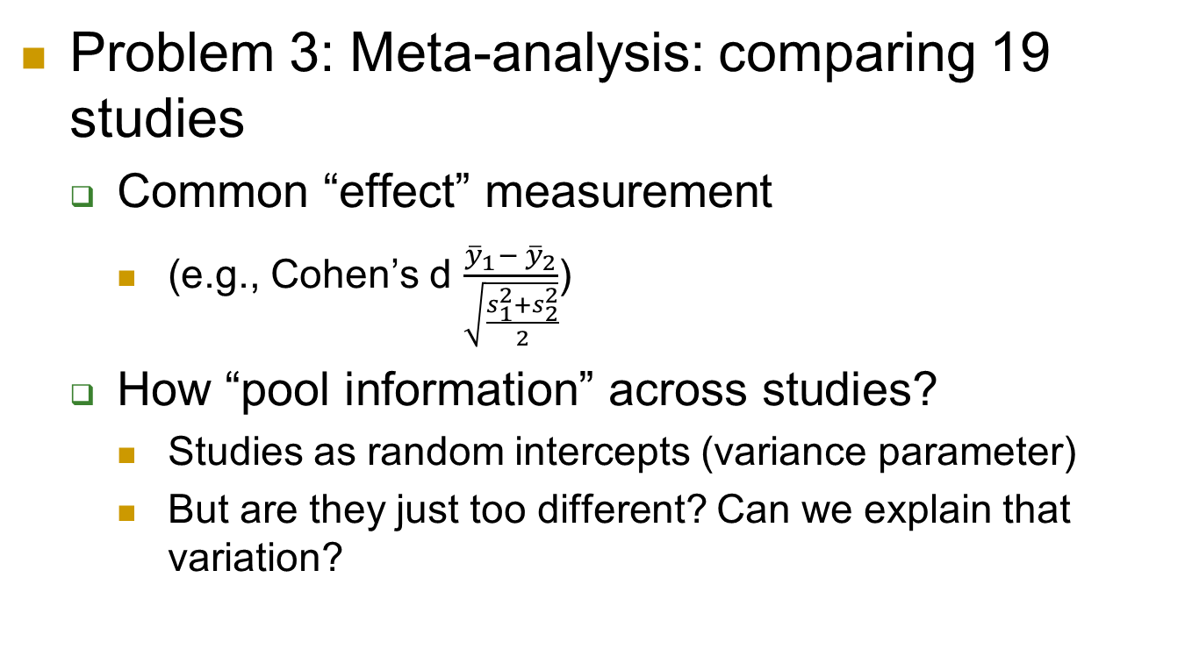
HW 8 cont
Problem 3: Meta-analysis: comparing 19 studies
Common “effect” measurement
(e.g., Cohen’s d $\frac{{{\overline{y}}_{1}− \overline{y}}_{2}}{\sqrt{\frac{s_{1}^{2}+s_{2}^{2}}{2}}}$)
How “pool information” across studies?
Studies as random intercepts (variance parameter)
But are they just too different? Can we explain that variation?

Slide 26
Week 10
Monday: Case studies
Guest speaker
Dr. Andrew Gelman, Columbia University
Blog: Statistical modeling, Causal inference, and Social science
Textbook author
Scores of research articles, including for general audience
R development (e.g., STAN)
Case studies: applied modelling – submit question(s)?!
Additional case study (see Lecture Notes page)
Wednesday: Project presentations

Slide 27
To Do
HW 8
Optional quiz(zes)
Can replace a lower scoring quiz
Due Monday 12/1 before class

Slide 28
Project advice cont
Tell a story with the data
Clearly identify primary variables (e.g., RV)
Don’t just list numbers
Don’t assume audience is familiar with your data
Use graphs to help tell your story
How the graphs and the model agree
Concern vs. interesting feature
Model vs. data
Start simple (impress with visuals, quality)
Why multilevel, structure of the data, assumptions (audience)
Null model, ICC
Be ready to justify choices
Keep audience’s interest
Notes:
Don’t start sentences with numbers, significant digits, tables

Slide 29
Project advice
Graphs of models
plot(ggeffects::ggpredict(model.income, terms=c("income", "COUNTRY [sample=9]"), type="re"))
Features of “final model”
Includes important EVs (research question, covariates)
Potential interactions have been investigated
Variables are centered where can enhance interpretation
Unnecessary terms have been removed
Checked validity using residual plots
Defensible/context

Slide 30
Project advice cont.
Comparing models
performance::compare_performance(m1,m2, metrics = c("BIC", “AIC"), bf = FALSE)
texreg::screenreg(list(m1, m2), digits = 3, single.row = TRUE, stars = 0, custom.model.names=c(“m1", “m2"))
stargazer
Warning messages
```{r, echo=FALSE}
```{r message=FALSE}
knitr::opts_chunk$set(warning = FALSE, message = FALSE)

Slide 31
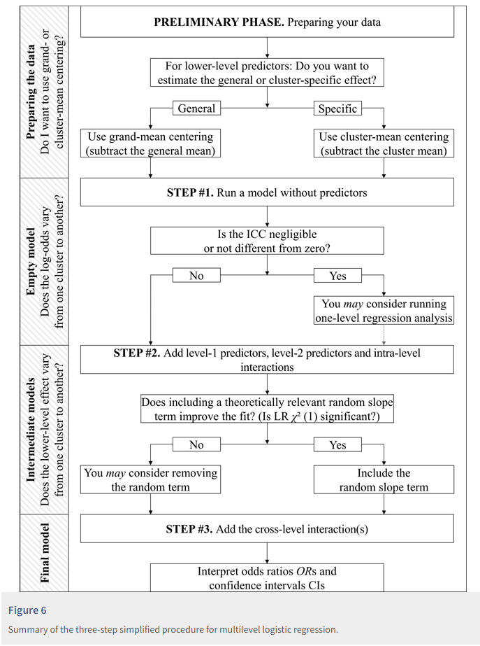
Example flowchart
Sommet & Davide (2017)
Notes:
https://rips-irsp.com/articles/10.5334/irsp.90#ill-show-you-a-three-step-simplified-procedure-for-multilevel-logistic-regression

