Slide 1
Stat 414 – Day 17
Longitudinal data, cont. (Ch. 15)

Slide 2
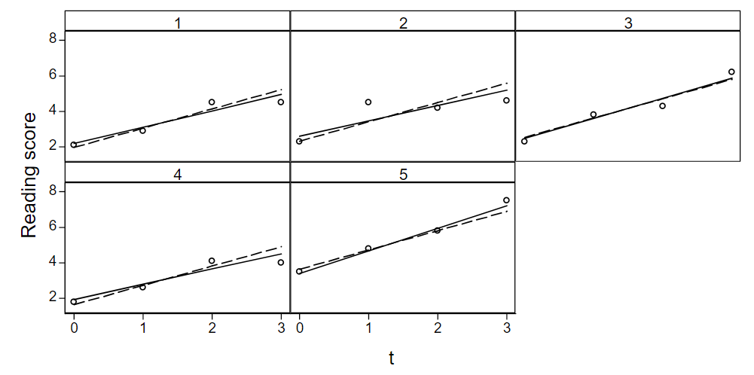
Last time: Longitudinal data
Include time, with random intercepts and random slopes (growth trajectory)

Slide 3
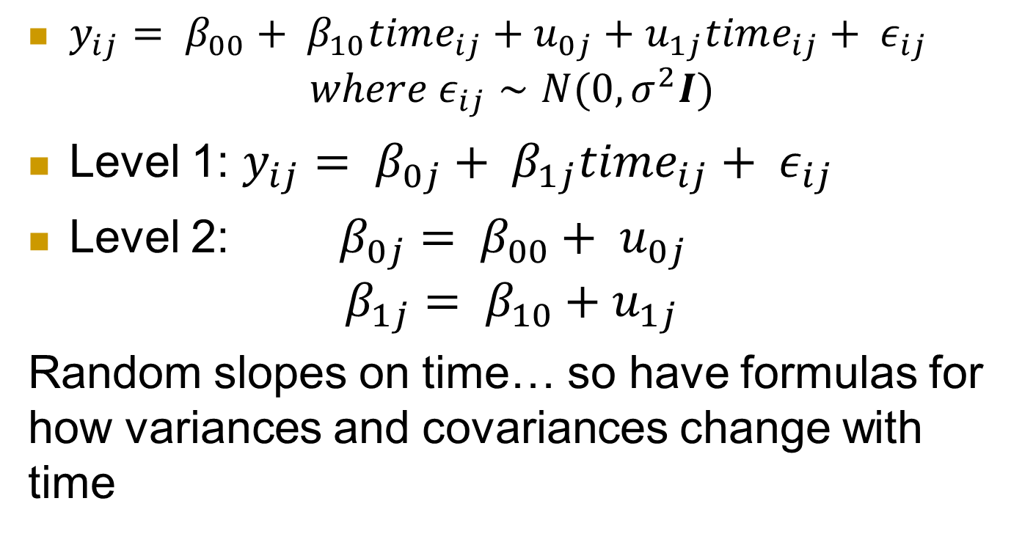
Unconditional growth model
$y_{ij}= β_{00}+ β_{10}time_{ij}+u_{0j}+u_{1j}time_{ij}+ ε_{ij}$
$$where ε_{ij}∼N(0, σ^{2}I)$$
Level 1: $y_{ij}= β_{0j}+ β_{1j}time_{ij}+ ε_{ij}$
Level 2: $β_{0j}= β_{00}+ u_{0j}$
$$β_{1j}= β_{10}+u_{1j}$$
Random slopes on time… so have formulas for how variances and covariances change with time

Slide 4

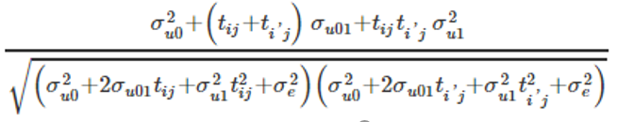
Cov(Y_{1j}, Y_{2j})?
After accounting for time trend…
  Var (Y_{ij})
  Cov(Y_{1j}, Y_{2j})
  Corr(Y_{1j,} Y_{2j})
Now depend on which two time points are comparing!

Slide 5
Fitted unconditional growth model
Random effects:
Groups Name Variance Std.Dev. Corr
schoolnum (Intercept) 39.4410 6.2802
year08 0.1105 0.3325 0.72
Residual 8.8200 2.9699
Number of obs: 1733, groups: schoolnum, 618
Fixed effects:
Estimate Std. Error t value
(Intercept) 651.40766 0.27934 2331.96
year08 1.26495 0.08997 14.06
Fanning out?
  Min: -(.72)(6.28)(.332)/.115 < 0

Slide 6
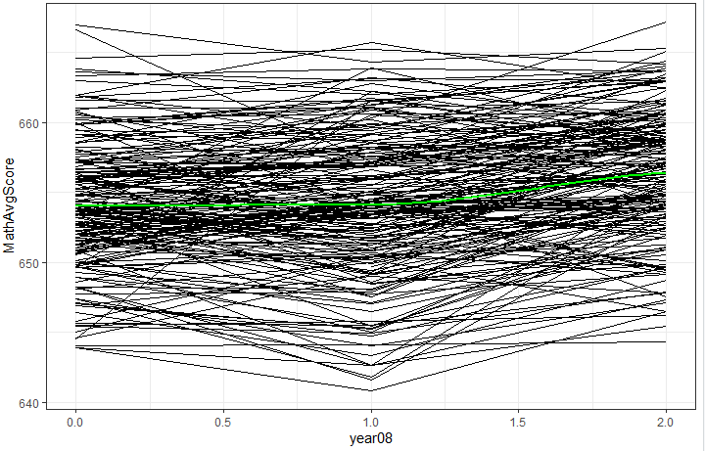
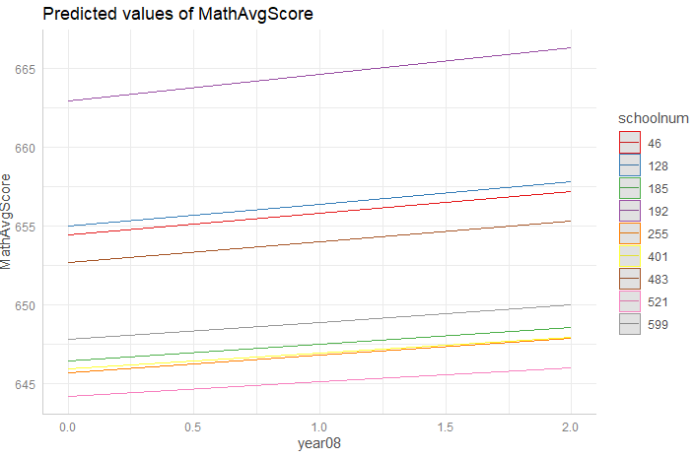
Is the model doing what we want?
Observed
Model

Slide 7
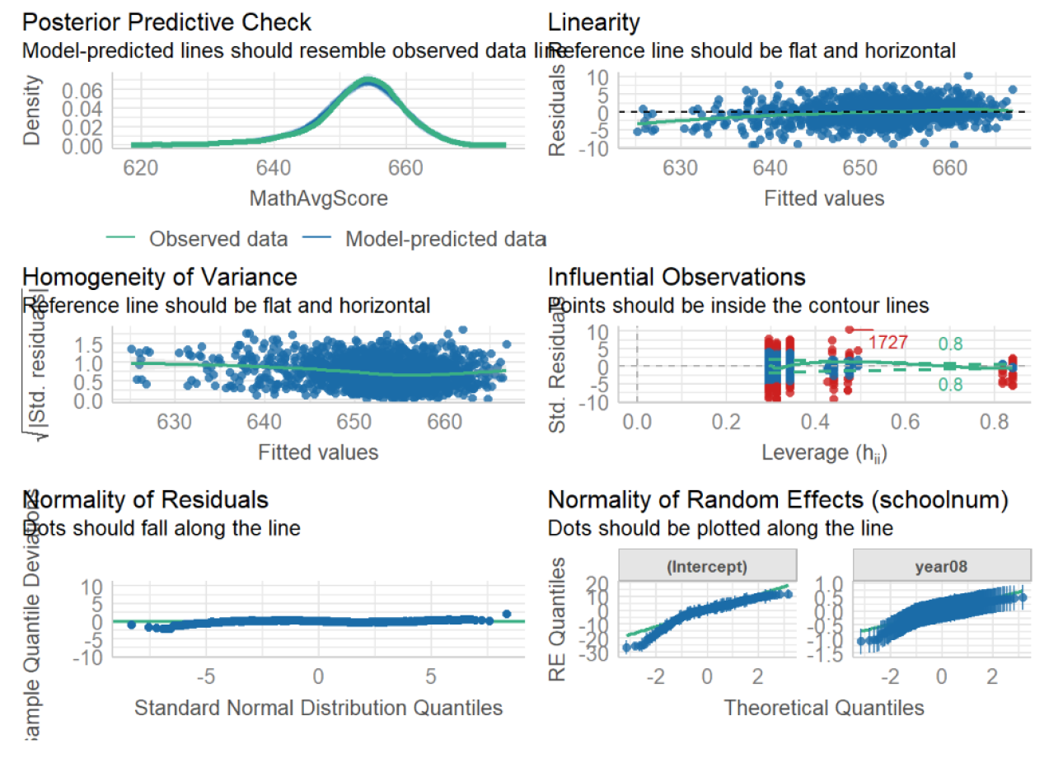
Performance:: check_model

Slide 8
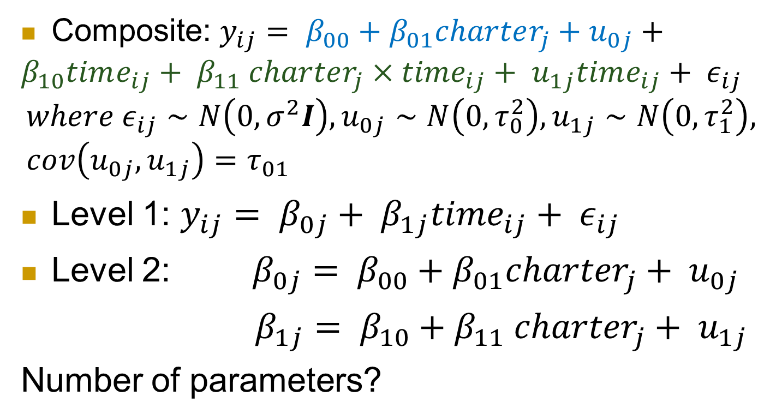
Adding Level 2 variable
Composite: $y_{ij}= β_{00}+β_{01}charter_{j}+u_{0j}+{β_{10}time_{ij}+ β}_{11}{ charter_{j}×{time}_{ij}+ u}_{1j}time_{ij}+ ε_{ij}$
$$where ε_{ij}∼N\left(0, σ^{2}I\right), u_{0j}∼N\left(0, τ_{0}^{2}\right), u_{1j}∼N\left(0, τ_{1}^{2}\right), cov\left(u_{0j}, u_{1j}\right)=τ_{01}$$
Level 1: $y_{ij}= β_{0j}+ β_{1j}time_{ij}+ ε_{ij}$
Level 2: $β_{0j}= β_{00}+{β_{01}charter}_{j}+ u_{0j}$
$β_{1j}= β_{10}+{{β_{11} charter}_{j}+ u}_{1j}$
Number of parameters?

Slide 9
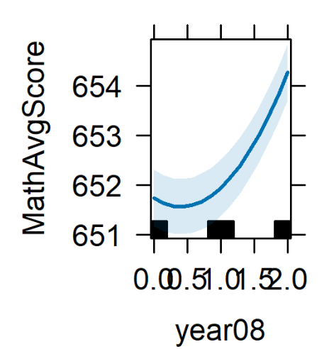
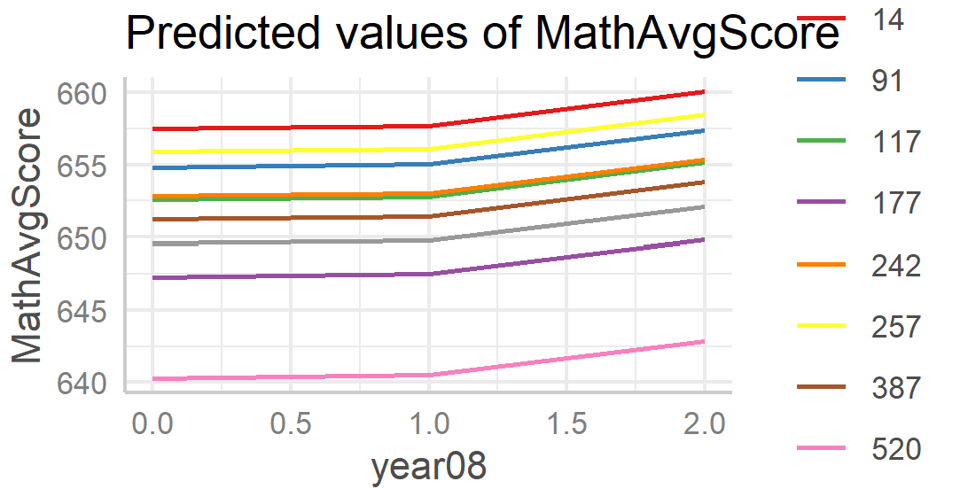
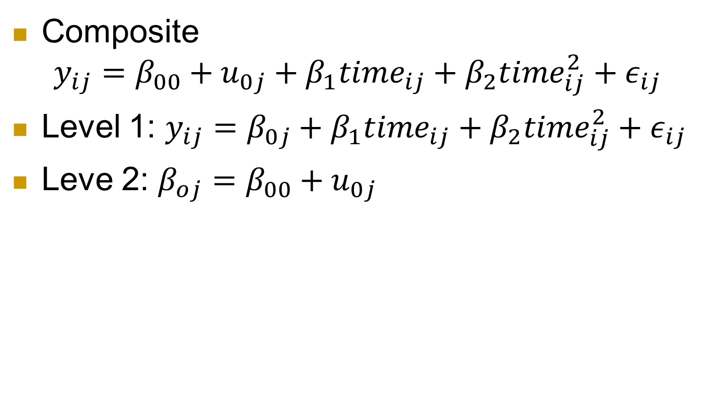
Non linear?
Composite
$$y_{ij}=β_{00}+u_{0j}+β_{1}time_{ij}+β_{2}time_{ij}^{2}+ε_{ij}$$
Level 1: $y_{ij}=β_{0j}+β_{1}time_{ij}+β_{2}time_{ij}^{2}+ε_{ij}$
Leve 2: $β_{oj}=β_{00}+u_{0j}$

Slide 10
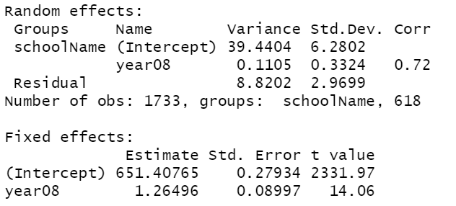

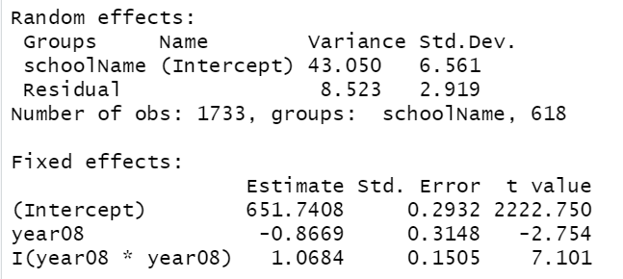
Model comparison
Linear model
6 parameters
Quadratic but only
random intercepts
5 parameters

Slide 11
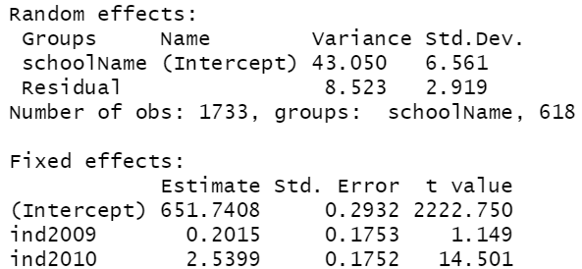
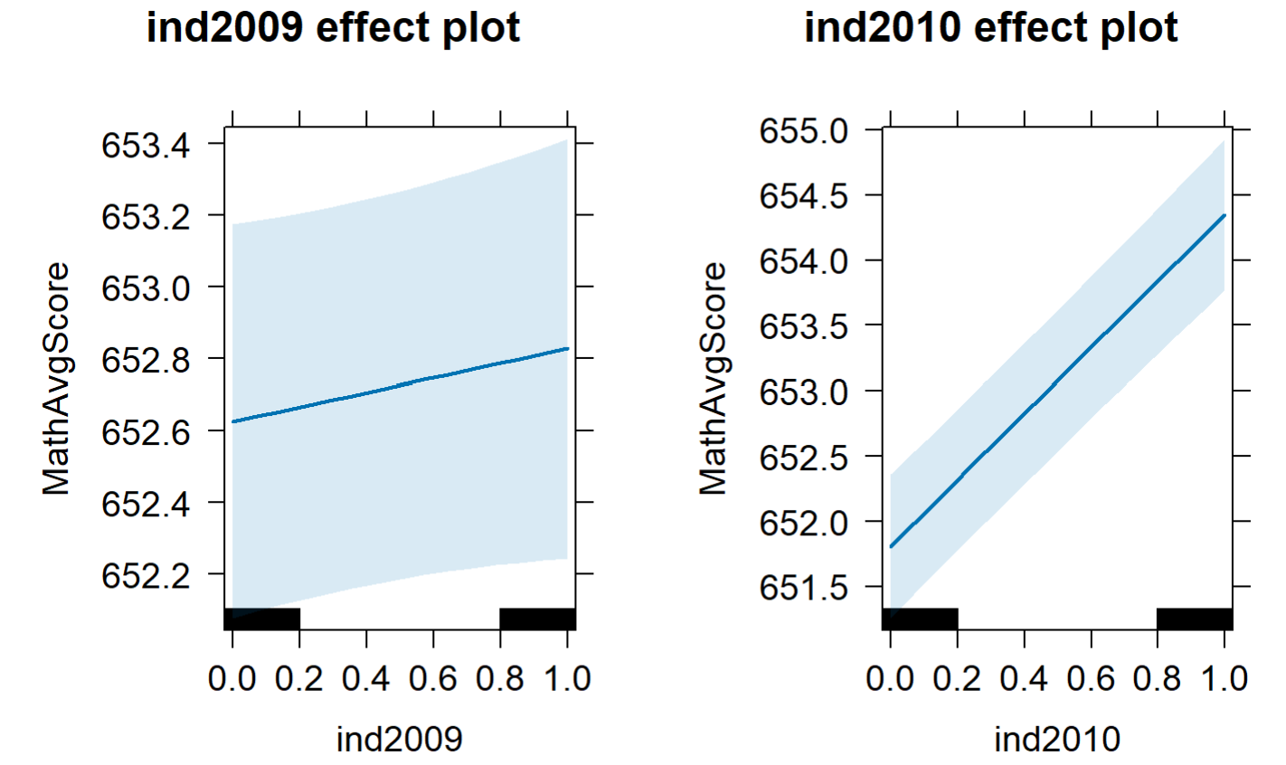
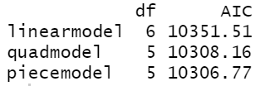

Piecewise linear
$Y_{ij}=β_{0}+u_{i}+β_{1}year0809+β_{2}year0810+ε_{ij}$

Slide 12
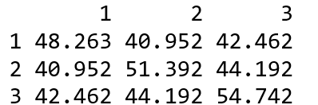
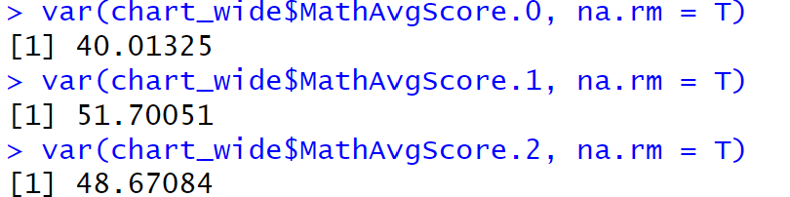
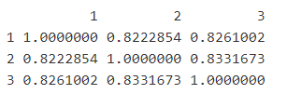

Is the model doing what we want?
Observed
Model (fitted)

Slide 13
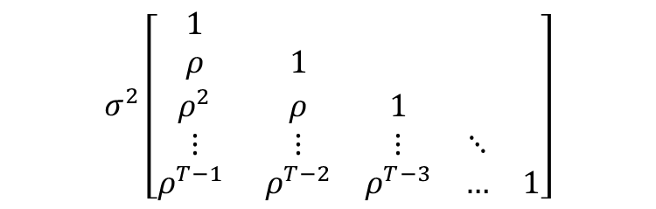
Autoregressive (Level 1) residuals
After accounting for the time trend, is there remaining correlation in the Level 1 residuals?
  AR(1) model: ε_{ij}=ρε_{i−1,j}+ν_{ij} where ν_{ij} ~i.i.d. N(0,σ²)
Var(ε_{ij}) = σ²
Cov(ε_{ij}, ε_{i’j}) = σ² ρ^{|i} ^{– i’|}
Corr(ε_{ij}, ε_{i’j}) = ρ^{|i} ^{– i’|}
  Constant correlation at given “lag”
  Observations equally spaced
  “This models a type of dependence between adjacent observations, which quickly dies out between observations which are further apart”
$$σ^{2}\left[\begin{matrix}1 & & & & \\ ρ & 1 & & & \\ ρ^{2} & ρ & 1 & & \\ ⋮ & ⋮ & ⋮ & ⋱ & \\ ρ^{T−1} & ρ^{T−2} & ρ^{T−3} & … & 1\end{matrix}\right]$$

Slide 14
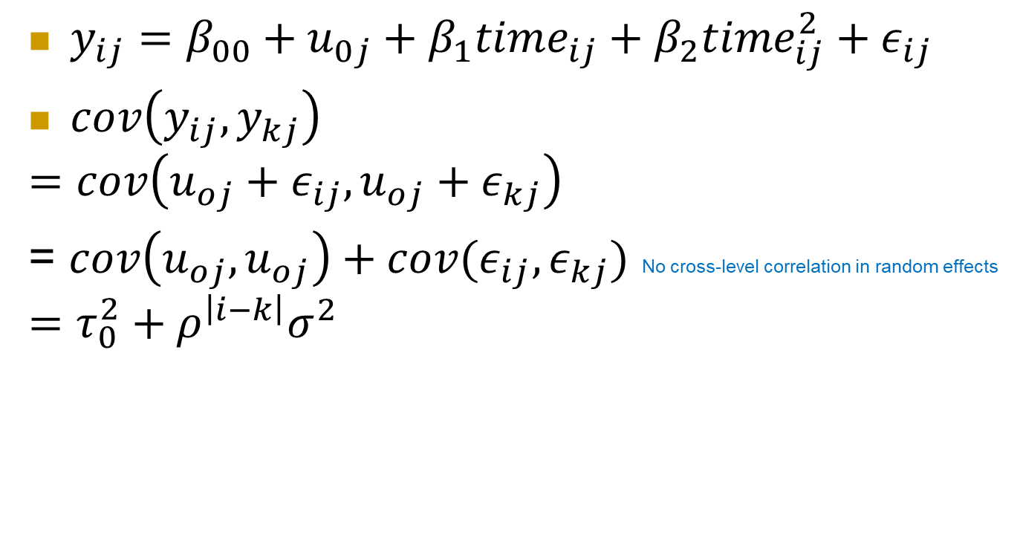
AR(1) model
$y_{ij}=β_{00}+u_{0j}+β_{1}time_{ij}+β_{2}time_{ij}^{2}+ε_{ij}$
$cov\left(y_{ij}, y_{kj}\right)$
$$=cov\left(u_{oj}+ε_{ij}, u_{oj}+ε_{kj}\right)$$
= $cov\left(u_{oj}, u_{oj}\right)+cov(ε_{ij}, ε_{kj})$ No cross-level correlation in random effects
$$=τ_{0}^{2}+ρ^{\left|i−k\right|}σ^{2}$$

Slide 15
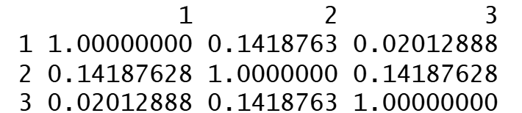
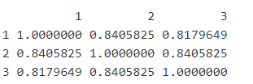
Better?
Observed correlation matrix
Predicted correlation matrix with AR(1) errors

Slide 16
Notes
“The extent to which time dependence can be modeled by random slopes, or rather by autocorrelated residuals, or a combination of both, depends on the phenomenon being modeled. This issue usually will be decided empirically.”

Slide 17
From Roback and Legler (2019)
… as is often true in multilevel models, the choice of covariance matrix does not greatly affect estimates of fixed effects. The choice of covariance structure could potentially impact the standard errors of fixed effects, and thus the associated test statistics… In fact, the standard model typically works very well. So is it worth the time and effort to accurately model the covariance structure? If primary interest is in inference regarding fixed effects, and if the standard errors for the fixed effects appear robust to choice of covariance structure, then extensive time spent modeling the covariance structure is not advised. However, if researchers are interested in predicted random effects and estimated variance components in addition to estimated fixed effects, then choice of covariance structure can make a big difference. For instance, if researchers are interested in drawing conclusions about particular schools rather than charter schools in general, they may more carefully model the covariance structure in this study.

Slide 18
Key ideas
Variability explained by time trend
  Level 1 residuals = Unexplained variation about the time trend
  Evaluation of linearity of time trend
  Exchangeability means no “pattern” to the time points
Adding a Level 2 variable
  Does it explain variation in intercepts
    Variable becomes part of the intercept
  Does it explain variation in slopes
    With interaction, variable becomes part of slope coefficient

Slide 19
Repeated measures ANOVA
Repeated measures ANOVA is traditionally one of the most common methods for analysis of change. However, when it is used with longitudinal data, the assumptions upon which repeated measures rests may be too restrictive. In particular the assumption of sphericity (assuming equal variances of outcome variable differences) may be unreasonable given that variability can change considerably as time passes. On the other hand, analyzing longitudinal data from a multilevel modeling perspective does not require the assumption of sphericity. In addition, it also provides flexibility in model definition, thus allowing for information about the anticipated effects of time on error variability to be included in the model design. Finally, multilevel models can easily incorporate predictors from each of the data levels, thereby allowing for more complex data structures. In the context of longitudinal data, this means that it is possible to incorporate measurement occasion (level 1), individual (level 2), and cluster (level 3) characteristics. … On the other hand, in the context of repeated measures ANOVA or MANOVA, incorporating these various levels of the data would be much more difficult. Thus, the use of multilevel modeling in this context not only has the benefits listed above pertaining specifically to longitudinal analysis, but it brings the added capability of simultaneous analysis of multiple levels of influence.

Slide 20
Leftovers
We saw with the moms and prenatal care, adding fixed effects often eliminates the need for random effects (is why some recommend doing them first)
When analyzing significance of fixed effects, can often look at both t(z) and LRT
  Usually give similar results, if not LRT might be more trustworthy (robust to model assumptions)

Slide 21
Leftovers cont
“The question of which method to use, ML or REML, is largely a matter of personal taste. In samples with many groups, differences between ML and REML estimates are negligible. ML estimates of variance components, however, are biased downwards when there are few groups; REML estimates are not. A disadvantage of REML is that LR tests are inappropriate for comparing models with different fixed-effects specifications; this is not the case for ML.”

Slide 22
To Do
Proposal for Wednesday
Monday after break: guest speaker
HW 7 due
Bonus quiz(zes)

Slide 23
Project advice
Tell a story with the data
  Clearly identify primary variables (e.g., RV)
  Don’t just list numbers
Don’t assume audience is familiar with your data
Use graphs to help tell your story
  How the graphs and the model agree
  Concern vs. interesting feature
  Model vs. data
Start simple (impress with visuals, quality)
  Why multilevel, structure of the data, assumptions (audience)
  Null model, ICC
  Be ready to justify choices
  Keep audience’s interest
Notes:
Don’t start sentences with numbers, significant digits, tables

Slide 24
Project advice
Graphs of models
  plot(ggeffects::ggpredict(model.income, terms=c("income", "COUNTRY [sample=9]"), type="re"))
Features of “final model”
  Includes important EVs (research question, covariates)
  Potential interactions have been investigated
  Variables are centered where can enhance interpretation
  Unnecessary terms have been removed
  Checked validity using residual plots
  Defensible/context

Slide 25
Project advice
Comparing models
performance::compare_performance(m1,m2, metrics = c("BIC", “AIC"), bf = FALSE)
texreg::screenreg(list(m1, m2), digits = 3, single.row = TRUE, stars = 0, custom.model.names=c(“m1", “m2"))
stargazer
Warning messages
```{r, echo=FALSE}
```{r message=FALSE}
knitr::opts_chunk$set(warning = FALSE, message = FALSE)

Slide 26
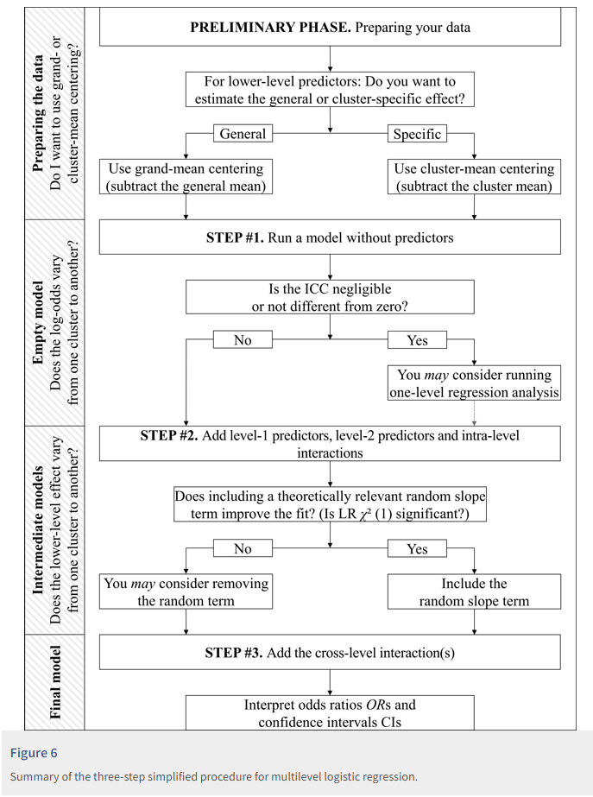
Sommet & Davide (2017)
Notes:
https://rips-irsp.com/articles/10.5334/irsp.90#ill-show-you-a-three-step-simplified-procedure-for-multilevel-logistic-regression

