Slide 1
Stat 414 – Day 15
Longitudinal data (Ch. 15)

Slide 2
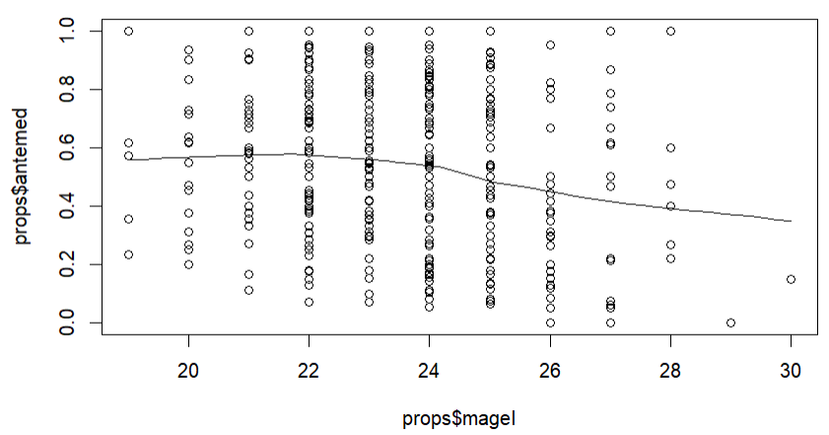
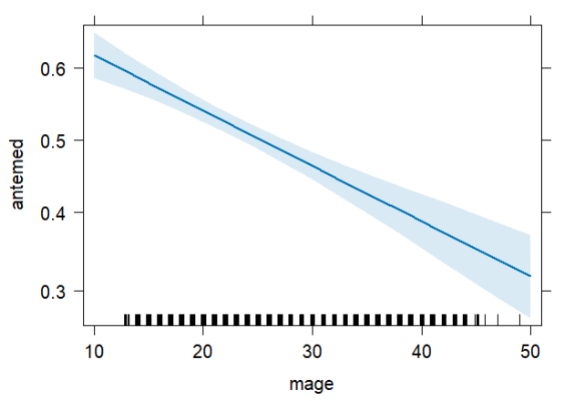
Last Time: Probability of prenatal care
Logistic regression
glm(formula = antemed ~ mage, family = binomial
Coefficients:
Estimate Std. Error z value Pr(>|z|)
(Intercept) 0.785578 0.107847 7.284 3.24e-13
mage -0.031029 0.004415 -7.028 2.10e-12
Predicted odds age 33 = exp(.786 - .031(33)) = .789
Predicted prob age 33 = .789/(1.789) = 0.441

Slide 3
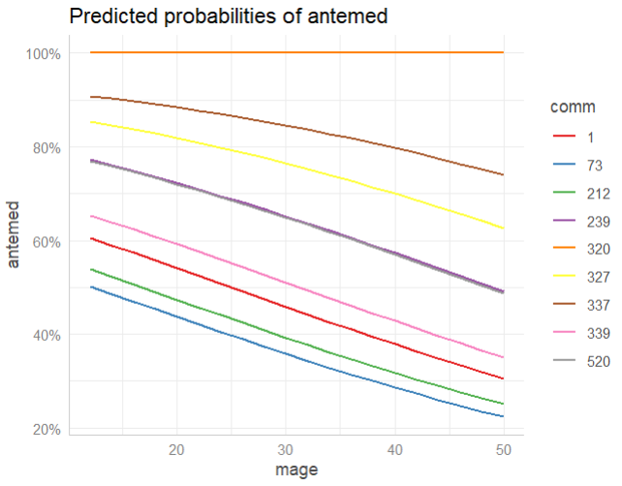
Account for community differences
Fixed effects
glm(formula = antemed ~ mage + community, family = binomial
Estimate Std. Error z value
(Intercept) 1.37009837 9.749664504 0.14052774
mage -0.03298677 0.005541306 -5.95288701
comm1 -0.54559224 9.763490704 -0.05588086
comm2 -1.17173005 9.760474257 -0.12004848
In the average community
Predicted odds age 33 = exp(1.37 - .033(33)) = 1.32
Predicted prob age 33 = 1.31/.32 = 0.569

Slide 4
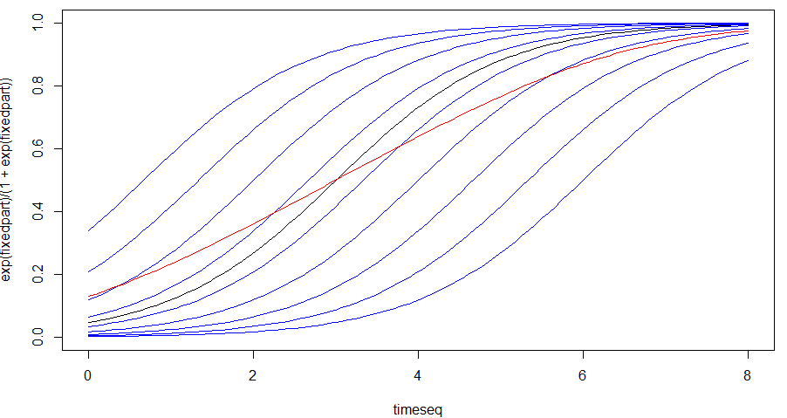
Conditional vs. Marginal models
Fixed or Random
Conditional (community-specific) estimates vs. averaging across all of the estimated probabilities (marginal)
In nonlinear models, the average of the back-transformed values is not
the same as the back-transformed average value…

Slide 5
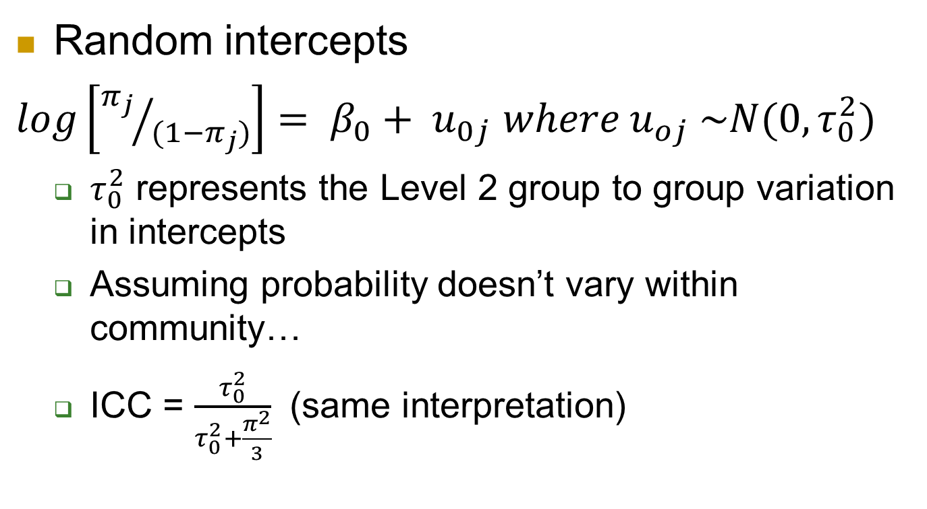
Multilevel logistic models
Random intercepts
$log\left[{π_{j}}/{(1−π_{j})}\right]= β_{0}+ u_{0j}$ $where u_{oj} \sim N(0, τ_{0}^{2})$
  $τ_{0}^{2}$ represents the Level 2 group to group variation in intercepts
  Assuming probability doesn’t vary within community…
  ICC = $\frac{τ_{0}^{2}}{τ_{0}^{2}+\frac{π^{2}}{3}}$ (same interpretation)

Slide 6
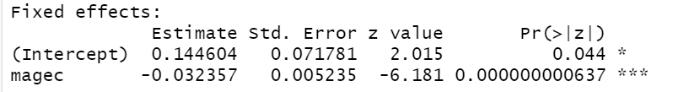
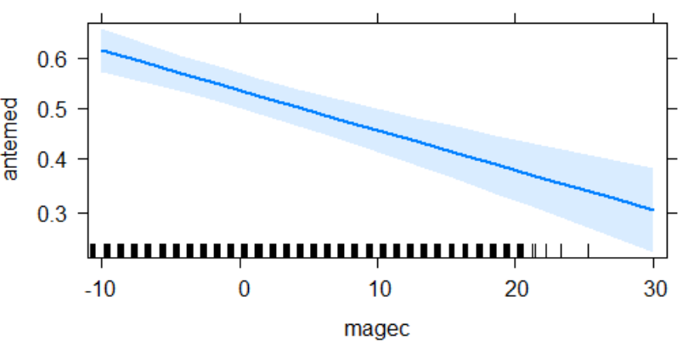
model1.mlm
Allows probability to change within community
mage = 23.6 years
pred prob = e^{.145}/(1+ e^{.145}) = .536
Predicted probability for mom of
average age in the average community
ICC = .308

Slide 7
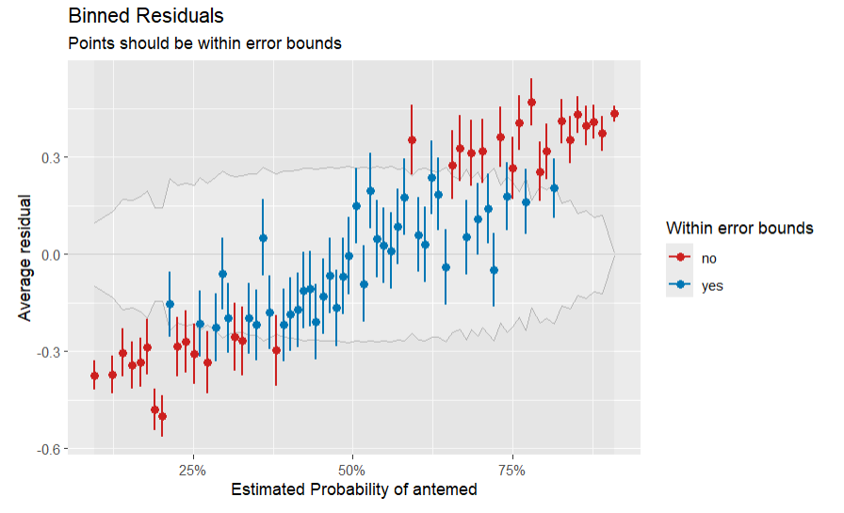
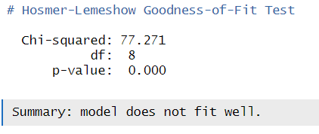
Residuals?

Slide 8
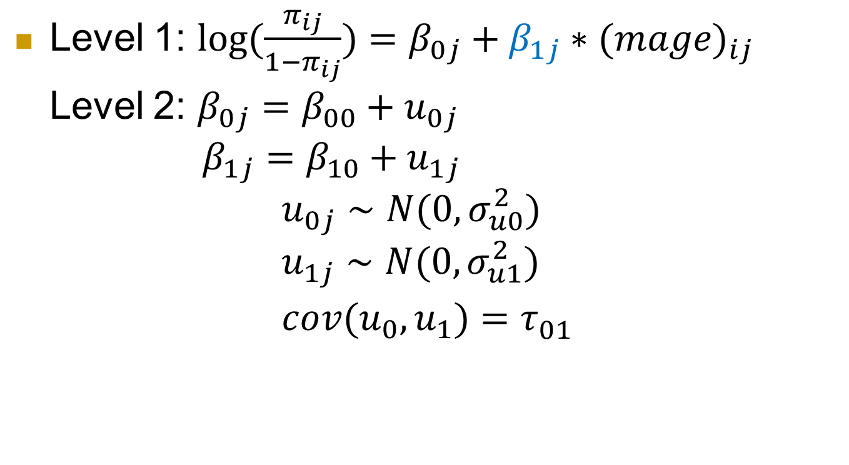
Include random slopes (model)
Level 1: $log(\frac{π_{ij}}{1−π_{ij}})=β_{0j}+β_{1j}∗(mage)_{ij}$
Level 2: $β_{0j}=β_{00}+u_{0j}$
$β_{1j}=β_{10}+u_{1j}$
$$u_{0j}∼N(0,σ_{u0}^{2}) \\ u_{1j}∼N(0,σ_{u1}^{2}) \\ cov(u_{0},u_{1})=τ_{01}^{}$$

Slide 9
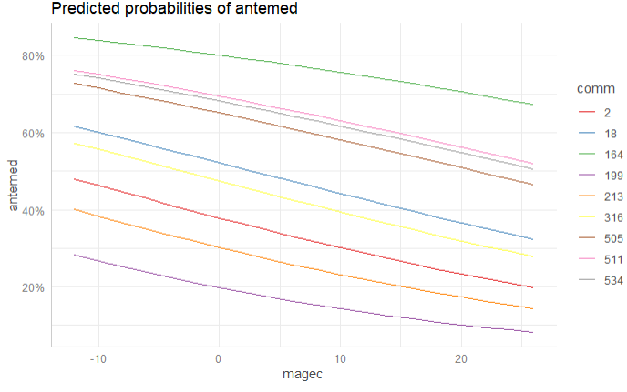
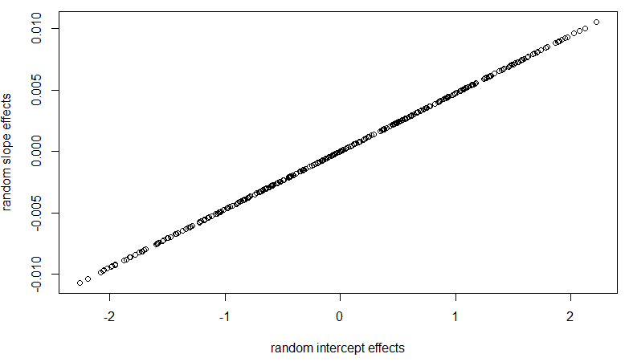
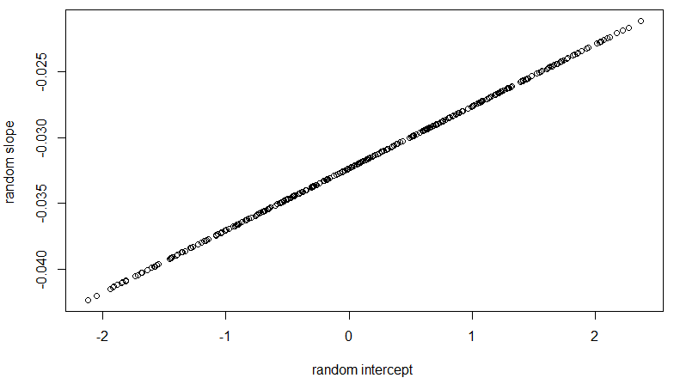
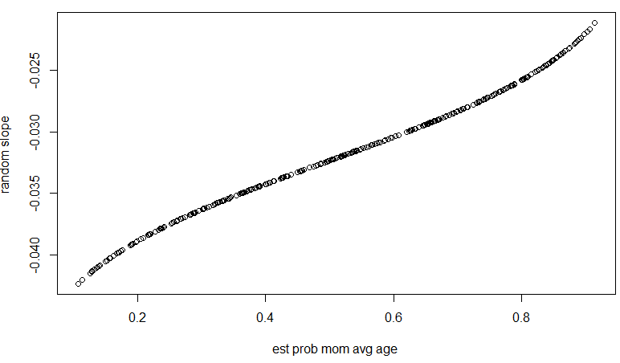
Include random slopes (output)
model2.rs = glmer(antemed~ 1 + magec + (magec | comm),
Random effects:
Groups Name Variance Std.Dev. Corr
comm (Intercept) 1.461 1.208863
magec 3.266e-05 0.005715 1.00
Number of obs: 5366, groups: comm, 361
Fixed effects:
Estimate Std. Error z value Pr(>|z|)
(Intercept) 0.143237 0.071793 1.995 0.046 *
magec -0.031658 0.005347 -5.921 3.2e-09 ***
Communities with higher intercepts tend to have a larger (less negative) change with mom’s age, but not much community to community variation in slopes (cov ≈ 0)
Notes:
The likelihood of prenatal care decreases as the mother’s age at birth increases and this rate of decrease does not seem to change across communities (don’t really need random slopes), though there is a fair bit of community to community variation in the overall probability (estimated overall intercept = .143, SD = 1.21).
The correlation of one says we can perfectly predict the slope from the intercept. This could be from the variation in the slopes being so small, that once we know the intercept, we know the community?)

Slide 10
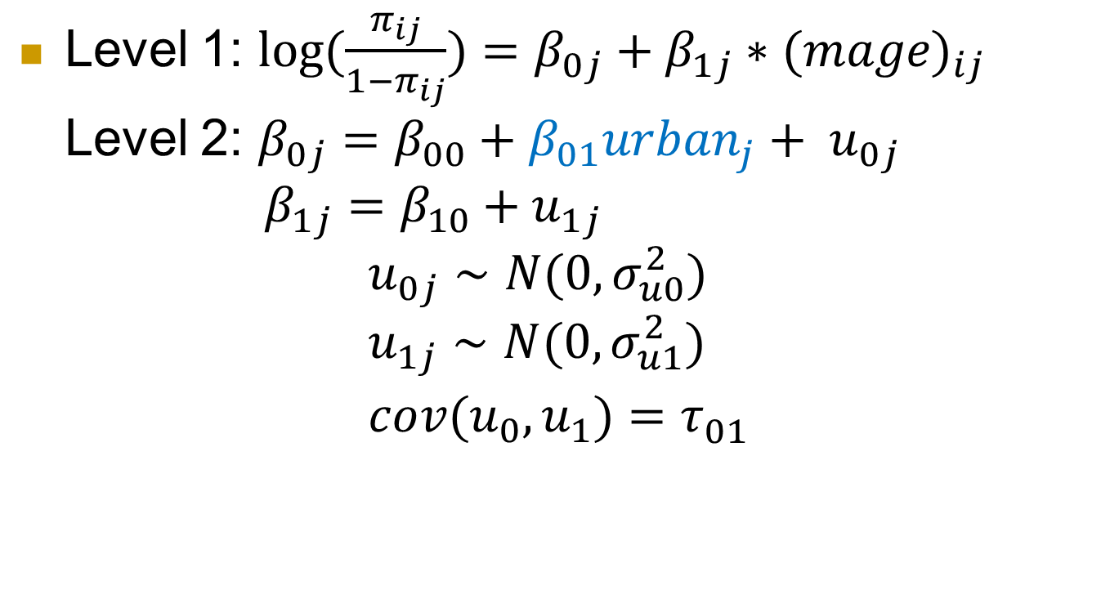
Include urban (model)
Level 1: $log(\frac{π_{ij}}{1−π_{ij}})=β_{0j}+β_{1j}∗(mage)_{ij}$
Level 2: $β_{0j}=β_{00}+β_{01}urban_{j}+ u_{0j}$
$β_{1j}=β_{10}+u_{1j}$
$$u_{0j}∼N(0,σ_{u0}^{2}) \\ u_{1j}∼N(0,σ_{u1}^{2}) \\ cov(u_{0},u_{1})=τ_{01}^{}$$

Slide 11
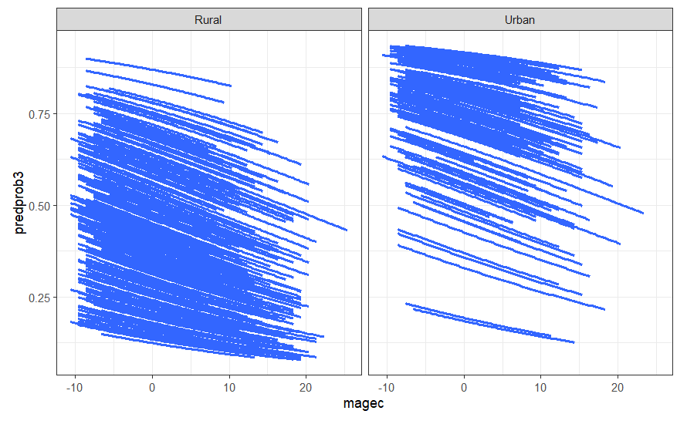
Including urban (output)
Formula: antemed ~ 1 + magec + urban + (1 + magec | comm)
Random effects:
Groups Name Variance Std.Dev. Corr
comm (Intercept) 9.701e-01 0.9849293
magec 3.505e-07 0.0005921 -1.00
Number of obs: 5366, groups: comm, 361
Fixed effects:
Estimate Std. Error z value Pr(>|z|)
(Intercept) -0.346427 0.074294 -4.663 3.12e-06 ***
magec -0.032522 0.005242 -6.204 5.49e-10 ***
urban 1.495306 0.133285 11.219 < 2e-16 ***
Very significant (z = 11.219) that the log odds of prenatal care for average-aged women is higher (positive coefficient) for urban communities compared to rural communities
  (but also not changing with age)
Explained (1.46 - .9701)/1.46 => 33% of var in intercepts
Moms in urban communities have exp(1.495) = 4.46 times higher odds of prenatal care than moms in rural communities of the same age (and adjusting for community effects)
Notes:
Whether or not the community is urban does explain some of this variation, with a higher probability of prenatal care in urban communities (very significant, p-value < .0001

Slide 12
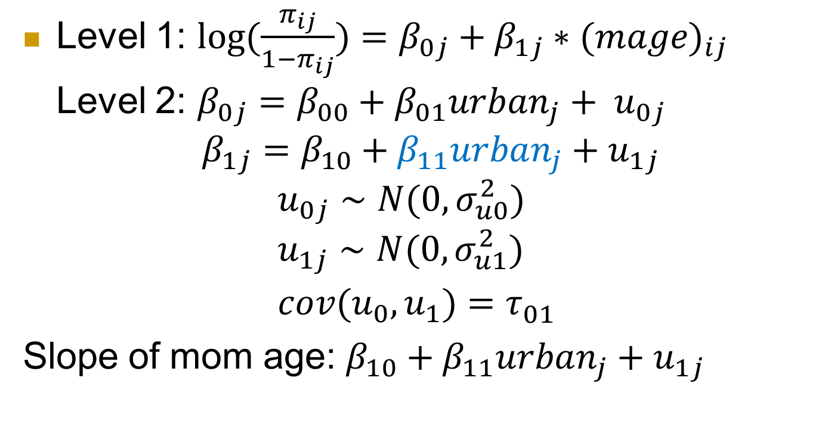
Include urban*mom age interaction
Level 1: $log(\frac{π_{ij}}{1−π_{ij}})=β_{0j}+β_{1j}∗(mage)_{ij}$
Level 2: $β_{0j}=β_{00}+β_{01}urban_{j}+ u_{0j}$
$β_{1j}=β_{10}+β_{11}urban_{j}+u_{1j}$
$$u_{0j}∼N(0,σ_{u0}^{2}) \\ u_{1j}∼N(0,σ_{u1}^{2}) \\ cov(u_{0},u_{1})=τ_{01}^{}$$
Slope of mom age: $β_{10}+β_{11}urban_{j}+u_{1j}$
Notes:
There are two types of interactions here. One with an "interaction" between community and mom age through the random slopes. The other is a more "traditional" interaction between urban and mom age. Both are trying to allow the rate of change in probability of prenatal care as mom's age to vary, one by community, the other by type of community. Neither seems all that impressive, due to the small slope variance component (especially after adjust for urban) and due to the large p-value (.17) when added to the model.

Slide 13
Including cross-level interaction
Formula: antemed ~ 1 + magec + urban + magec:urban + (magec | comm)
Random effects:
Groups Name Variance Std.Dev. Corr
comm (Intercept) 9.690e-01 0.984371
magec 4.101e-06 0.002025 1.00
Number of obs: 5366, groups: comm, 361
Fixed effects:
Estimate Std. Error z value Pr(>|z|)
(Intercept) -0.347863 0.074279 -4.683 2.82e-06 ***
magec -0.036815 0.006147 -5.989 2.11e-09 ***
urban 1.494654 0.132798 11.255 < 2e-16 ***
magec:urban 0.016832 0.012278 1.371 0.17 (or LRT)
Urban communities have slower decrease with age (-.037 vs. -.037 + .017) but not statistically significant
Even less community to community variation in slopes?
Notes:
Whether or not the community is urban does explain some of this variation, with a higher probability of prenatal care in urban communities (very significant, p-value < .0001) and a lower rate of decrease for older moms in the probability of prenatal care for urban communities (not significant, p-value ≈ 0.17).
There are two types of interactions here. One with an "interaction" between community and mom age through the random slopes. The other is a more "traditional" interaction between urban and mom age. Both are trying to allow the rate of change in probability of prenatal care as mom's age to vary, one by community, the other by type of community. Neither seems all that impressive, due to the small slope variance component (especially after adjust for urban) and due to the large p-value (.17) when added to the model.

Slide 14
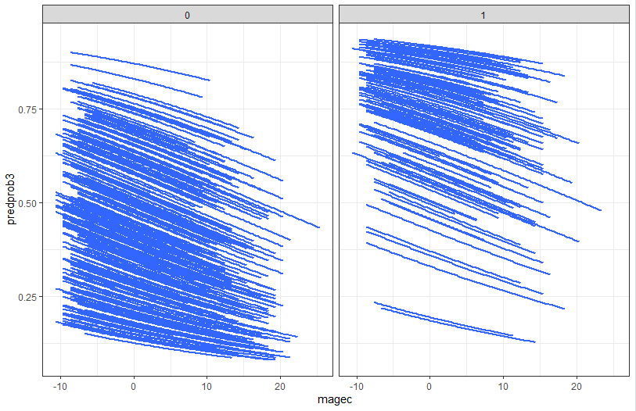
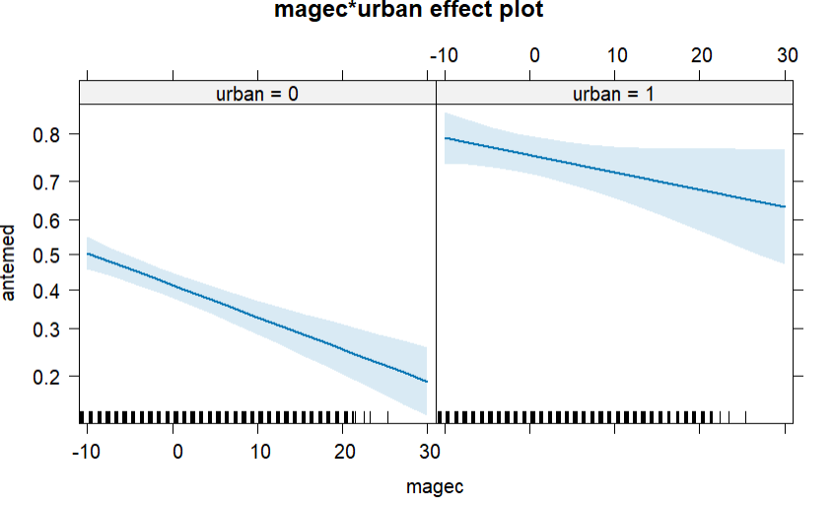
Urban vs. Rural
Urban communities tend to have higher probability of prenatal care (intercepts)
The rate of change from mom’s age doesn’t seem that different urban vs. rural (slopes)
  Smaller vs. weaker

Slide 15
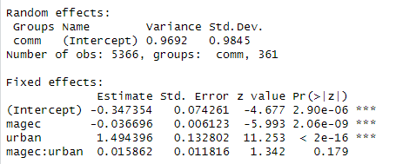

Don’t need random slopes?
Notes:
There are two types of interactions here. One with an "interaction" between community and mom age through the random slopes. The other is a more "traditional" interaction between urban and mom age. Both are trying to allow the rate of change in probability of prenatal care as mom's age to vary, one by community, the other by type of community. Neither seems all that impressive, due to the small slope variance component (especially after adjust for urban) and due to the large p-value (.17) when added to the model.

Slide 16
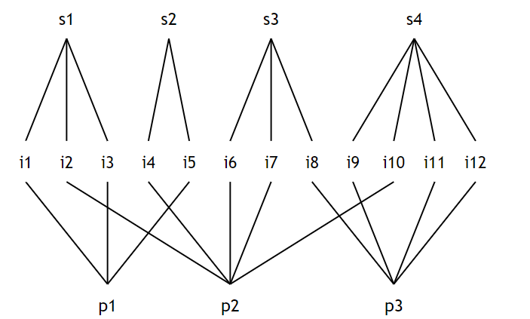
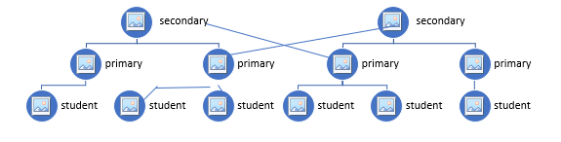

Recap: Cross-classified effects
Which primary school and secondary school students attend may be crossed
$y_{i\left(jk\right)}=β_{0\left(jk\right)}+ε_{i\left(jk\right)}$
$β_{0\left(jk\right)}=β_{00}+u_{oj}+v_{ok}$

Slide 17
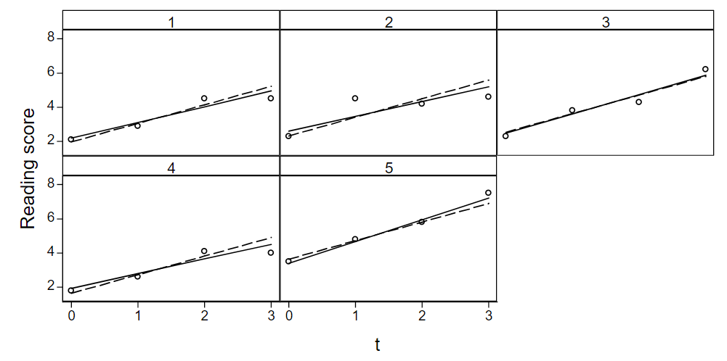
“Longitudinal” data
Include time, with random intercepts and random slopes (growth trajectory)

Slide 18
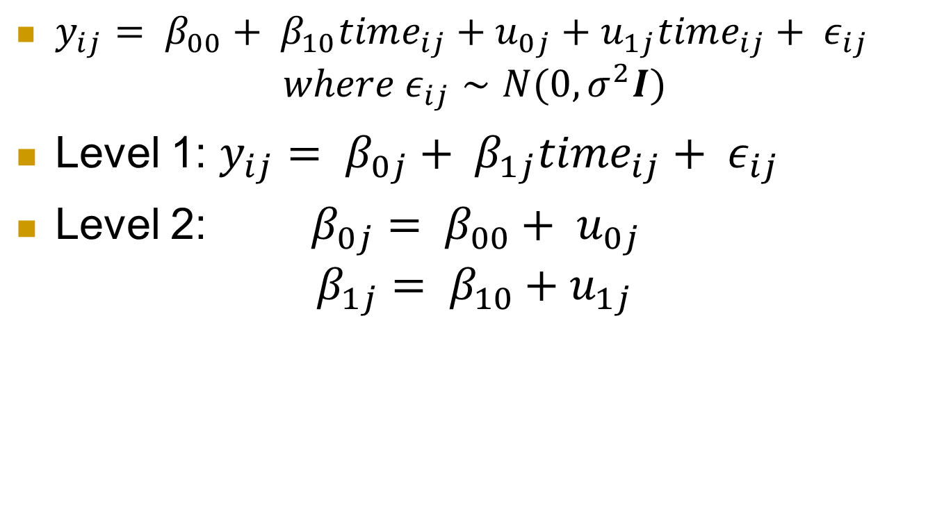
Unconditional growth model
$y_{ij}= β_{00}+ β_{10}time_{ij}+u_{0j}+u_{1j}time_{ij}+ ε_{ij}$
$$where ε_{ij}∼N(0, σ^{2}I)$$
Level 1: $y_{ij}= β_{0j}+ β_{1j}time_{ij}+ ε_{ij}$
Level 2: $β_{0j}= β_{00}+ u_{0j}$
$$β_{1j}= β_{10}+u_{1j}$$

Slide 19
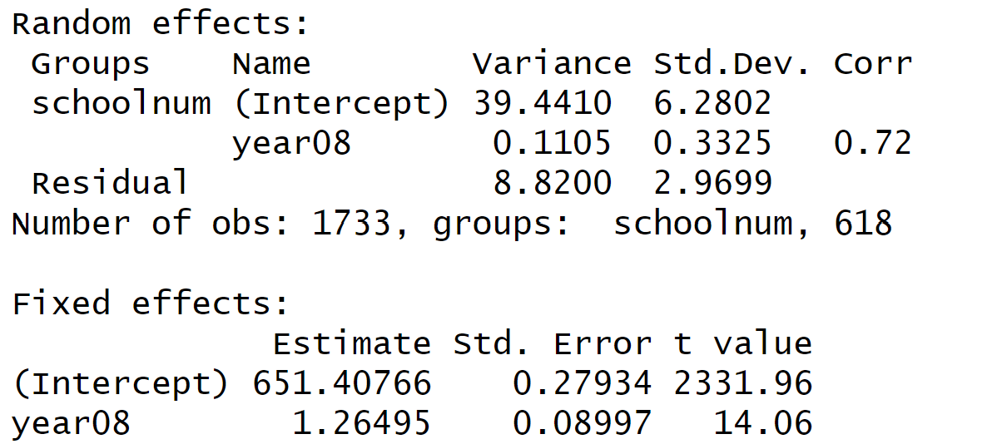
Fitted unconditional growth model

Slide 20
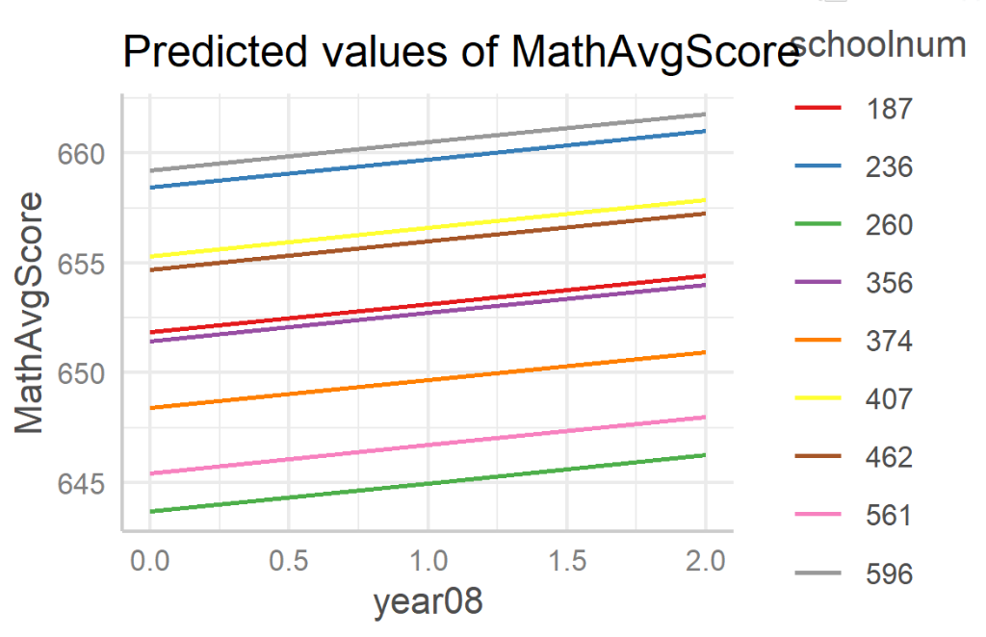
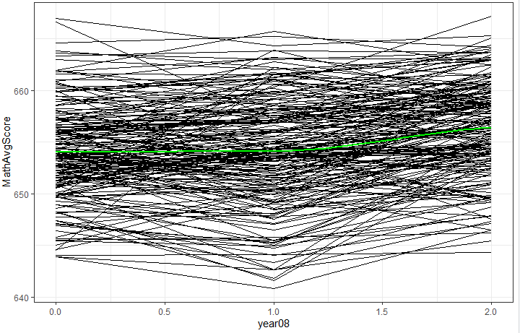
Is the model doing what we want?
Observed
Model

Slide 21

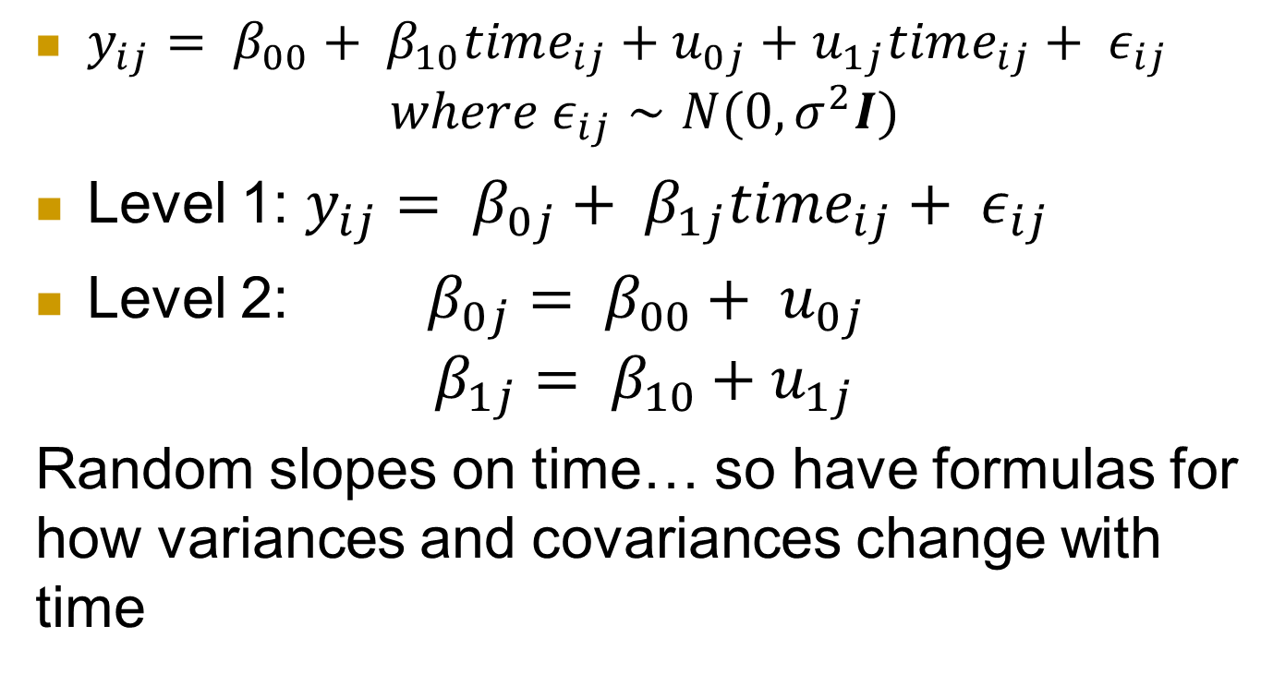
Unconditional growth mode(l
$y_{ij}= β_{00}+ β_{10}time_{ij}+u_{0j}+u_{1j}time_{ij}+ ε_{ij}$
$$where ε_{ij}∼N(0, σ^{2}I)$$
Level 1: $y_{ij}= β_{0j}+ β_{1j}time_{ij}+ ε_{ij}$
Level 2: $β_{0j}= β_{00}+ u_{0j}$
$$β_{1j}= β_{10}+u_{1j}$$
Random slopes on time… so have formulas for how variances and covariances change with time

Slide 22
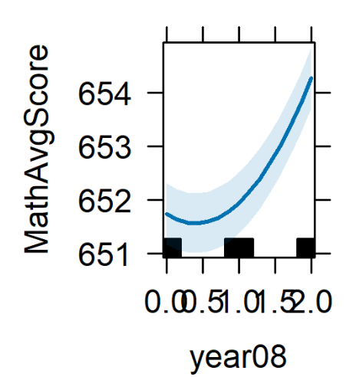
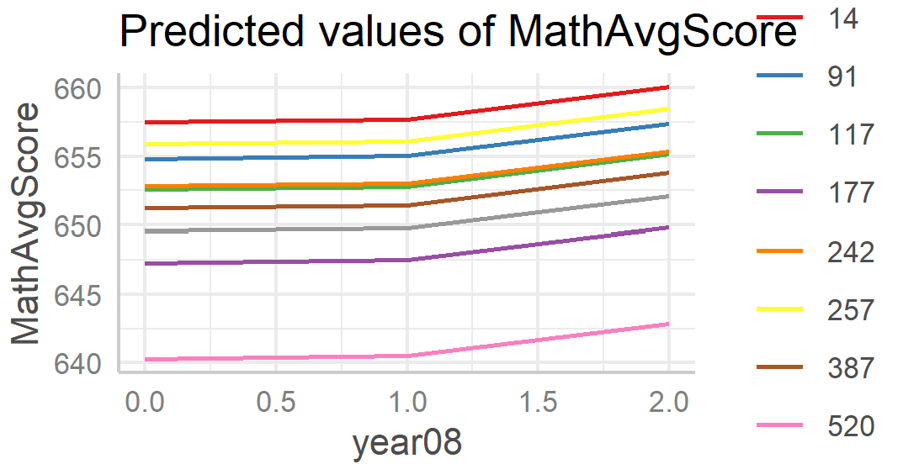
Linear time trend?
Composite
Level equations

Slide 23
Random slopes?
How many parameters do we add?
Notes:
2 beta’s, 2 variances, 3 covariances

Slide 24
Key ideas
Variability explained by time trend
  Level 1 residuals = Unexplained variation about the time trend
  Evaluation of linearity of time trend
  Exchangeability means no “pattern” to the time points
Adding a Level 2 variable
  Does it explain variation in intercepts
    Variable becomes part of the intercept
  Does cross level interaction explain variation in slopes
    With interaction, variable becomes part of slope coefficient

Slide 25
To Do
Day 15 quiz – due noon Friday
Day 15 computer problem (with partner?) – due noon Friday
HW 7 – due 7am Monday
Guest speaker first thing Monday
Projects!
  Submit part 3

Slide 26
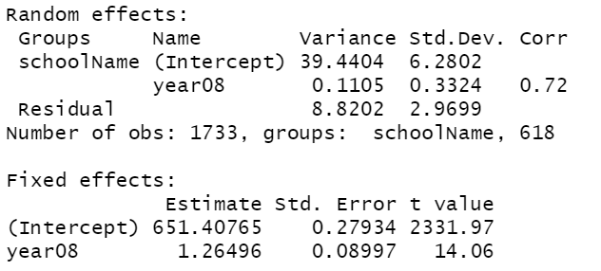

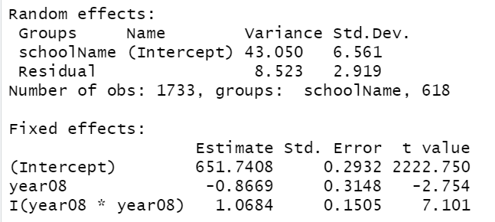
Linear model
6 parameters
Quadratic but only
random intercepts
5 parameters

Slide 27
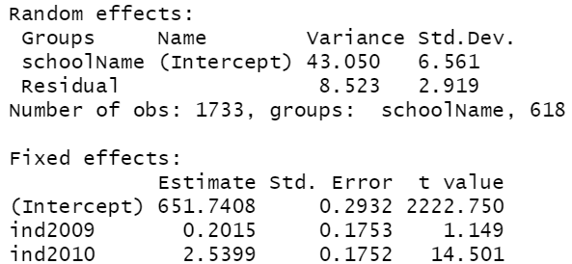
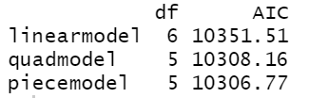

Piecewise linear
$Y_{ij}=β_{0}+u_{i}+β_{1}year0809+β_{2}year0910+ε_{ij}$

Slide 28

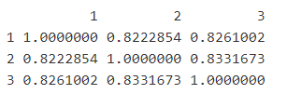
Is the model doing what we want? (2)
Observed correlation matrix
Predicted correlation matrix

Slide 29
Autoregressive (Level 1) residuals
After accounting for the time trend, is there remaining correlation in the Level 1 residuals?
  AR(1) model: ε_{ij}=ρε_{i−1,j}+ν_{ij} where ν_{ij} ~i.i.d. N(0,σ²)
Var(ε_{ij}) = σ²
Cov(ε_{ij}, ε_{i’j}) = σ² ρ^{|i} ^{– i’|}
Corr(ε_{ij}, ε_{i’j}) = ρ^{|i} ^{– i’|}
  Constant correlation at given “lag”
  Observations equally spaced
  “This models a type of dependence between adjacent observations, which quickly dies out between observations which are further apart”

Slide 30
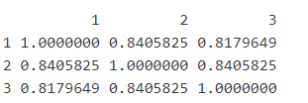
Better?
Observed correlation matrix
Predicted correlation matrix

Slide 31
“The extent to which time dependence can be modeled by random slopes, or rather by autocorrelated residuals, or a combination of both, depends on the phenomenon being modeled. This issue usually will be decided empirically.”

Slide 32
From Roback and Legler (2019)
… as is often true in multilevel models, the choice of covariance matrix does not greatly affect estimates of fixed effects. The choice of covariance structure could potentially impact the standard errors of fixed effects, and thus the associated test statistics… In fact, the standard model typically works very well. So is it worth the time and effort to accurately model the covariance structure? If primary interest is in inference regarding fixed effects, and if the standard errors for the fixed effects appear robust to choice of covariance structure, then extensive time spent modeling the covariance structure is not advised. However, if researchers are interested in predicted random effects and estimated variance components in addition to estimated fixed effects, then choice of covariance structure can make a big difference. For instance, if researchers are interested in drawing conclusions about particular schools rather than charter schools in general, they may more carefully model the covariance structure in this study.

Slide 33
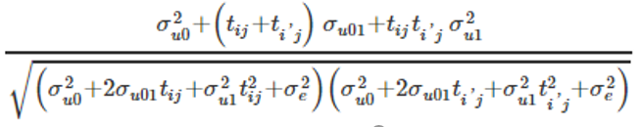
Cov(Y_{1j}, Y_{2j})?
After accounting for time trend…
  Var (Y_{ij})
  Cov(Y_{1j}, Y_{2j})
  Corr(Y_{1j,} Y_{2j})
Now depend on which two time points are comparing!

Slide 34
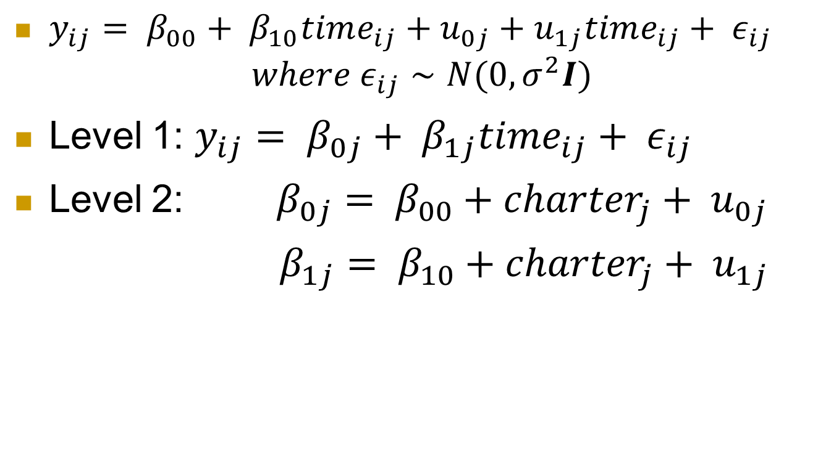
Adding Level 2 variable
$y_{ij}= β_{00}+ β_{10}time_{ij}+u_{0j}+u_{1j}time_{ij}+ ε_{ij}$
$$where ε_{ij}∼N(0, σ^{2}I)$$
Level 1: $y_{ij}= β_{0j}+ β_{1j}time_{ij}+ ε_{ij}$
Level 2: $β_{0j}= β_{00}+{charter}_{j}+ u_{0j}$
$β_{1j}= β_{10}+{{charter}_{j}+ u}_{1j}$

Slide 35
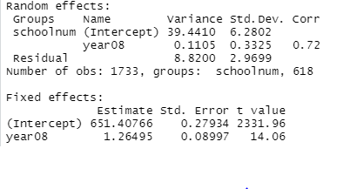
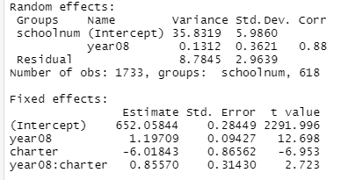
Charter vs. Noncharter schools?
Without charter
With charter
Explains 9% of variation in intercepts
Variation in slopes increases! (39.44+.11 > 35.83 + .13)
In 2008, charter schools averaged lower average scores (by 6.018) then the non-charter schools (consistent with lower intercept of the green model in the graph).

Slide 36
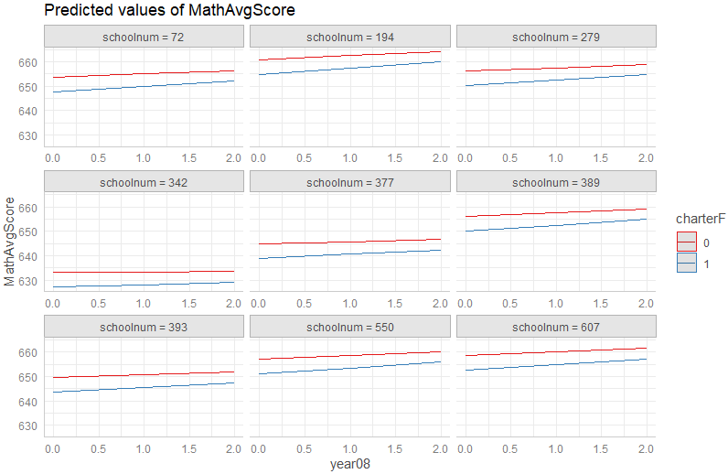
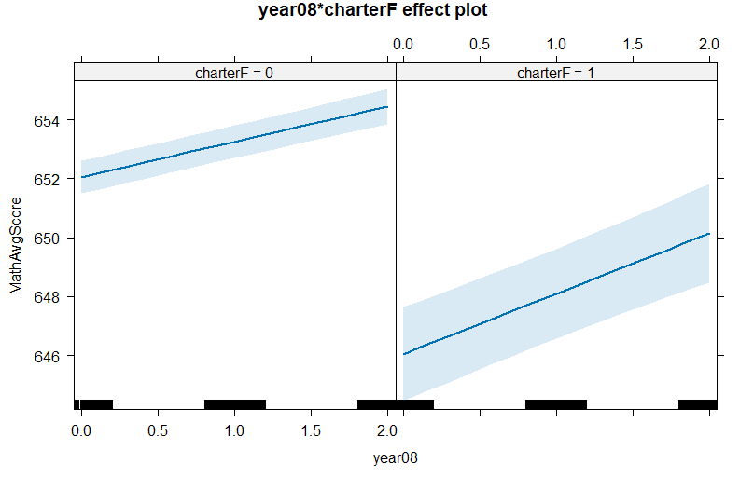
Charter vs. Noncharter schools
Charter schools have a larger rate of increase in average scores than public schools, on average
The difference between charter and public schools decreases from 2008-2010 (on avg)

Slide 37
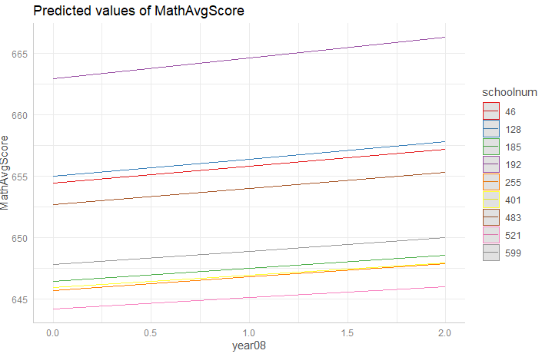
Is the model doing what we want? (3)
Observed
Model

Slide 38
Things to watch out for?
“Since charter is negative…”
  Main effect vs. interaction
“The interaction is positive …”
  Especially with categorical variables
  Especially with negative main effect
Relate back to visuals, raw data
-6 is greater than 2
Percent vs. percentage
Within model vs. between model questions
  The charter effect vs. adjusting for charter
More
Consistent with graphs (yes/no)

