Slide 1
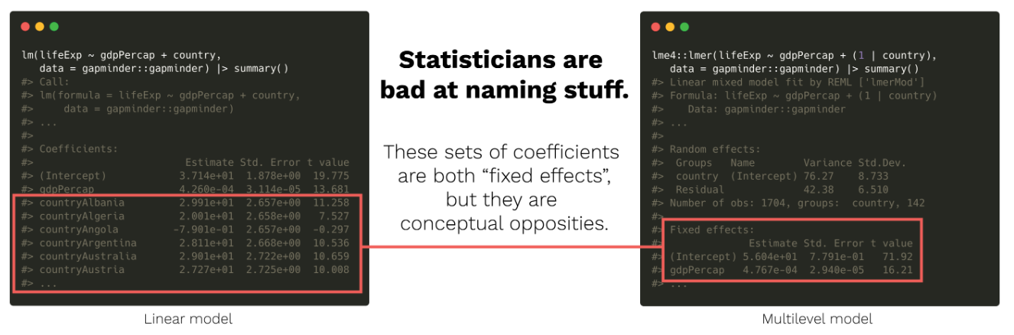
Stat 414 – Day 14
Extending our multilevel models
In my opinion, data scientists are worse!

Slide 2
What’s next
Logistic regression multilevel models (Ch. 17)
Cross-classified hierarchies (Ch. 13)
More on longitudinal data (more complicated covariance structures) (Ch. 15)

Slide 3
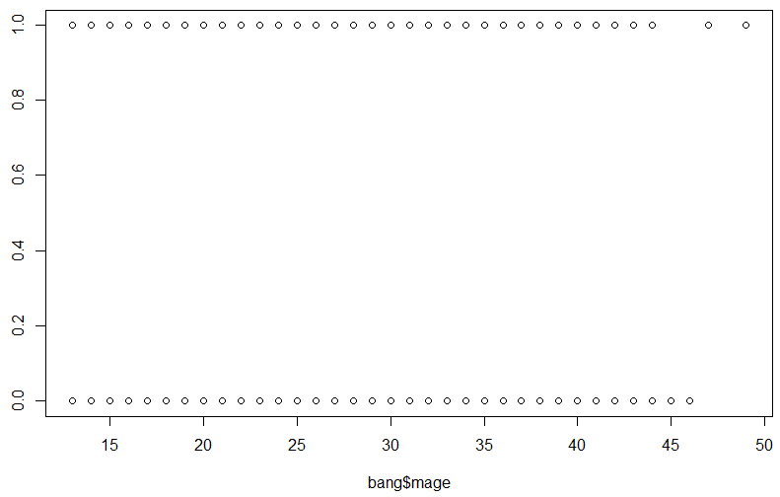
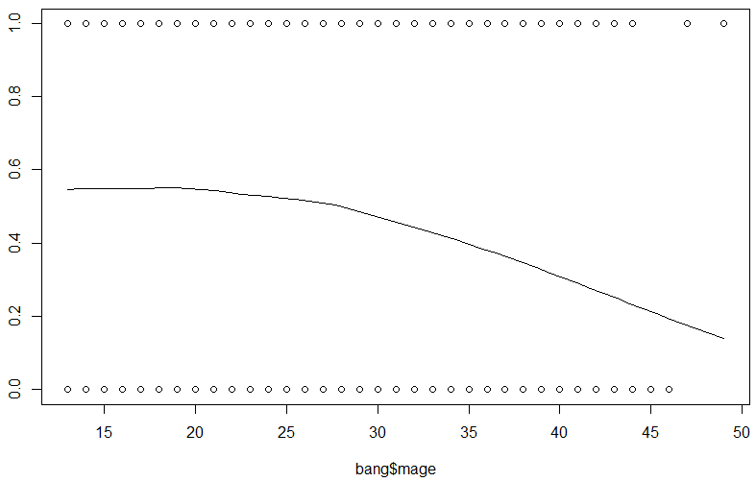
Logistic Regression
When you have a categorical (binary) response, can’t really fit a line…
Instead, will transform the data by computing the “log odds” of success (same direction)

Slide 4
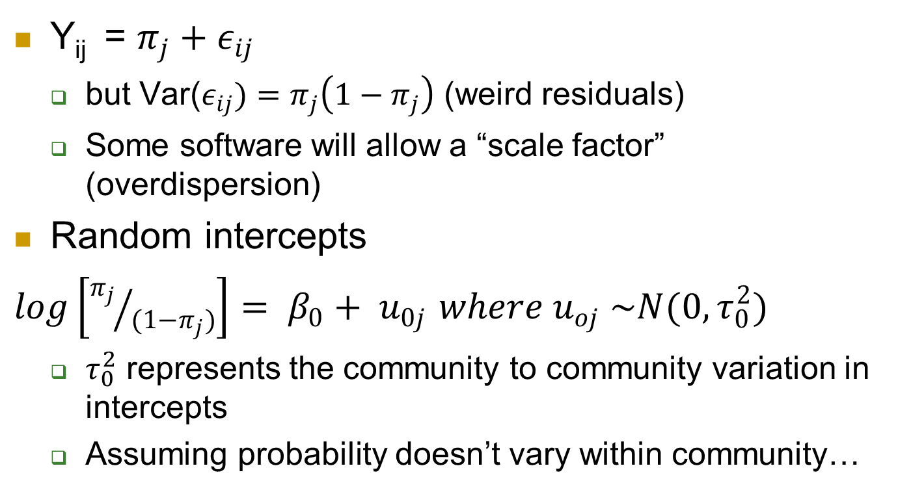
Multilevel Logistic Regression
Y­_{ij} = $π_{j}+ε_{ij}$
but Var($ε_{ij})=π_{j}\left(1−π_{j}\right)$ (weird residuals)
Some software will allow a “scale factor” (overdispersion)
Random intercepts
$log\left[{π_{j}}/{(1−π_{j})}\right]= β_{0}+ u_{0j}$ $where u_{oj} \sim N(0, τ_{0}^{2})$
$τ_{0}^{2}$ represents the community to community variation in intercepts
Assuming probability doesn’t vary within community…
Notes:
Underdispersion implies misspecification of model (e.g., omission of interactions)
Overdispersion can occur if omit important random effects/ level, small group sizes

Slide 5
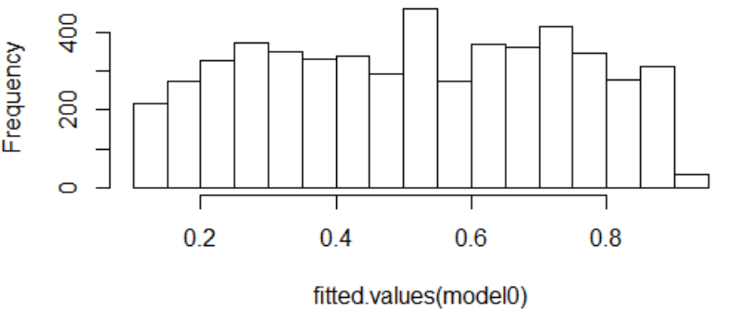

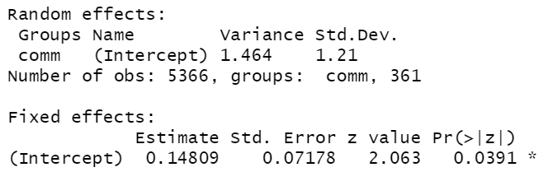

Example 2
Lots of variation in the sample proportions across communities
Statistically significant chi-square test
Random intercepts model
e^{0.148}
(1 + e^{0.148})
=.537
Notes:
exp($β$₀)/(1 + exp($β$₀)) is the population average probability
Could use scale factor: 3.29s

Slide 6
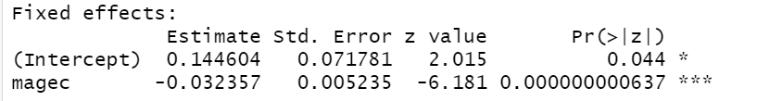
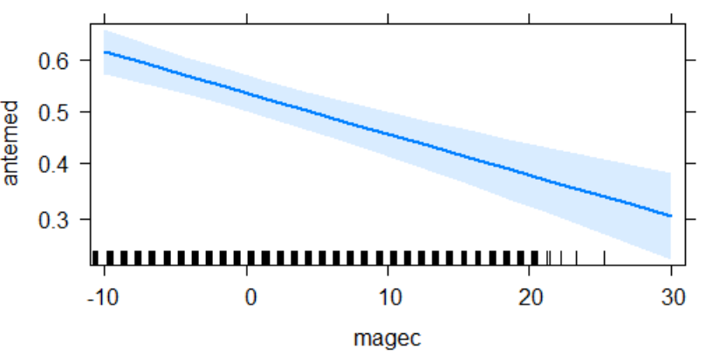
Include mom’s age
Allows probability to change within community
mage = 23.6 years
pred prob = e^{.145}/(1+ e^{.145}) = .536

Slide 7
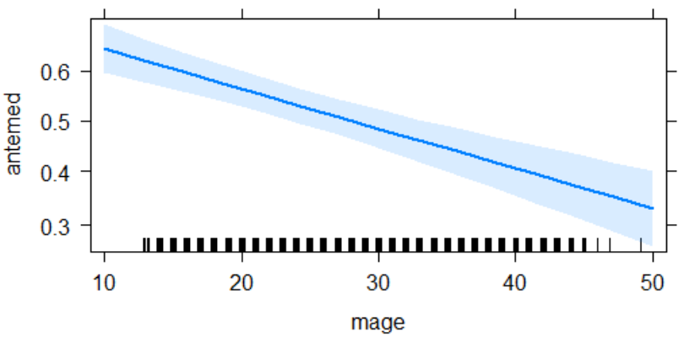
Predicted probability
40-year-old
Predicted log odds = .1446 - .03236(40-23.6) = -.386
Predicted odds = exp(-.386) = .6797
Predicted probability = .6797/1.6797 = .404
In the average community

Slide 8
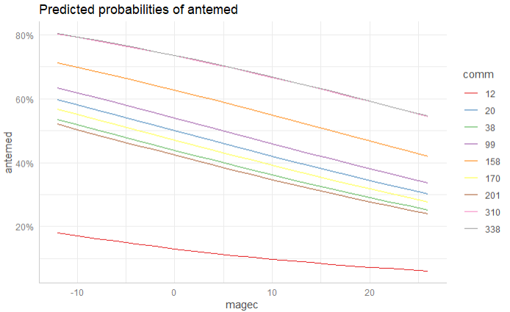
plot(ggpredict…)

Slide 9
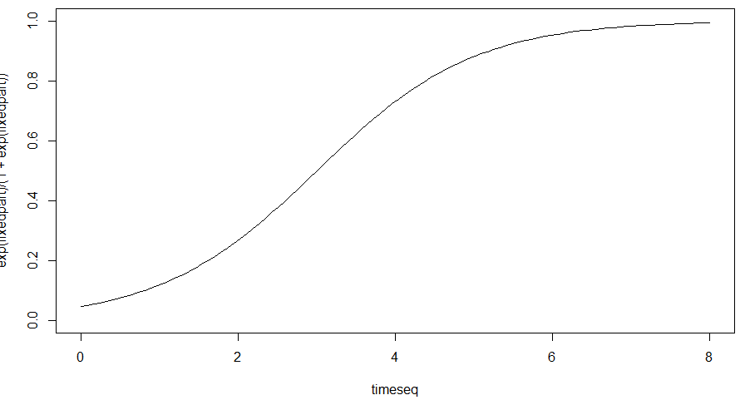
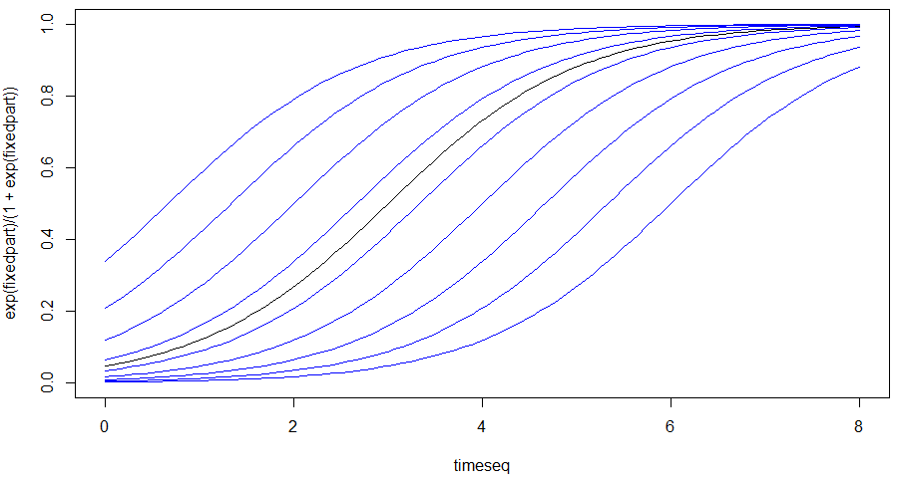
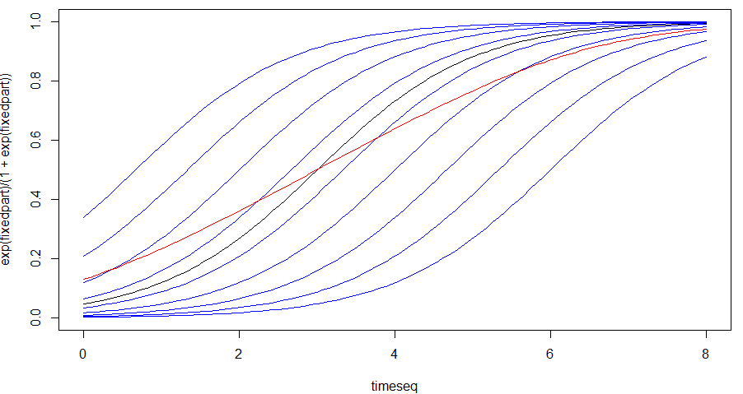
Multilevel logistic models
Average community
(“subject-specific”)
Random intercepts
(black = typical cluster)
Average predicted probability
(“Marginal” association)

Slide 10
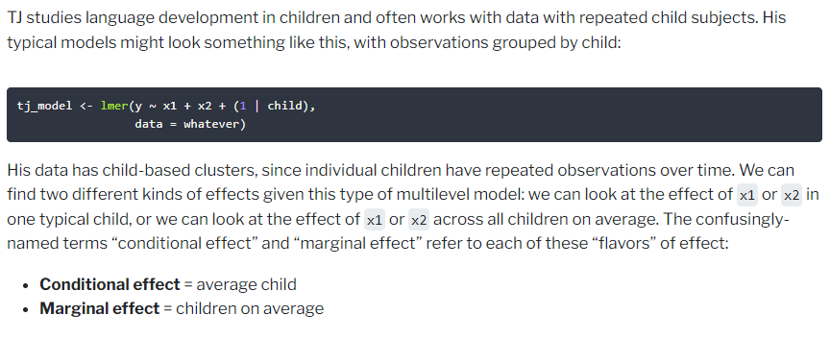
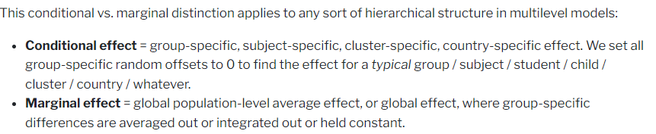
https://www.andrewheiss.com/blog/2022/11/29/conditional-marginal-marginaleffects/

Slide 11
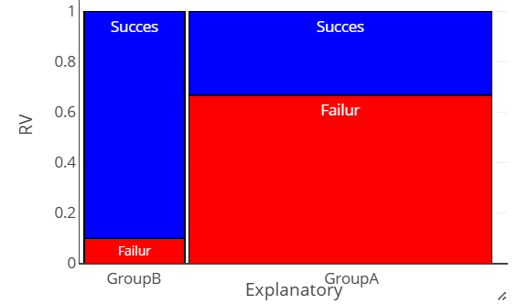
Quick Example
 | GroupA | GroupB | Total
Success | 10 | 9 | 30
Failures | 20 | 1 | 21
Proportion | 0.333 | 0.900 | 0.475
Prediction for a typical person?
0.333
Prediction for the population
‘average”?
0.475
“conditional”
“marginal”

Slide 12
terminology
Multilevel regression: … emphasizes the fact that in many data sets, there are complex inter-relationships between the observations that are not explained by the covariates. These inter-relationships allow us to speak in terms of unobserved “random effects” that are added to the linear predictors of one or more observations. This gives rise to dependence, and a way to model variances and covariances, although these are modeled through random effects, rather than directly.
Conditional/marginal effect (in multilevel regression): In a multilevel model, a “marginal effect” is usually defined as the change in expected response corresponding to a one unit change of a specific covariate x. A “conditional effect” is usually defined as the change in expected response conditional on the random effect for a one unit change in x. For linear models, conditional and marginal effects are the same. But in nonlinear models the two types of effects differ. Methods either target the marginal effects, or the conditional effects, but usually not both. In most cases the conditional effect will be numerically larger than the marginal effect. Note that the word “effect”, while widely used, conveys causality that may not be warranted.
Another use of the term “marginal effect” arises in single-level regression models. In this case the marginal effect is the change in expected response corresponding to a one unit change of xk, while the conditional effect is the change in expected response corresponding to a single unit change in xk with the other variables xj held fixed.

Slide 13
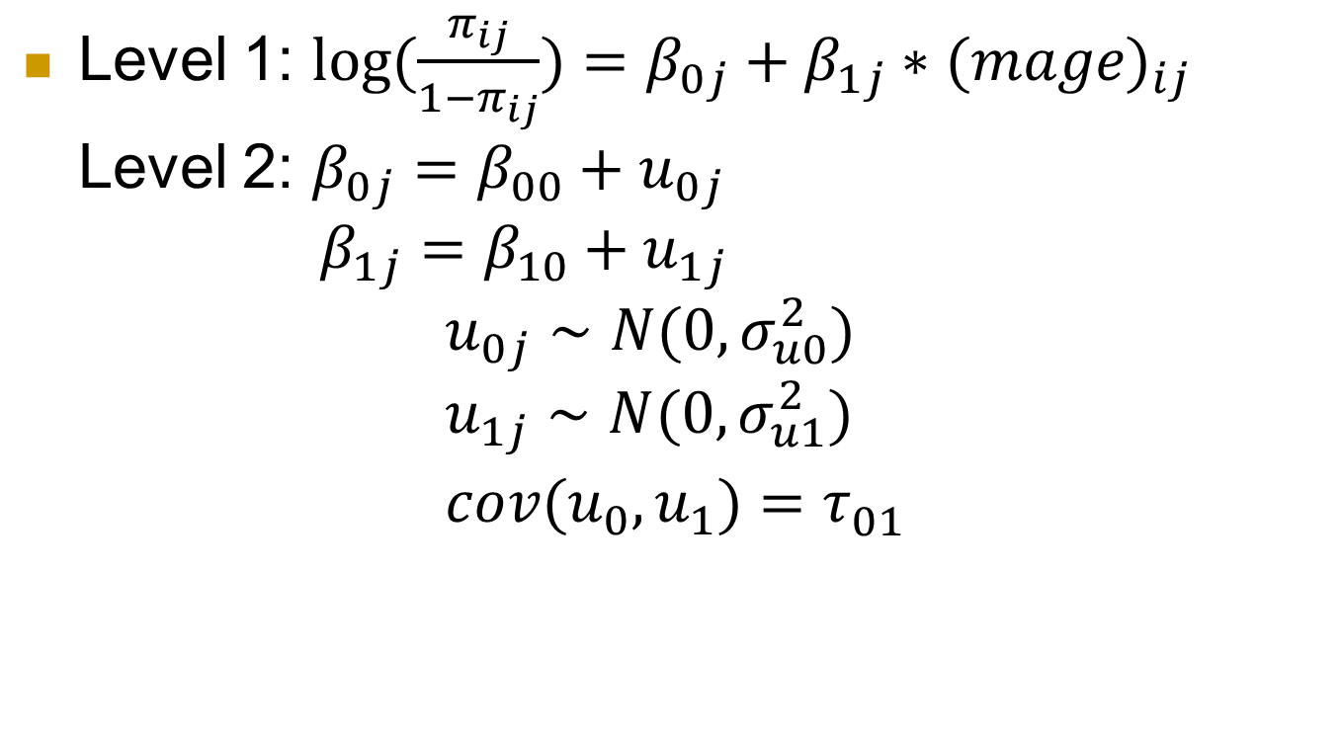
Including mom’s age, random slopes
Level 1: $log(\frac{π_{ij}}{1−π_{ij}})=β_{0j}+β_{1j}∗(mage)_{ij}$ Level 2: $β_{0j}=β_{00}+u_{0j}$ $β_{1j}=β_{10}+u_{1j}$
$$u_{0j}∼N(0,σ_{u0}^{2}) \\ u_{1j}∼N(0,σ_{u1}^{2}) \\ cov(u_{0},u_{1})=τ_{01}^{}$$

Slide 14
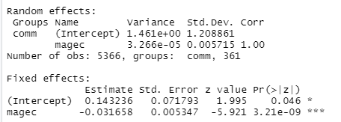
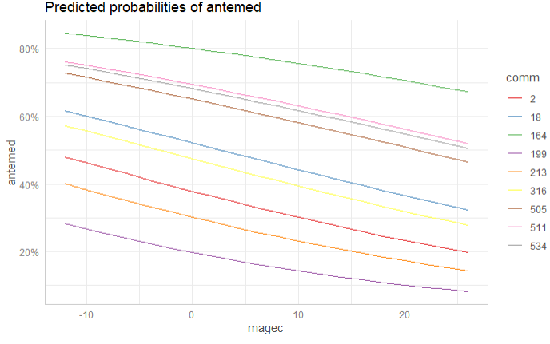
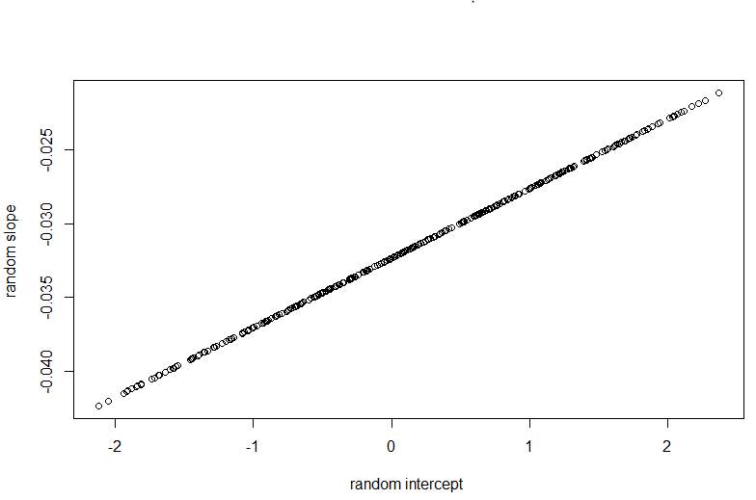
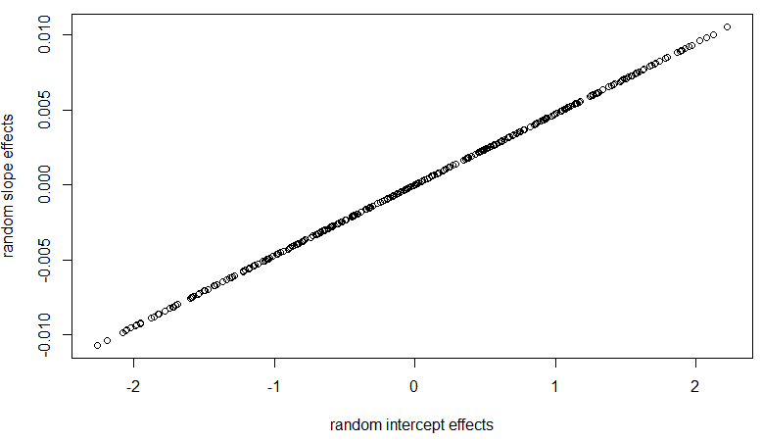
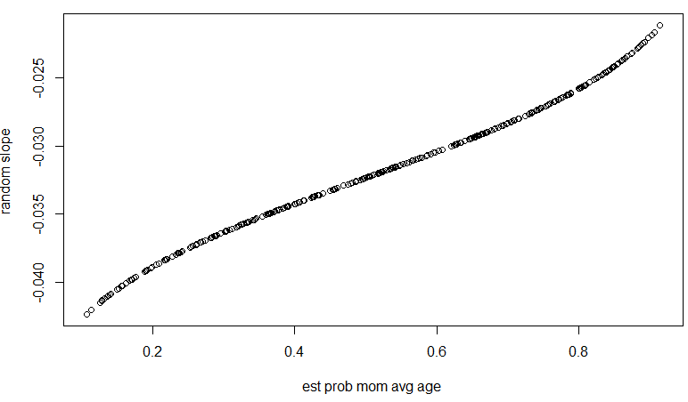
Random slopes mom’s age
Communities with higher intercepts
tend to have a larger (less negative) change with mom’s age, but not much community to community variation in slopes
Notes:
The likelihood of prenatal care decreases as the mother’s age at birth increases and this rate of decrease does not seem to change across communities (don’t really need random slopes), though there is a fair bit of community to community variation in the overall probability (estimated overall intercept = .148, SD = 1.21).
The correlation of one says we can perfectly predict the slope from the intercept. This could be from the variation in the slopes being so small, that once we know the intercept, we know the community?)

Slide 15
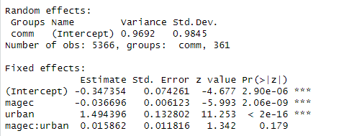

Don’t need random slopes?
Notes:
There are two types of interactions here. One with an "interaction" between community and mom age through the random slopes. The other is a more "traditional" interaction between urban and mom age. Both are trying to allow the rate of change in probability of prenatal care as mom's age to vary, one by community, the other by type of community. Neither seems all that impressive, due to the small slope variance component (especially after adjust for urban) and due to the large p-value (.17) when added to the model.

Slide 16
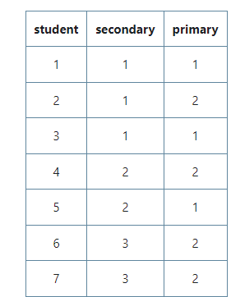
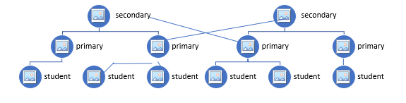
What about
Multiple random effects but not hierarchical, e.g., hockey player and goalie
Students from same primary school can go to different secondary schools
“Cross-classified”
Notes:
Multilevel but not purely hierarchical

Slide 17
“Additive” effects
The standard cross-classified model assumes that the higher level units have additive effects on the response. That is, the total school effect on the response is simply the additive sum of the secondary school effect and the primary school effect. This implies that the effect a secondary school has on its students is the same for all its students, irrespective of which primary schools they attended.

Slide 18
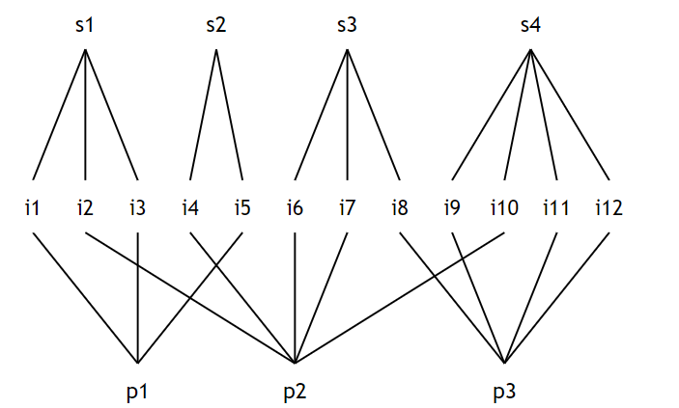

Cross-classified
$y_{ijk}=intercept+psch effect+ssch effect$
$y_{i\left(jk\right)}=β_{0\left(jk\right)}+ε_{i\left(jk\right)}$
$β_{0\left(jk\right)}=β_{00}+u_{oj}+v_{ok}$

Slide 19
To Do
Finish Computer Problem 14
Review Ch. 13 on imperfect hierarchies
Quiz 14
Start HW 7
Working on project
See “project advice” to follow

Slide 20
Project advice
Tell a story with the data
Clearly identify primary variables (e.g., RV)
Don’t just list numbers
Don’t assume audience is familiar with your data
Use graphs to help tell your story
How the graphs and the model agree
Concern vs. interesting feature
Model vs. data
Start simple (impress with visuals, quality)
Why multilevel, structure of the data, assumptions (audience)
Null model, ICC
Be ready to justify choices
Keep audience’s interest
Notes:
Don’t start sentences with numbers, significant digits, tables

Slide 21
Project advice (2)
Graphs of models
plot(ggeffects::ggpredict(model.income, terms=c("income", "COUNTRY [sample=9]"), type="re"))
Features of “final model”
Includes important EVs (research question, covariates)
Potential interactions have been investigated
Variables are centered where can enhance interpretation
Unnecessary terms have been removed
Checked validity using residual plots
Defensible/context

Slide 22
Project advice (3)
Comparing models
performance::compare_performance(m1,m2, metrics = c("BIC", “AIC"), bf = FALSE)
texreg::screenreg(list(m1, m2), digits = 3, single.row = TRUE, stars = 0, custom.model.names=c(“m1", “m2"))
stargazer
Warning messages
```{r, echo=FALSE}
```{r message=FALSE}
knitr::opts_chunk$set(warning = FALSE, message = FALSE)

Slide 23
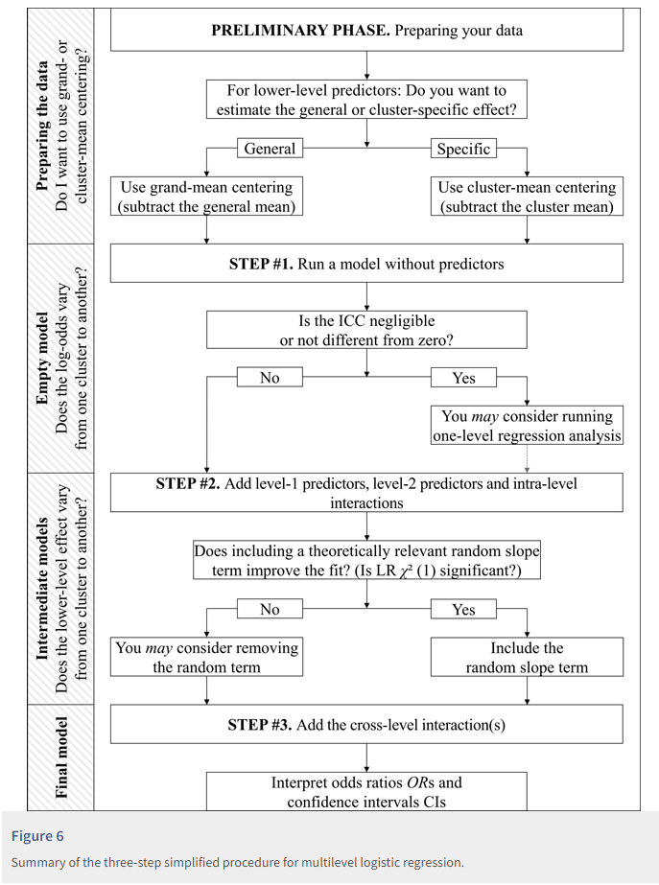
Example flowchart
Notes:
https://rips-irsp.com/articles/10.5334/irsp.90#ill-show-you-a-three-step-simplified-procedure-for-multilevel-logistic-regression

