Slide 1
Stat 414 – Day 13
Recap random slopes
Brief intro to logistic regression

Slide 2
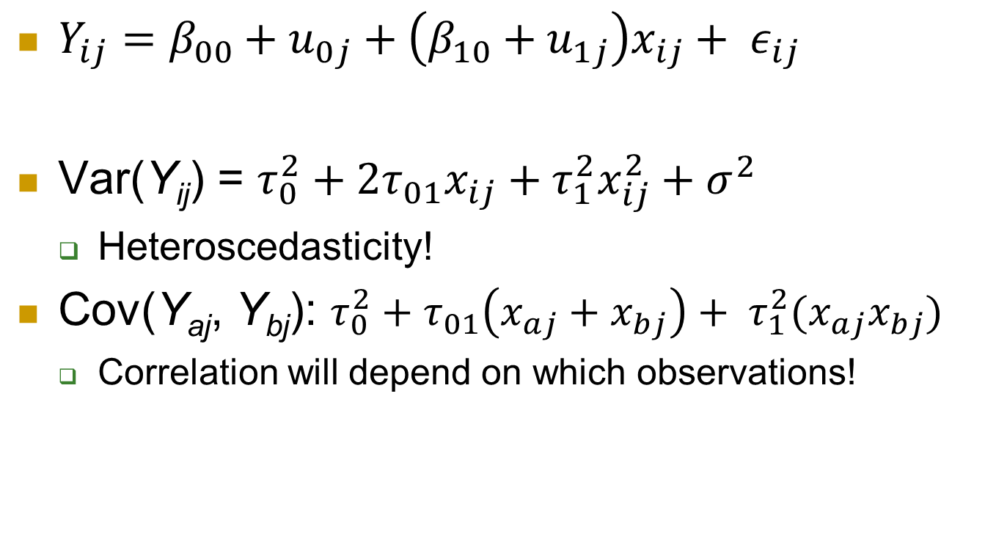
Implications of the random slopes …
$Y_{ij}=β_{00}+u_{0j}+\left(β_{10}+u_{1j}\right)x_{ij}+ ε_{ij}$
Var(Y­_{ij}) = $τ_{0}^{2}+2τ_{01}x_{ij}+τ_{1}^{2}x_{ij}^{2}+σ^{2}$
Heteroscedasticity!
Cov(Y_{aj}, Y_{bj}): $τ_{0}^{2}+τ_{01}\left(x_{aj}+x_{bj}\right)+ τ_{1}^{2}(x_{aj}x_{bj})$
Correlation will depend on which observations!

Slide 3
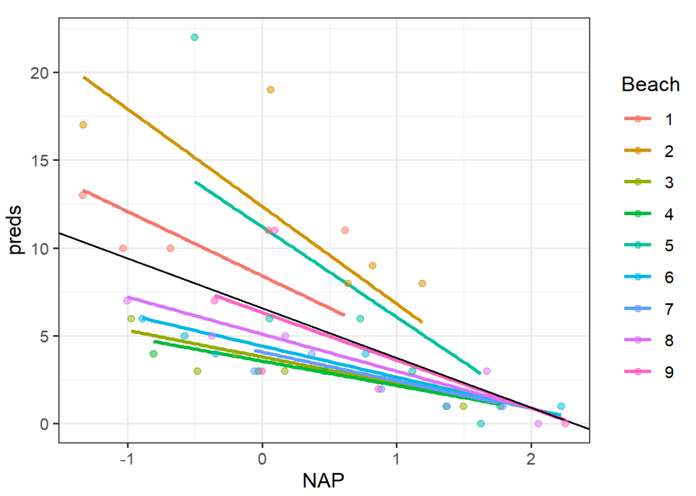
Variances with random slopes
Random effects:
Groups Name Variance Std.Dev. Corr
Beach (Intercept) 12.600 3.550
NAP 2.942 1.715 -0.99
Residual 7.307 2.703
$τ_{0}^{2}+2τ_{01}x_{ij}+τ_{1}^{2}x_{ij}^{2}+σ^{2}$ = 12.6 + 2(-.99)(3.55)(1.715) x + 2.942 x² + 7.307

Slide 4

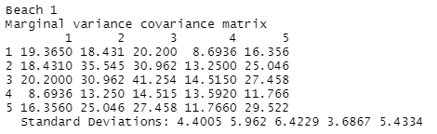
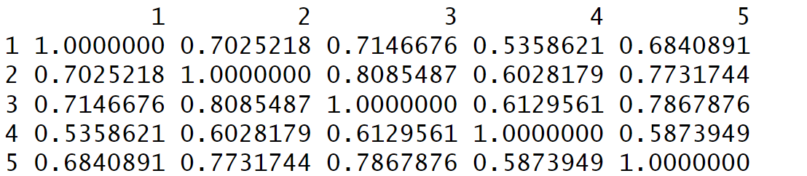
Variances with random slopes cont.

Slide 5
Keep in mind
Variance in intercepts, covariance of pairs of observations changes with x
Doesn’t make sense to compute ICC (within school correlation) with random slopes
Or just for x = 0
Be clear which variance you are “explaining”

Slide 6
Multiple random slopes
PISA data, model 4
z_read ~ cen_pos + cen_escs + female + (1 + cen_escs + female | schoolid)
Random effects:
Groups Name Variance Std.Dev. Corr
schoolid (Intercept) 0.18716 0.4326
cen_escs 0.01782 0.1335 -0.41
female 0.02218 0.1489 -0.49 -0.26
Residual 0.67069 0.8190
Number of obs: 13559, groups: schoolid, 354
Intercept cen_escs
cen_escs
female
Most of the random variation is among students within schools

Slide 7
Multiple random slopes
Just try not to over do it – models will have trouble converging
Adds many covariance terms C(k,2) where k is the number of terms with random slopes
Can force the random slopes to not be correlated, but consider context
Centering variables can help with convergence
Note: Models can also have different sources of random intercepts…

Slide 8
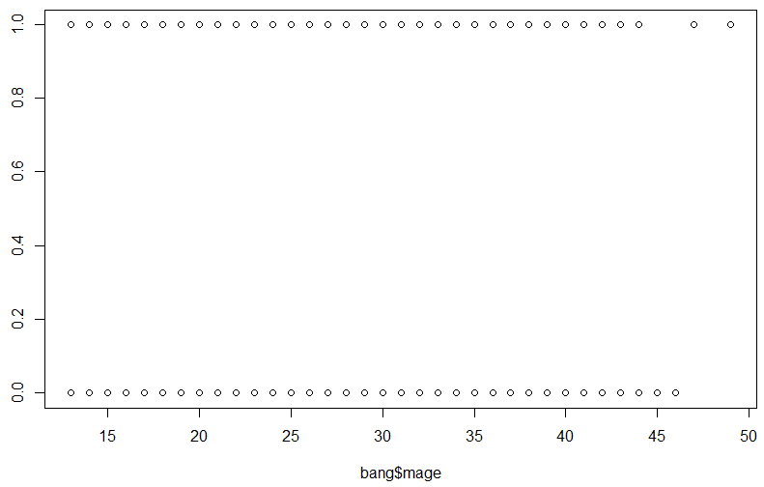
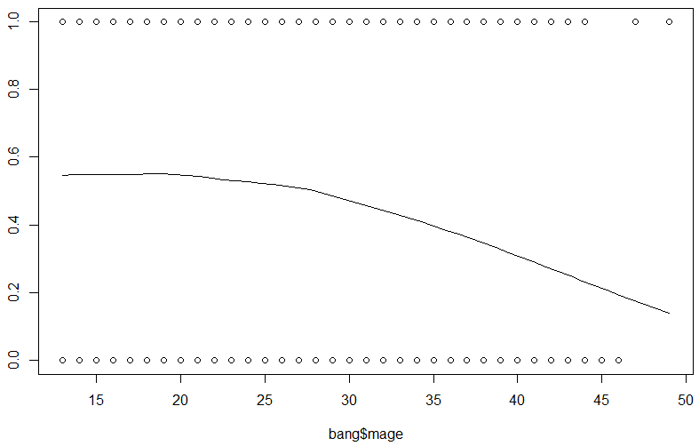
Logistic Regression
When you have a categorical (binary) response, can’t really fit a line…
Instead, will transform the data by computing the “log odds” of success (same direction)

Slide 9
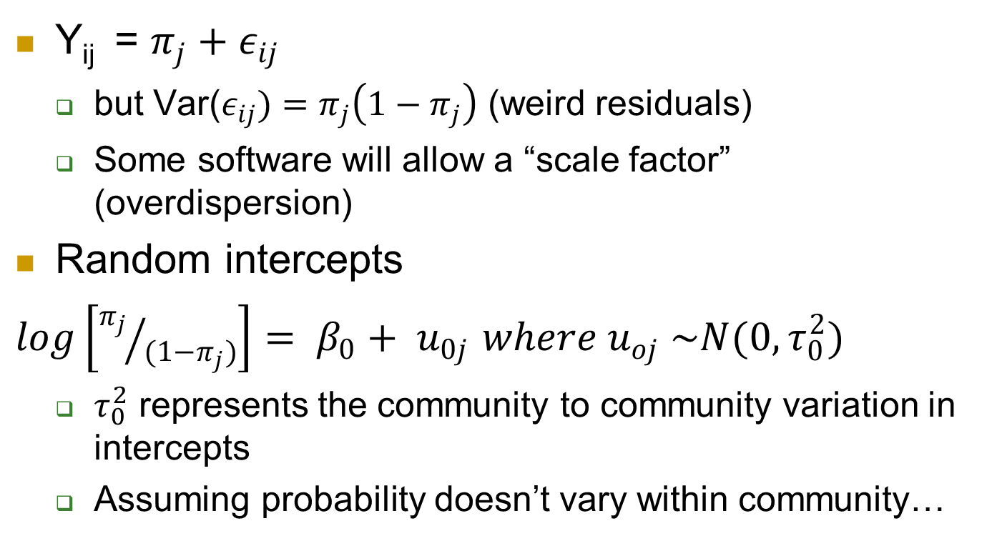
Multilevel Logistic Regression
Y­_{ij} = $π_{j}+ε_{ij}$
but Var($ε_{ij})=π_{j}\left(1−π_{j}\right)$ (weird residuals)
Some software will allow a “scale factor” (overdispersion)
Random intercepts
$log\left[{π_{j}}/{(1−π_{j})}\right]= β_{0}+ u_{0j}$ $where u_{oj} \sim N(0, τ_{0}^{2})$
$τ_{0}^{2}$ represents the community to community variation in intercepts
Assuming probability doesn’t vary within community…
Notes:
Underdispersion implies misspecification of model (e.g., omission of interactions)
Overdispersion can occur if omit important random effects/ level, small group sizes

Slide 10
To Do
Quiz 13
Computer problem 13 – example 3
Continue HW 6
Continue working on projects (3rd project report)
Nov 10 target

