Slide 1
Stat 414 – Day 12
Using random slopes to model heteroscedasticity (5.1)

Slide 2
Leftovers
Exam (Avg: .82)
  Course Avg added and partially updated
Computer problem 11
Quiz 11
HW 5
Projects
  Read feedback! Ask questions!!

Slide 3
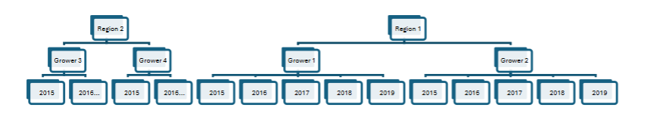
Exam comments
Worthwhile picture
Watch scaling (e.g., activity vs. log activity)
Combination of communication, basic calculation, reading R syntax, output
Variation in Y explained by random effects vs. Reduction in unexplained variation
  Percentage vs. percentage points

Slide 4
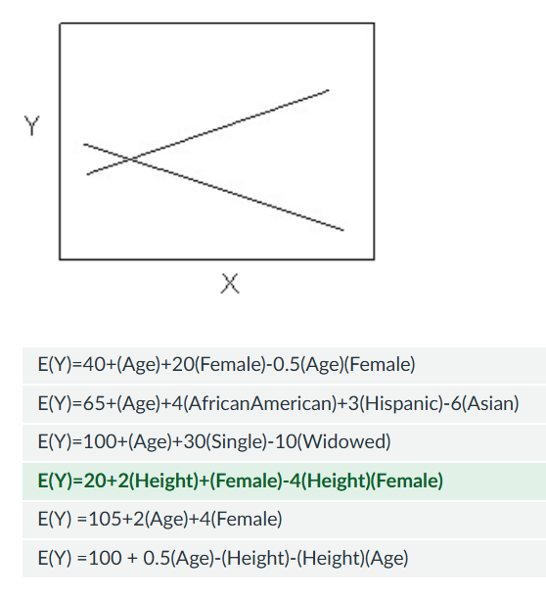
Quiz 11

Slide 5
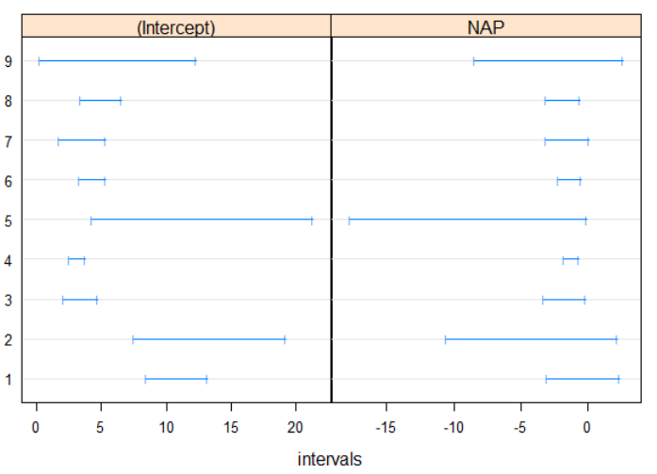
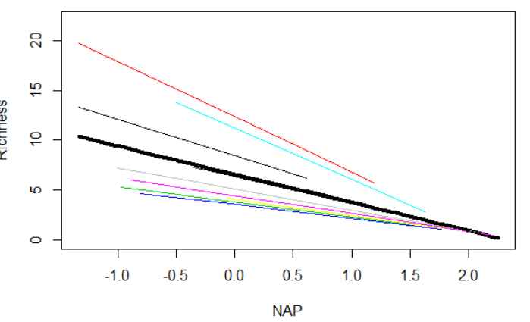

Last Time: Random Slopes
Model: $Y_{ij}=β_{00}+u_{0j}+\left(β_{10}+u_{1j}\right)x_{ij}+ ε_{ij}$
  Two new parameters: $τ_{1}^{2}$ and $τ_{01}$
  ${\hat{τ}}_{01}:−0.99$, beaches with larger intercepts tended to have small (more negative) slopes, larger “impact” of NAP on richness

Slide 6
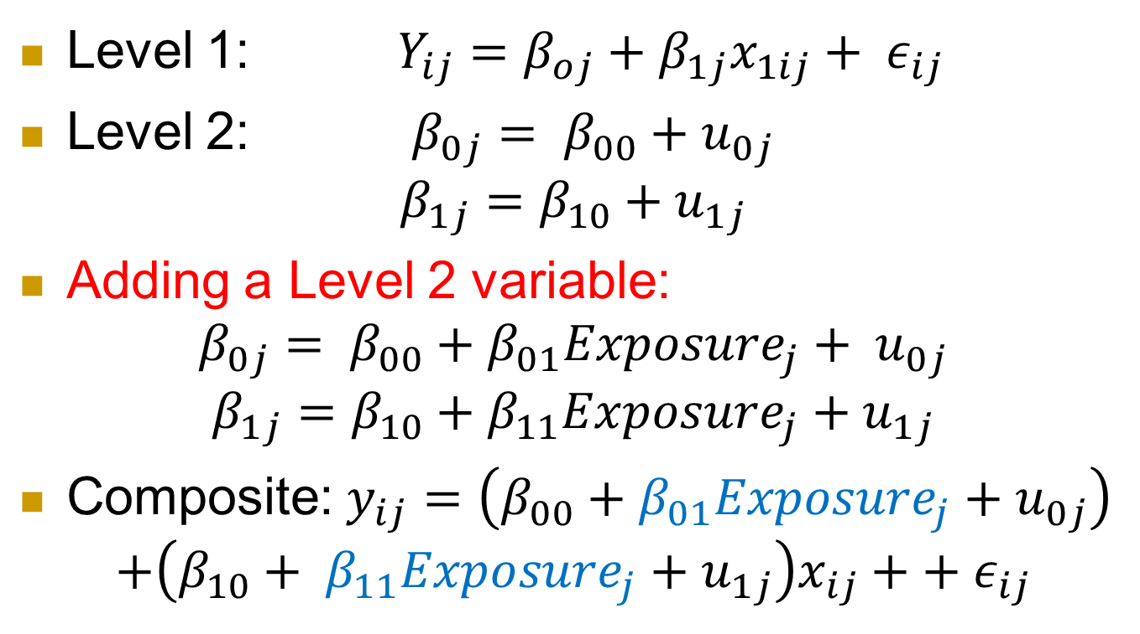
Random Slopes
Level 1: $Y_{ij}=β_{oj}+β_{1j}x_{1ij}+ ε_{ij}$
Level 2: $β_{0j}= β_{00}+u_{0j}$
$$β_{1j}=β_{10}+u_{1j}$$
Adding a Level 2 variable:
$$β_{0j}= β_{00}+β_{01}Exposure_{j}+ u_{0j}$$
$$β_{1j}=β_{10}+β_{11}Exposure_{j}+u_{1j}$$
Composite: $y_{ij}=\left(β_{00}+β_{01}Exposure_{j}+u_{0j}\right)$
$$+\left(β_{10}+ β_{11}Exposure_{j}+u_{1j}\right)x_{ij}++ ε_{ij}$$

Slide 7
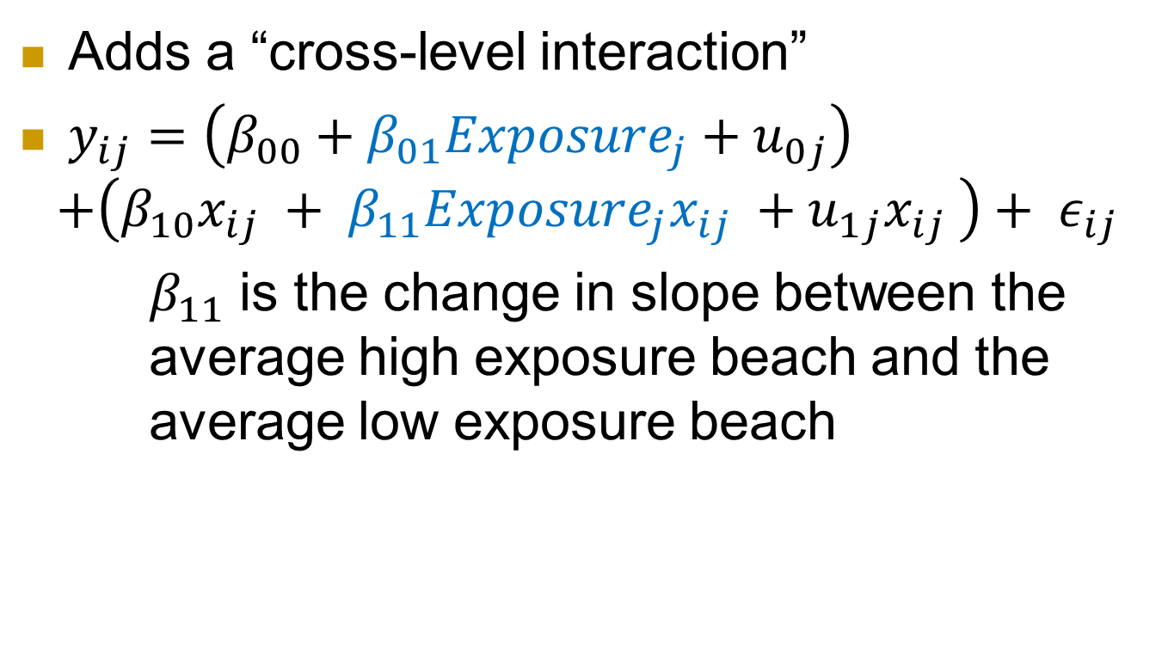
Adding a Level 2 variable
Adds a “cross-level interaction”
$y_{ij}=\left(β_{00}+β_{01}Exposure_{j}+u_{0j}\right)$
$$+\left(β_{10}x_{ij} + β_{11}Exposure_{j}x_{ij} +u_{1j}x_{ij} \right)+ ε_{ij}$$
$β_{11}$ is the change in slope between the average high exposure beach and the average low exposure beach

Slide 8
Model 4
Random effects:
Groups Name Variance Std.Dev. Corr
Beach (Intercept) 3.832 1.957
NAP 1.002 1.001 -1.00
Residual 7.161 2.676
Number of obs: 45, groups: Beach, 9
Fixed effects:
Estimate Std. Error t value
(Intercept) 8.9590 1.0474 8.553
NAP -3.8812 0.7228 -5.370
ExposureCat>10 -5.3824 1.5864 -3.393
NAP:ExposureCat>10 2.4460 1.0991 2.225

Slide 9
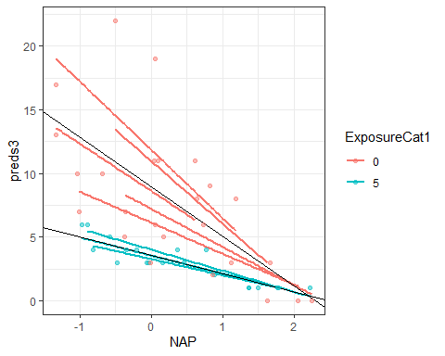
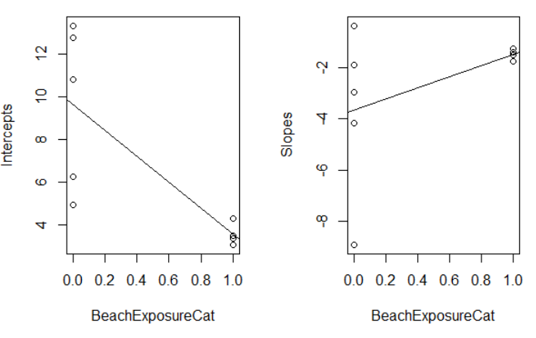
Exp*NAP
low exposure: intercept: 8.9850, slope: -3.8812
high exposure:
  intercept: 8.9580 - 5.3825 = 3.5755,
  slope: -3.8812 + 2.4460 = -1.4352
  (so still negative but flatter for the high exposure beaches)

Slide 10
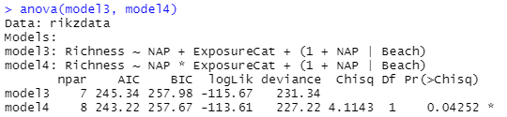
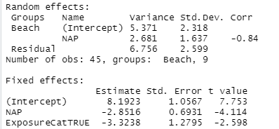
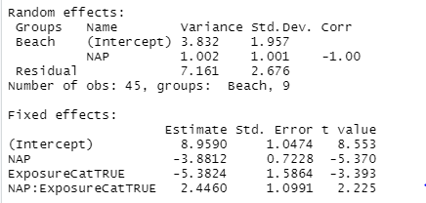
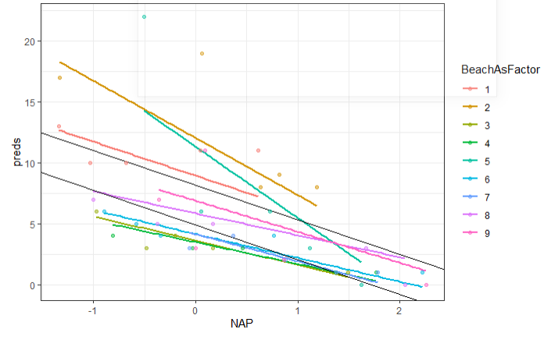
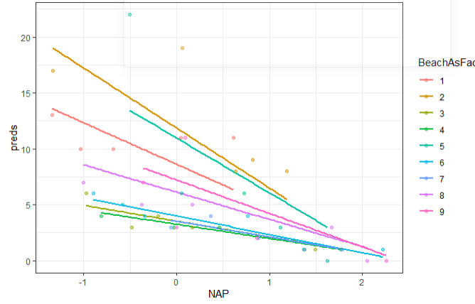
Model 3 vs.
Model 4
Model 3
Model 4

Slide 11
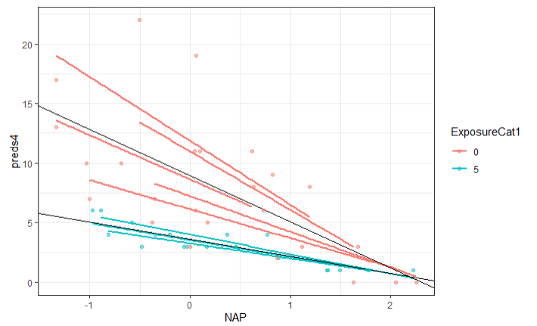
Computer problem 11
Just to improve colors
The residual standard error increased. This tells us that including the interaction term may account for slightly less within group variance in exchange for modelling the relationship between beaches more accurately. This is not necessarily better or worse, more so preference in what you intend to learn about the data.
Notes:
The residual standard error increased from 6.756 to 7.161. This tells us that by adding the interaction term to the model, on average, our predicted values are 0.405 units further from the actual observations (our model is less accurate).

Slide 12
Note
In cases where the explanation of the random effects works extremely well, one may end up with models with no random effects at level two… random intercepts, slope have zero variance.. Omitted.. The resulting model may be analyzed just as well with OLS regression analysis… within group dependence has been fully explained by the available explanatory variables/interactions (no more dependence in the residuals)

Slide 13
Model selection
Many recommend starting with all the fixed effects and interactions, decide on the random effects (REML), then pare down fixed effects (ML), report final model (REML)
  Well chosen level 2 variables/cross level interactions can reduce need for random slopes

Slide 14
Bad model selection?
model1 = gls(Richness ~ NAP , data = rikzdata)
model2 = lme(Richness ~ NAP, random = ~1 | Beach, data = rikzdata)
model3 = lme(Richness ~ NAP, random = ~1 + NAP | Beach, data = rikzdata)
model4 = lme(Richness ~ NAP + ExposureCat , random = ~1 + NAP | Beach)
Model df AIC BIC logLik Test L.Ratio p-value
model1 1 3 258.2010 263.4846 -126.1005
model2 2 4 247.4802 254.5250 -119.7401 1 vs 2 12.720753 0.0004
model3 3 6 244.3839 254.9511 -116.1919 2 vs 3 7.096378 0.0288
model4 4 7 240.5327 252.6964 -113.2663 3 vs 4 5.851181 0.0156
Model 4
Fixed effects: Richness ~ NAP + ExposureCat
Value Std.Error DF t-value p-value
(Intercept) 8.407714 1.183419 35 7.104595 0.0000
NAP -2.808422 0.759642 35 -3.697034 0.0007
ExposureCat>10 -3.704917 1.517669 7 -2.441189 0.0447

Slide 15
Alternative
model1 = gls(Richness ~ NAP*ExposureCat, data = rikzdata)
model2 = lme(Richness ~ NAP*ExposureCat , random = ~1 | Beach)
model3 = lme(Richness ~ NAP*ExposureCat , random = ~1 + NAP | Beach)
Model df AIC BIC logLik Test L.Ratio p-value
model1 1 5 238.5329 247.1008 -114.2665
model2 2 6 236.4925 246.7739 -112.2462 1 vs 2 4.040477 0.0444
model3 3 8 237.1331 250.8416 -110.5665 2 vs 3 3.359399 0.1864
Model 2
Fixed effects: Richness ~ NAP * ExposureCat
Value Std.Error DF t-value p-value
(Intercept) 8.861084 1.0208449 34 8.680147 0.0000
NAP -3.463651 0.6278583 34 -5.516613 0.0000
ExposureCat>10 -5.255617 1.5452292 7 -3.401190 0.0114
NAP:ExposureCat>10 2.000464 0.9461260 34 2.114374 0.0419

Slide 16
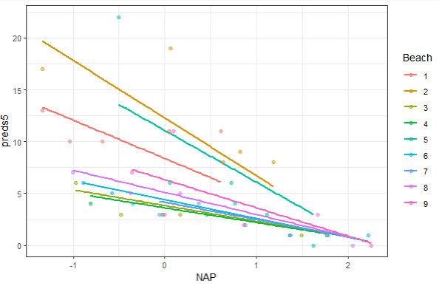
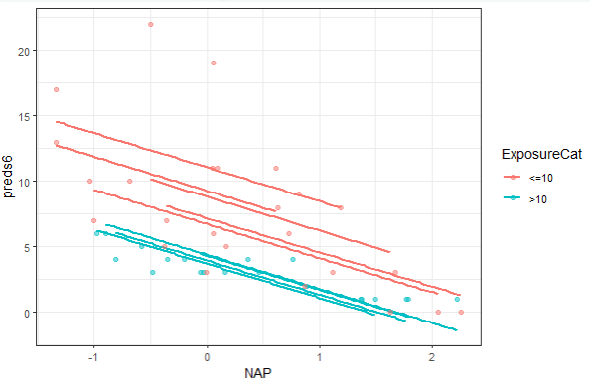
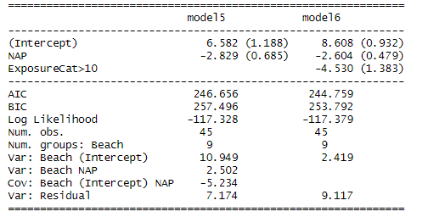
Model 5 vs. Model 6
Model 5: Random intercepts, slopes, no Exposure
Model 6: Random intercepts, Exposure

Slide 17
Reminders
Main lesson is that how you “build” the models (e.g., forward vs. backward selection) can impact choice of “best” model
  Document process, try a few different models
Reminder how to read sequence of nested models
  Better: using random intercepts significantly improves; rather than model 2 is better than model 1 ☺
  Watch for questions like “can I drop exposure” when it occurs as both main effect and in an interaction

Slide 18
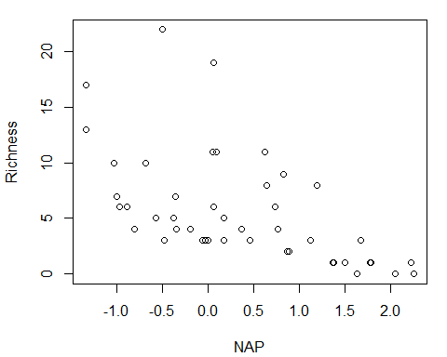
Beach data continued

Slide 19
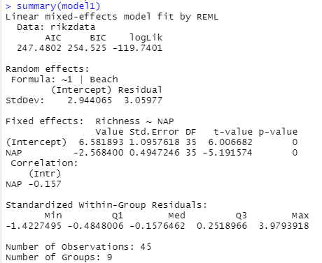
More beach time
nlme::lme(Richness ~ NAP,
random = ~ 1 | Beach, data = rikzdata)

Slide 20

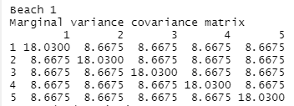
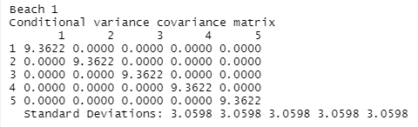


Variance-covariance matrix

Slide 21
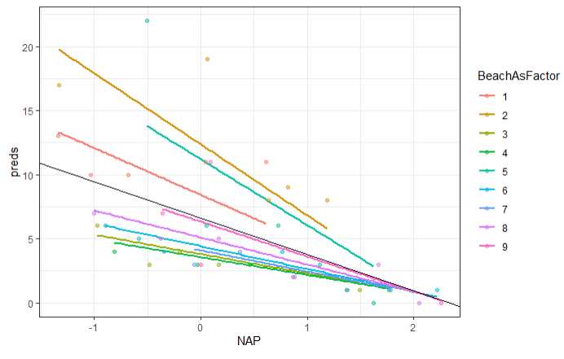

Model 2

Slide 22

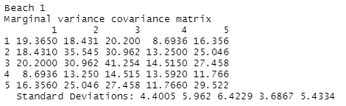
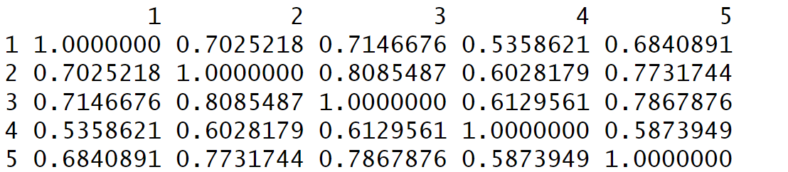
Variance-covariance with random slopes

Slide 23
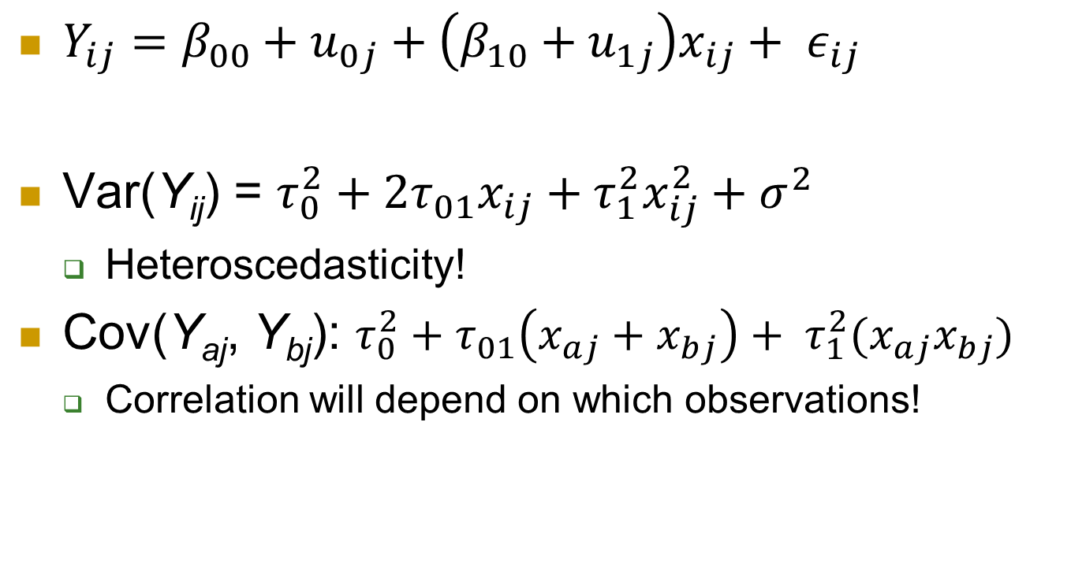
Implications of the random slopes …
$Y_{ij}=β_{00}+u_{0j}+\left(β_{10}+u_{1j}\right)x_{ij}+ ε_{ij}$
Var(Y­_{ij}) = $τ_{0}^{2}+2τ_{01}x_{ij}+τ_{1}^{2}x_{ij}^{2}+σ^{2}$
  Heteroscedasticity!
Cov(Y_{aj}, Y_{bj}): $τ_{0}^{2}+τ_{01}\left(x_{aj}+x_{bj}\right)+ τ_{1}^{2}(x_{aj}x_{bj})$
  Correlation will depend on which observations!

Slide 24
Keep in mind
Variance in intercepts, covariance changes with x
Doesn’t make sense to compute ICC (within school correlation) with random slopes
  Or just for x = 0
  Be clear which variance you are “explaining”

Slide 25
To Do
Start HW 6
Project
Computer problem 12
Quiz 12
Wednesday: Introduction to logistic regression
Monday: guest speaker

