Slide 1
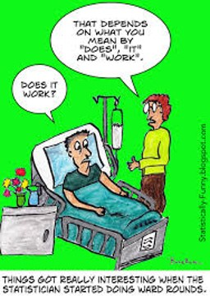
Stat 414 – Day 11
Interactions

Slide 2
Last Time – Adding Level 2 variable
Don’t really do anything different in R, but make sure data structured correctly
Compositive vs. Level equations
Level 2 variables in the Level 2 equation
Adding a Level 2 variable only explains variation at Level 2
Adding a Level 1 variable can decrease, not change, or increase (!) Level 2 variability

Slide 3
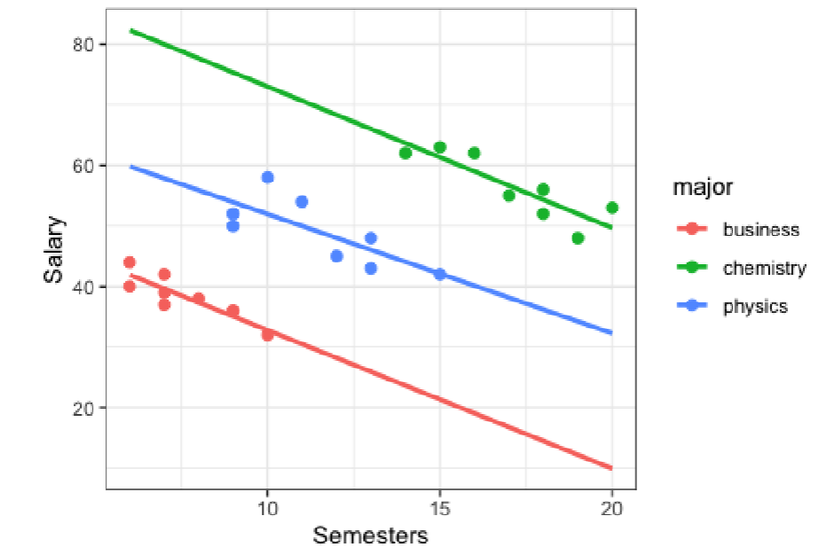

Why does adding a L1 variable increase L2 variability?
Chem – Bus
≈ $18k
Chem – Bus = 8.42 – (-9.46) = 17.88

Slide 4
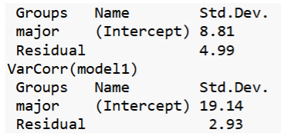
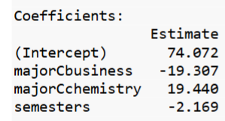
Why does adding a L1 variable increase L2 variability? cont
Chem – Bus
≈ $40k
Chem – Bus = 19.44 – (-19.31) = 38.75

Slide 5
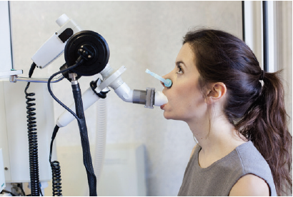
Example 1: FEV
Forced expiratory volume (FEV) is a measure of the strength of a person’s lungs
The max. vol. of air (in liters) a person can blow out in the first second.
Larger values indicate healthier lungs.
Researchers (1970s) were interested in the relationship between smoking status and FEV
Data were collected on 654 adolescent youth in the East Boston area during the middle to late 1970s

Slide 6
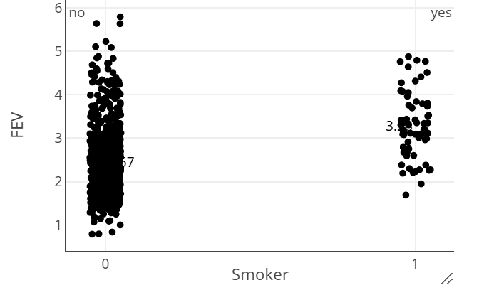

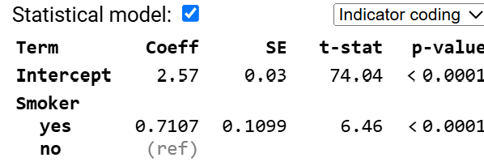
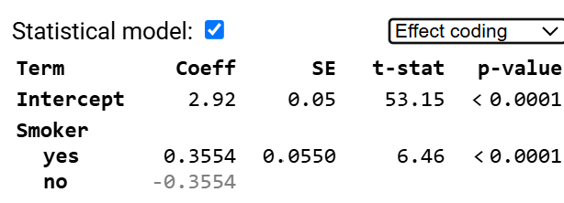
Smokers vs. Nonsmokers

Slide 7
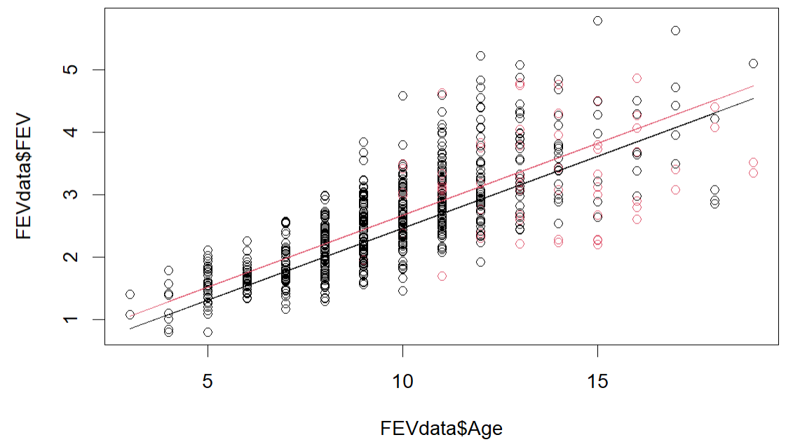
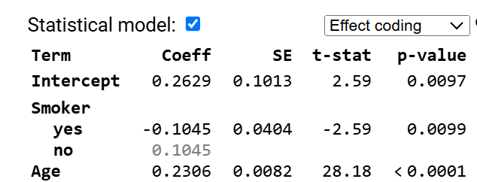
Model 2: Age + Smoker
The association between FEV and age changes when the smoker (yes/no) variable is added to the model.
Comparing people that differ in age but have the same smoking status.

Slide 8
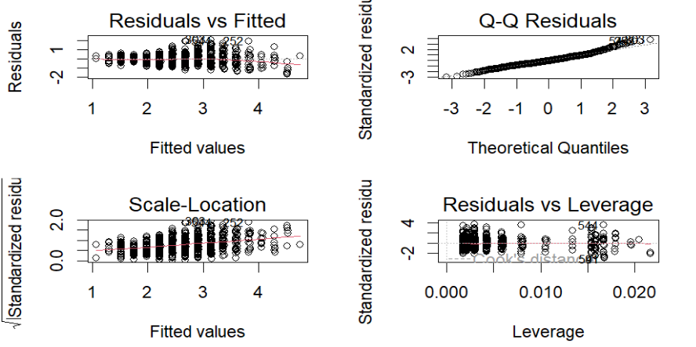
Model 2

Slide 9
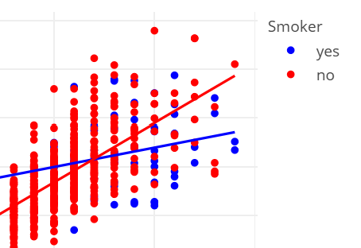
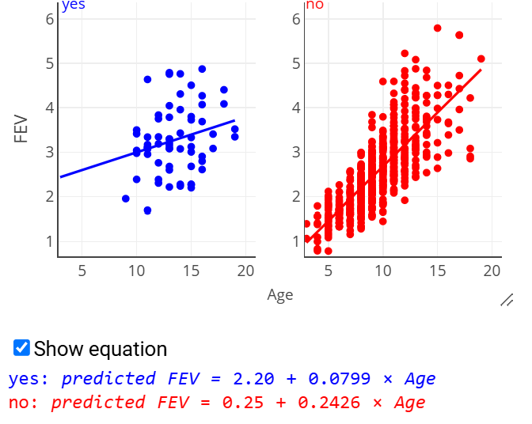
Slopes differ…
Smoking status and Age interact if
The association between FEV and Age differs between smokers and nonsmokers
The association between FEV and smoking status diffs at different ages
Difference in differences

Slide 10
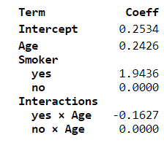
Adding interaction
Fitted model
Predicted FEV = .25 + .24 age + 1.94 Smoker - .143 Smoker*Age
Can we interpret the coefficient of age?
Can’t say there is “one effect” of age
Coefficient of age: .24 - .143 Smoker
.24 is the effect of age for nonsmokers

Slide 11
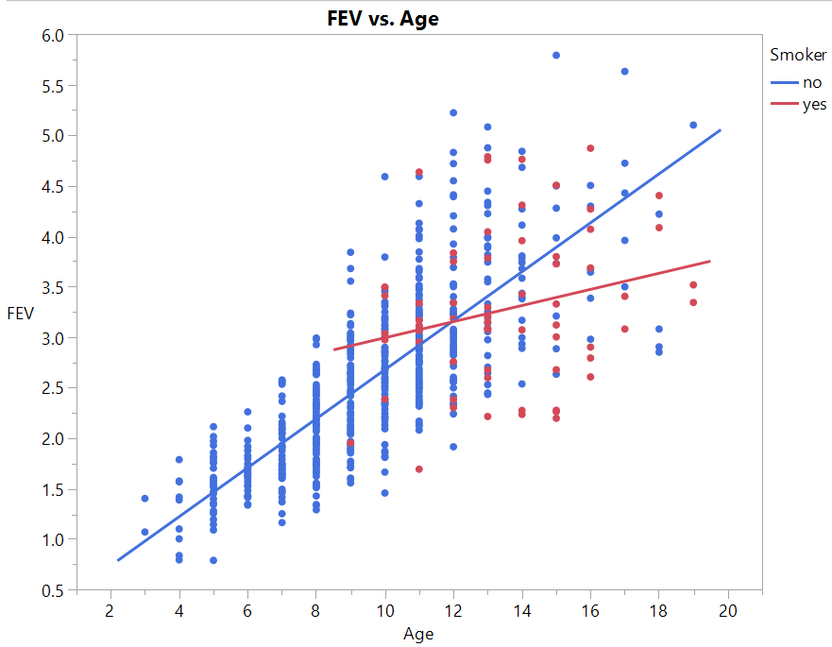
Interactions
Interactions = “effect modification”
The annual growth in FEV depends on smoker or non-smoker
The difference in FEVs between smokers and non smokers changes (increases) with age

Slide 12
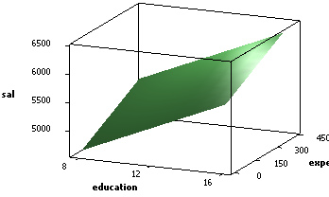
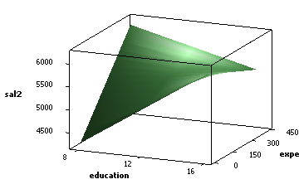
Interaction vs. Association
Saying two variables interact is NOT the same as saying they are associated or multicollinear!

Slide 13
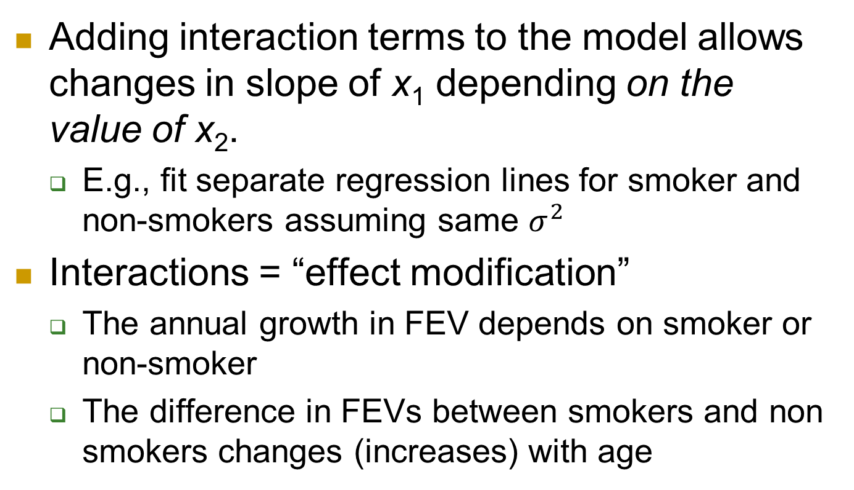
Interactions (summary)
Adding interaction terms to the model allows changes in slope of x₁ depending on the value of x₂.
E.g., fit separate regression lines for smoker and non-smokers assuming same $σ^{2}$
Interactions = “effect modification”
The annual growth in FEV depends on smoker or non-smoker
The difference in FEVs between smokers and non smokers changes (increases) with age

Slide 14
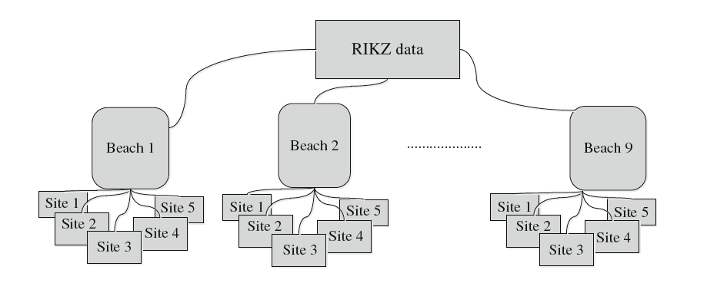
Example 2: RIKZ data
Species richness
NAP = height of sampling station relative to mean tidal level

Slide 15
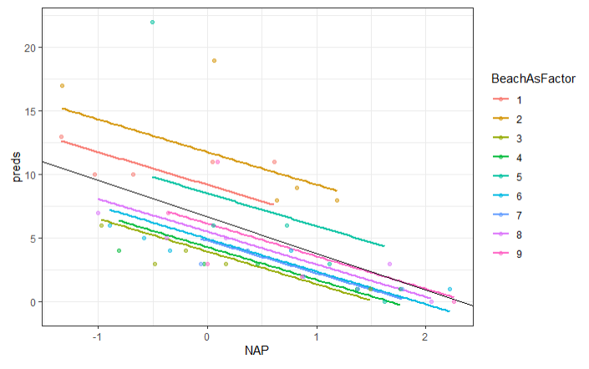
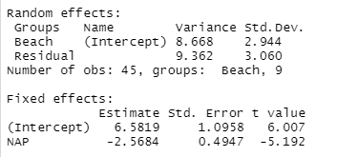

Random intercepts model
2.944: Beach to beach variation in intercepts (NAP = 0)
3.060: Within beach variation in Richness (after NAP)
6.58: Average richness when NAP = 0 (average beach)
-2.57: Increasing NAP predicts lower richness (a beach)
$${\hat{u}}_{1}$$

Slide 16
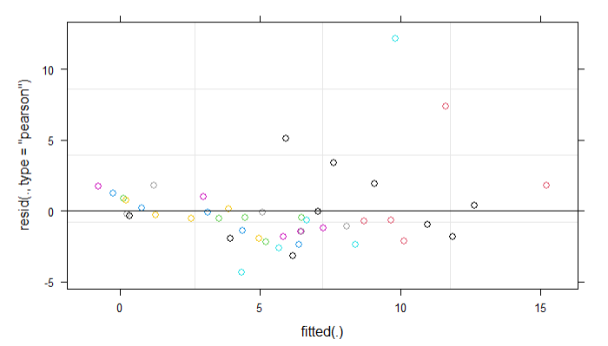
Random intercepts model residuals
What do the runs of negative and positive residuals tell us?

Slide 17
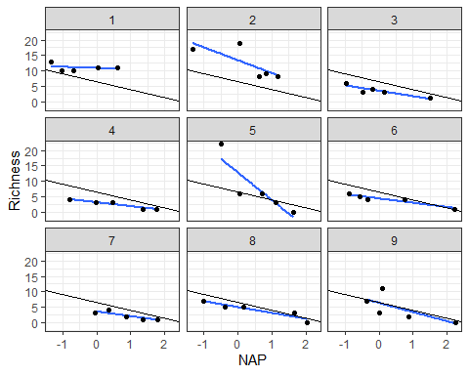
Compared to OLS line for each beach

Slide 18
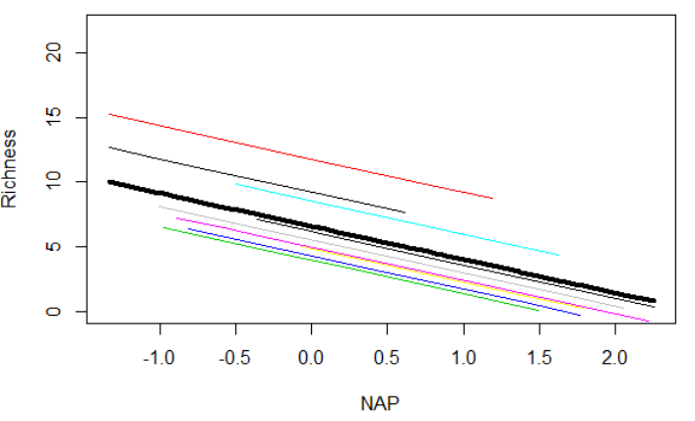
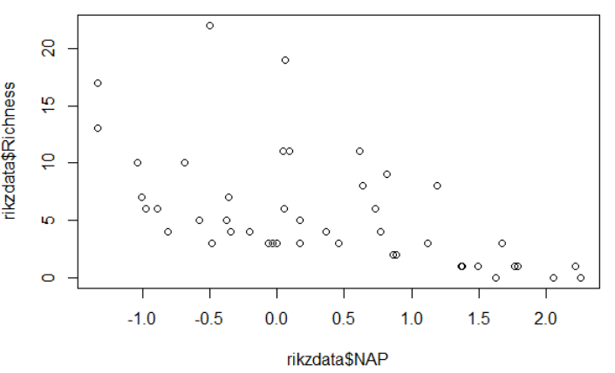
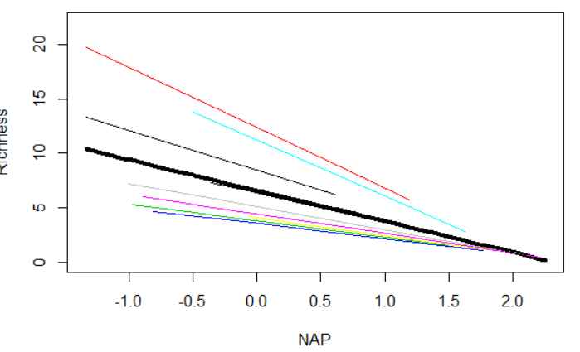
Random Slopes of level 1 variables
Saw an association between richness and NAP
To get good standard errors, we “adjusted” by beach
But maybe the slopes (association between NAP and Richness) varies by beach as well

Slide 19
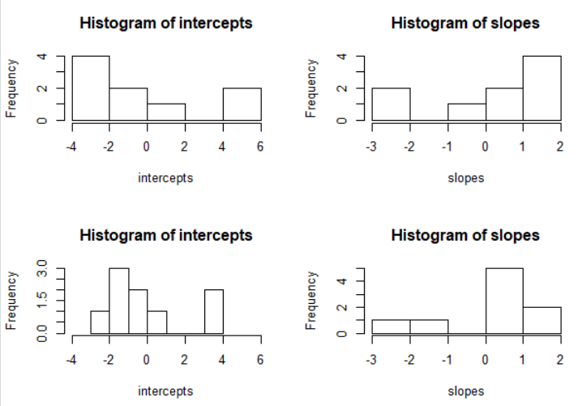
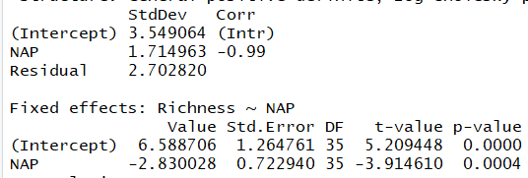

Random Slopes
Model: $Y_{ij}=β_{00}+u_{0j}+\left(β_{10}+u_{1j}\right)x_{ij}+ ε_{ij}$

Slide 20
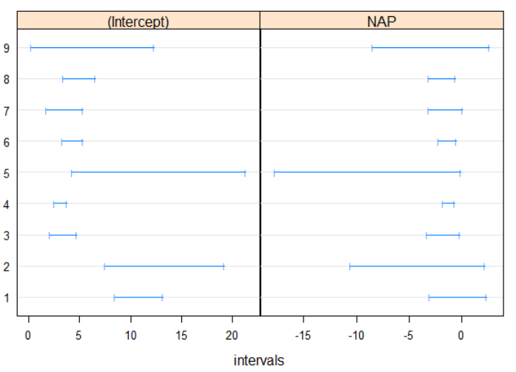

Random Slopes cont
Model: $Y_{ij}=β_{00}+u_{0j}+\left(β_{10}+u_{1j}\right)x_{ij}+ ε_{ij}$
Two new parameters: $τ_{1}^{2}$ and $τ_{01}$
${\hat{τ}}_{01}:−0.99$, beaches with larger intercepts tended to have small (more negative) slopes, larger “impact” of NAP on richness

Slide 21
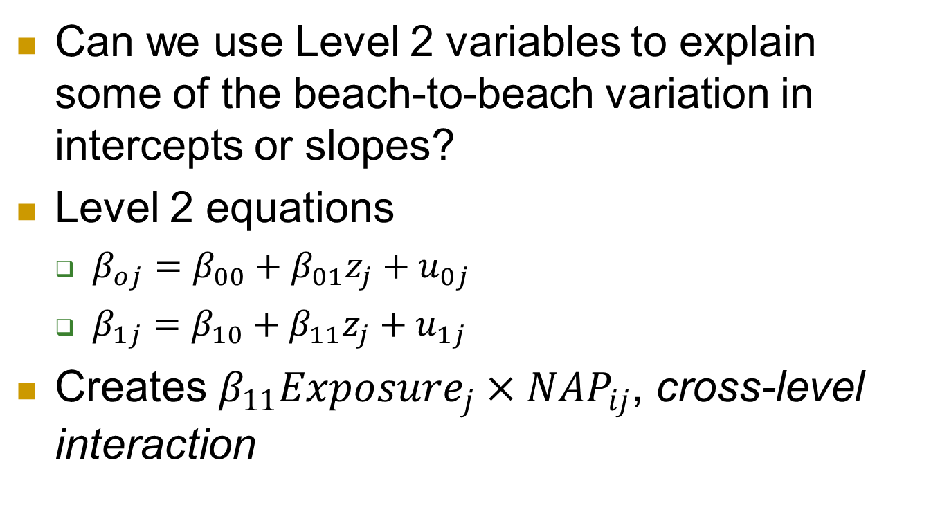
Exposure
Can we use Level 2 variables to explain some of the beach-to-beach variation in intercepts or slopes?
Level 2 equations
$β_{oj}=β_{00}+β_{01}z_{j}+u_{0j}$
$β_{1j}=β_{10}+β_{11}z_{j}+u_{1j}$
Creates $β_{11}Exposure_{j}×NAP_{ij}$, cross-level interaction

Slide 22

Adding a Level 2 variable
$y_{ij}=(β_{00}+u_{0j})+\left(β_{10}+u_{1j}\right)x_{ij}+β_{2}exposure_{j}+ ε_{ij}$

Slide 23
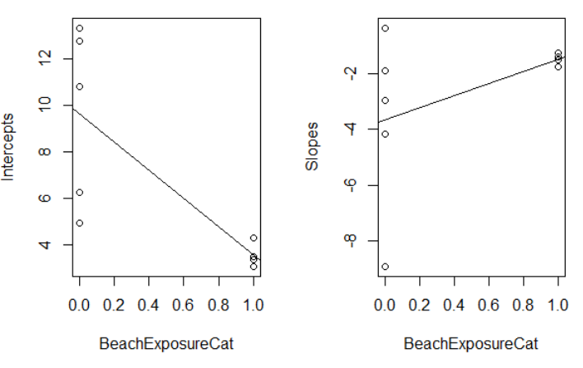
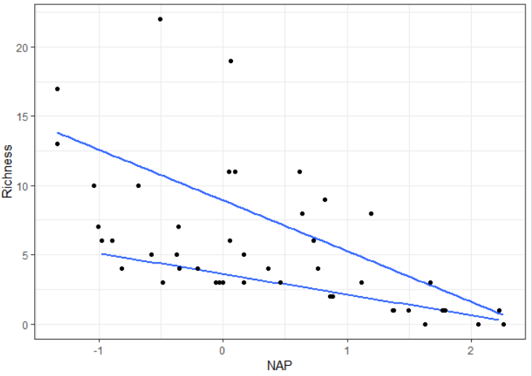
Exposure impacting intercept and slope
Beaches with more “exposure” tend to have smaller intercept and flatter slope with NAP

Slide 24
To Do
Computer problem 11 (Fri am)
Quiz 11 (Fri am)
Finish HW 5
Office hours this week
Email wed
Zoom thur

Slide 25
Exam
Mean 0.82
Median 0.825
Max 0.92
See Course Avg

