Slide 1
Stat 414 – Day 10
Adding Level 2 variables

Slide 2
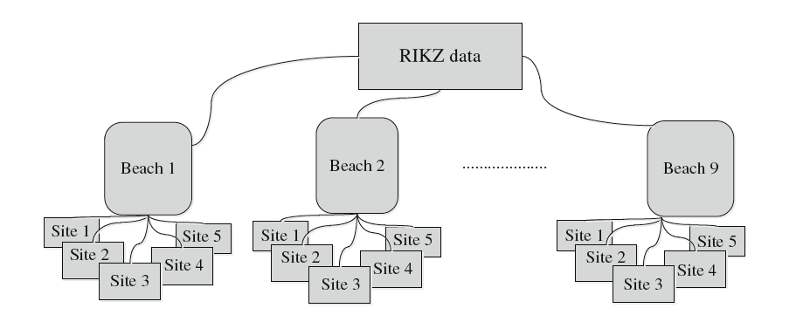
RIKZ data
Species richness

Slide 3
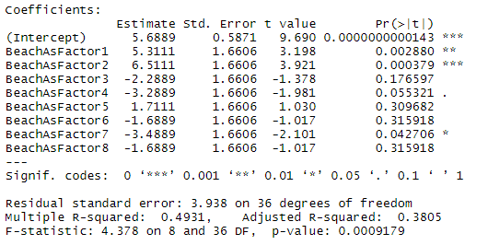
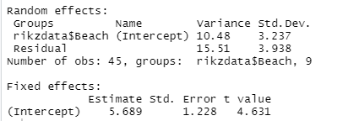

RIKZ data (adding Beach)
Beaches - Fixed
Beaches - Random

Slide 4
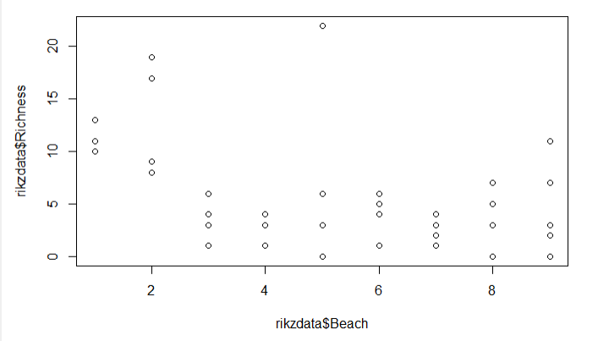

RIKZ data (random intercepts)
$y_{ij}=β_{0}+u_{j}+ ε_{ij}$

Slide 5
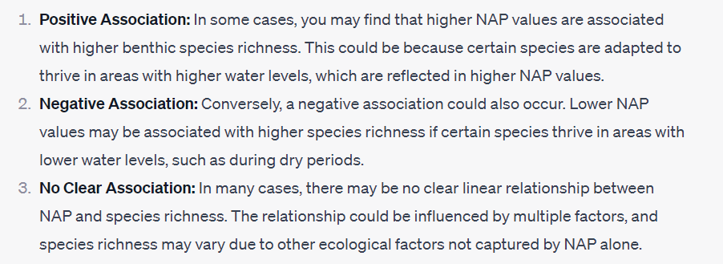
More background
A possible factor explaining species richness is Normal Amsterdam Peil (NAP), which measures the height of a site compared to average sea level, and represents a measure of food for birds, fish, and benthic species.

Slide 6
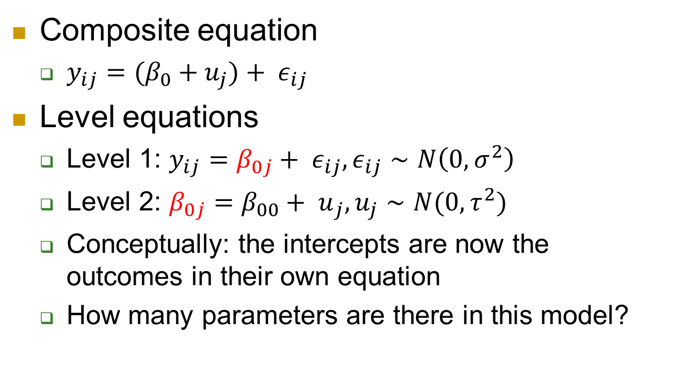
Level equations
Composite equation
$y_{ij}=(β_{0}+u_{j})+ ε_{ij}$
Level equations
Level 1: $y_{ij}=β_{0j}+ ε_{ij}, ε_{ij}∼N\left(0, σ^{2}\right)$
Level 2: $β_{0j}={β_{00}+ u}_{j}, u_{j}∼N(0, τ^{2})$
Conceptually: the intercepts are now the outcomes in their own equation
How many parameters are there in this model?

Slide 7
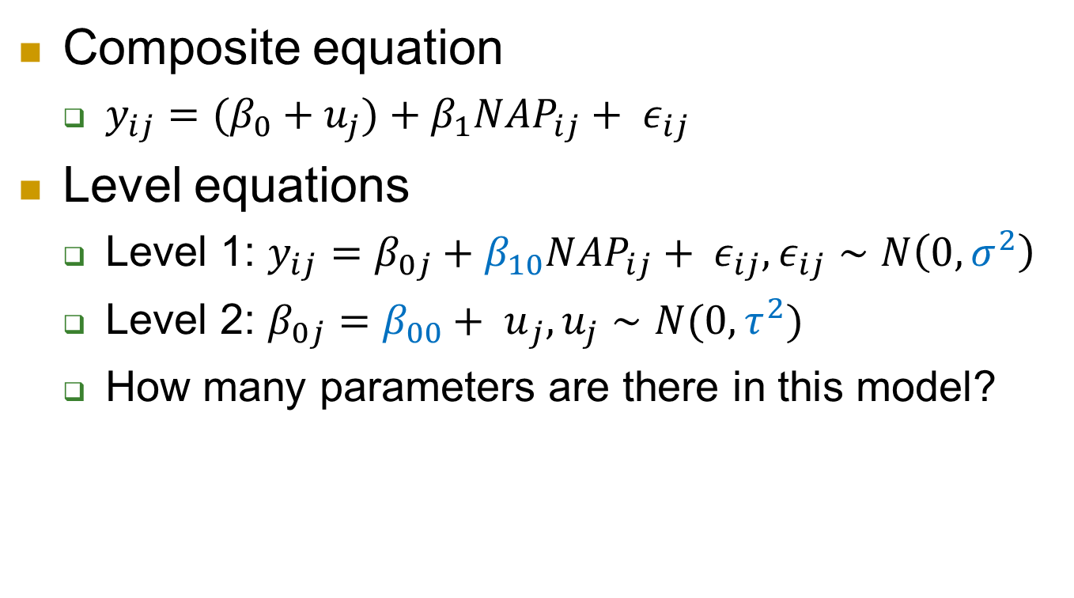
Adding a Level 1 variable
Composite equation
$y_{ij}=(β_{0}+u_{j})+β_{1}{NAP}_{ij}+ ε_{ij}$
Level equations
Level 1: $y_{ij}=β_{0j}+β_{10}{NAP}_{ij}+ ε_{ij}, ε_{ij}∼N\left(0, σ^{2}\right)$
Level 2: $β_{0j}={β_{00}+ u}_{j}, u_{j}∼N(0, τ^{2})$
How many parameters are there in this model?

Slide 8
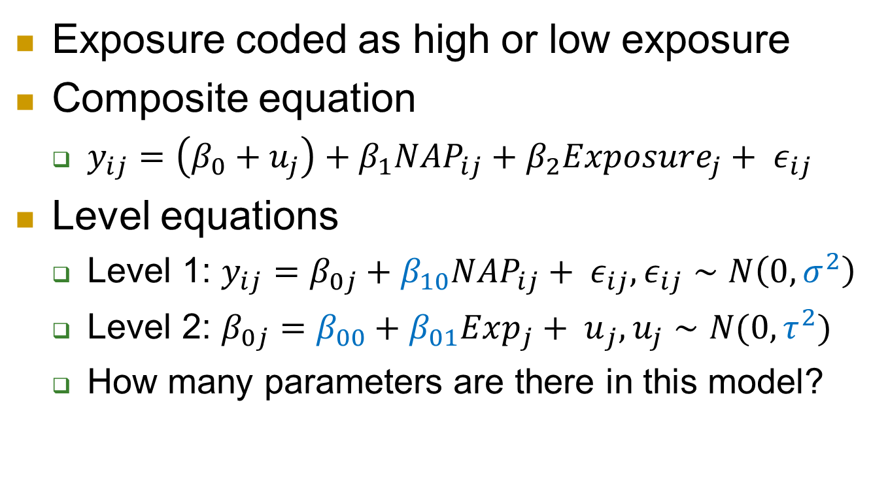
Adding a Level 2 variable
Exposure coded as high or low exposure
Composite equation
$y_{ij}=\left(β_{0}+u_{j}\right)+β_{1}{NAP}_{ij}+β_{2}Exposure_{j}+ ε_{ij}$
Level equations
Level 1: $y_{ij}=β_{0j}+β_{10}{NAP}_{ij}+ ε_{ij}, ε_{ij}∼N\left(0, σ^{2}\right)$
Level 2: $β_{0j}={β_{00}+β_{01}Exp_{j}+ u}_{j}, u_{j}∼N(0, τ^{2})$
How many parameters are there in this model?

Slide 9
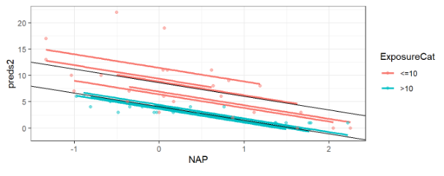
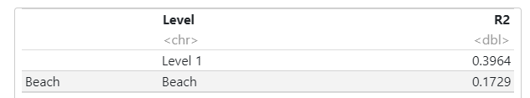
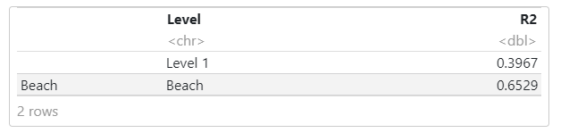
Adding Exposure
Beaches with low exposure tend to (on average) have higher richness than high exposure.
Adding NAP
Adding Exposure

Slide 10


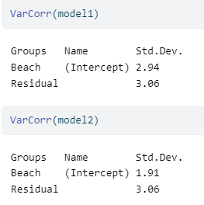
Variance components
Null model
Model 1: adding NAP
Model 2: adding Exp

Slide 11
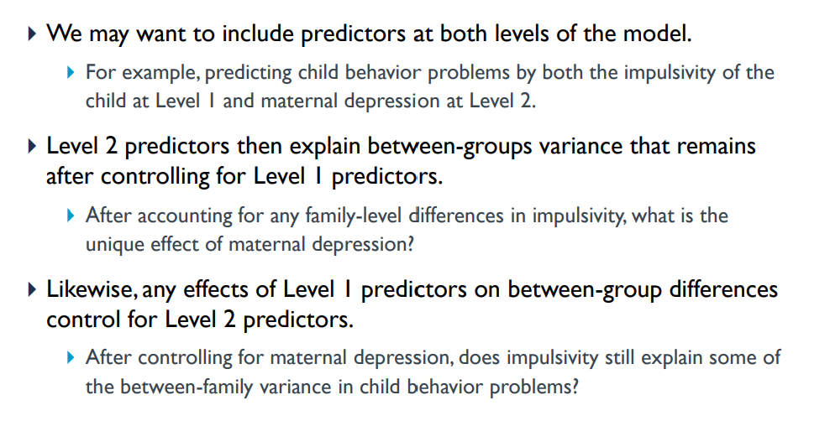
Example
Notes:
https://centerstat.org/wp-content/uploads/2021/08/MLM-Chapter-2-Notes-2021.pdf

Slide 12
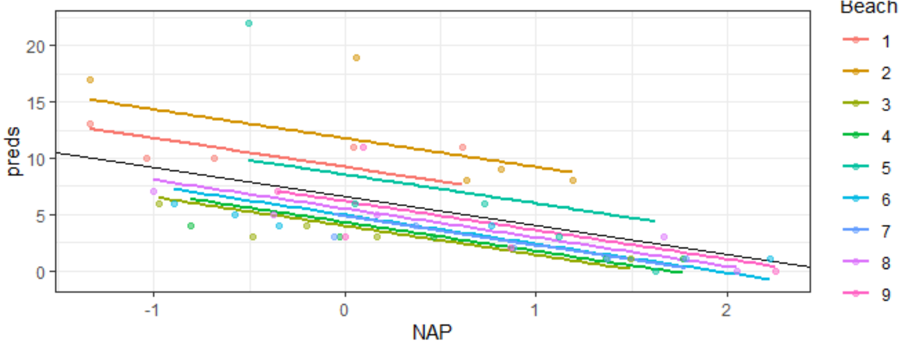
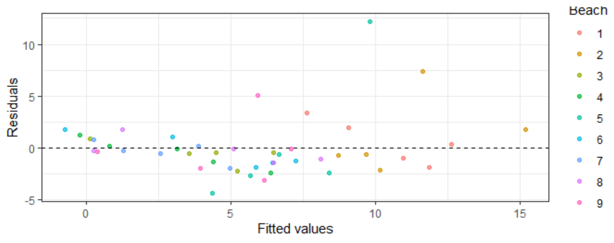
Random intercepts model
What do the runs of negative and positive residuals tell us?

Slide 13





Example 2: Contextual variables
$x_{ij}$ or $x_{1ij}$
Netherlands study
Composite:
$$langpost_{ij}=β_{00}+β_{1}IQ_{ij}+β_{2}{\overline{IQ}}_{j}+u_{j}+ε_{ij}$$
$$z_{j}$$
$$u_{0j}$$
$$β_{01}$$

Slide 14
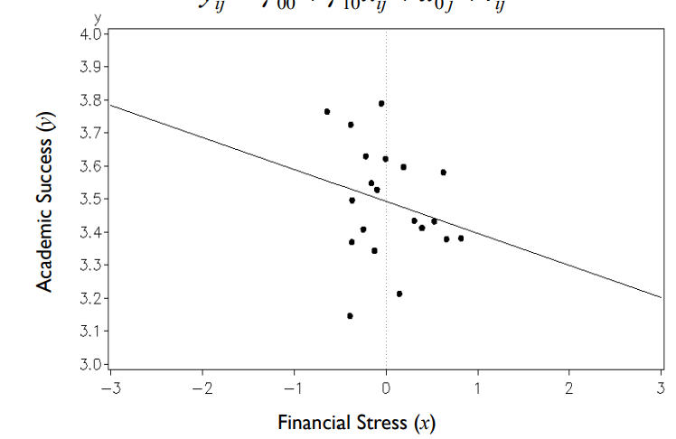
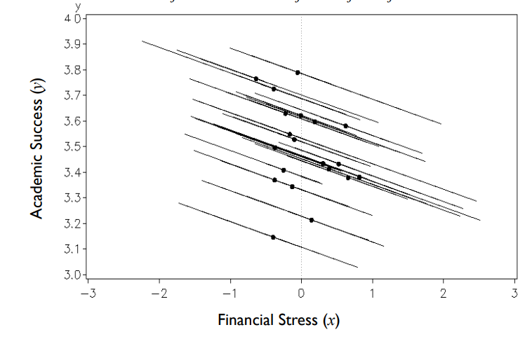
Within vs. Between

Slide 15
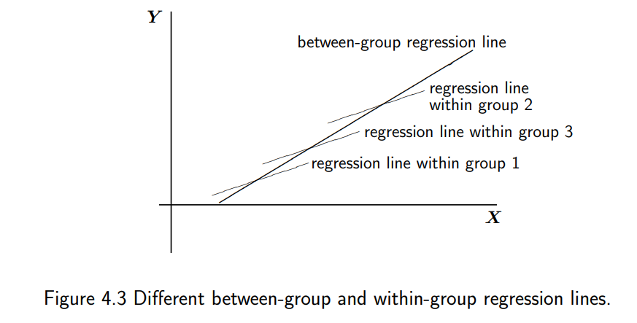

If only use IQ in the model
$${\hat{β}}_{1}$$

Slide 16


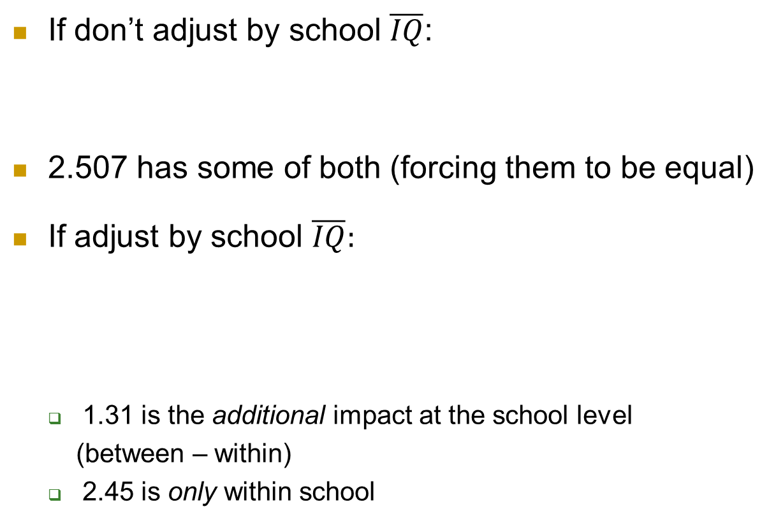
Using the group mean variable
If don’t adjust by school $\overline{IQ}$:
2.507 has some of both (forcing them to be equal)
If adjust by school $\overline{IQ}:$
1.31 is the additional impact at the school level
(between – within)
2.45 is only within school

Slide 17



Including $\overline{IQ}$in the model
Coefficient of IQ represents the difference, the additional effect at the school level
$$β_{2}$$
$$β_{1}$$

Slide 18

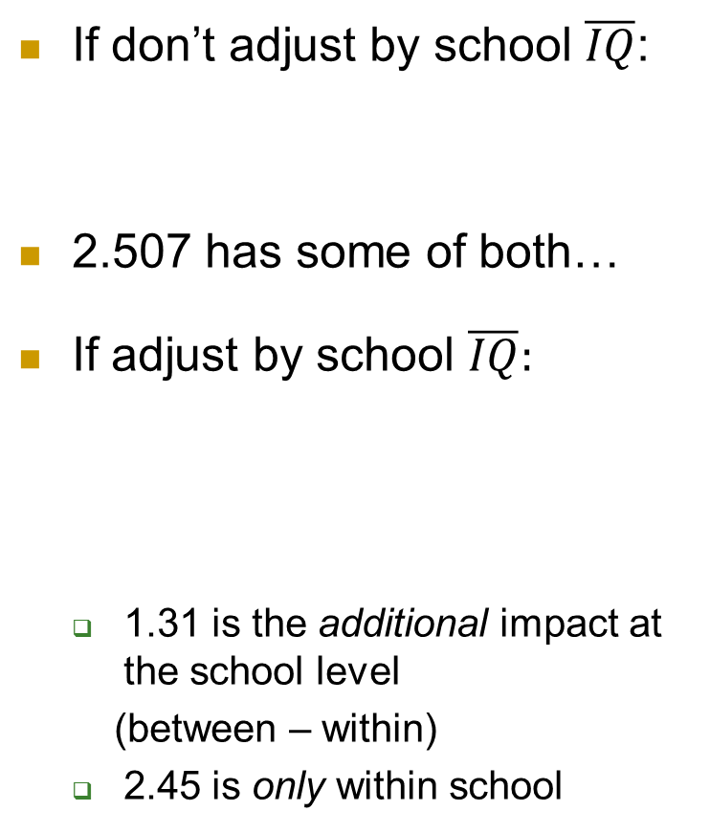
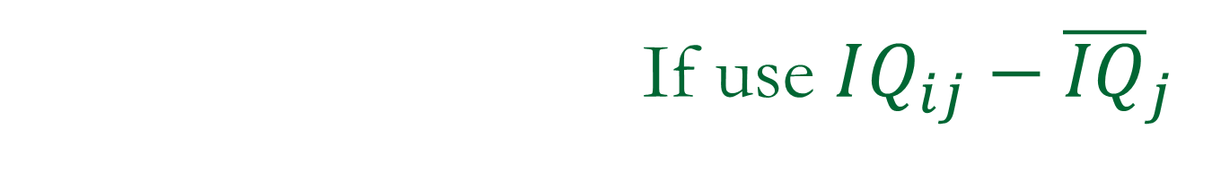
If use $IQ_{ij}−{\overline{IQ}}_{j}$
If don’t adjust by school $\overline{IQ}$:
2.507 has some of both…
If adjust by school $\overline{IQ}:$
1.31 is the additional impact at the school level
(between – within)
2.45 is only within school
3.766 is the impact at the school level (between group) = 2.45 + 1.31
devIQ can only explain variation at Level 1

Slide 19

Using the deviation variable
$$β_{2}$$
$$β_{1}$$

Slide 20
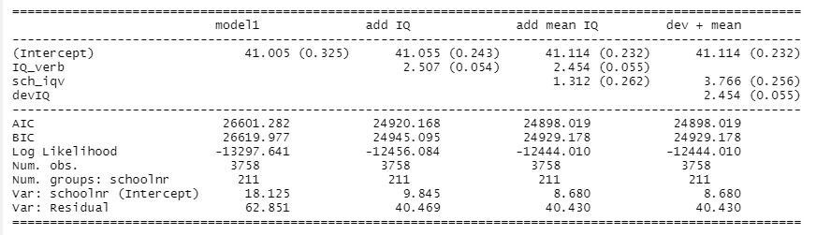
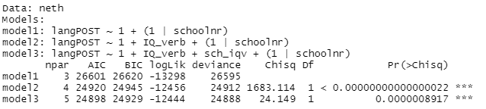
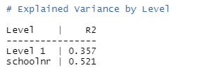
Adding school mean IQ
LRT: -2(-12456.084 - -12444.01) = 24.15

Slide 21
p. 56
Response: how much pocket money children receive
Predictors: age of child, average age of child
“Within”: effect of age differences within a family
“Between-group”: effect of average age on average pocket money

Slide 22
Bottom Line
Level 1 variables can explain variation at both Level 1 and Level 2
If the Level 1 variable varies across the Level 2 units
If “work against each other,” adding a level 2 variable can increase Level 2 variability
Deviation-type variables can only explain Level 1 variability
Level 2 variables can only explain variation at Level 2

Slide 23
To Do
Computer problem 10
(Then) Quiz 10
Start HW 5 (due Monday)
Submit part 2 of project
Next up: interactions!
Office hours this week:
Tuesday 9-10, 1-2 (normal)
Wednesday (email)
Thursday 12-1 zoom

