Slide 1
Stat 414 – Day 9
Random intercept models, diagnostics (Ch. 10)
Midterm review

Slide 2
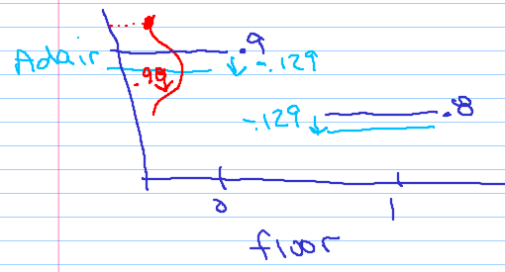
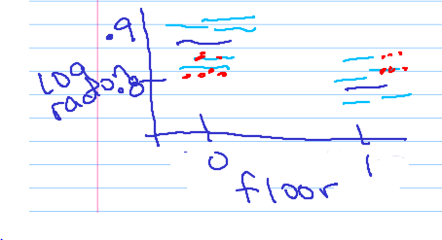
Announcements
Computer Problems 1 returned
  Check out grading notes/solutions on assignment pages
HW 4 solutions posted

Slide 3
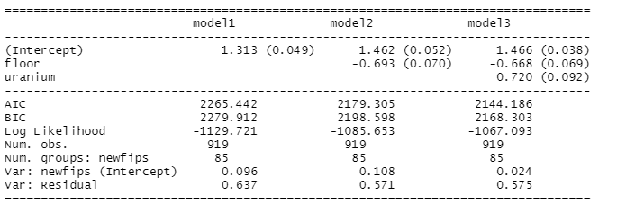
Adding Level 1 and Level 2 variables
texreg::screenreg
What is the variability?
Model2: variance components now “residual”

Slide 4
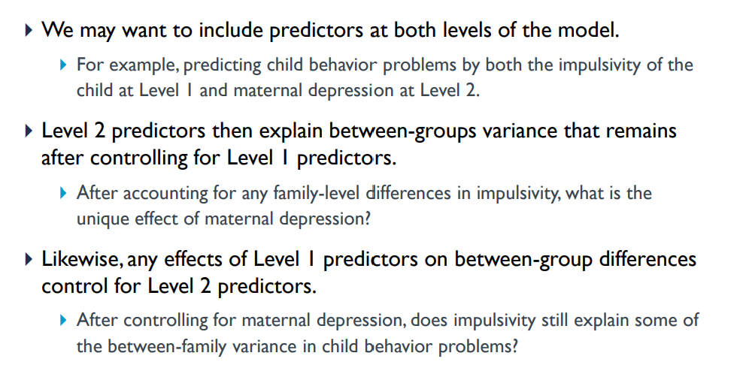
Example
Notes:
https://centerstat.org/wp-content/uploads/2021/08/MLM-Chapter-2-Notes-2021.pdf

Slide 5
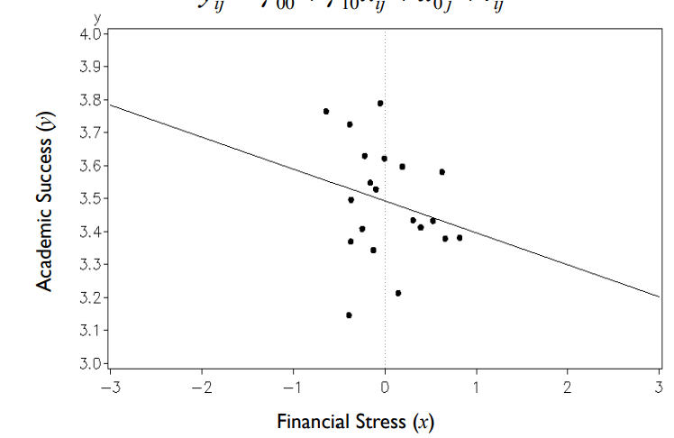
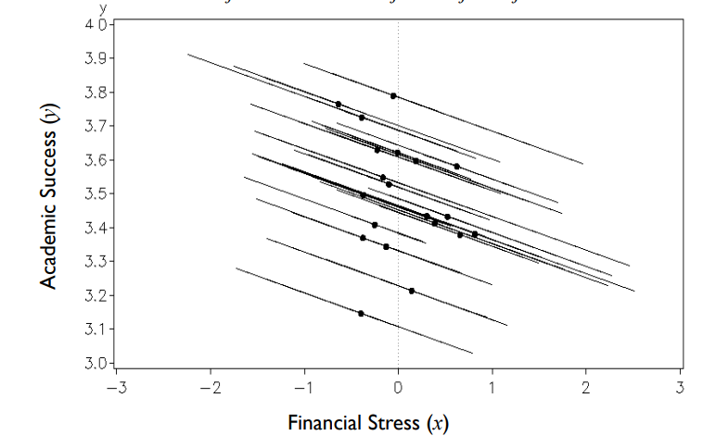
Within vs. Between

Slide 6





Contextual variables
$x_{ij}$ or $x_{1ij}$
Netherlands study
Composite:
$$langpost_{ij}=β_{00}+β_{1}IQ_{ij}+β_{2}{\overline{IQ}}_{j}+u_{j}+ε_{ij}$$
$$z_{j}$$
$$u_{0j}$$
$$β_{01}$$

Slide 7
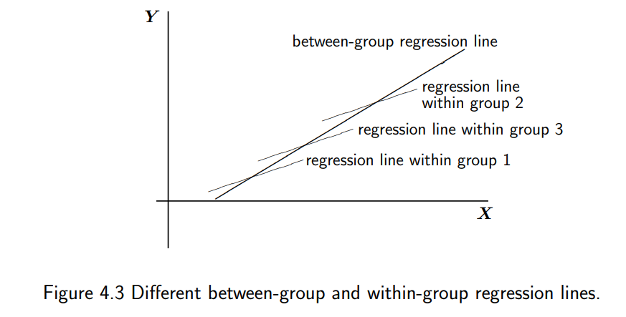

If only use IQ in the model
$${\hat{β}}_{1}$$

Slide 8


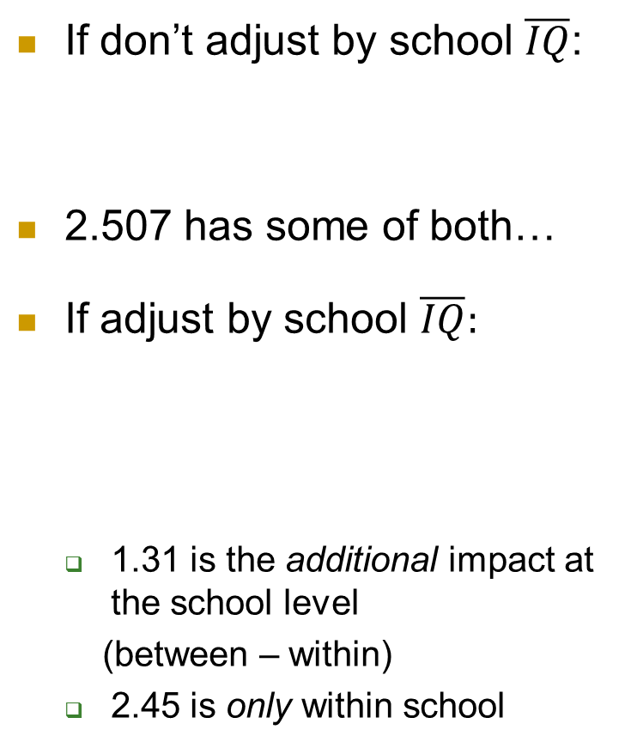
Using the group mean variable
If don’t adjust by school $\overline{IQ}$:
2.507 has some of both…
If adjust by school $\overline{IQ}:$
  1.31 is the additional impact at the school level
  (between – within)
  2.45 is only within school

Slide 9



Including $\overline{IQ}$in the model
Coefficient of IQ represents the difference, the additional effect at the school level
$$β_{2}$$
$$β_{1}$$

Slide 10


If use $IQ_{ij}−{\overline{IQ}}_{j}$
1.31 is the additional impact at the school level
(between – within)
2.45 is only within
2.507 has some of both…
3.766 is the impact at the school level (between group)
devIQ can only explain variation at Level 1

Slide 11

Using the deviation variable
$$β_{2}$$
$$β_{1}$$

Slide 12
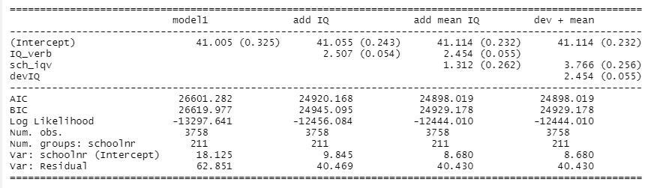
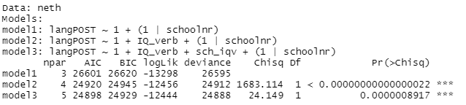
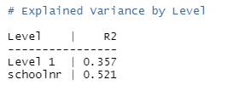
Adding school mean IQ
LRT: -2(-12456.084 - -12444.01) = 24.15

Slide 13
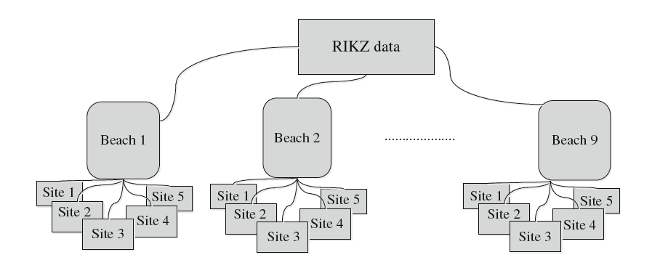
RIKZ data
Species richness
NAP = height of sampling station relative to mean tidal level

Slide 14
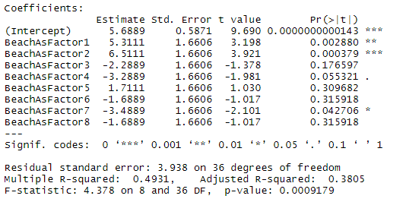
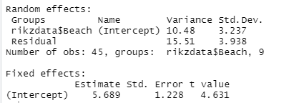

RIKZ data
Beaches - Fixed
Beaches - Random

Slide 15
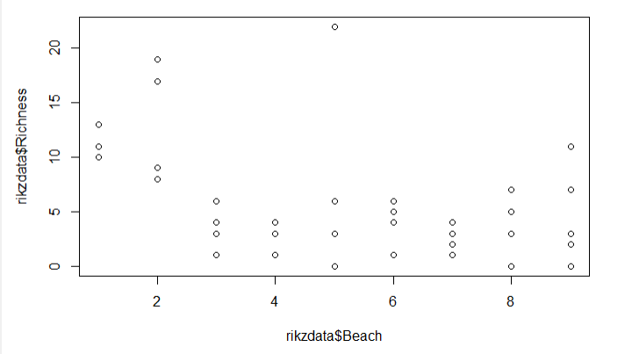
RIKZ data

Slide 16
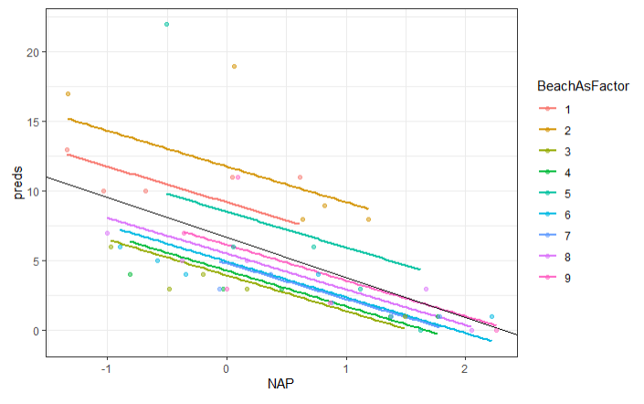
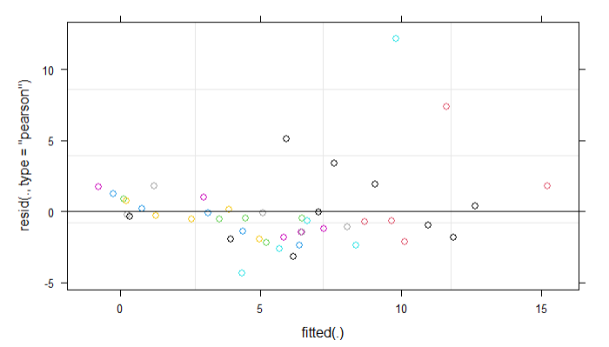
Random intercepts model
What do the runs of negative and positive residuals tell us?

Slide 17
Review
Will add more on the review handout re computer problems, quizzes
Will add review solutions
Will respond to questions on Exam 1 Discussion Board
  Also see “example questions”
Tues office hours (9-10, 2:30-3), want later as well? Tonight?

Slide 18
Exam
60 min written
  Spend 2 minutes on 2 pt problem, 5 min on 5 pt problem
  Short answer questions, with multiple parts to same context (like HW), a couple multiple choice?
  Bring calculator, one page of notes (2-sided, 8.5x11)
15 min computer
  Open notes
  Run a model, Query the model

Slide 19
Advice
What do the equations mean?
What do the numbers mean?
  In layman’s terms
  In context
Explain any assumptions you are making (e.g., one-sided vs. two-sided alternative)
Focus on big ideas, guiding principles

Slide 20
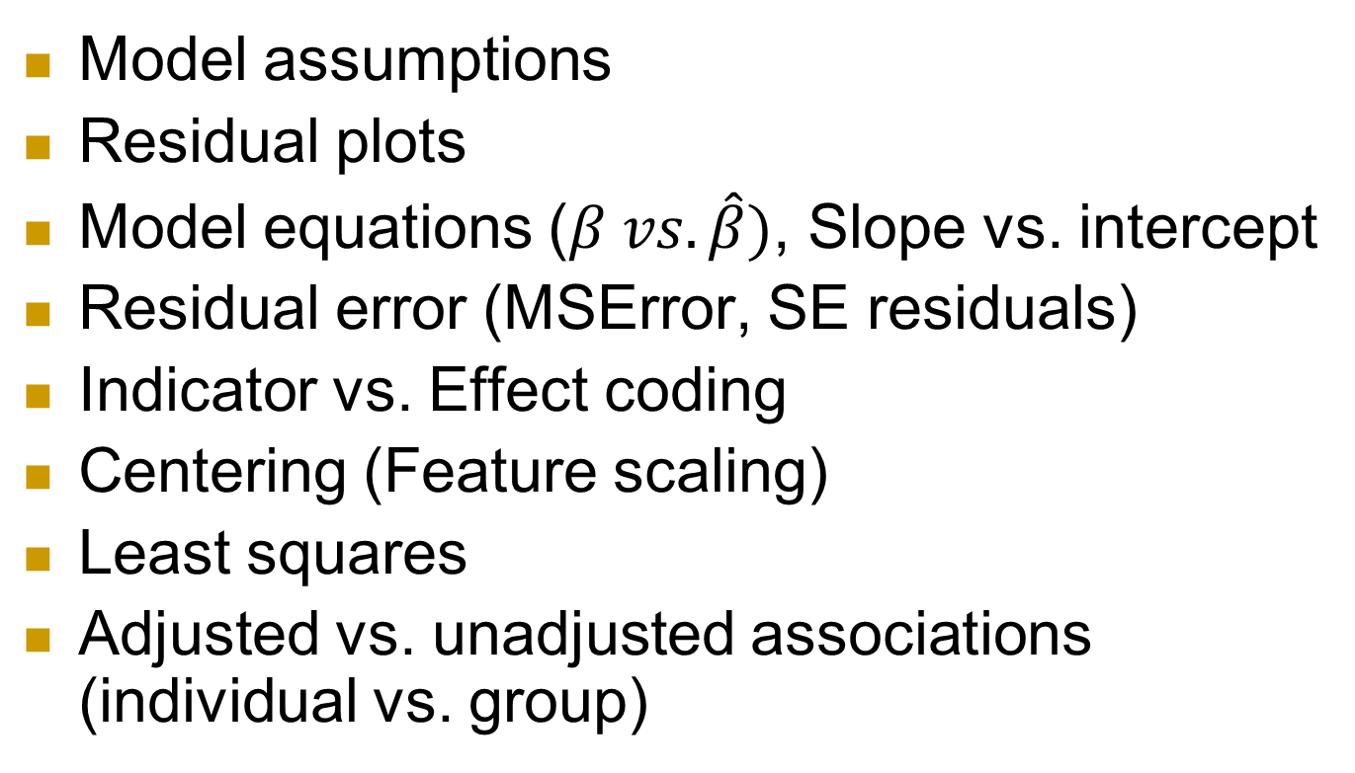
Components of regression models
Model assumptions
Residual plots
Model equations ($β vs. \hat{β})$, Slope vs. intercept
Residual error (MSError, SE residuals)
Indicator vs. Effect coding
Centering (Feature scaling)
Least squares
Adjusted vs. unadjusted associations (individual vs. group)

Slide 21
Model assumptions
Linearity (form)
Independence
Normal errors
Equal variance in the errors (right structure)

Slide 22
Independence
Not: Repeat observations on sample individual
Not: Observations nested with groups that are more similar to each other than to observations in other groups
  e.g., nurses in a hospital
Notes:
Repeated measures anova now considered an outdated technique

Slide 23

Multilevel models
Treating a “grouping variable” as having random effects ⇒ Level 2 units
  Shrinkage, Focus on Level 2 variance components, Generalize to population
  Null model = random intercepts (and nothing else)
Level 1 variables
  Explain Level 1 (and maybe Level 2) variability
Level 2 variables
  Explain Level 2 variability
  Including “constructed variables” (e.g., group mean)
    aka Contextual variables, Within vs. Between effects
Model diagnostics
  Types of residuals, Types of influence

Slide 24
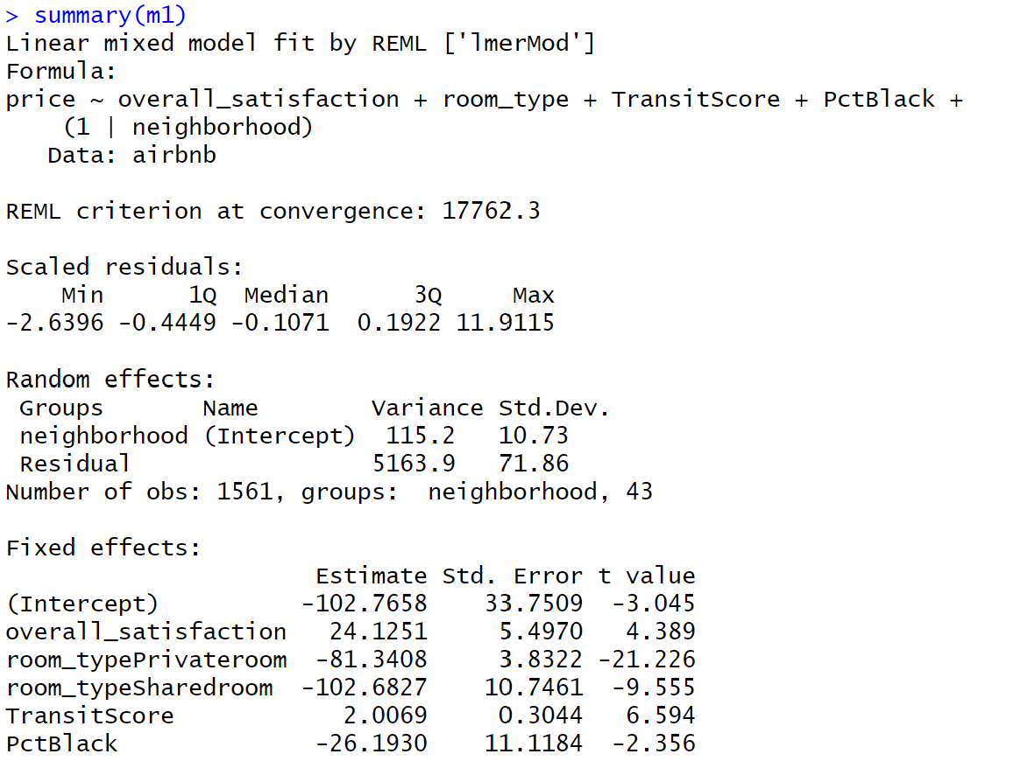
Interpretations

