Slide 1
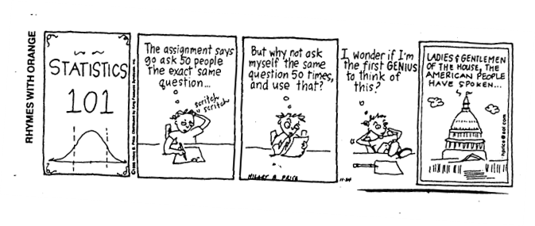
Stat 414 – Day 5
Adjusted associations…
Correlated observations…

Slide 2
Data collection!

Slide 3
Last Time - Heterogeneity
… of the responses at each x
Of market share values with a discount and without a discount
Normality of market share values with a discount and without a discount
Linearity of mean market share with a discount and without

Slide 4
Last Time - Heterogeneity
Impacts the estimates of the standard errors of the coefficients.
Could just adjust these (HC standard errors)
In our view, heterogeneity is interesting ecological information that you should not throw away, just because it is statistically inconvenient. With a ‘little’ bit of extra mathematical effort, heterogeneity can be incorporated into the models and can provide extra biological information.” (Zuur et al.)

Slide 5
Last Time – Categorical predictors
If have k categories
Add k -1 “dummy variables” (terms) to the model
Effect coding vs. Indicator coding
Testing significance of the variable

Slide 6
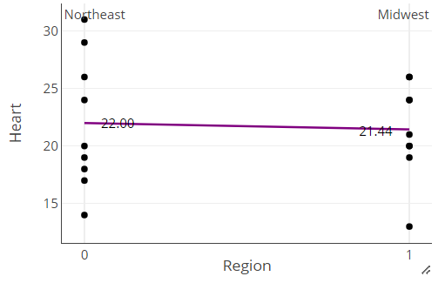
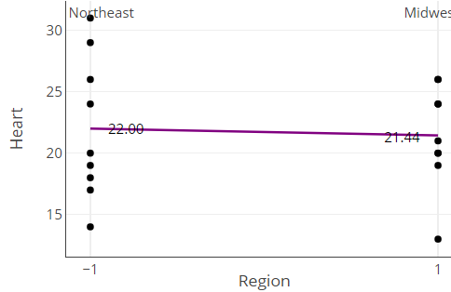
Coding Categorical Variables
Indicator coding
Effect coding
Reference group
A one-unit change in region…
Overall mean + effects…
+0.28
21.44-22.00 = -0.56
-0.28

Slide 7
Some cool facts
$R^{2}=corr\left(y, \hat{y}\right)=1−\frac{SSError}{SSTotal}$
$R_{adj}^{2}=1 −\frac{MSError}{MSTotal}$

Slide 8
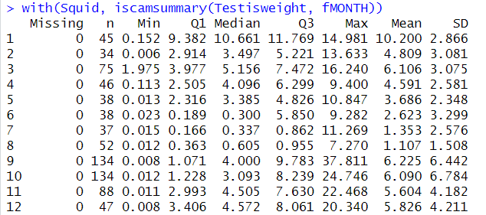
HW 2
Raw data vs. Model estimates

Slide 9
What does it mean to say “adjusting for other variables”?

Slide 10
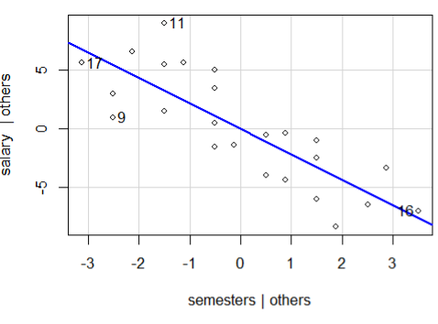
R
car::avPlots(model)
Residuals from regressing salary on all variables but semester vs. residuals from regressing semesters on all other variables
Can the information in semesters not explained by major help explain the information in salary not explained by major?

Slide 11
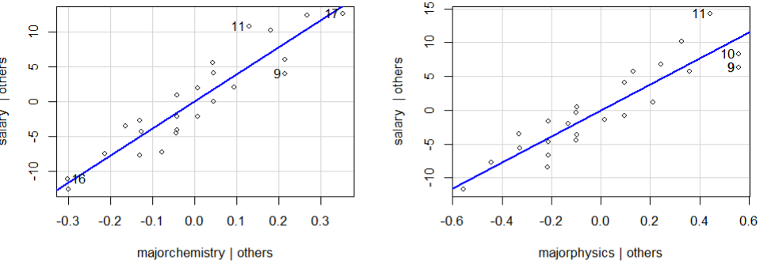
R
car::avPlots(model)

Slide 12
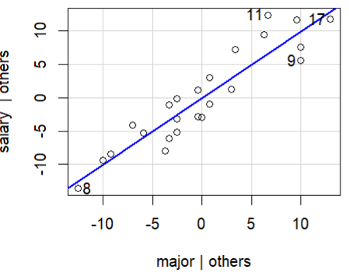
R/JMP
car::leverage(model)
Residuals from regressing salary on all variables but semester vs. fitted values from regressing semesters on all residuals of dummy variables on semesters
Look for
Strong linear association
Outliers/Influential observations

Slide 13
Key Idea
The “within group” association may be very different compared to the “between group” association

Slide 14
Intraclass Correlation Coefficient
Between group (subject) var / Total var
E(MSGroups) = $kσ_{g}^{2}+ σ_{ε}^{2}$
E(MSError) = $σ_{ε}^{2}$
So…
MSGroups – MSError ≈ $kσ_{s}^{2}$
Total = (MSG – MSE)/k + MSE
ICC = (MSG-MSE)/k / (MSG – MSE)/k + MSE
= (MSG-MSE)/(MSG+(k-1)MSE)

Slide 15
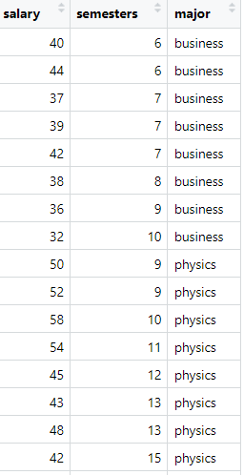
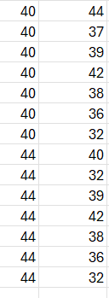
“Pairwise ICC”
r = .670
How correlated are pairs of observations within each major…

Slide 16
ICC
Represents degree of common environments (individuals) that observations share
Proportion of total variance attributed to correlated unit (individual, cluster, etc.)
Degree of homogeneity among observations from the same individual (or cluster)
Anticipated correlation between two observations that are randomly chosen from the same unit (individual, cluster, etc.)

Slide 17
R
install.packages("ICC")
install.packages("multilevel")

Slide 18
To Do
Quiz 5 (Wed 7am)
Computer problem 5 (Wed 7am)
Review HW 2 solutions
HW 3
Project proposals…

