Slide 1
Stat 414 - Day 6
Partial F tests

Slide 2
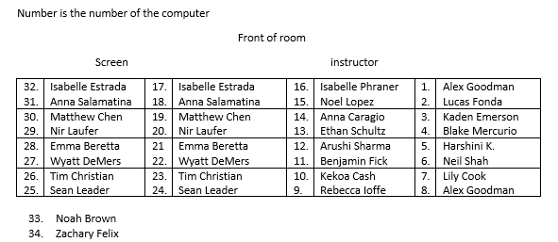
New seats today

Slide 3
Last time
Scatterplot matrix (direction, form, strength)
Associations among pairs of predictors
VIF relates to the linear dependence of one predictor from the others
Feature scaling
Centering
Standardizing
Min-Max

Slide 4
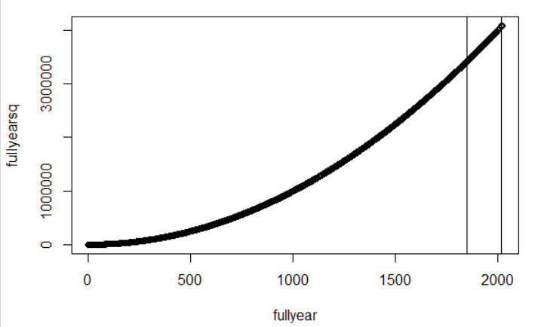
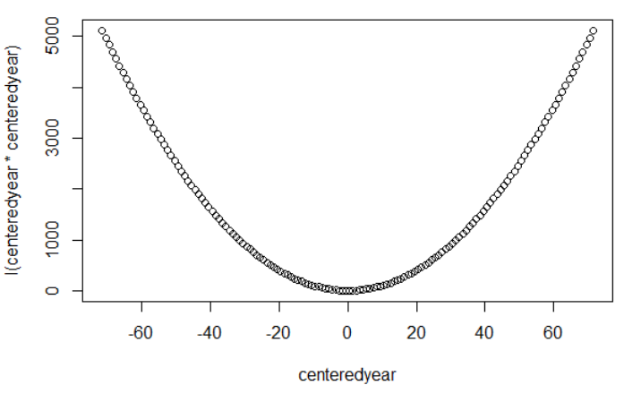
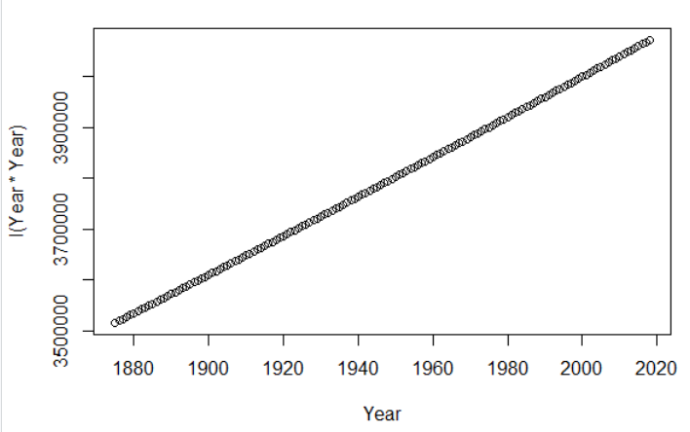
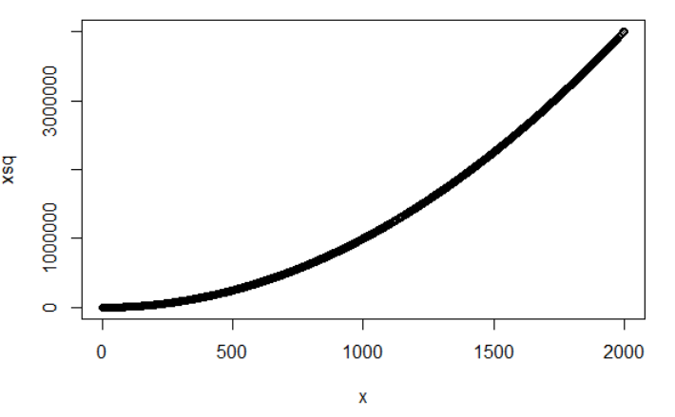
Centering
With both quadratics (x*x), centering the variables first can reduce multicollinearity between the variables
Can also help with numerical stability
Also helps with interpretation of intercept
Year – mean(Year)
Notes:
Never a bad idea

Slide 5
Pace of Life
Four factors
“To compensate for these distortions we combined the scores from the four sets of measurements, creating an overall index of the pace of life in each city. First we normalized the scores, so that they all extended over the same range (an operation that has the effect of assigning equal weight to all four factors); then we added the normalized values.”

Slide 6
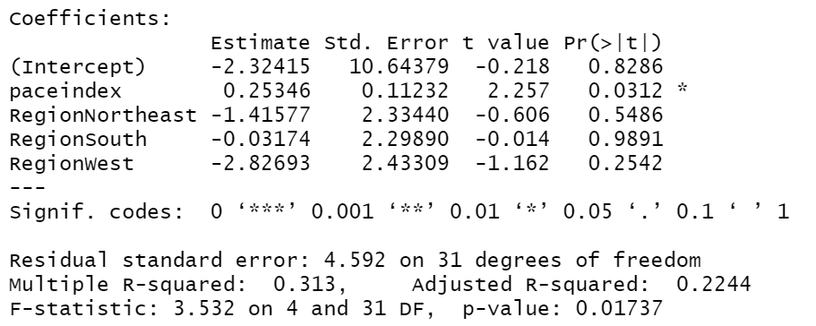
Output (Model 3)
Overall F-test
H₀: $β_{pi}=β_{NE}=β_{S}=β_{W}=0$

Slide 7
Partial F-test
SSError from “reduced” model: 701.21
SSError from “full” model: 653.73
Difference in model df: 3 (adding region)
F = (47.48/3)/(21.088) = 0.7505
Alternative: (.313 - .2632)/3 / (1-.313)/31
Df = 3, 31
H₀: $β_{NE}=β_{S}=β_{W}=0$
Applying Ho to model 3 gives us model 1

Slide 8
Pace Index after adjusting for region
Adding paceindex on top of region/after adjusting for region
t-statistic = 2.257 (df = 31)
F = (761.11-653.73)/1 / 21.088 = 5.09 (df = 1, 31)
anova(model2, model3)
Anova(model3, type = 2)
Type 1 anova with paceindex added last

Slide 9
To Do
Quiz 6
Cont HW 2
Can start later problems based on lots of details in HW assignment…

