Slide 1
Stat 414 - Day 5
Multiple regression review

Slide 2
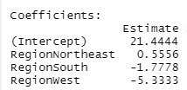
Last time
Straight forward to incorporate categorical variables using k-1 indicator terms
Most software packages create these for you now
R default: indicator/treatment/dummy coding (missing category is reference level)
Can use relevel() to change reference level
Can change to effect/sum to zero coding

Slide 3
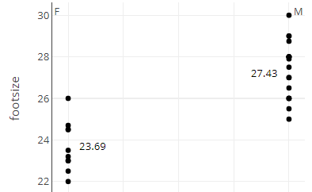
Last Time
Including categorical variables in the model

Slide 4
Effect vs. Indicator coding
Effect coding
Indicator coding
$${\hat{β}}_{0}$$
$${\hat{β}}_{1}$$
$${\hat{β}}_{1}$$
$${\hat{β}}_{0}$$

Slide 5
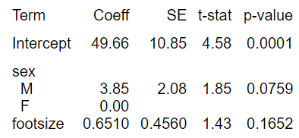
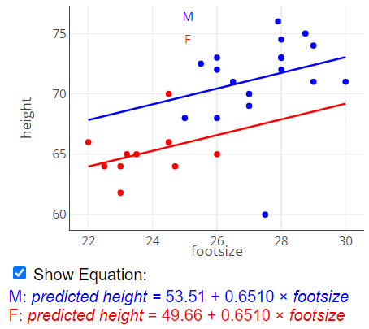
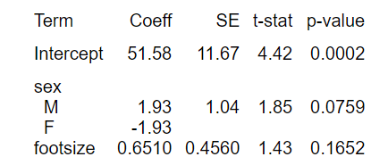
Example
Indicator coding
Effect coding

Slide 6
Quiz 4

Slide 7
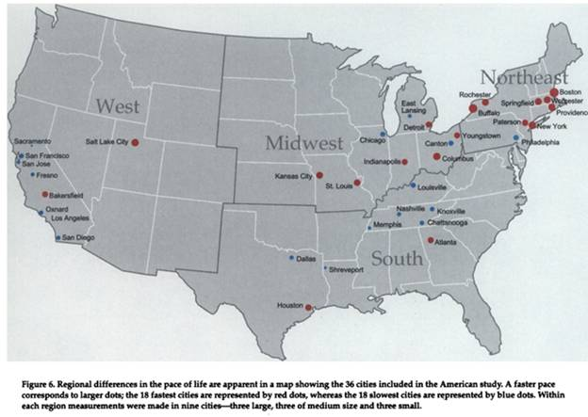
Pace of Life

Slide 8
Pace of Life
Walking speed of pedestrians over a distance of 60 feet during business hours on a clear summery day along a main downtown street
Average time a sample of bank clerks takes to make change for two $20 bills or to give $20 bills for change
Recorded responses of postal clerks explaining the difference between regular, certified, and insured mail and divided the total number of syllables by the time of their response
Proportion of men and women in downtown areas during business hours who were wearing a wrist watch

Slide 9
Feature Scaling
Centering: subtract mean
Standardizing: subtract mean and divide by standard deviation
Will range from roughly -3 to 3
Allows us to compare slopes of different variables “on the same scale”
Min-max scaling: subtract min and divide by range $new x=(x−\min{x})/(\max{x −\min{x)}}$
Will range from 0 to 1
A one-unit change in x corresponds to min to max
“Normalizing”

Slide 10
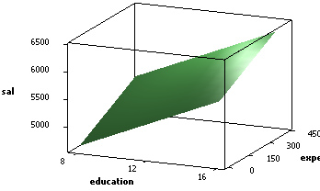
Multicollinearity
Doesn’t show up in residual plots but sometimes can spot something (e.g., sign of a coefficient) not making sense in context
$VIF_{i}=1/(1−R_{i}^{2})$, where $R_{i}^{2}$ is the coefficient of determination regression x_{i} against all of the other explanatory variables in the model
$$se\left({\hat{β}}_{i}\right)="se\left({\hat{β}}_{i}\right)"∗\sqrt{VIF_{i}}$$

Slide 11
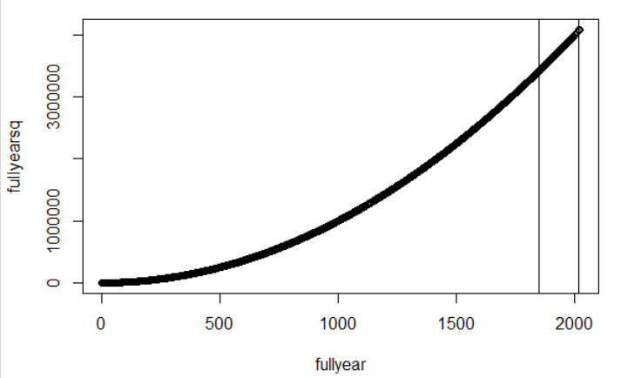
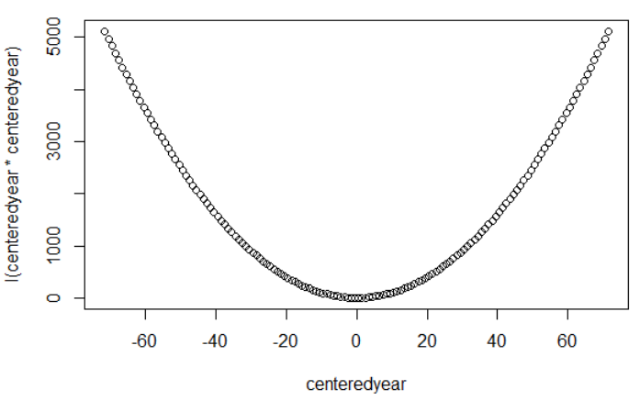
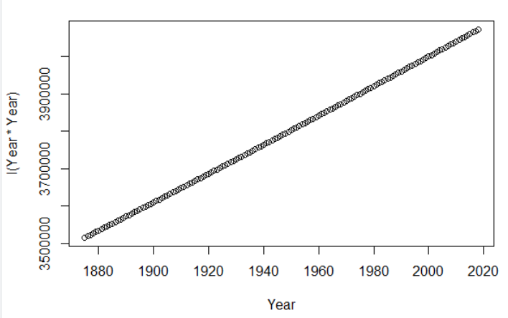
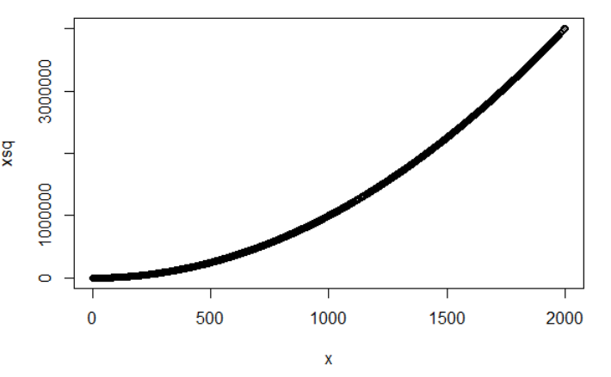
Centering
With both quadratics (x*x), centering the variables first can reduce multicollinearity between the variables
Can also help with numerical stability
Also helps with interpretation of intercept
Year – mean(Year)
Notes:
Never a bad idea

Slide 12
To Do
Quiz 5 (mostly review)
Review HW 1 Solutions
Start HW 2 (once posted)

