Slide 1
Stat 414 – Day 2
Basic Linear Regression Model Assumptions

Slide 2
Last Time
Anticipating behavior of variable, form of relationship
Does skewness make sense in context? Curvature?
Interpreting the equation for a linear model
Intercept, slope, residual
Quiz 0

Slide 3
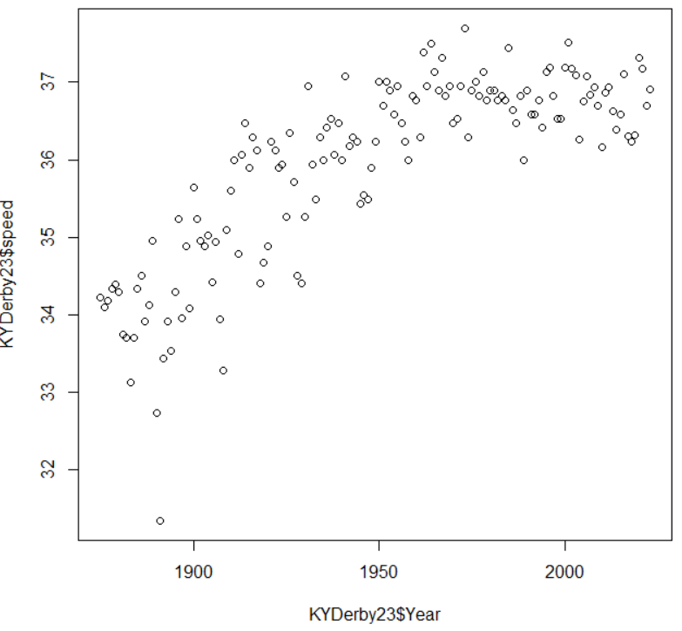
Statistical Inference
We have
$$pred speed=−7.16+0.22 year$$
What does that tell us about $E\left(Y\right)=β_{0}+β_{1}year ?$
Inference
Sampling from a population
Measurement-error model $y_{i}=β_{0}+β_{1}x_{i}+ε_{i}$
The “errors” can be considered a random sample from a hypothetical “super population”

Slide 4
Superpopulation (LEMMA)
Sometimes, it may appear that we have included the entire relevant population in our study and thus there is no issue of randomness
We can consider generalizing to a larger, potential or hypothetical population: the actual population which we have included in our study can be seen as one realization sampled by nature or by events in the real world from a superpopulation consisting of all the many theoretical possibilities.

Slide 5
Superpopulation (LEMMA)
For example, suppose interview all teachers at a particular time. It is unlikely that we would get the same observations if we were to hypothetically conceive of repeating the study.
We recognize uncertainty in the measurement of human characteristics such as those involving teachers, and there is likely to be measurement error.
Statisticians will assume they are dealing with a sample from the hypothetically infinite superpopulation of all teachers who might conceivably have been teachers in this school.
The idea is that it makes sense to make more abstract generalizations about this school than are governed by the situation and context of just one measurement occasion.

Slide 6
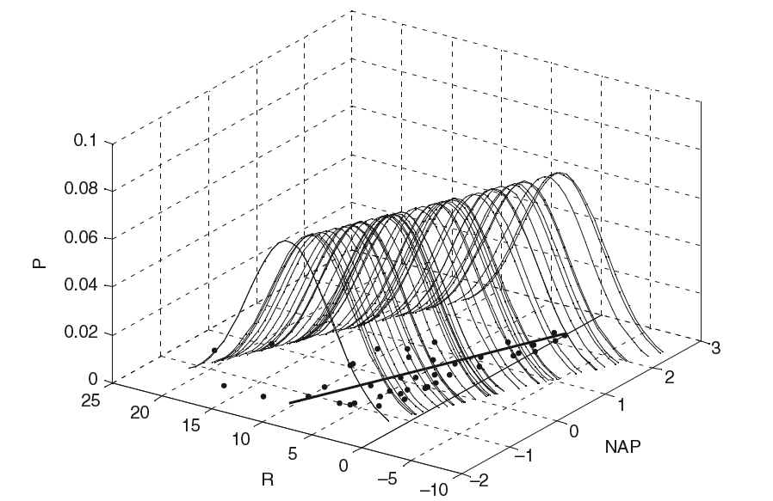
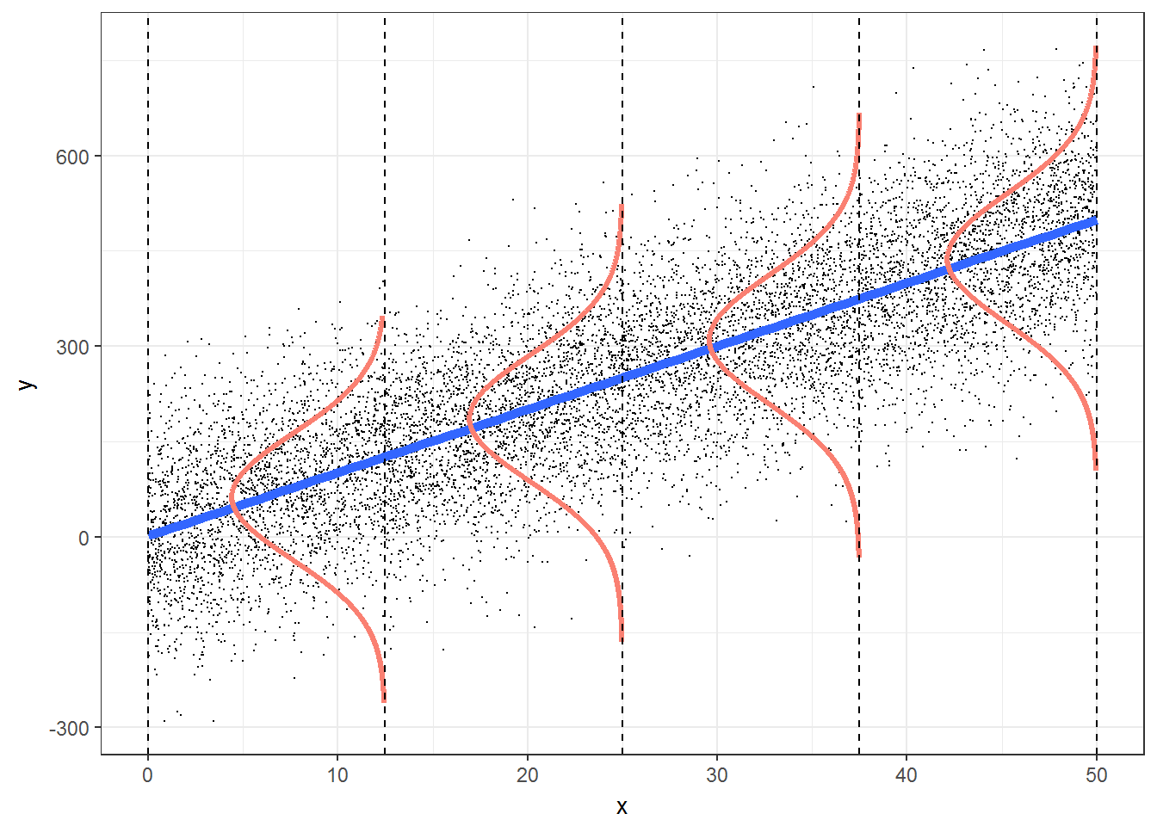
LINE assumptions for inference
(L) The mean value for Y at each level of X falls on the regression line.
(I) We’ll need to check the design of the study to determine if the errors (deviations from the line) are independent of one another.
(N) At each value of X, the values for Y are normally distributed.
(E) The spread in the Y’s for each level of X is the same.
$$y_{i}=β_{0}+β_{1}x_{i}+ε_{i}, ε_{i}∼N\left(0, σ^{2}\right)$$

Slide 7
Practice
A researcher suspects that loud music can affect how quickly drivers react. She randomly selects drivers to drive the same stretch of road with varying levels of music volume. Stopping distances for each driver are measured along with the decibel level of the music on their car radio.
Describe each assumption of the basic regression model in this context.
Which do you think are most likely violated?

Slide 8
Practice
Practice translating the conditions into the particular context
L: The mean reaction time is linearly related to decibel level of the music.
I: Stopping distances are independent. The random selection of drivers (individually measured) should assure independence.
N: The stopping distances for a given decibel level of music vary and are normally distributed.
E: The variation in stopping distances should be approximately the same for each decibel level of music.

Slide 9
Practice – Suspect issues?
Linearity: if there is threshold for the volume of music where the effect on reaction times remains the same, mean reaction times would not be a linear function of music.
Equal variance: At low decibels, everyone may have quick reaction times. At larger decibels, with larger average reaction times, may be much more variability
Normality: If a few subjects at each decibel level took a really long time to react. In this case, reaction times would be right skewed and the normality assumption would be violated.

Slide 10
Model Validation
Normality at each x vs. normality of the response variable
Can check residuals “after removing the effects of the explanatory variables” (apply the model)
Can get away with slight violations, esp with large sample size
How test heterogeneity
Graphically/residual plots
Context (e.g., males vs. females)
Significance tests? (e.g., Bartlett’s test)

Slide 11
Model Validation
Linearity
“Additivity” (y = a + b₁x₁ + b₂x₂ +…)
Residual plots (including unknown variables)
Transformation? Additive models…
abc ⇒ log(a) + log(b) + log(c)
Independence
Probably the most serious, all F-tests, t-tests are inaccurate (usually standard error of slope coefficient is too small!)
But can also be hardest to verify
Limited information in graphs of residuals
Dependence nature of the data…

Slide 12
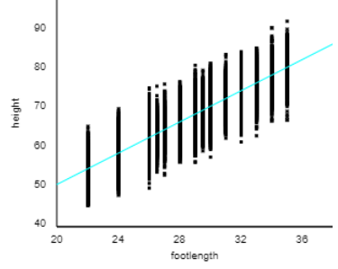
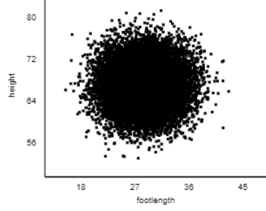
A hidden assumption?
Fixed X values
In an experiment, we know these values in advance (‘deterministic’)
Generally not true in “field studies”
Usually not a problem if the measurement error is small compared to SD(X)
Notes:
Bootstrapping

Slide 13
Another hidden assumption?
Influential observations
Leverage measures uniqueness of observation
Cook’s Distance measures change in model (estimated parameters) if observation is removed
Influence
Larger than one?
Combination of large residuals and/or large leverage

Slide 14
And don’t forget
Model validity (#1!)
You have the right data for your research question
“This sounds obvious but is often overlooked or ignored because it can be inconvenient”
You have the most important variables, response accurately measures phenomenon of interest, generalizability
Commentary
Normality and equal variance are typically minor concerns, unless you’re using the model to make predictions for individual data points.
I wish we could get beyond: these are the assumptions, make sure they are met. To something more like this is the impact of heteroscedasticity, but you don’t need to worry about it in this context, and this is how you can introduce it into a model if you want to incorporate it.
Notes:
Earnings vs. assets, test scores vs. intelligence

Slide 15
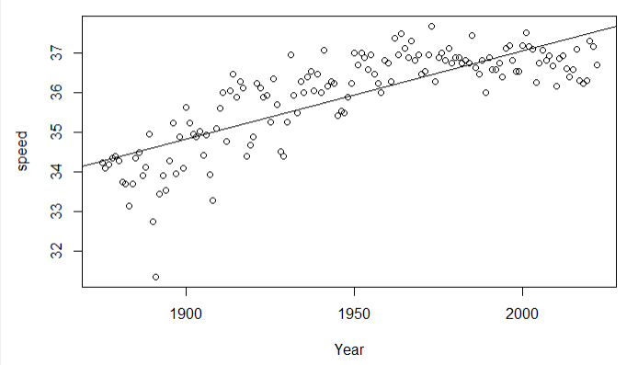
Example 1: Kentucky Derby cont

Slide 16
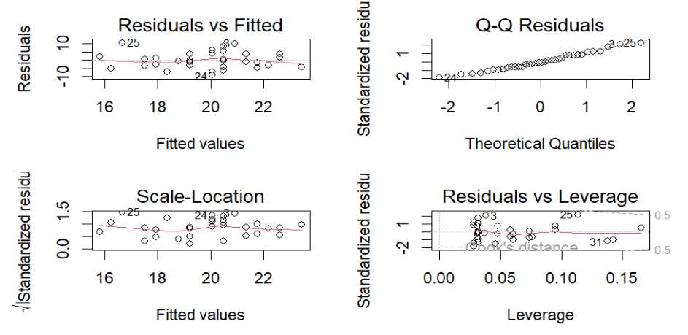
Example 1: Kentucky Derby

Slide 17
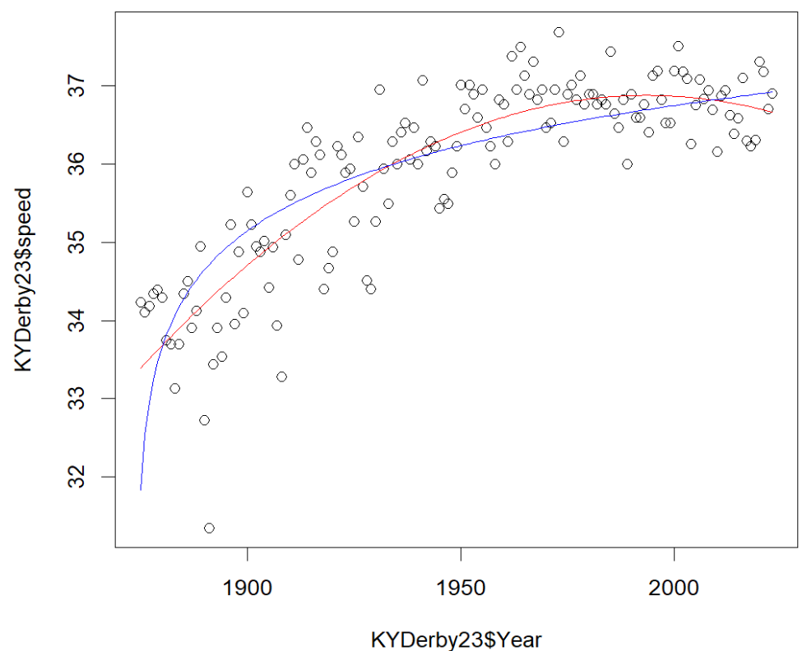
Example 1: Kentucky Derby

Slide 18
Advice…
The statistical package output can be beautiful
even with grossly inappropriate models
Always apply the simplest statistical technique on your data, but ensure it is applied correctly!
“The easiest solution is a data transformation, but we try to avoid this for as long as possible. In our view, heterogeneity is interesting ecological information that you should not throw away, just because it is statistically inconvenient. With a ‘little’ bit of extra mathematical effort, heterogeneity can be incorporated into the models and can provide extra biological information.”

Slide 19
To Do
Day 2 Quiz (Including (e) Pick a model and justify your choice, (f) Comment on model form) in Canvas
Review “centering” (see end of today’s Rmarkdown file?)
Continue HW 1

