Slide 1
Stat 414 – Day 11
Introduction to Maximum Likelihood Estimation

Slide 2
Last Time
Handling unequal variances
Transformations of response
Weighted least squares
Special case of generalized least squares:
Heterogeneity consistent standard errors
library(sandwich)
library(lmtest)
coeftest(model1, vcov = vcovHC(model1, type = "HC3"))

Slide 3
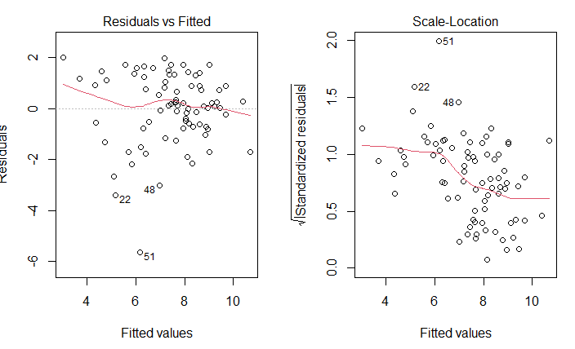
Example 2

Slide 4
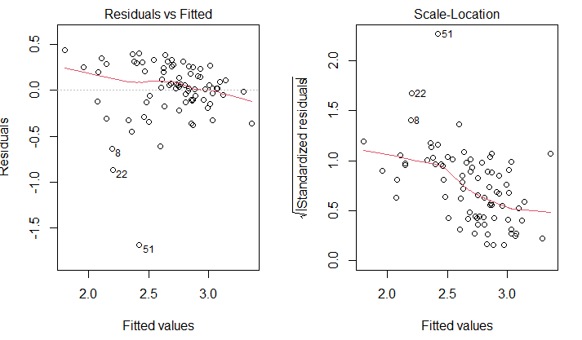
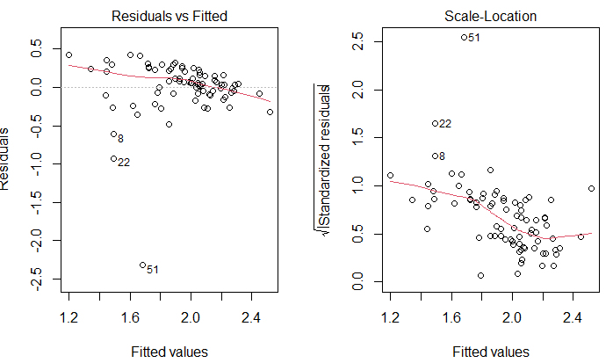
Example 2
sqrt(gpa)
ln(gpa)

Slide 5
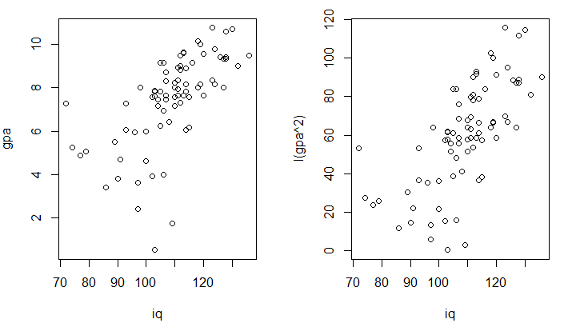
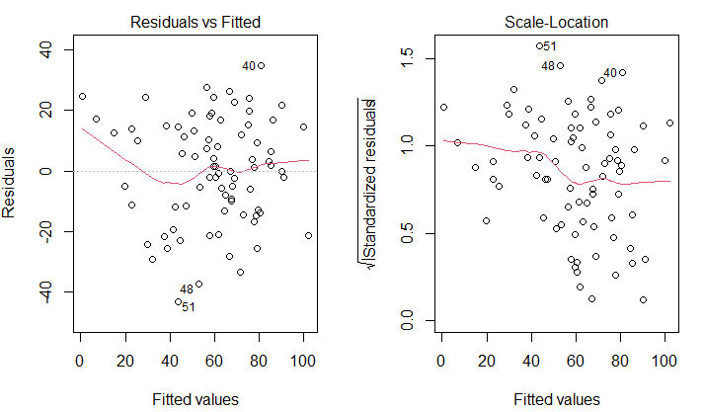
Actually…
GPA²

Slide 6
HC standard errors
Original
Adjusted (HC1)

Slide 7
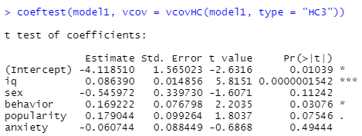
HC standard errors
Original
Adjusted (HC3)

Slide 8
Day 10 Quiz

Slide 9
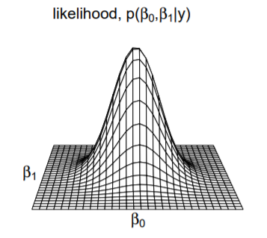
MLEs

Slide 10
Likelihood Ratio Test
Test statistic
= 2 ln(Lfull/ Lreduced)
= - 2 x log likelihood red - (-2 log likelihood full)
= -2 x (L₀ – L₁)
Reference distribution?
Chi-square with df = difference in number of parameters
Notes:
Drop in deviance

Slide 11
Likelihood ratio test
Intuitively, when the likelihood for the larger model is much greater than it is for the reduced model, we have evidence that the larger model is more closely aligned with the observed data. This isn’t really a fair comparison on the face of it. We need to account for the fact that more parameters were estimated and used for the larger model.
That is accomplished by taking into account the degrees of freedom for the χ2 distribution. The expected value of the χ2 distribution is its degrees of freedom. Thus when the difference in the number of parameters is large, the test statistic will need to be much larger to convince us that it is not simply chance variation with two identical models.

Slide 12
To Do
Day 11 Quiz
Submit Project Part 1 (Sun midnight)
Computer problem
HW 3
Preview Day 12 models?

