Slide 1
Stat 414 – Day 1
Review Basic Linear Regression Model
R Markdown/R Notebook

Slide 2
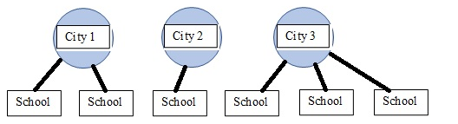
Last Time: Multilevel data
Nested/Clustered data
Example: Take a multistage sample – random sample of cities; random sample of schools within each city
Quiz 0

Slide 3
Example responses
Level 1 = cancer patients; type of cancer treatment
Level 2 = oncologist; years of experience
Level 1 = homes in the US; cost of home
Level 2 = neighborhood; average income in area

Slide 4
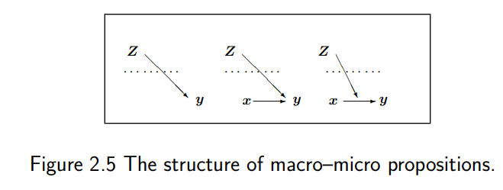
Important picture

Slide 5
Example 1: Kentucky Derby
The Kentucky Derby is an annual horse race run at Churchill Downs in Louisville, KY, USA, on the first Saturday in May (2020 is the first year since 1945 that it wasn’t run in May). The race is known as the “Most Exciting Two Minutes in Sports,” and is the first leg of racing’s Triple Crown.
Y = response variable = time to finish the race?

Slide 6
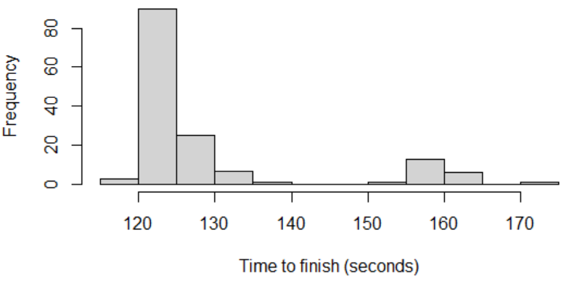
Explore the data
Why is it called the fastest 2 minutes?

Slide 7
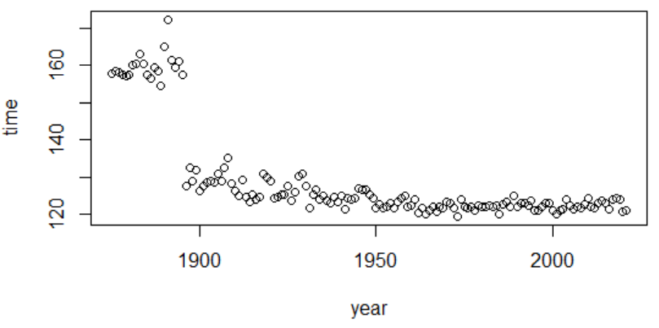
Time plot
Explain the pattern?

Slide 8
New variable
Wikipedia: The Kentucky Derby was first run at 1.5 miles (12 furlongs; 2.4 km) the same distance as the Epsom Derby, before changing lengths in 1896 to its current 1.25 miles (10 furlongs; 2 km).
Convert to speed
If before 1896, 1.5 miles/(time/3600)
If 1896 or later, 1.25 miles/(time/3600)
miles per hour

Slide 9
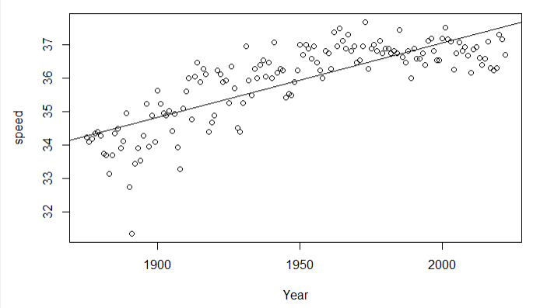
Regression line
In year 0, predict winning speed of -7.2 mph
Each year, the predicted speed increases by 0.022 mph
$$predicted speed=−7.16+0.022 year$$

Slide 10
Fitted model vs. Regression model
You just found $\hat{y}={\hat{β}}_{0}+{\hat{β}}_{1}x$
You are hoping this tells you about $Y=β_{0}+β_{1}x+ε$
What are the assumptions of this model?

Slide 11
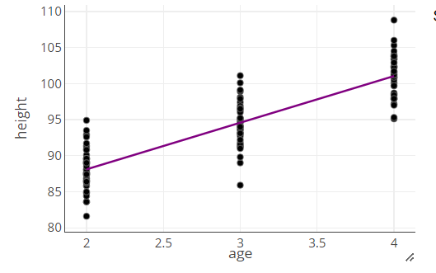
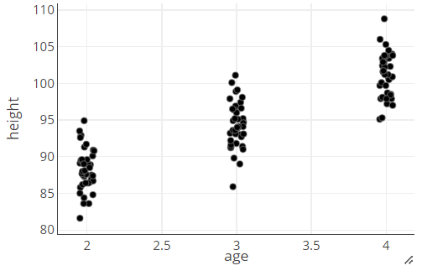
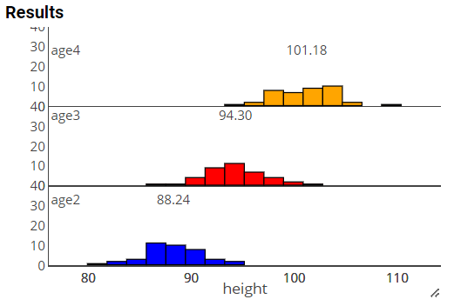
Model assumptions

Slide 12
LINE assumptions for inference
(L) The mean value for Y at each level of X falls on the regression line.
(I) The errors (distances from the line) are independent of one another.
(N) At each level of X, the values for Y are normally distributed.
(E) The spread in the Y’s for each level of X is the same.
Others?

Slide 13
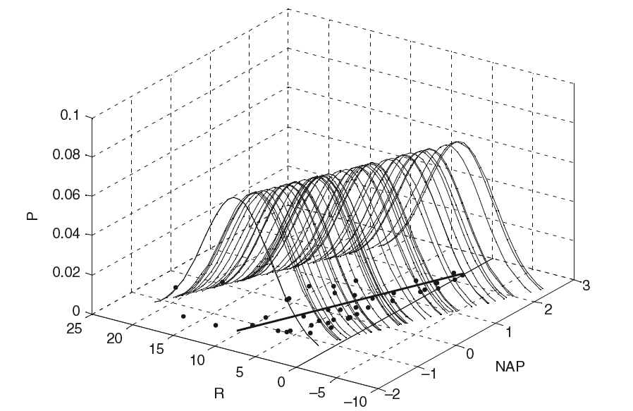
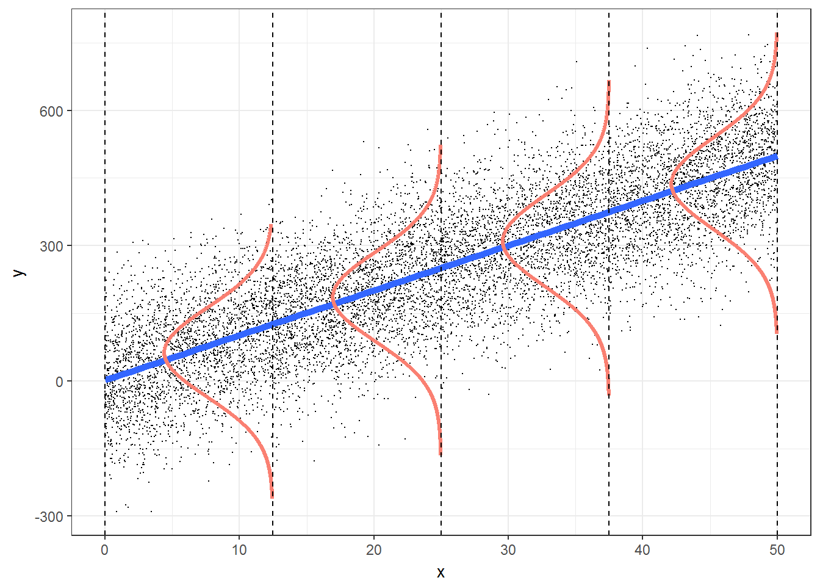
LINE assumptions for inference
(L) The mean value for Y at each level of X falls on the regression line.
(I) We’ll need to check the design of the study to determine if the errors (distances from the line) are independent of one another.
(N) At each level of X, the values for Y are normally distributed.
(E) The spread in the Y’s for each level of X is the same.

Slide 14
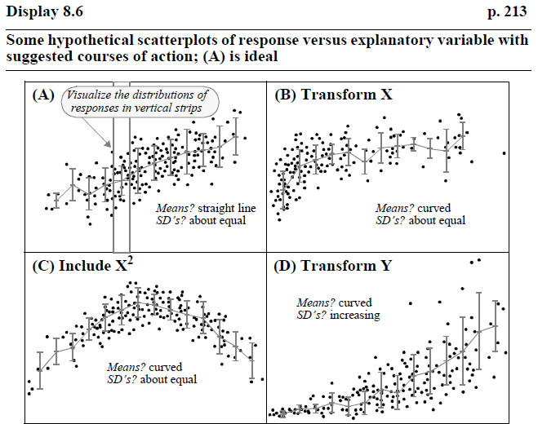

Slide 15
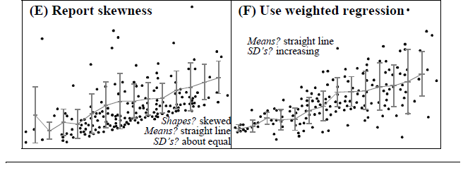

Slide 16
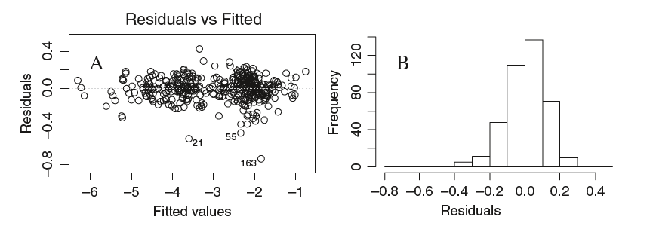
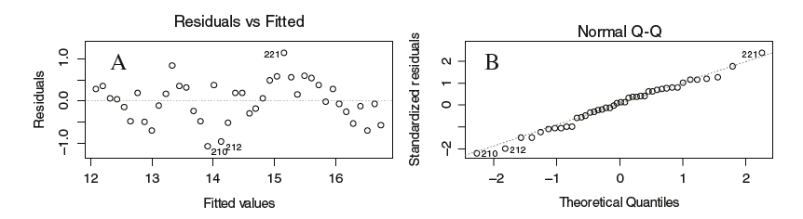
Residual Plots

Slide 17
Saving your RMarkdown file

Slide 18
To Do
Quiz 1 (due 8am Tuesday)
Be reviewing/thinking about: What are the assumptions of the basic regression model (e.g., for inference)? How do we check them? What are consequences if the assumptions aren’t met? What can we do if the assumptions aren’t met?
See handout in Canvas?
What’s missing?

Slide 19
Practice
A researcher suspects that loud music can affect how quickly drivers react. She randomly selects drivers to drive the same stretch of road with varying levels of music volume. Stopping distances for each driver are measured along with the decibel level of the music on their car radio.
Describe each assumption of the basic regression model in this context.
Which do you think are most likely violated?

Slide 20
Practice
Practice translating the conditions into the particular context
L: The mean reaction time is linearly related to decibel level of the music.
I: Stopping distances are independent. The random selection of drivers (individually measured) should assure independence.
N: The stopping distances for a given decibel level of music vary and are normally distributed.
E: The variation in stopping distances should be approximately the same for each decibel level of music.

Slide 21
Practice
Linearity: if there is threshold for the volume of music where the effect on reaction times remains the same, mean reaction times would not be a linear function of music.
Equal variance: At low decibels, everyone may have quick reaction times. At larger decibels, with larger average reaction times, may be much more variability
Normality: If a few subjects at each decibel level took a really long time to react. In this case, reaction times would be right skewed and the normality assumption would be violated.

