Slide 1

Stat 414 – Multilevel and Mixed Models
Introductions

Slide 2
Multilevel models
Multilevel data (Ch. 2)
Modelling (Review + Enhance)
Technical and Nontechnical communication
Applications
Software

Slide 3

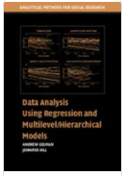

Stat 414
Syllabus
Textbook
Software
Handouts
Homework
Quizzes
Office hours (in person, zoom)
Project
Discord server

Slide 4
Linear Regression Models…
When can I find a line? How do I find a line?
How do I measure the strength of the association?
When am I allowed to interpret this slope?
When am I allowed to use causal language?
When am I allowed to use the p-values? Confidence intervals?

Slide 5
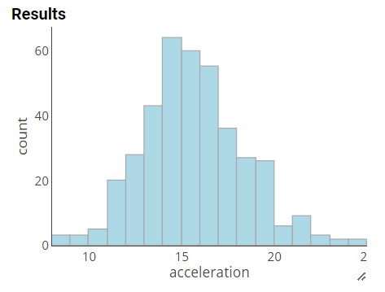
Example 1
Time for cars to reach 60 mph
  “cases”?
  Measurement units
  Why are these values not all the same?

Slide 6
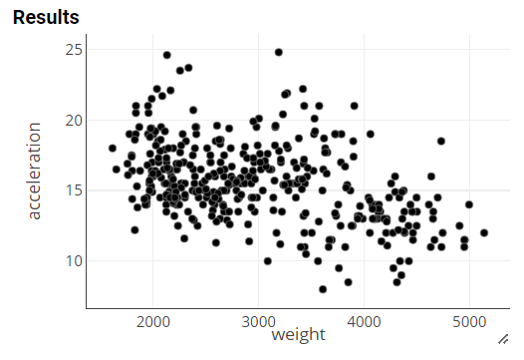
Example 1
Can we predict acceleration time from weight?

Slide 7
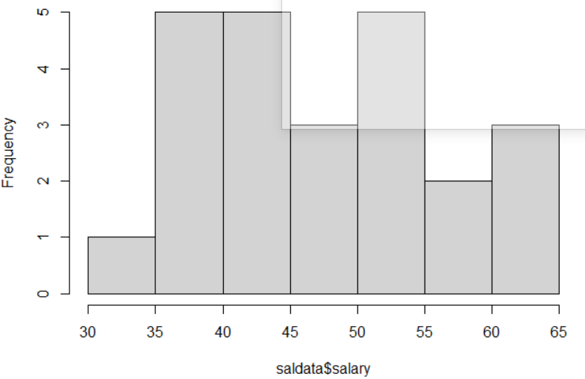
Example 2
Staring salaries of 24 college graduates, including their starting salary
  What’s wrong with this graph?
  Why aren’t these values all the same?

Slide 8
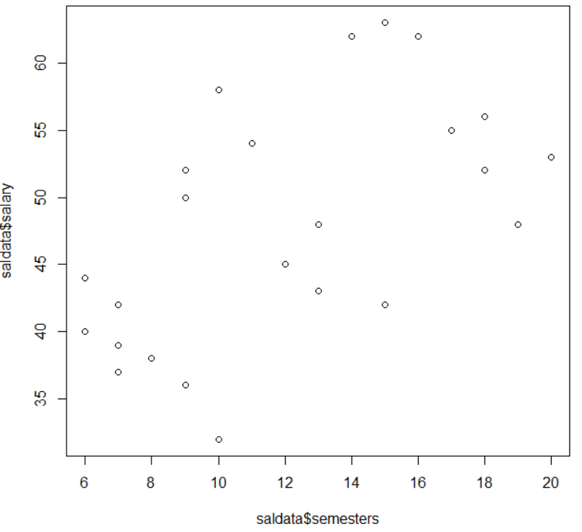
Example 2 cont.
Can we predict salary based on how many semesters they spent in college?
  What should we be careful of?

Slide 9
If we don’t have a random sample
For example:
  Cluster sampling (e.g., classrooms)
  Repeat observations on the same individual (aka “longitudinal data”)
  Observations collected over time (e.g., several years of data on same firm, aka “panel data”, “growth models”)
Notes:
Exert difference, independent effects

Slide 10
If we don’t have a random sample, cont.
A little history/timeline:
  70s, 80s: didn’t analyze the data at the right level (journalists)
    Ecological fallacy: using aggregate-level results to make inferences about individuals
    Atomistic fallacy: using individual-level results to make inferences about groups
    Examples:
      The greater the proportion of immigrants in a state, the lower its average illiteracy; but immigrants are on average more illiterate (Robinson, 1950)
      Wealthier states tend to vote more Democratic, but wealthier people tend to vote Republican
      That Italian was unfriendly to me so all Italians are unfriendly
      Individual-level poverty vs. neighborhood level poverty on well-being
  80s: Better understand classroom dynamics (impact of contextual factors)
  90s and 00s: wanted to understand how the environment/ organization impacts the individual; data collecting over time (e.g., panel data), community level interventions

Slide 11
Hierarchical data
university
class
student
student
class
student
university
class
student
student
class
student
Level 3
What might impact a student’s exam score?
The relationships can differ across levels:
  A high-pressure class can negatively impact performance;
  A high-pressure institution can positively impact performance (e.g., work together)
Level 2
Level 1

Slide 12


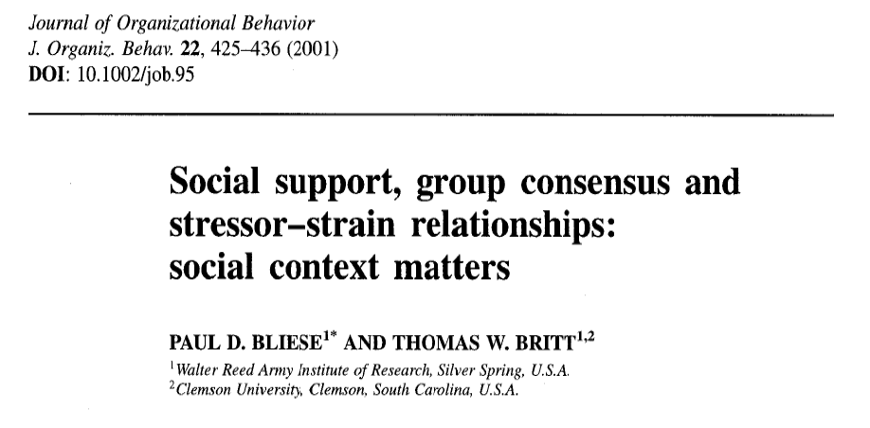
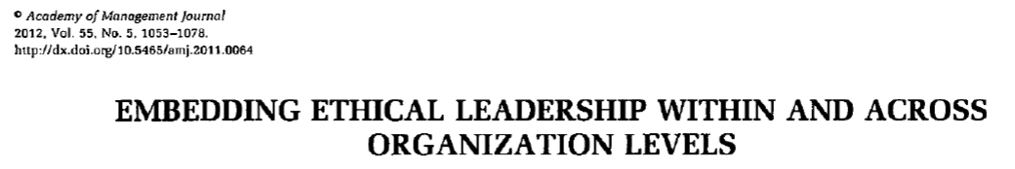

Slide 13
Multilevel data
Cases are “nested” or “clustered” with groups that are more similar to each other than to observations in other groups
  e.g., geographical area or institution
  e.g., plants in the same pot
  e.g., repeated measurements of individual over time
Individual | Cluster
Micro | Macro
Level 1 | Level 2

Slide 14
Example 3, with partner
Level 1 units = criminals
  Sentence
Level 2 units = judges
  Age
Level 1 units = survey respondent
  Response
Level 2 units = interviewers
  How asked the question

Slide 15
To Do
Skim Ch. 2
Start looking for multilevel data
Initial survey, introduction
Install R/RStudio
Review: When can I fit a regression model to data?

