Slide 1
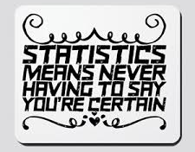
Stat 301 – Day 9
Normal approximation to Binomial

Slide 2
Last Time – Confidence intervals
Confidence intervals are used to estimate the value of the parameter
Often more informative than yes/no decision
Though conclusions should match
Interval of plausible values of parameter, with statement of reliability of method (confidence)
vs. possible and probable…
Interpretation: I’m 95% confident that <<parameter in context>> is between X and X

Slide 3
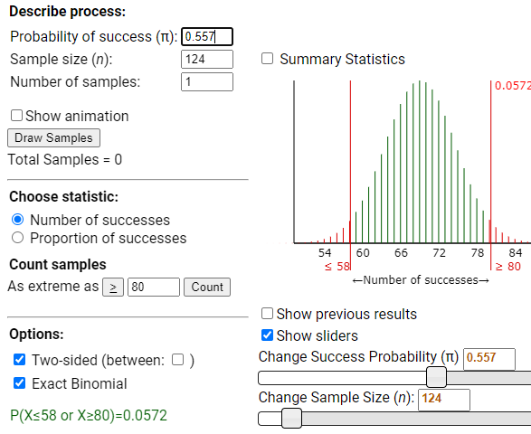
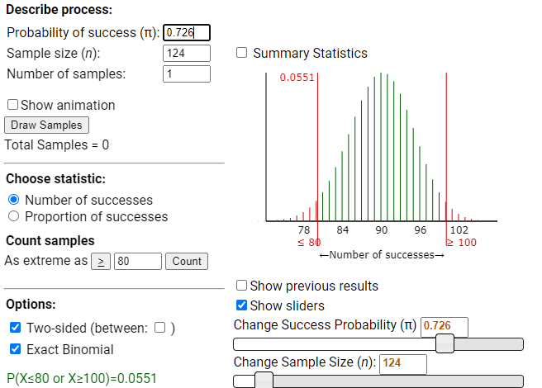
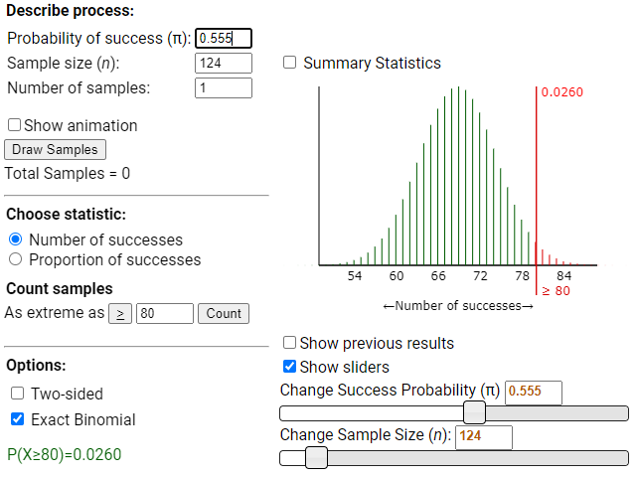
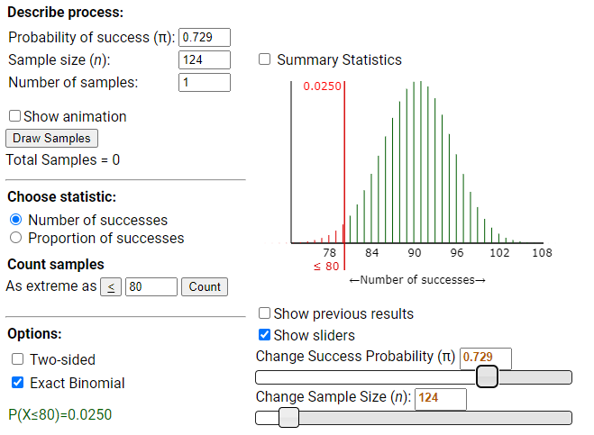
Last Time (n = 124, x = 80)
Using applet: (.557, .726)
Using R: (.5542, .7290)
Slightly different method in R, 95% interval looks for both one-sided p-values below 0.025

Slide 4
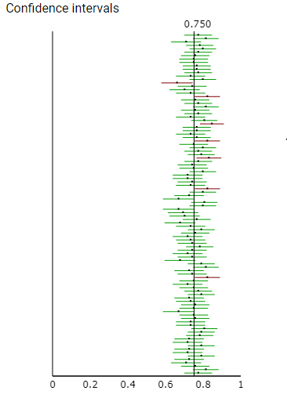
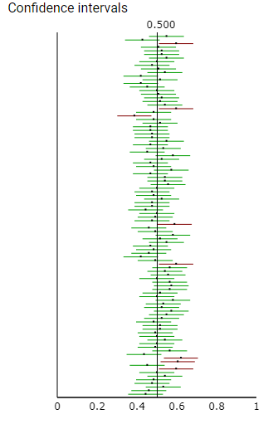
“Confidence”?
I’m 95% confident the <<parameter>> is in the interval
There is 95% probability that this method will lead to an interval that captures the parameter

Slide 5
Example
Write down the number of orange candies you found in a sample of 25 candies on the note card
Use technology to determine the exact 95% confidence interval
Write down the exact 95% confidence interval and your interpretation on the note card

Slide 6
Moral
“Confidence” is a statement about the reliability of the method

Slide 7
So far
Research Question
Binary variable
Descriptive statistics
Inferential statistics
Graph: Bar graph
Statistic: Count, Proportion, Percentage
Is that statistic surprising under the null model (in direction of alternative)?
-- p-value, std. statistic
Binomial
Plausible values of π?
-- confidence interval

Slide 8
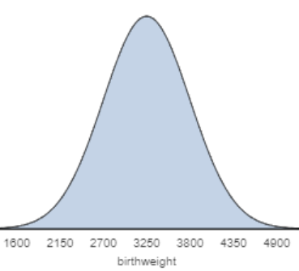
Detour: Normal Distribution
Can often model the distribution of a quantitative variable with the normal probability model (μ, σ)
Mean μ = 3250 g
SD σ = 550 g

Slide 9
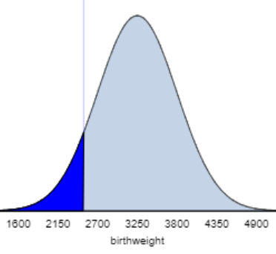
Detour: Normal Distribution
Probabilities are represented by “area under the curve” (below, above, between)

Slide 10
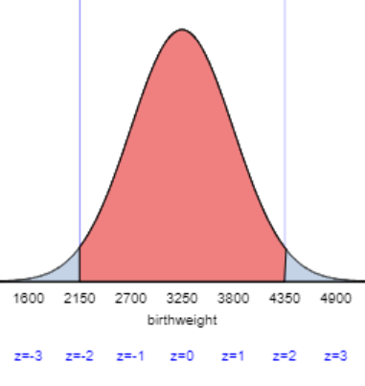
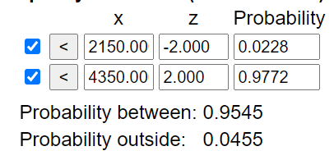
Detour: Normal Distribution
95% of distribution falls within 2SD of mean
= (obs – mean)/SD
= (X – μ)/σ
= z
Approx 95% of US newborns weigh between 2150 and 4350 grams

Slide 11
Why do we care?
Because we have seen our “null distribution” often has this symmetric, bell-shaped curve
Can we use the friendlier normal distribution to calculate p-values rather than the annoying binomial distribution?

Slide 12
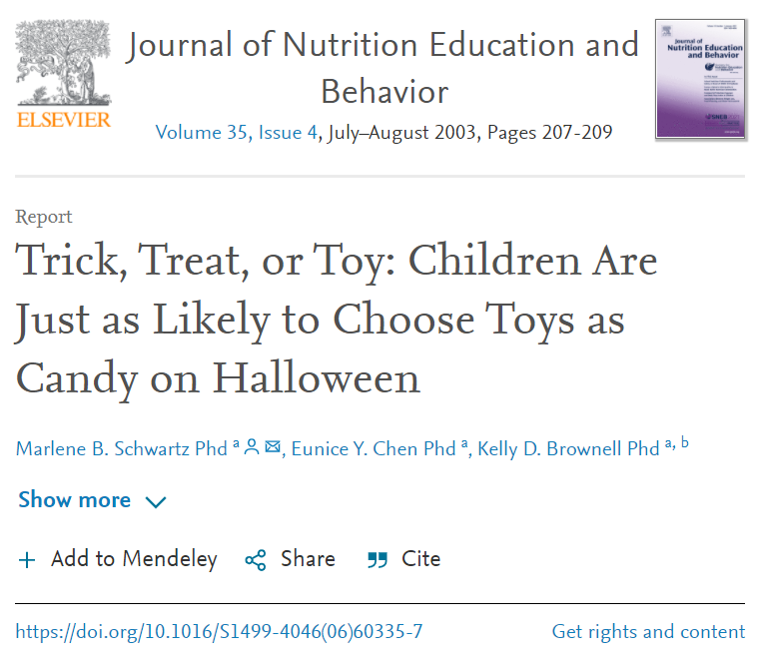
To Do
Skipping Investigation 1.7 for now
Investigation 1.8 through part (o)
Inv 1.9 through part (l)

Slide 13
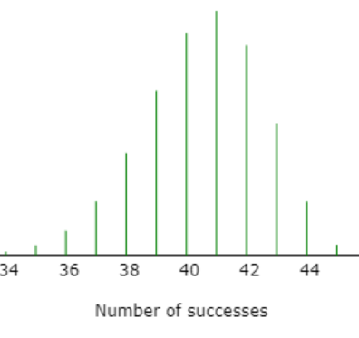
Central Limit Theorem
Aka Normal Approximation to Binomial
We can use the normal distribution instead of the binomial distribution when the sample size is large relative to the probability of success

Slide 14
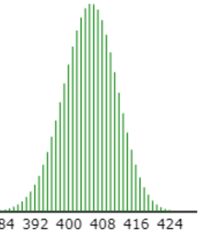
Central Limit Theorem
Aka Normal Approximation to Binomial
We can use the normal distribution instead of the binomial distribution when the sample size is large relative to the probability of success

Slide 15
Central Limit Theorem

Slide 16
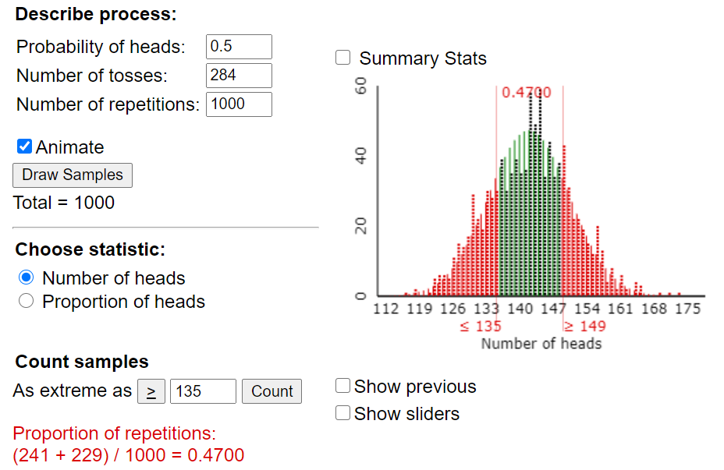
Simulation vs. Binomial

Slide 17
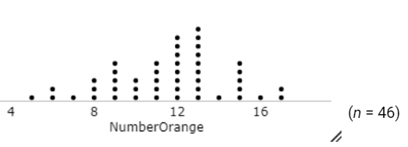
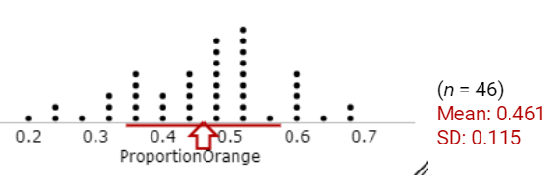
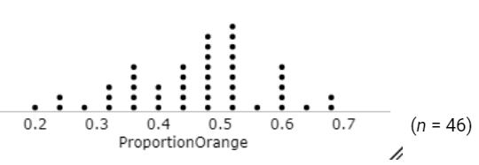
Class results

Slide 18
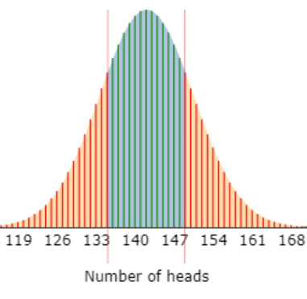
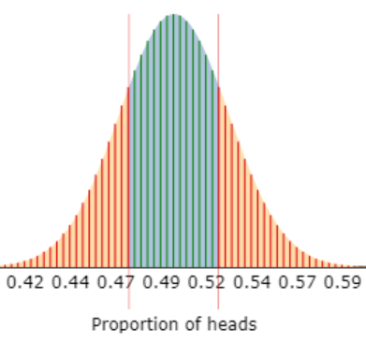
Normal approximation
Guideline?
284(.5) and 284(1-.5) > 10

Slide 19
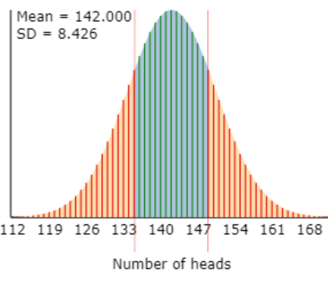
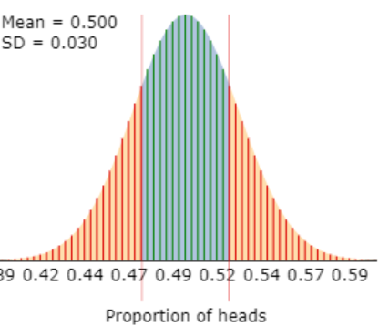
Replacement Formulas

Slide 20
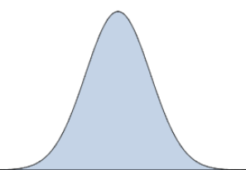
Distribution of sample proportions
Using sample proportion as statistic rather than sample count
For this graph
Obs unit = sample
Variable = sample proportion
p-value = probability of a sample proportion in this region… assuming null is true…

Slide 21
Advantages to Normal Distribution, Sample proportions

Slide 22
“One Proportion z-test”
Define parameter (e.g., process probability)
State null and alternative hypotheses
Check whether CLT applies: nπ, n(1-π) > 10
Calculate test statistic (z-score)
Interpretation: Number of SDs from null value
Calculate p-value using normal distribution
State conclusions

Slide 23
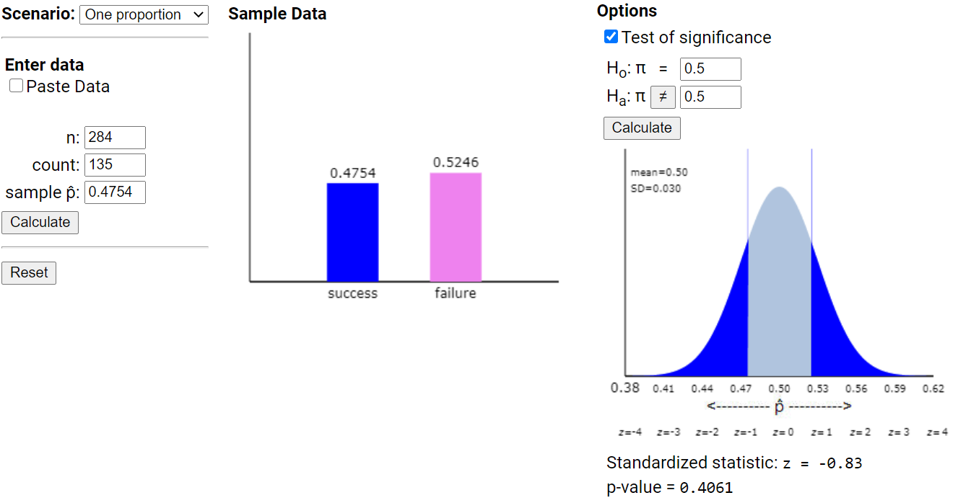
Theory-Based Inference applet

Slide 24
To Do
Office hours
Today 2:30-3:30
Tomorrow 10-11
Be submitting practice questions
See/Try Technology Detours
Be working on HW 3

