Slide 1
Stat 301 – Day 6

Slide 2
Inv 1.2 practice problem
Inv 1.2: “behavioral cues” showing intent such as reaching for, but not obtaining, or trying to open an object.
PQ 1.2: “communicative cues” = looking at the container, pointing to the container
Null hypothesis: Yukon does not consistently understand communicative cues (and is guessing randomly = equally between the two containers)
H₀: π = 0.5 where π represents Yukon’s (long-run) probability of picking the indicated container

Slide 3
Investigation 1.3
Variable: Identified the symbol correctly or not
→ proportions…
Proportion of correct identifications in 10 attempts
Probability of correctly identifying the correct symbol

Slide 4
Definitions
Statistic = number summarizing the observed results
observed
Parameter = number summarizing the entire random process
Usually unknown

Slide 5
Inv 1.3: Parameter vs. Statistic
Variable: Identified the symbol correctly?
→ proportions…
Proportion of correct identifications in 10 attempts
We can also use “number of correct” identifications” as the statistic
Probability of correctly identifying the correct symbol
Statistic (sample)
Parameter (process)

Slide 6
Null model
X = number of correct identifications (success)
Parameter: π = probability of correct identification
H₀: purely guessing among the 5 symbols (π = 0.20)
H_{a}: better than guessing (π > 0.20)
Simulate outcomes under the null hypothesis

Slide 7
Today
Working on 1.3 and 1.4 with partner…

Slide 8
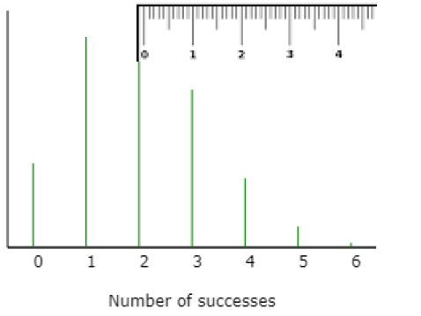
Standardizing
More than 2 SD from mean ≈ p-value < .05
SD
SD
SD
SD
SD

Slide 9
Test of Significance
Define parameter of interest,
Let π = probability of picking correct symbol
Conjecture a value of the parameter
Null hypothesis H_{o}: π = hypothesized probability
What values do you want to consider evidence against the null?
Alternative hypothesis H_{a}: π <,>, ≠ hypothesized probability
Is our statistic consistent with the null hypothesis?
Calculate the p-value or the standardized statistic (number of standard deviations from expected)
If the p-value is small or standardized statistic large, we reject the null hypothesis in favor of the alternative hypothesis
State the conclusion in context

Slide 10
Investigation 1.4
Obs units = heart transplant patients
Variable = whether or not survived 30 days
Success = did not survive 30 days after operation
Parameter: Let π represent the probability of a heart transplant death within 30 days at St. George’s hospital
Binomial: Independence, constant probability of success?

Slide 11
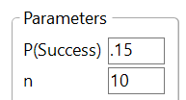
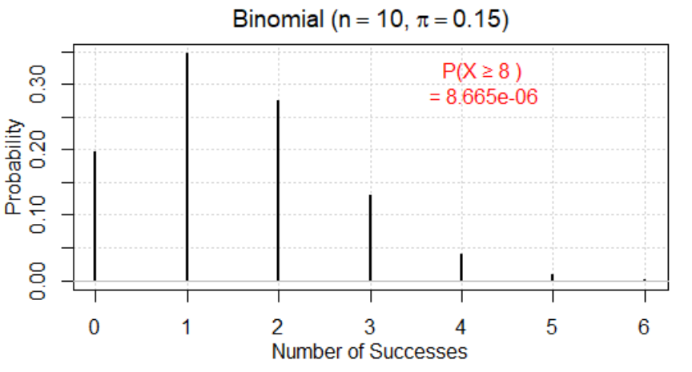
Investigation 1.4
Null hypothesis: π = 0.15
Alternative hypothesis: π > 0.15
Statistic: 8 or 8/10
p-value = P(X > 8 with n = 10 and π = 0.15)
Simulation (One Proportion applet)
Exact p-value (applet, JMP, R)

Slide 12
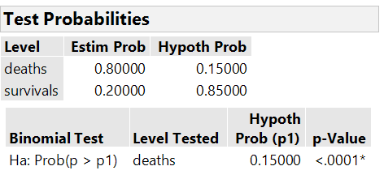
Another technology option
R
JMP

Slide 13
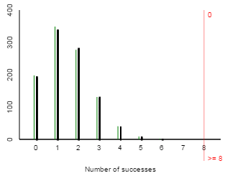
Investigation 1.4 (h)(i)
p-value ≈ 0
Interpretation: 0% of sets of n = 10 operations from a random process with π = 0.15 have 8 or more successes
Appears to be something other than random chance going on here
Problem at hospital?
Problem with our binomial model?
All models are wrong, but some are useful

Slide 14
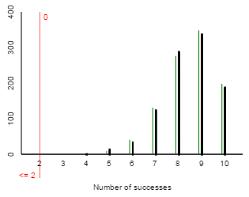
Investigation 1.4 (j)
π represents the probability of a heart transplant survival past 30 days at St. George’s hospital
Null hypothesis: π = 0.85
Alternative hypothesis: π < 0.85
p-value = P(X < 2 with n = 10 and π = 0.85)

Slide 15
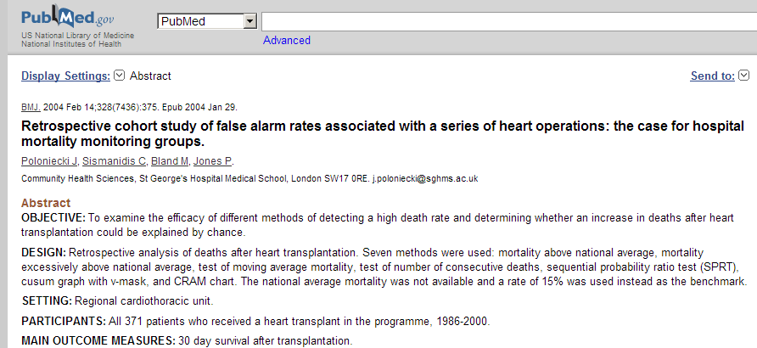
Investigation 1.4(m)

Slide 16
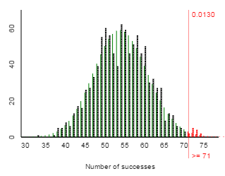
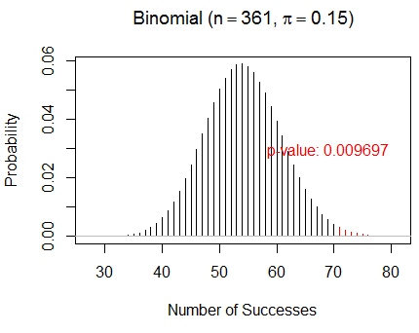
Investigation 1.4
What about 71 deaths in 361 operations?
Larger sample size
Smaller proportion (.157)
Strong evidence but a little weaker than before (larger p-value)

Slide 17
Investigation 1.4 Moral
When considering statistical significance, care about both how far the observed result is from the hypothesized value and the sample size involved.

Slide 18
To Do
Submit practice questions by this evening
Can revise and resubmit until class tomorrow but need initial submission by midnight tonight
Continue HW 2

Slide 19
R/JMP Reminders
R
Very picky about syntax (e.g., capitalization)
Can use ?s to get help, also autocorrect in RStudio
Use ISCAM workspace to launch
JMP
Colored icons indicate if JMP thinks variable is categorical or quantitative
Hot spots
Use Journal file to launch
Watch strict inequalities, e.g., P(X > 8) vs. P(X > 8)

