Slide 1
Stat 301 – Day 5
Day 5: Binomial tests

Slide 2
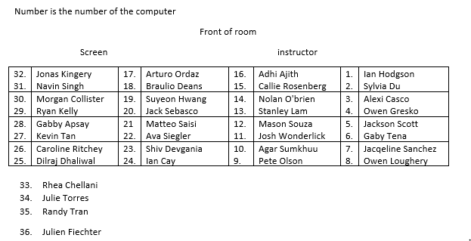
Section 1

Slide 3
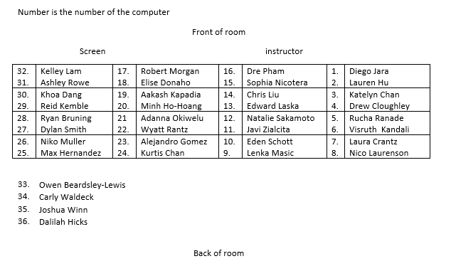
Section 2

Slide 4
Quiz 1
Shape, center, spread

Slide 5
Quiz 1
Interpret vs. Evaluate
Inv B Quiz: Your interpretation should not include the words “probability,” “chance,” "odds," or “likelihood" or any other synonyms of "probability."
if we were to repeatedly play a 'daily number' lottery game over and over again forever for an infinite amount of times, then, in the long run, we would win about 0.1% of the time
Only make probability statements about something repeatable/random

Slide 6
Quiz 1
Lots of pees….
Probability of GY answering correction
Proportion of times GY correct in the study
Hypothesized probability of GY correct
Probability of 141 successes in 200 attempts if GY guessing
Interpret vs. Evaluate
If the "daily number" lottery game was played everyday for an infinite amount of days, roughly 0.1% of those days would be winning lottery days.

Slide 7
The CA Lottery “Jackpot”
Winning anything in scratch off games: .20
A particular number coming up in Roulette: .026
A U.S. male living to be 100: .023
Picking all 5 numbers in Fantasy Five: .0000017
Being struck by lightning: .00000167
Picking all 6 numbers in SuperLotto: .000000055

Slide 8
The CA Lottery “Jackpot”
If you buy 50 tickets a week, you should win the jackpot once every 9,000 years
If you drive 10 miles to buy a Lotto ticket, you are four times more likely to get killed in a car crash on the way to buy the ticket than you are to win the jackpot
The odds are longer than flipping a coin and getting heads 24 times in a row

Slide 9
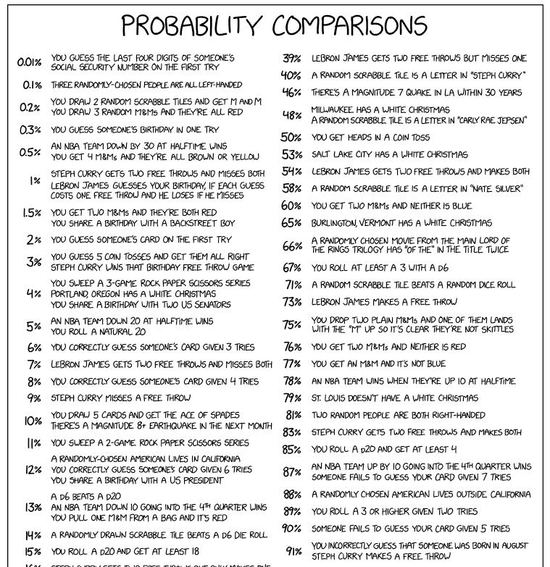
Xkcd…

Slide 10
Quiz 1
Strong evidence vs. large probability GY can “see” the object
Loaded dice
Is there a strong probability there is something fishy with my dice?

Slide 11
So far
Research Question
e.g., do infants evaluate behavior? Do wolves understand human cues?
Binary variable
Descriptive statistics
Inferential statistics
Graph: Bar graph
Number: Count, Proportion, Percentage
Is that number surprising under the null model (coin tossing)?
-- p-value

Slide 12
This week
Another way to calculate the p-value
Another way to measure strength of evidence against the null hypothesis (standardizing)
Using values other than 0.50 in the null hypothesis
New terms: Parameter vs. Statistic
Two-sided p-values

Slide 13
Binomial random process
Two outcomes
Independent trials
Constant probability of success
Fixed number of trials
Define success and failure
No pattern, nothing influencing next result
Not changing over time
Not “keep going until you are a winner”

Slide 14
Binomial random process
Two outcomes
Independent trials
Constant probability of success
Fixed number of trials
Success= Helper, Failure = Hinderer
Babies were tested individually
Assuming 0.5 for each infant (null model), identical infants
n = 16
Notes:
Fix up these examples a bit, maybe refer to toast and/or pop quiz (where is the randomness)

Slide 15
Binomial p-values
Our coin tossing model is equivalent to assuming we have a binomial random variable with π = 0.50
So we can use the binomial distribution to calculate (an exact) p-value
Interpretation of the p-value is the same
Evaluation/decision-making is the same
Notes:
Applet/JMP/R

Slide 16
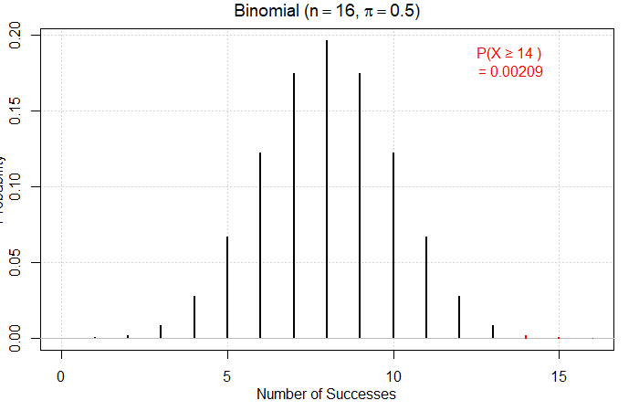
load(url("http://www.rossmanchance.com/iscam3/ISCAM.RData"))

Slide 17
“Binomial test” of significance
Define the parameter of interest
Let π represent the long-run probability that…
Conjecture a value of the parameter
Null hypothesis, π = 0.50
What values do you want to consider evidence against the null?
Alternative hypothesis, π > 0.50
Is our result consistent with the null hypothesis?
Simulate the binomial process
Calculate the exact p-value using the binomial distribution
If the p-value is small, we reject the null hypothesis in favor of the alternative hypothesis
Small p-values are stronger evidence
State the conclusion in context
Notes:
R and JMP

Slide 18
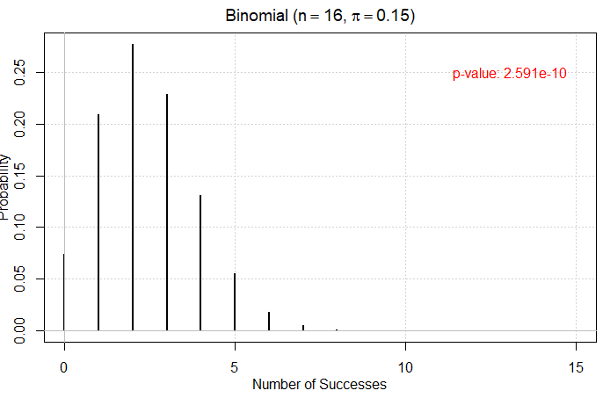

Slide 19
Other properties of Binomial RV

Slide 20
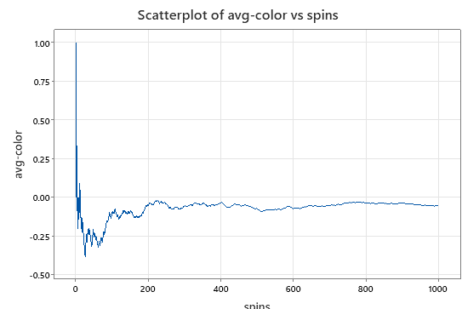
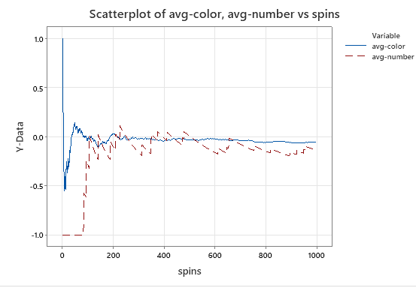
Other properties of Binomial random variables
Expected value where X is number of successes
E(X) = n π
Long-run average
Standard deviation
SD(X) = $\sqrt{n π\left(1−π\right)}$
Variation in numbers

Slide 21
Investigation 1.3: ESP/Clairvoyance
How many do I have to get correct to convince you I have ESP?

Slide 22
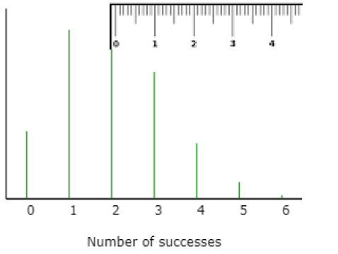
Standardizing
SD
SD
SD
SD
SD

Slide 23
For Thursday
I recommend working through Inv 1.3 and 1.4 on your own (about 1 hour?) and then have class time tomorrow to jointly submit the 1.2-1.4 practice questions
Have a group area in Canvas if want to start sharing ideas…

Slide 24
Philosophy
Volleyball…
Foreign language
No resubmissions on HW, Quizzes
Do hope to keep up with the practice questions

Slide 25
What is wrong with
Nightline, Oct. 1997
TED KOPPEL: Dr. Andrews, I'm sure you have heard such cautionary advice before so on what basis is the assumption being made that this is the one that's going to have the kind of impact on southern California in particular that's being predicted?
RICHARD ANDREWS: Well, in the business that I'm in and that local government and state government is in, which is to protect lives and property, we have to take these forecasts very seriously. We have a lot of forecasts about natural hazards in California and we have a lot of natural events here that remind us that we need to take these forecasts seriously. I listen to earth scientists talk about earthquake probabilities a lot and in my mind every probability is 50-50, either it will happen or it won't happen. And so we're trying to take the past historical record, our own recent experience of the last, two of the last three years and make the necessary preparedness measures that can help protect us as much as we can from these events.

