Slide 1
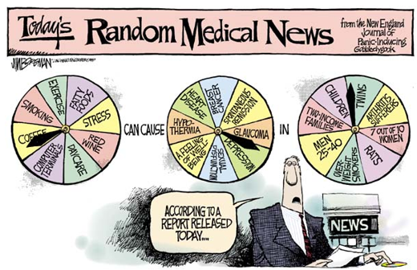
Stat 301 – Day 38
Review

Slide 2
A small fire breaks out in the dean’s office in a waste basket. A physicist, a chemist, and a statistician come running to the rescue. An argument ensues: The physicist argues that they should measure the heat of the fire, then apply sufficient cold to lower the temperature below the ignition point. The chemist argues they should assay the material in the wastebasket and identify a suitable reagent to neutralize the oxidation reaction. The statistician, meanwhile, has been off setting fire to all the other wastebaskets in the office….
When confronted as to why he would do such a thing, he replied,
“To get a large enough sample size, of course!”

Slide 3
Last Time – Paired Data - Categorical
Remove the “ties”
Sample size = number of observations that differed on the two treatments
X = number of observations in favor of “response 1”
p-value = P(X > observed assuming π = 0.5)
May consider a normal approximation if have at least 10 observations in each category
Use normal or binomial confidence intervals for π
Often called McNemar’s Test
Notes:
Coronavirus vaccine

Slide 4
Practice Questions for this week
Remember to review comments even if 5/5!

Slide 5
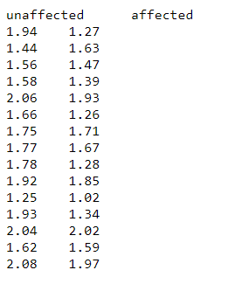
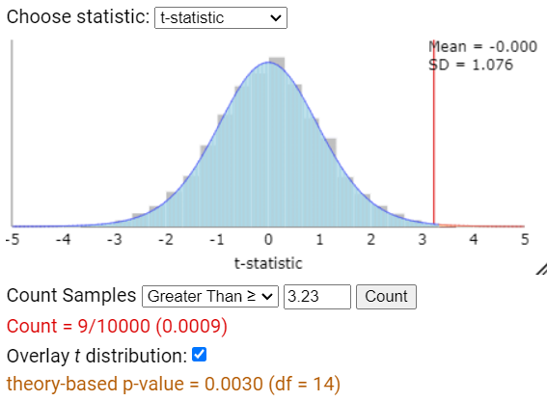
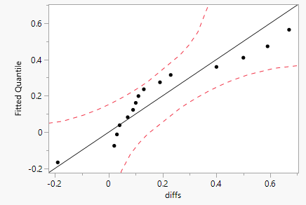
Practice questions: 4.9B
Calculate the differences: 0.199
Stacked vs. unstacked data
Validity conditions for CI: Needed to address both the sample size and the distribution of the differences
Confidence interval
Mean difference vs. Difference
This population of twins

Slide 6
Practice questions: 4.11
(a) Need to be able to compare the children to themselves, “maintain the pairing”
Parameter: π = probability that for children that only escape to one alarm, it’s the mom’s voice (“non-ties”)
“Success” = escape to mom’s voice and not conv
Or$,π_{mom}−π_{conv}$
“State your conclusions”
Significance (Ha), Estimation, Causation, Generalizability
Don’t stop with “reject null hypothesis”

Slide 7
Practice questions: 4.11
Good simulation descriptions
Make sure comparison is clear
Not as good: Kids are more likely to escape with the mom’s voice
Is ok to think in terms of $H_{0}:π_{mom}−π_{conv}=0$ as long as you remember these are paired samples
Be able to pick out simulation-based vs. exact vs. theory-based p-value
Evidence vs. Convincing evidence

Slide 8
HW 8
Due Tonight/Sat…
Solutions posted Sun am
Course evaluations due tonight!
Focus group opportunity early next quarter

Slide 9
Final Exam
Anyone else want to switch Mon → Wed?
3 pages of notes
Can include “overview of statistical procedures” handout??
Performance assessment
Think “big picture”: how design a study, how explore data, test/intervals, conclusions, critique, extend
Will be expected to use the computers
Typing in longer answers
Carrying out an analysis (but I can often help if ask a “this isn’t working” question) in R or applet
Uploading screen shot

Slide 10
Case Study – The Biggest Loser
Choice of procedures
Starting point: observational units and variable
How many variables? Are the variable(s) quantitative or categorical? Are the technical conditions met for a large sample procedure? Does the situation fit one of our common models?
Plus
Elements of good study design
Explaining the process

Slide 11
HW 7 highlights
Use numbers to back up statements about spread and center
Hypotheses are about either
Association between variables (direction)
Difference between means
Can test for difference other than 0
CI I’m 95% confident that the average amount of chili sauce measured by people who play aggressive video games is between 2.22 and 11.91 grams higher than the average amount of chili sauce measured by people who play neutral video games.

Slide 12
HW 7 highlights
Use numbers to back up statements about spread and center
Hypotheses are about either
Association between variables (direction)
Difference between means
Can test for difference other than 0
CI I’m 95% confident that the average amount of chili sauce measured by people who play aggressive video games would be (in the long run) between 2.22 and 11.91 grams higher than the average amount of chili sauce measured by people who play neutral video games.

Slide 13
Exam highlights
Exam 1
Defining obs unit, variable, sample, population (or random process), parameter vs. statistic
Values other than 0.50 in a test (research question) for a single proportion
Central Limit Theorem
Standardized statistic = (statistic – hypothesized)/(SE statistic)
CI: statistic + critical value x SE statistic
Alternatives to one-sample z-procedures
Exact, simulation, theory-based

Slide 14
Exam highlights
Exam 2
Distributions of quantitative variables
Anticipate behavior (patterns, exceptions)
Data transformation
CLT for sample mean
Confidence interval vs. Prediction interval
Comparing groups
Association vs. causation, confounding variables
Comparing proportions (difference vs. ratio vs. odds)

Slide 15
More recently
Random sampling vs. random assignment vs. Paired designs
Impact on simulation strategy
Impact on standard error of statistic
Impact on theory-based approach
Categorical vs. Quantitative response
Identify corresponding procedures, validity conditions
Choice of statistic
Duality between CI and p-value
Plausible value(s) for parameter
One-sided vs. two-sided p-values
Stating hypotheses about parameters…

Slide 16
Reminders
Practice quizzes
Practice multiple choice questions
Not a great match…
HW 8, course evaluations due tonight
Optional Review sessions Sun/Tues 5/4pm
Optional Final Exam Discussion Board
Last Piece of Advice:
About 18% of statistics are made up on the spot…

