Slide 1
Stat 301 – Day 36
Paired data – Categorical response
The National Transportation Safety Board recently divulged a highly secret plan they had funded with the U.S. auto makers for the past five-years. The NTSB covertly funded a project whereby the auto makers were installing black boxes in four-wheel drive pick-up trucks in an effort to determine, in fatal accidents, the circumstances in the last 15 seconds before the crash.

Slide 2
They were surprised to find in 49 of the 50 states the last words of drivers in 61.2% of fatal crashes were, "Oh, Shit!"
Only the state of Texas was different, where 89.3% of the final words were, "Hey Y'all, watch this!"

Slide 3
Announcements

Slide 4
Last Time – Analysis of paired data
1) Simulation = randomly interchanging observations (null)
2) One-sample analysis of differences (Ch. 2)
One-sample t-procedures
Validity conditions: distribution of differences is approximately normal or number of pairs is large (30)
Can interpret parameter as either “mean difference” or “difference in means”
Including prediction interval
Option: Remove ties
Notes:
Coronavirus vaccine

Slide 5
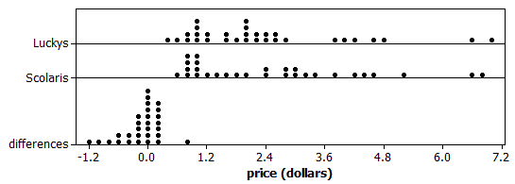
Investigation 4.10
Comparing prices at 2 grocery stores
Observational study, Paired data
Parameter = mean price difference

Slide 6
Investigation 4.10
Can I remove outliers?
Yes for the case of the milk because we did find a data collection error. Not for the others.

Slide 7
Investigation 4.10
Confidence interval vs. prediction interval
Estimating mean price difference vs. estimating one price difference

Slide 8
Analysis 2:
When there is a difference, is it more likely to be at Lucky’s or Scolari’s?
Notes:
Coronavirus vaccine

Slide 9
Analysis 2:
What if we counted up how many products were more expensive at Scolari’s?
13 negatives (more expensive at Scolari’s)
8 positive
7 zeros
How would you decide if there is a genuine tendency for one store to be more expensive?
Notes:
Is reasonable to discard the ties because they don’t give us any information about which store is more expensive

Slide 10
What about ties?
There are several reasonable options including
Make half positive and half negative
Make all positive and see how p-value changes and then reverse
Drop them… don’t add any information about which store is cheaper
(could consider this in the earlier case with the quantitative response as well)

Slide 11
Analysis 2:
13
8
Let X count the number that are more expensive at Scolari’s, when there is a difference (ignoring ties)
Let π represent the probability of a product being more expensive at Scolari’s
H₀: π = 0.50 (equally likely)
H_{a}: π > 0.50 (Scolari’s more likely)

Slide 12
Analysis 2:
13
8
Let X count the number of negative differences
Under the null hypothesis, X follows a Binomial distribution with n = 21 and π = 0.50.
Exact p-value = P(X > 13) = 0.192

Slide 13
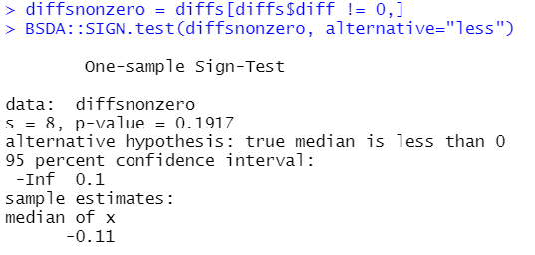
Technology Detour
π = 0.50 corresponds to Median Diff = 0
s = number positive

Slide 14
Analysis 2
Normal approximation?
Same (one sample) rules apply
At least 10 successes and at least 10 failures

Slide 15
Conclusion…
We do not have convincing evidence that “in the population” a majority of products are more expensive at Scolari’s
Advantages?
Works with skewed data, outliers
More sensitive to lots of small differences
Disadvantages?
Throwing away information
Can’t estimate how much more expensive

Slide 16
Last Time – Analysis of paired data
1) Simulation = randomly interchanging observations (null)
2) One-sample analysis of differences (Ch. 2)
One-sample t-procedures (vs. prediction interval)
3) Binary response variable (“sign test”) (Ch. 1)
Count the number of observations that have positive differences, usually n = represents the number of non-zero differences (can see how sensitive to this)
X ~ Binomial(n, π = 0.50): Exact p-value, or simulation, or (if appropriate) one-proportion z-test
CI’s for π
Equivalent to a test about the population median difference
Notes:
Coronavirus vaccine

Slide 17
To be working on
Resubmitting practice questions?
Please highlight your changes
Investigation 4.11

Slide 18
Investigation 4.11
Obs units = children
EV = type of alarm
RV = whether or not woke up
Matched pairs design
Random: which heard first

Slide 19
Investigation 4.11
23/24 woke up to mom’s voice
14/24 work up to conventional alarm
Can’t treat as independent samples
Simulation to interchange order?

Slide 20
BAD table
 | Mom’s voice | Conventional | Total
Woke up | 23 | 14 | 37
Didn’t wake up | 1 | 10 | 11
Total | 24 | 24 | 48

Slide 21
Investigation 4.11
What are the two variables measured on each child?
When there was a difference in response, tended to wake up to mom’s voice
Significantly more often?
14
9
0
1

Slide 22
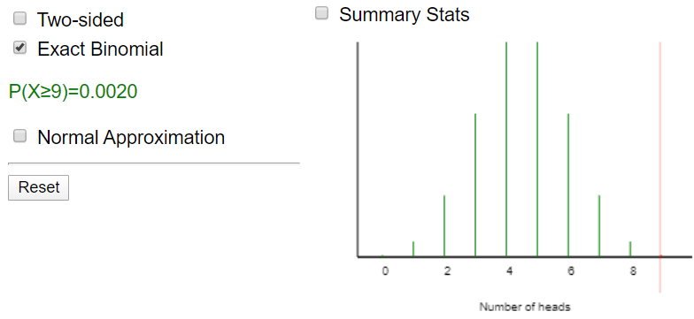
Investigation 4.11
Let π represent the probability of waking up to only the mom’s voice
H₀: π = 0.50 (equally likely)
H_{a}: π > 0.50 (more likely)
Let X represent the number waking up to only mom’s voice and n = number waking up to only one alarm
Exact binomial p-value = P(X > 9)

Slide 23
Binomial confidence interval?

Slide 24
Conclusion
We have strong evidence (p-value = 0.00195) to reject H₀: π = 0.5 (equally likely to wake up to mom/conventional) when wake up to exactly one of the two alarms. This is convincing evidence that mom’s voice increases (causation because this was a randomized matched-pairs experiment) the likelihood of waking up (0.66 to 1.00), at least for children like those in this study (healthy children aged 6-12).

Slide 25
To Do
Finish practice question submissions
If resubmit, highlight changes
Finish HW 8
Read Ch. 4 summary, examples, choice of procedures
I hope to post more review materials later today
Is a Final Exam Multiple Choice Practice Quiz
Is a Case Study posted
Is an “overview of procedures” handout posted
Final Exam Discussion Board now open

