Slide 1
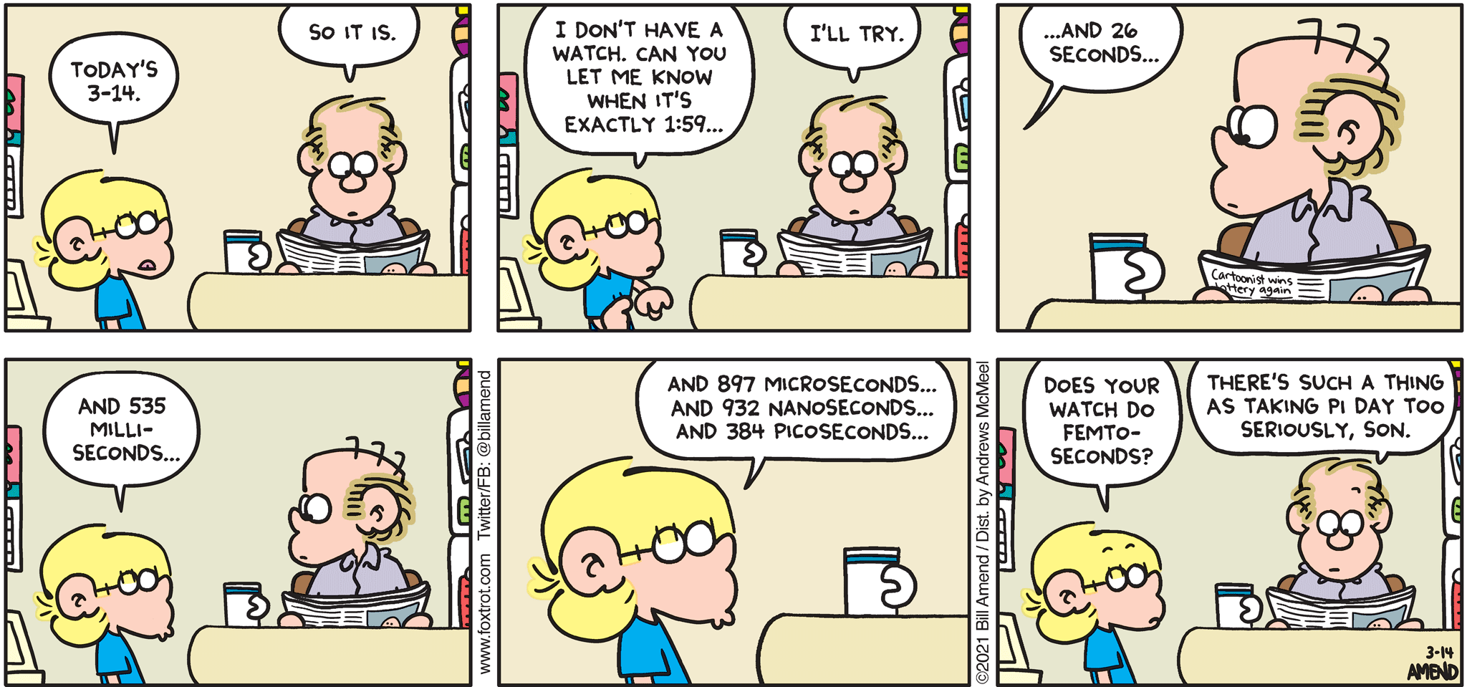
Stat 301 – Day 36
Analyzing Paired Data

Slide 2
Announcements
HW 7 returned at 2…
Most Q4s were graded off line and uploaded
Credit for water survey
More R instructions added to HW 8

Slide 3
Last Time – Paired Data
What a paired design looks like
Experiment or Observational
How to carry out (e.g., randomizing order of treatments)
Want two units in each pair to be as similar as possible (e.g., same person twice, identical twins, two halves of orange)
If observations within pairs aren’t related, won’t really help much (e.g., coronavirus vaccine)
Possible benefits of a paired design
Goal: Reduce “unexplained variation” to better see differences in EV groups of interest (↑ power)
Notes:
Coronavirus vaccine

Slide 4
Estimating Power
Actual difference in typing speeds is 4 words per minute on average
Person-to-person variation is on the order of 15 wpm,
Have 34 people in each group
Estimate the power of this experiment

Slide 5
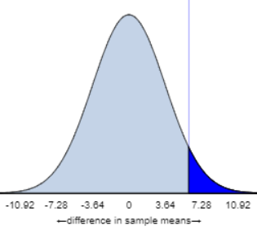
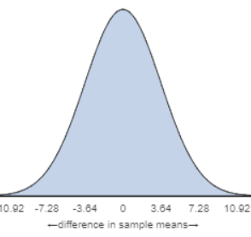
Calculating Power
$$H_{0}:μ_{music}−μ_{nomusic}=0$$
$$H_{a}:μ_{music}−μ_{nomusic}>0$$
1. How large of a difference is needed to reject the null hypothesis?
SE = $\sqrt{\frac{{15}^{2}}{34}+\frac{{15}^{2}}{34}}=3.64$
0.05
Need ${\overline{x}}_{music}−{\overline{x}}_{nomusic}≥5.987$ to reject H₀ at 5% level

Slide 6
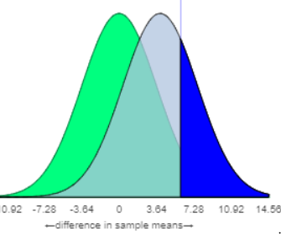
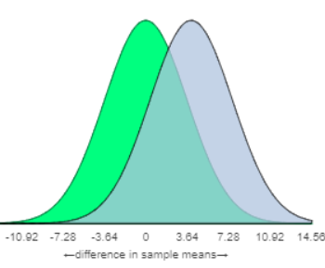
Calculating Power
$$H_{0}:μ_{music}−μ_{nomusic}=0$$
$$H_{a}:μ_{music}−μ_{nomusic}>0$$
2. How often will you reject the null when the alternative is true (actual difference $μ_{music}−μ_{nomusic}$ = 4)
0.30
If $μ_{music}−μ_{nomusic}$ = 4, ${\overline{x}}_{music}−{\overline{x}}_{nomusic}≥5.987$ about 30% of samples

Slide 7
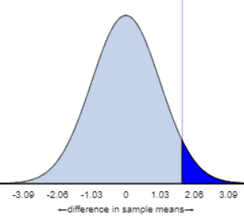
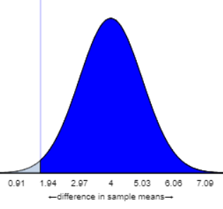
Paired Design
Saw the standard deviation of the differences was more like 6 wpm. Using the same 34 people for both tests:
SE = $\frac{6}{\sqrt{34}}=1.03$
1.693

Slide 8
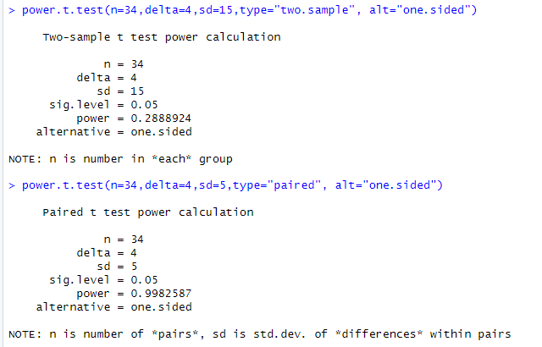
R output

Slide 9
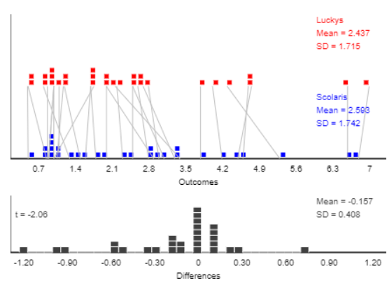
Was pairing helpful?

Slide 10
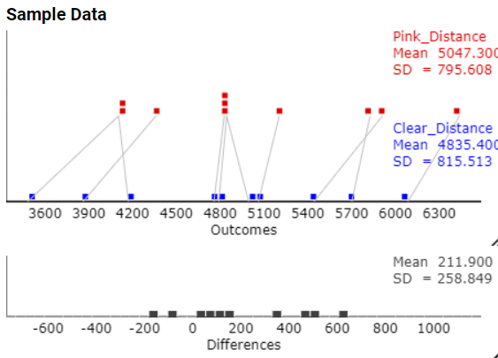
Example: Color of sports drink

Slide 11
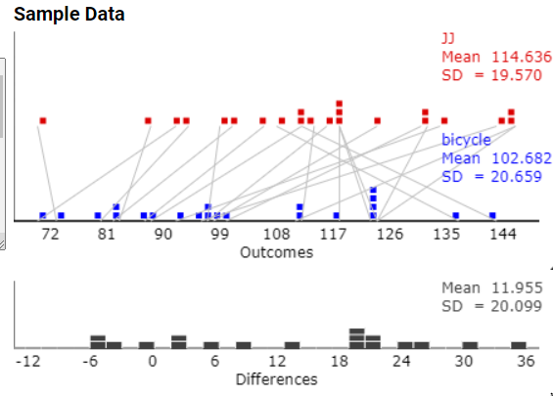
Example: Jumping Jacks vs. Bicycle Kicks

Slide 12
Analysis of paired data: Differences
1) Simulation
Randomly interchange the two observations within each pair to get a sense of the “by chance alone” variation in the mean difference
2) Mathematical model?

Slide 13
Analysis of paired data: Differences
1) Simulation
Randomly interchanged the two observations within each pair to get a sense of the “by chance alone” variation in the mean difference
2) One-sample analysis of differences (Ch. 2)
One-sample t-procedures
Are differences normally distributed? Have more than 30 differences?

Slide 14
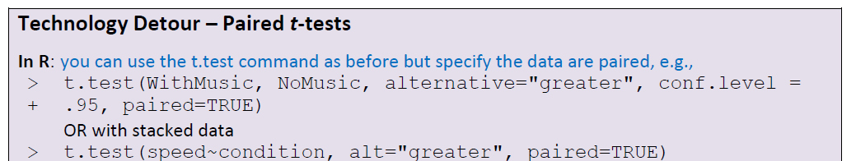
Using R
Using R widget (need to read in data)
typing = read.delim("http://www.rossmanchance.com/iscam3/data/TypingMusic.txt", sep="\t")
with(typing, t.test(WithMusic, NoMusic, alternative="greater", conf.level = .95, paired=TRUE))
with(typing2, t.test(speed~condition, paired=TRUE))

Slide 15
Big typo!
$SE\left({\overline{x}}_{1}−{\overline{x}}_{2}\right)=\sqrt{\frac{s_{1}^{2}+s_{2}^{2}−2 r s_{1}s_{2}}{n}}$ $\sqrt{\frac{{13.773}^{2}+{14.091}^{2}−2( .916)\left(13.773\right)\left(14.091\right)}{34} }$= $\frac{5.705}{\sqrt{34}}$
$≈0.98$

Slide 16
Practice Question 4.9
Apply one-sample t-procedures
Applet or R (find the differences)
Include output

Slide 17
To Do
PQ 4.9
Inv 4.10
Tomorrow: Inv 4.11

Slide 18
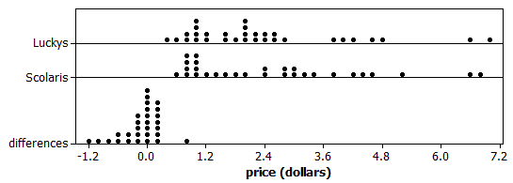
Investigation 4.10
Comparing prices at 2 grocery stores
Observational study, Paired data
Parameter = mean price difference

Slide 19
Was pairing helpful?

Slide 20
Investigation 4.10
Can I remove outliers?
Yes for the case of the milk because we did find a data collection error. Not for the others.

Slide 21
Investigation 4.10
Confidence interval vs. prediction interval
Estimating mean price difference vs. estimating one price difference

Slide 22
Analysis 2 (PP 4.10B):
What if we counted up how many products were more expensive at Scolari’s?
13 negatives (more expensive at Scolari’s)
8 positive
7 zeros
How would you decide if there is a genuine tendency for one store to be more expensive?
Notes:
Is reasonable to discard the ties because they don’t give us any information about which store is more expensive

Slide 23
What about ties?
There are several reasonable options including
Make half positive and half negative
Make all positive and see how p-value changes and then reverse
Drop them… don’t add any information about which store is cheaper
(could consider this in the earlier case with the quantitative response as well)

Slide 24
Analysis 2:
13
8
Let X count the number that are more expensive at Scolari’s, when there is a difference
Let π represent the probability of a product being more expensive at Scolari’s
H₀: π = 0.50 (equally likely)
H_{a}: π > 0.50 (Scolari’s more likely)

Slide 25
Analysis 2:
13
8
Let X count the number of negative differences (“sign test”, Investigation 2.7)
What about ties?
Under the null hypothesis, X follows a Binomial distribution with n = 21 and π = 0.50.
Exact p-value = P(X > 13) = 0.192

Slide 26
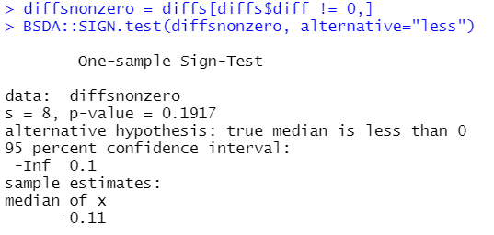
Technology Detour
π = 0.50 corresponds to Median Diff = 0
s = number positive

Slide 27
Analysis 2
Normal approximation?
Same (one sample) rules apply
At least 10 successes and at least 10 failures

Slide 28
Conclusion…
We do not have convincing evidence that “in the population” a majority of products are more expensive at Scolari’s
Advantages?
Works with skewed data, outliers
More sensitive to lots of small differences
Disadvantages?
Throwing away information
Can’t estimate how much more expensive

