Slide 1
Stat 301 – Day 35
Prep work: Complete Inv 4.8 (a)-(f) in CourseKata
Matched Pairs Designs

Slide 2
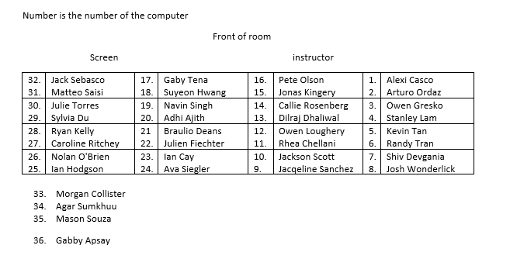
Section 1

Slide 3
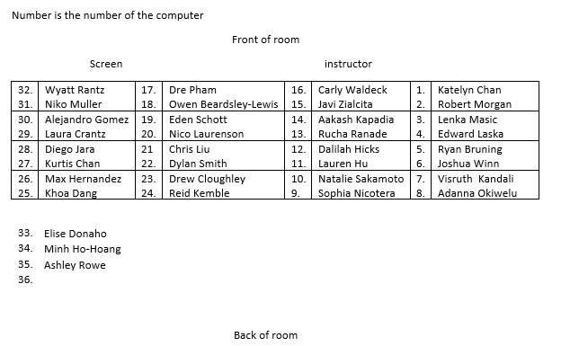
Section 2

Slide 4
Announcements
This week – “paired data”
Includes review of some Ch. 1, Ch. 2 material
HW 8 (2 problems)
Start reviewing
Review session Sun? Tues?
Extra office hours this week?
Course evaluations (due Friday)

Slide 5
HW 7/Quiz 8
HW 7: Using simulation as a way to verify validity of t procedures
Q2: bootstrapping
Models random sampling
Pooling – models null hypothesis (no difference in populations)
Like randomization distribution, usually larger SD for the null distribution (if large difference between groups)
CI: observed statistic + 2 (SD of statistic)
Standard error

Slide 6
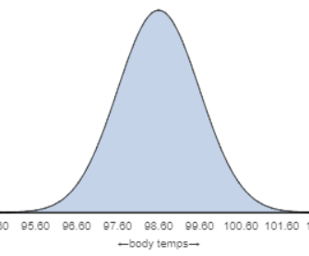
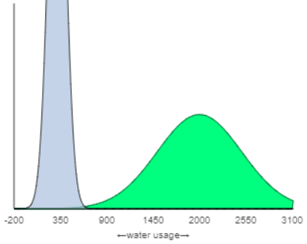
HW 7/Quiz 8 – Stat 302 preview
Recall: Is healthy body temp 98.6?
$temp_{i}=98.6+random error_{i}$
Q4: Hypothesizing difference of 1690
${usage}_{i}=survey_{i}+random error_{i}$
$$=\left\{\begin{matrix}μ_{S} \\ μ_{S}+1690\end{matrix}\right.+random error_{i}$$
If hadn’t been short/long difference, the means would be the same. So then observations interchangeable, but then anyone going to short group answers 1690 less.

Slide 7
Quiz 8
Some questions given partial or full credit

Slide 8
Last Time
When comparing two groups on a quantitative response, are alternatives to two-sample t-test (e.g., don’t think validity conditions are met, don’t want to focus on means)
Difference in medians: Randomization test
Log transformation: Back-transforming confidence interval gives interval for ratio of medians

Slide 9
Paired designs
When there is a lot of natural variation in the response outcomes (large s’s), can “design out” some of that variation by “blocking” on each individual, i.e., use a paired design
Example:
Each subject receives both treatments (randomize order of the treatments to account for any “carry over” effects)
Married couples, political opinions
Twins, one with condition and one without

Slide 10
Consequence
Have to account for the pairing/lack of independence in the observations in the analysis

Slide 11
Goal
To reduce “unexplained variation”
Standard deviation of differences smaller than standard deviations of original observations
Increases power of detecting a genuine group difference when there is one

Slide 12
Key Idea
With a paired design, analysis will focus on the differences
SD(${\overline{x}}_{diff}$) generally smaller than $SD({\overline{x}}_{1}−{\overline{x}}_{2})$
Impacts our judgement of how unusual the observed statistic is (when the null hypothesis is true)
Paired t-test: one sample t-test on differences
Simulation model: two values are interchangeable

Slide 13
To Do for Wednesday
PP 4.8B (PQ 4.8)
Multiple choice, individual, unlimited attempts
Start HW 8

