Slide 1
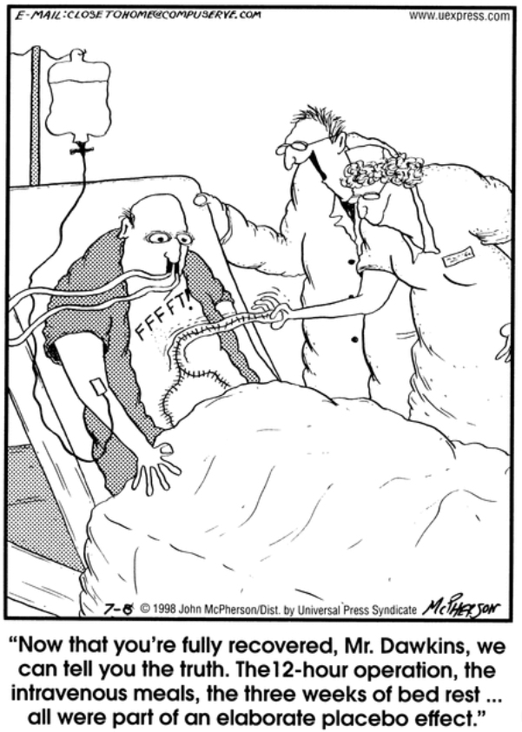
Stat 301 – Day 33
Comparing Two Means
cont.

Slide 2
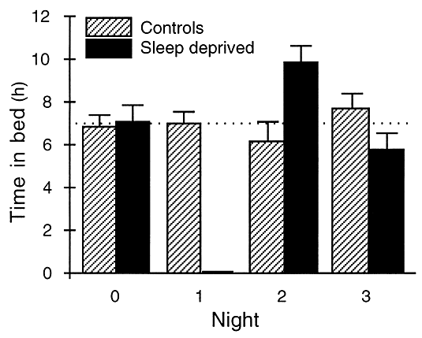
Comparing groups - quantitative
Standard error bars

Slide 3
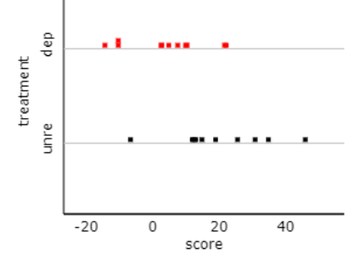
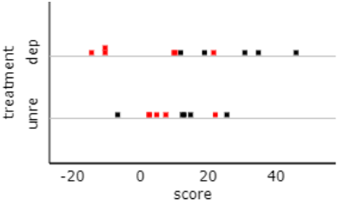
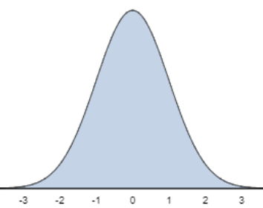
Comparing Two Means
Ind random samples
Random assignment
$$μ_{1}$$
$$μ_{2}$$
$${\overline{x}}_{1}$$
$${\overline{x}}_{2}$$
$${\overline{x}}_{1}− {\overline{x}}_{2}$$
$${\overline{x}}_{1}$$
$${\overline{x}}_{1}$$
$${\overline{x}}_{2}$$
$${\overline{x}}_{2}$$
$${\overline{x}}_{1}$$
$${\overline{x}}_{2}$$
$$μ_{1}−μ_{2}$$
0
$${\overline{x}}_{1}− {\overline{x}}_{2}→$$
$${\overline{x}}_{1}− {\overline{x}}_{2}→$$

Slide 4
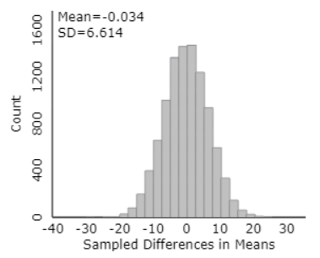
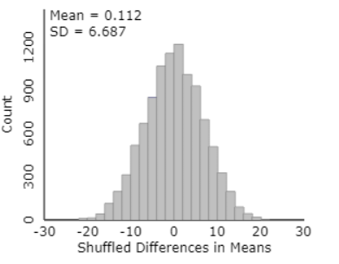
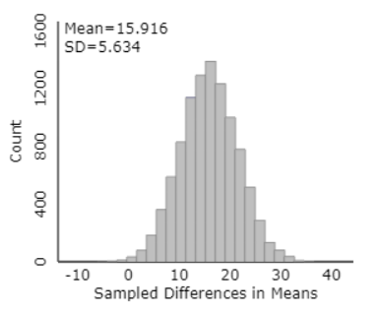
Sleep deprivation study…
$\sqrt{\frac{{12.17}^{2}}{11}+\frac{{14.73}^{2}}{10}}$ = 5.93
Bootstrapping (pooled)
Randomization test
(unpooled)

Slide 5
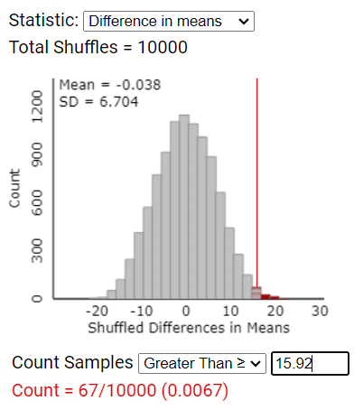
Last Time – Comparing 2 Treatment Means
Random assignment (fixed response values)
$H_{o}:$ no association between RV and EV
$H_{o}:μ_{1}−μ_{2}=0$ (“long-run treatment means”)
How does ${\overline{x}}_{1}−{\overline{x}}_{2}$ behave in random shuffles?
Simulation:
Assume “scores fixed”
Reshuffle to groups (11 and 10)
Record difference in means
“Randomization distribution”

Slide 6
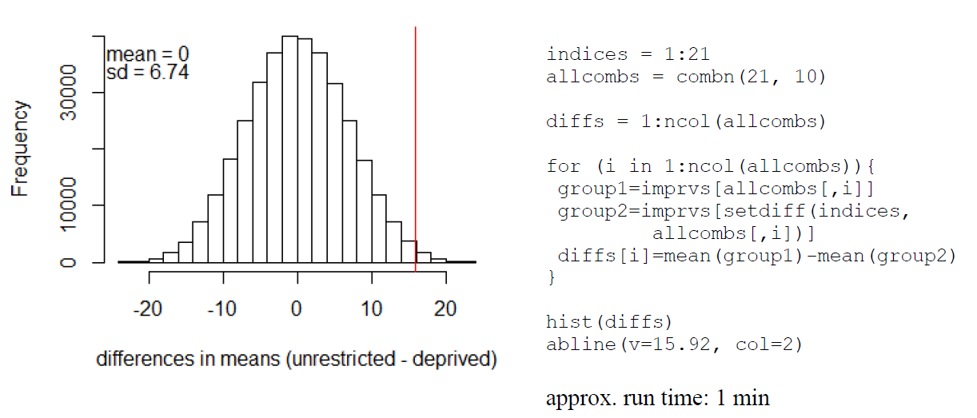
Last Time – Comparing 2 Treatment Means
Random assignment (fixed response values)
$H_{o}:μ_{1}−μ_{2}=0$ (“long-run treatment means”)
How does ${\overline{x}}_{1}−{\overline{x}}_{2}$ behave in random shuffles?
“exact randomization distribution”
0.0069
pvalue=sum(diffs >= 15.92)/ncol(allcombs)
exact p-value = 0.0072

Slide 7
Can we model this with the normal distribution?
$SE\left({\overline{x}}_{1}−{\overline{x}}_{2}\right)=\sqrt{\frac{s_{1}^{2}}{n_{1}}+\frac{s_{2}^{2}}{n_{2}}}$?
$=\sqrt{\frac{{12.17}^{2}}{11}+\frac{{14.73}^{2}}{10}}$ = 5.93
Not a great match…
Assumes independent random samples
But if all the high scores go to one group, we know all the low scores are in the other group
So instead of variances adding, need to consider that relationship

Slide 8
How find $SE\left({\overline{x}}_{1}−{\overline{x}}_{2}\right)$
Considering the (common) population standard deviation, finite population correction, and the correlation (-1) between the two means … that formula actually simplifies to*
$$SE\left({\overline{X}}_{1}−{\overline{X}}_{2}\right)=s\sqrt{\frac{1}{n_{1}}+\frac{1}{n_{2}}}$$
where s is the standard deviation of all N = n₁+ n₂ observations

Slide 9
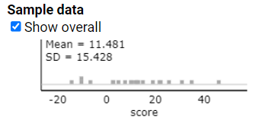
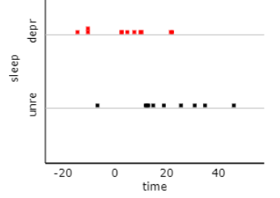
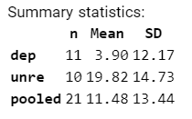
How find $SE\left({\overline{x}}_{1}−{\overline{x}}_{2}\right)$
Under the null hypothesis
Note, this isn’t the same as “averaging” the two SDs together
$$15.428\sqrt{\frac{1}{10}+\frac{1}{11}}=6.74$$
$$\sqrt{\frac{{12.17}^{2}}{11}+\frac{{14.73}^{2}}{10}}=5.93$$
$$13.44\sqrt{\frac{1}{10}+\frac{1}{11}}=5.87$$

Slide 10
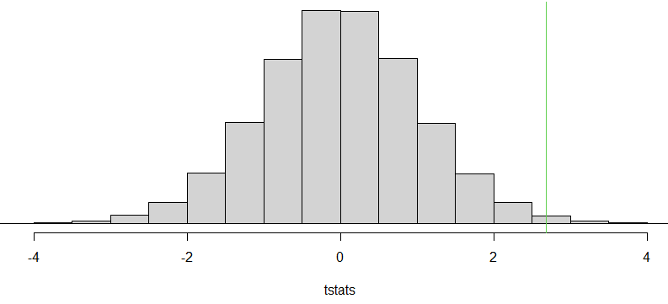
Can we model this with the normal distribution?
$SE\left({\overline{x}}_{1}−{\overline{x}}_{2}\right)=\sqrt{\frac{s_{1}^{2}}{n_{1}}+\frac{s_{2}^{2}}{n_{2}}}$?
$=\sqrt{\frac{{12.17}^{2}}{11}+\frac{{14.73}^{2}}{10}}$ = 5.93
Not a great match…
What if we use it anyway?
$t=\frac{15.92−0}{5.93}=2.685$
Need a reference distribution
p-value = .00733

Slide 11
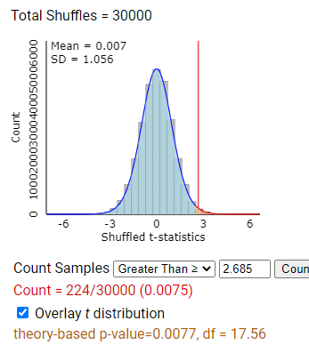
Can we model this with the t-distribution?
The t distribution still provides a reasonable approximation to the randomization distribution of the standardized statistic!!!
Larger differences in means go with smaller standard deviations…

Slide 12
Confidence interval
15.92 + t*(5.93) = (3.44, 28.40)
I’m 95% confident that the long-run treatment mean improvement score is 3.44 to 28.40 ms faster if allowed unrestricted sleep than if sleep deprived

Slide 13
Moral
Can use the t-procedures with either
Independent random samples (large populations)
Randomized experiment
As long as normally distributed data or large sample sizes
We will always use “unpooled” version
Let computer estimate degrees of freedom
Worry about which source of randomness when draw final conclusions
Notes:
Simulate differently, won’t worry about exact tests

Slide 14
Practice Question 4.5

Slide 15
Investigation 4.6

Slide 16
To Do
Office hour tomorrow 2:30-3:30pm
Submit PQ 4.5
Baseline = “time 0”
Work through Investigation 4.6 in Course Kata
HW 7
Tomorrow Investigation 4.7

Slide 17
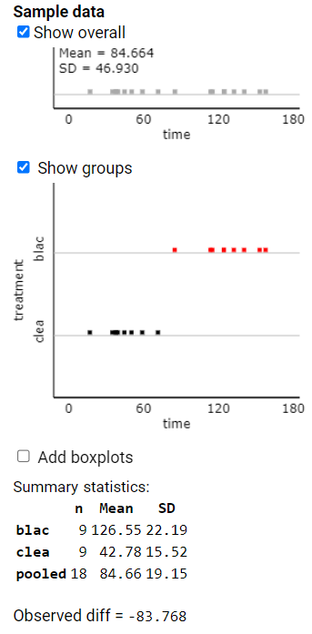
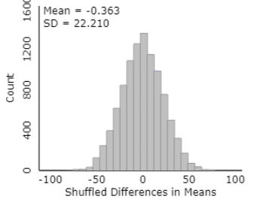
Side example
Dung beetles…
$$46.930\sqrt{\frac{1}{9}+\frac{1}{9}}=22.12$$
$$\sqrt{\frac{{22.19}^{2}}{9}+\frac{{15.52}^{2}}{9}}=9.03$$

