Slide 1
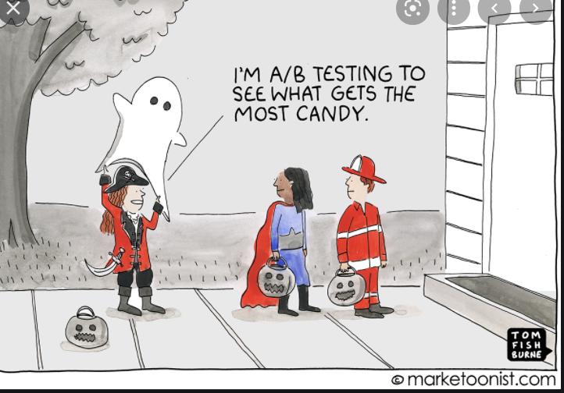
Stat 301 – Day 32
Prep for today: Inv 4.4(a)-(i)
Randomization test (Quantitative response)

Slide 2
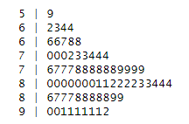
Announcements
Exam 2
HW 7
Optional applet explorations

Slide 3

Last Time – Two-sample tests
Factors that impact the statistical significance when comparing two sample means
  Size of the difference in means
  Sample sizes of the groups
  Sizes of the sample (‘within group’) standard deviations
    More “noise” in the data means harder to eliminate ‘random chance’ as an explanation for the difference
    Related to the idea of “power” – want your procedure to be sensitive enough to detect genuine differences

Slide 4
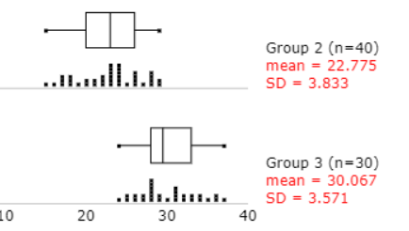
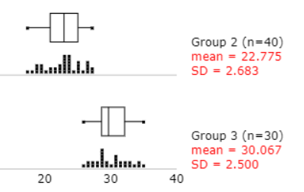
PQ
Please highlight changes in your resubmission!
(a) Baseline data… prior to intervention
(b) Explain why?
(c) Tie back to (a) and (b)?
  Confounding variables not at play here?

Slide 5

Investigation 4.4
“Sleep is required for memory consolidation - the process by which experience or training is transformed into improvements in performance.”

Slide 6
Visual Discrimination Tasks

Slide 7
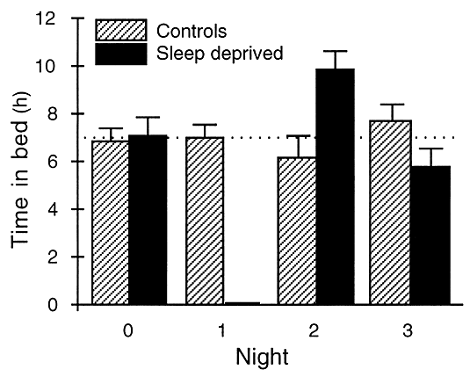
Stickgold, James, Hobson (2000)
Investigated whether you can make up for a missed night’s sleep
  60-90 minute training sessoin
  Group A: Sleep deprived one night, unrestricted sleep 2 nights
  Group B: Unrestricted sleep all 3 nights
  Retested after 72 hours

Slide 8
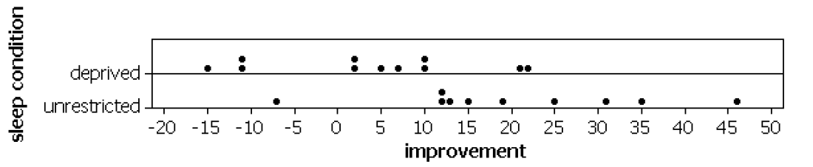
Sample data
Observed difference in means
  Unrestricted – Deprived: 19.82 – 3.90 = 15.92 ms
Is this a statistically significant difference?
How large do you think the difference is in the long run?

Slide 9
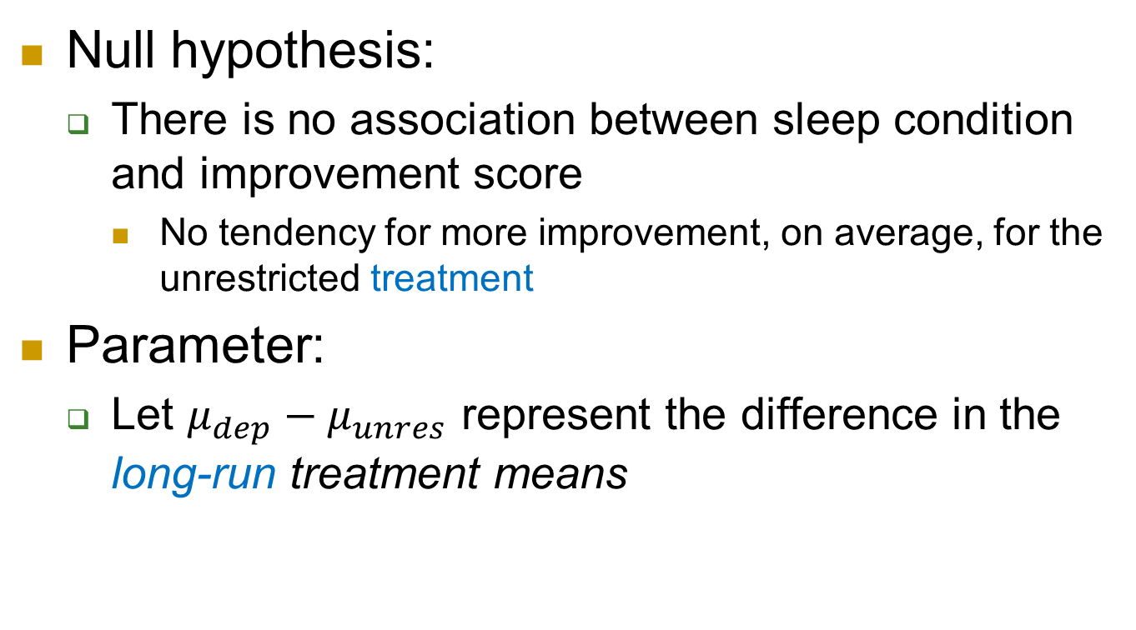
Statistical inference
Null hypothesis:
  There is no association between sleep condition and improvement score
    No tendency for more improvement, on average, for the unrestricted treatment
Parameter:
  Let $μ_{dep}−μ_{unres}$ represent the difference in the long-run treatment means

Slide 10
Simulation
21 index cards to represent the 21 subjects in the study
Write the improvement scores on the cards (-10.7, 4.5, 2.2…) to represent the treatment having no effect on the outcome
Shuffle into group of 11 and 10 to represent the random assignment in the study
Compute the difference in the group means
Repeat many, many times

Slide 11
Inv 4.4
(s) Significance?
  Yes, p-value is small (< .05). The chance of random assignment alone (assuming no treatment effect) producing a difference in sample means as large as 15.92 or larger is below .05.
(t) Causation?
  Yes, random assignment with a small p-value
(u) Generalizability?
  College-aged volunteers

Slide 12
PQ 4.4

Slide 13
To Do
Office hours
Today 2:30-3:30
Tomorrow 10-11
Before tomorrow: Inv 4.4 (v) and (w)
  Exact p-value
Submit Practice Question 4.4
Tomorrow: Normal approximation to randomization distribution

