Slide 1
Stat 301 – Day 31
Factors impacting p-values
Three statisticians and three mathematicians were going for a trip by train. Before the journey, the mathematicians bought 3 tickets but statisticians only bought one. When the conductor was approaching their compartment, all three statisticians crowded inside the nearest bathroom. The conductor, noticing that somebody was in the bathroom, knocked on the door. In reply he saw a hand with one ticket.

Slide 2
The next day, the mathematicians decided to use the same strategy- they bought only one ticket, but the statisticians did not buy tickets at all! When the mathematicians saw the conductor, they hid in the bathroom, and when they heard knocking they handed in the ticket.
They did not get it back. Why?
The statisticians took it and went to the other bathroom.

Slide 3
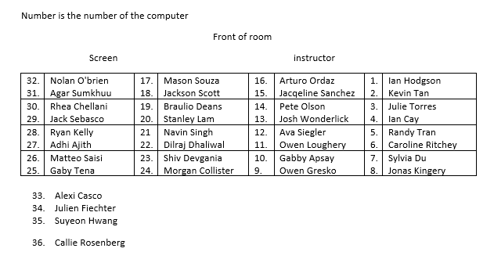
Section 1
Please open R or applets page

Slide 4
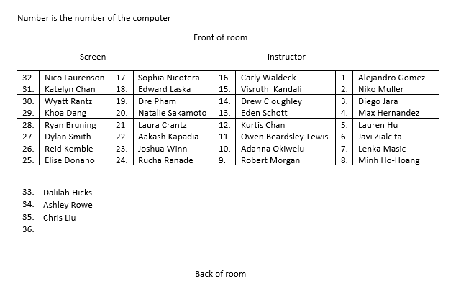
Section 2
Please open R or applets page

Slide 5
Announcements
Review Exam 2 scores/comments
  Exam avg ≈ 0.80
  Dropped lowest HW, lowest quiz (6), Exam 2 15%, updated Course Avg (3/4, 80%)
  Solutions/video in Canvas
HW 7 posted
Continuing format of doing a chunk of Investigation in CourseKata so more time in class to review, practice questions

Slide 6
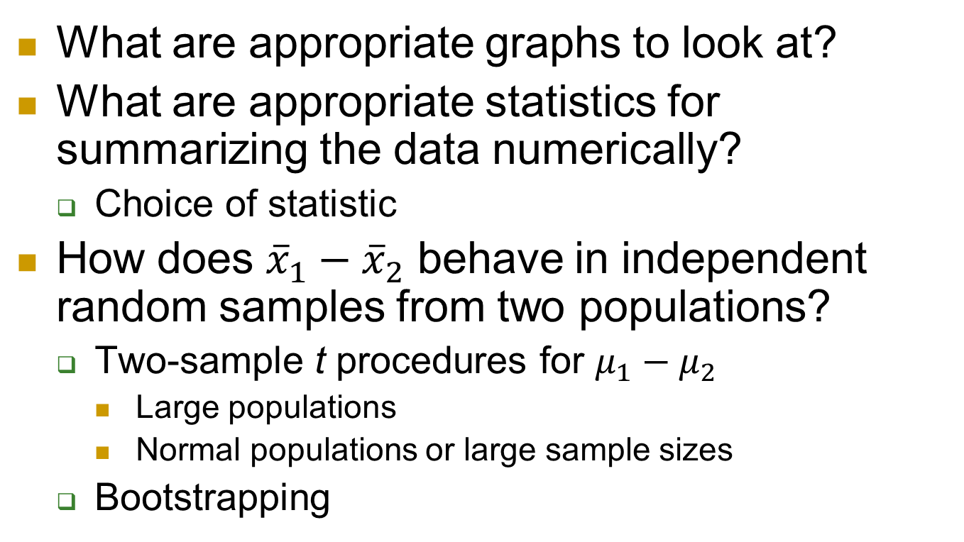
Last Week – Comparing groups on quantitative response
What are appropriate graphs to look at?
What are appropriate statistics for summarizing the data numerically?
  Choice of statistic
How does ${\overline{x}}_{1}−{\overline{x}}_{2}$ behave in independent random samples from two populations?
  Two-sample t procedures for $μ_{1}−μ_{2}$
    Large populations
    Normal populations or large sample sizes
  Bootstrapping

Slide 7
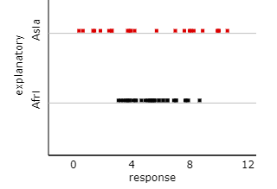

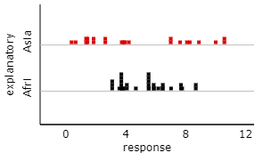
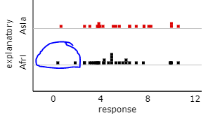

Pooled vs. Unpooled
Pooled vs. Unpooled t-test
  Pooled:
    Requires assuming population variances are equal
    We won’t use in this course (but you will in 302)
  Unpooled
Bootstrapping (simulation)
  Pool together first (H₀ true)
  Each sample individually (confidence interval)

Slide 8
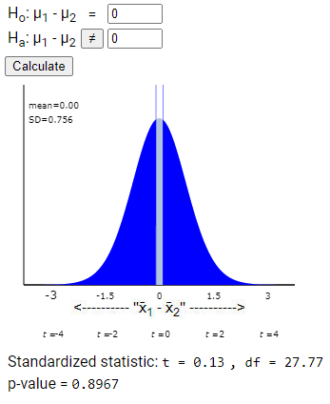
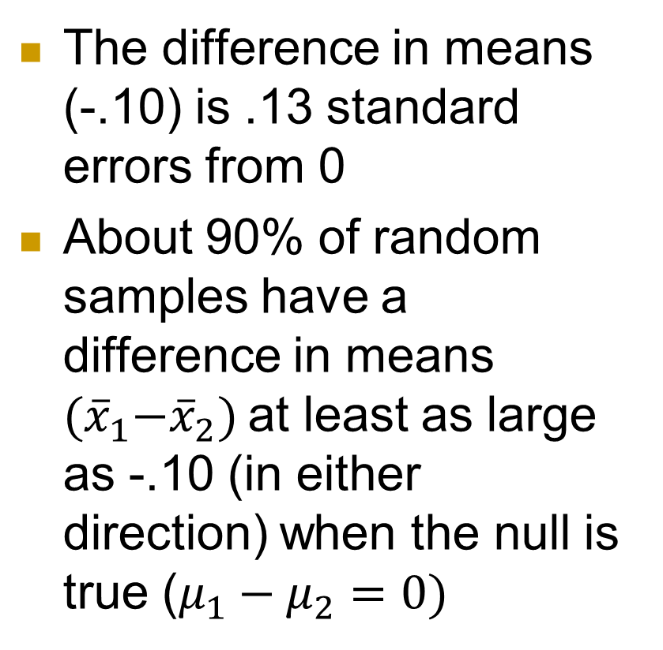
Elephants
The difference in means (-.10) is .13 standard errors from 0
About 90% of random samples have a difference in means ${(\overline{x}}_{1}−{\overline{x}}_{2})$at least as large as -.10 (in either direction) when the null is true ($μ_{1}−μ_{2}=0)$

Slide 9
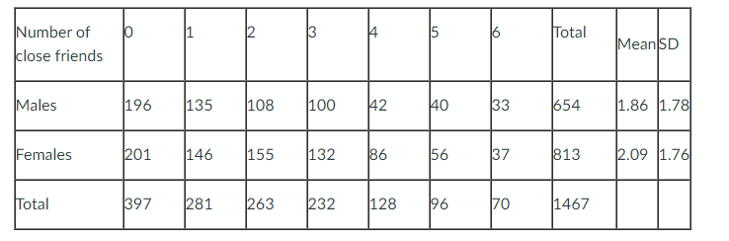
Quiz 7
Skewed data
t-procedures still valid due to large sample sizes (654, 813)
Parameter: Difference in mean number of close friends
CI all negative values so male – female
Decreasing sample sizes ↑ p-value, width
Two-sided p-value = 2 x one-sided p-value

Slide 10
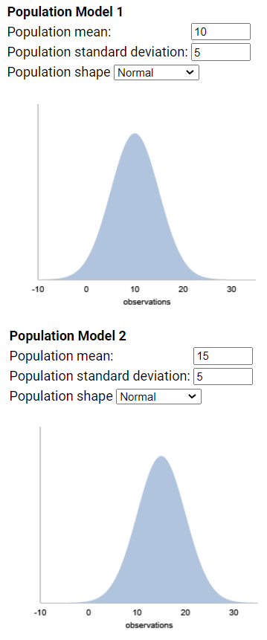

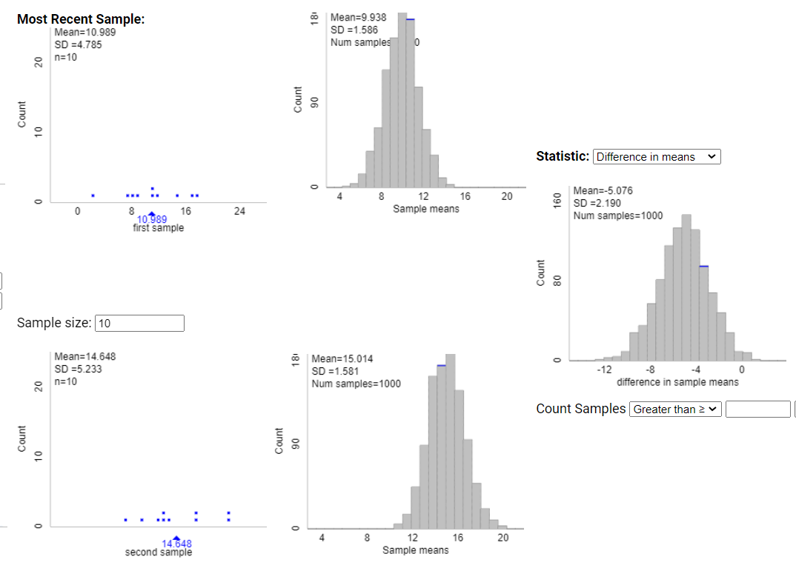

Demo (PQ 4.2, 4.3)
$$\sqrt{\frac{s_{1}^{2}}{n_{1}}+\frac{s_{2}^{2}}{n_{2}}}$$

Slide 11
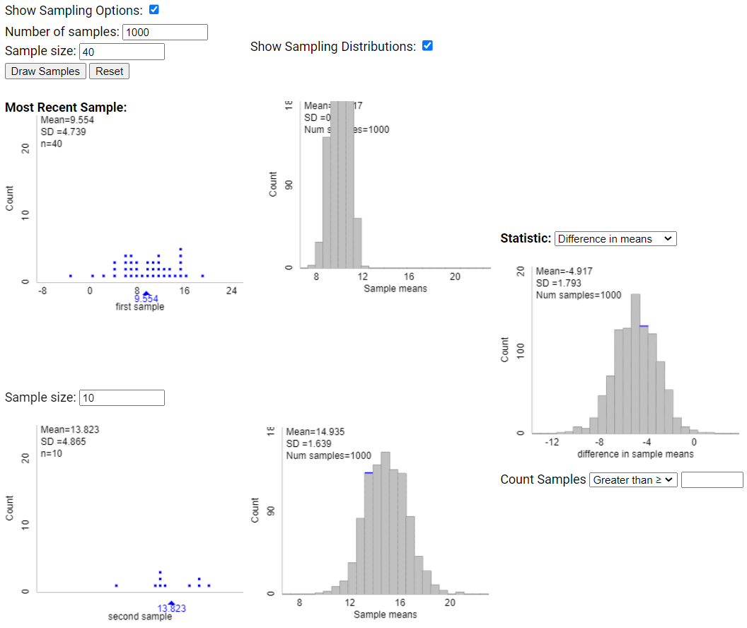
Demo (PQ 4.2, 4.3)

Slide 12
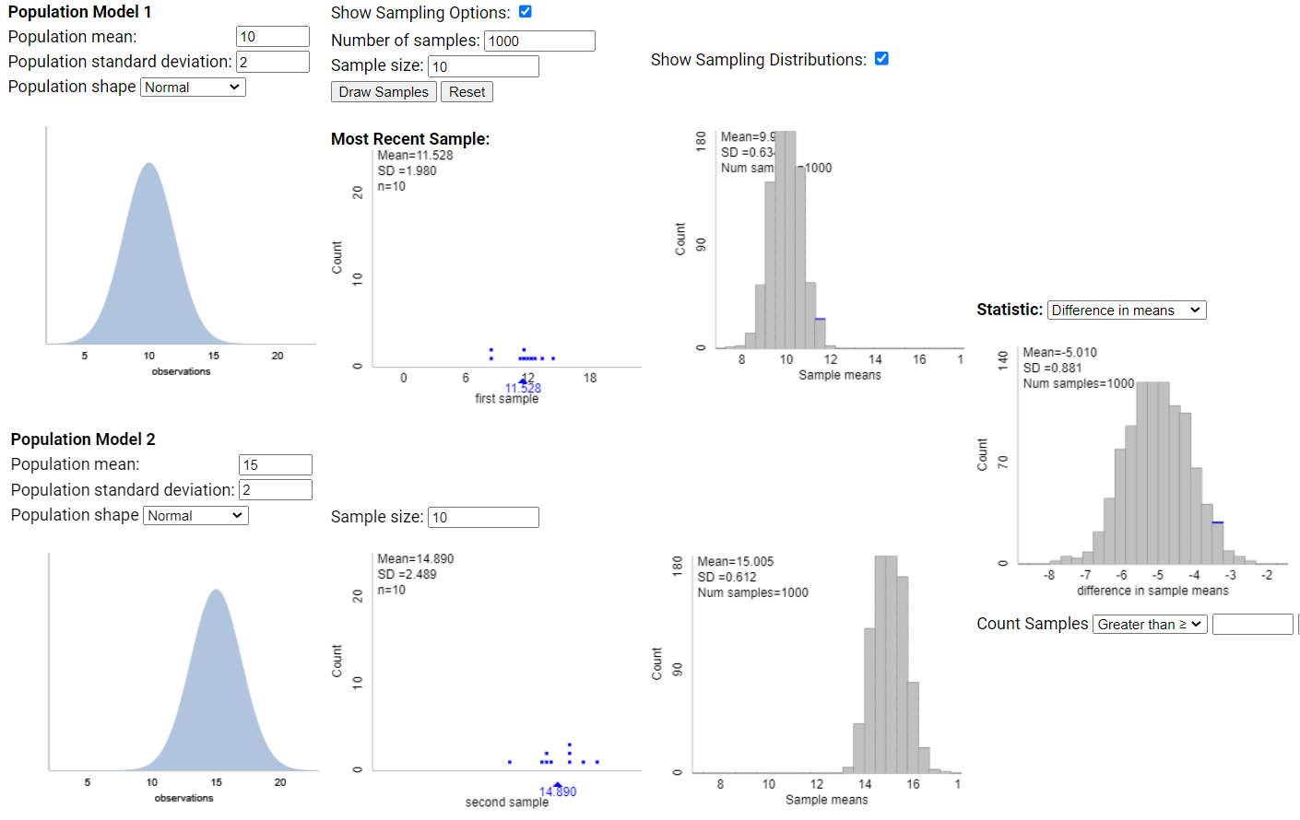
Demo (PQ 4.2, 4.3)

Slide 13
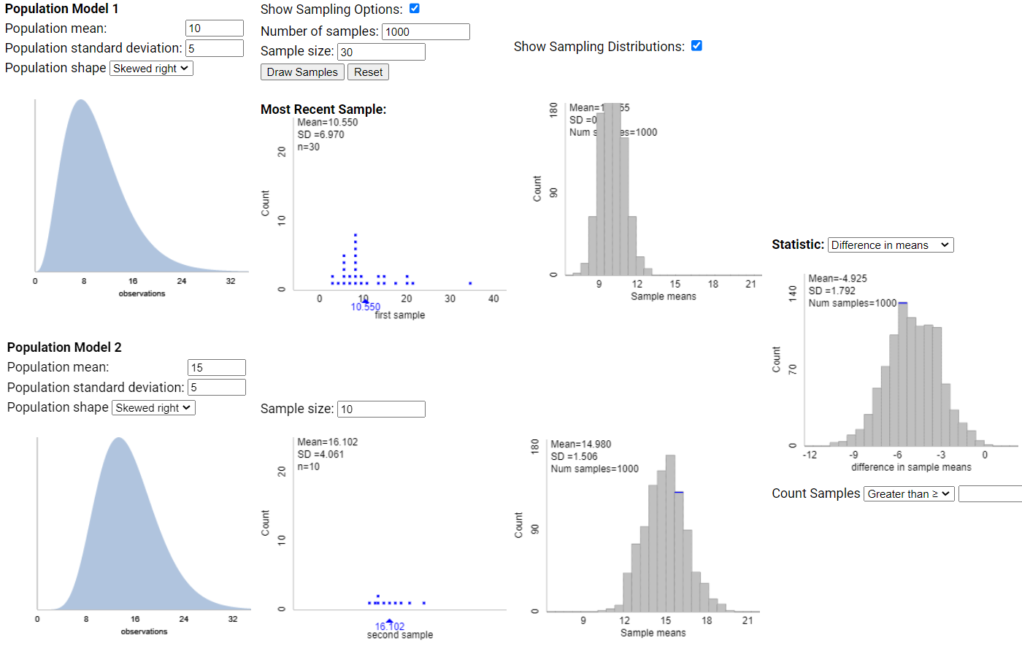
Demo (PQ 4.2, 4.3)

Slide 14
Investigation 4.3
Left-handedness and life expectancy
Coren and Halpern (1991) found 987 records
  Right handers: 75 years
  Left handers: 66 years
Can this difference be explained by random chance (random sampling error) alone?
  What additional information do you need to know? Why?

Slide 15
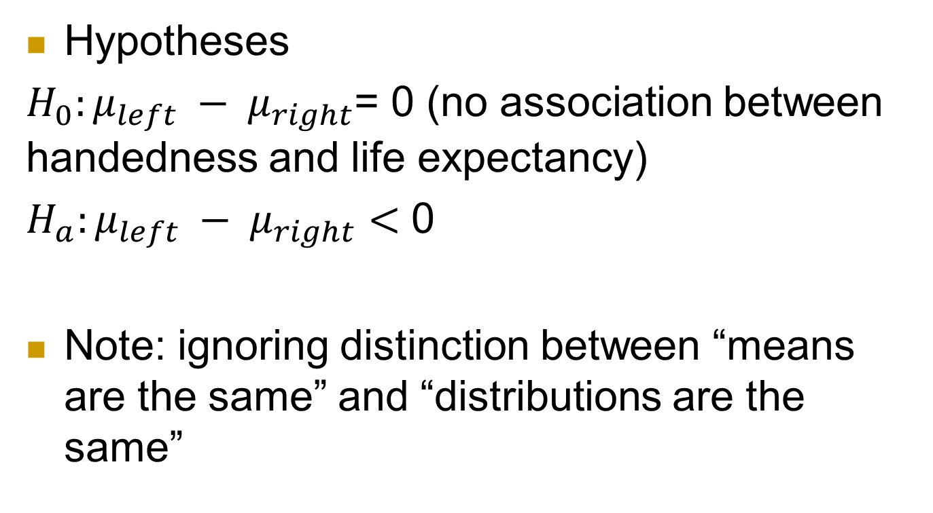
Investigation 4.3
Hypotheses
$H_{0}:{μ_{left} − μ}_{right}$= 0 (no association between handedness and life expectancy)
$H_{a}:{μ_{left} − μ}_{right}<$ 0
Note: ignoring distinction between “means are the same” and “distributions are the same”

Slide 16
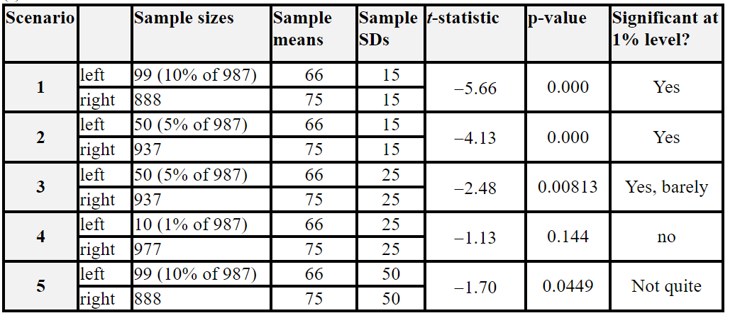
Investigation 4.3

Slide 17
Investigation 4.3
t-statistic = -5.66, p-value < .0001
  Less than 1 in 1000 (pairs of) random samples from right/left handed populations would give us a difference in sample means at least this large (> 9 years) if the population means were actually equal
95% CI: (-12.15, -5.85)
  I’m 95% confident that the mean age of death for the population of right handers is between 5.85 and 12.15 years larger than the mean age of death for the population of left handers

Slide 18
PQ 4.3

Slide 19

Investigation 4.4
“Sleep is required for memory consolidation - the process by which experience or training is transformed into improvements in performance.”

Slide 20
Visual Discrimination Tasks

Slide 21
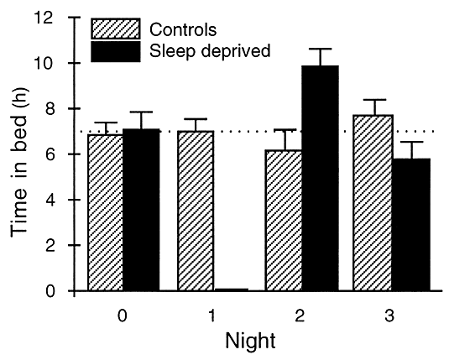
Stickgold, James, Hobson (2000)
Investigated whether you can make up for a missed night’s sleep
  60-90 minute training sessoin
  Group A: Sleep deprived one night, unrestricted sleep 2 nights
  Group B: Unrestricted sleep all 3 nights
  Retested after 72 hours

Slide 22
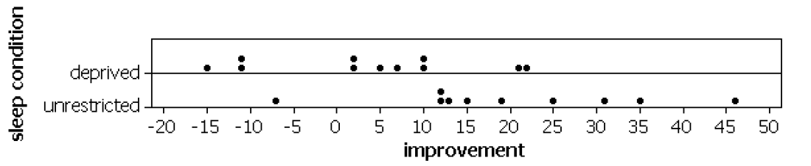
Sample data
Observed difference in means
  Unrestricted – Deprived: 19.82 – 3.90 = 15.92 ms
Is this a statistically significant difference?
How large do you think the difference is in the long run?

Slide 23
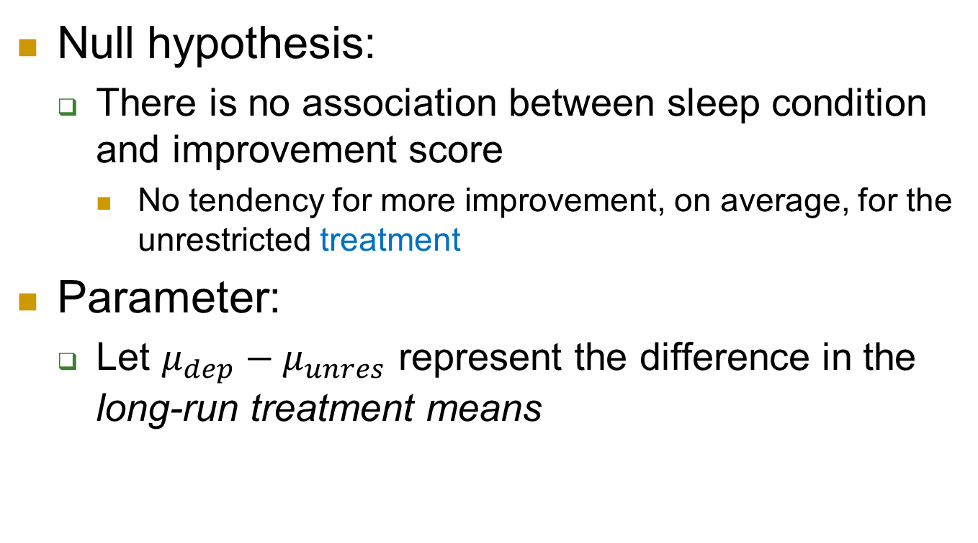
Statistical inference
Null hypothesis:
  There is no association between sleep condition and improvement score
    No tendency for more improvement, on average, for the unrestricted treatment
Parameter:
  Let $μ_{dep}−μ_{unres}$ represent the difference in the long-run treatment means

Slide 24
Simulation
21 index cards to represent the 21 subjects in the study
Write the improvement scores on the cards (-10.7, 4.5, 2.2…) to represent the treatment having no effect on the outcome
Shuffle into group of 11 and 10 to represent the random assignment in the study
Compute the difference in the group means
Repeat many, many times

Slide 25
To Do
Review exam comments, solutions
This week: Investigations 4.4-4.6
  Practice questions
  Friday: Investigation 4.7
Inv 4.4 practice question before tomorrow
HW 7
  Simulation, exact, theory-based (two-sample t)

