Slide 1
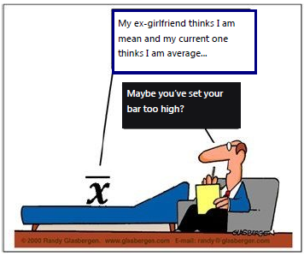
Stat 301 – Day 30
Comparing groups on a quantitative response (Ch. 4) cont

Slide 2
Announcements
Today:
Finish 4.2, Practice questions
I did update PQ 4.2A last night (not the one from text)
PQ 4.2B = PP 4.2B from the text
No office hour today?
Optional Quiz on Monday
Inv 4.2 material, two-sample t-test
HW 7 posted
Prep work for Tuesday: Inv 4.3 (a)-(e)

Slide 3
Last Time
Technology detour: Graphical and Numerical summaries for comparing two (or more) groups on a quantitative response
Stacked vs. Unstacked data

Slide 4
Last Time: Central Limit Theorem
Tells us about the sampling distribution of ${\overline{x}}_{1}−{\overline{x}}_{2}$, but what we really care about is the distribution of $t=\frac{{\overline{x}}_{1}−{\overline{x}}_{2}−δ_{0}}{\sqrt{\frac{s_{1}^{2}}{n_{1}}+\frac{s_{2}^{2}}{n_{2}}}}$

Slide 5
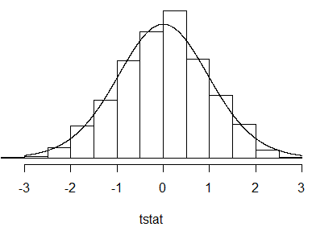
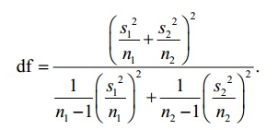
Last Time
When we use the sample standard deviations to calculate the standard error, the standardized statistic will often be well-modelled by a t-distribution
The appropriate degrees of freedom are a little complicated, but we’ll let the computer deal with that

Slide 6
Two-sample t procedures
Validity conditions for t procedures
Large populations
Normal populations or Large sample sizes (~both at least 20, preferable if similar shape)
Two-sample t-test ($μ_{1}−μ_{2}=δ_{0}$)
$t=\frac{{\overline{x}}_{1}−{\overline{x}}_{2}−δ_{0}}{\sqrt{\frac{s_{1}^{2}}{n_{1}}+\frac{s_{2}^{2}}{n_{2}}}}$ compare to a t distribution
Two-sample t-interval
${\overline{x}}_{1}−{\overline{x}}_{2}±t^{∗}$ $\sqrt{\frac{s_{1}^{2}}{n_{1}}+\frac{s_{2}^{2}}{n_{2}}}$

Slide 7
Technology Options
Theory-based Inference applet
Summary data
Raw data (stacked vs. unstacked)
R
iscamtwosamplet (summary data)
t.test(y ~ x, alt = “”, var.equal = FALSE) (raw data)

Slide 8
Apply to our elephant data?

Slide 9
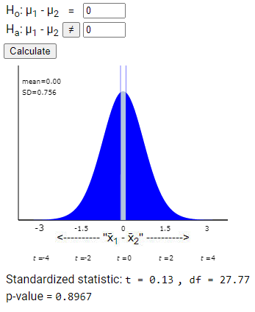
Elephants
The difference in means (-.10) is .13 standard errors from 0
About 90% of random samples have a difference in means at least as large as -.10 (in either direction) when the null is true

Slide 10
Bootstrapping
NBA Salaries: We generated many random samples from finite populations and looked at the distribution of the t-statistic.
If we don’t have populations, we can take random samples with replacement from the sample(s) we do have
Pool together first (H₀ true)
Each sample individually (confidence interval)

Slide 11
To Do
Submit Practice problems 4.2A and 4.2B (tonight?)
See Week 8 wrap-up
Optional (make-up) Quiz on Investigation 4.2 due Monday night
Prep-work for Tuesday: Inv 4.3 (a)-(e)
Start HW 7

Slide 12
Investigation 4.3
Left-handedness and life expectancy
Coren and Halpern (1991) found 987 records
Right handers: 75 years
Left handers: 66 years
Can this difference be explained by random chance (random sampling error) alone?
What additional information do you need to know? Why?

Slide 13
Investigation 4.3
Hypohteses
$H_{0}:{μ_{left} − μ}_{right}$= 0 (no association between handedness and life expectancy)
$H_{a}:{μ_{left} − μ}_{right}<$ 0
Note: ignoring distinction between “means are the same” and “distributions are the same”

Slide 14
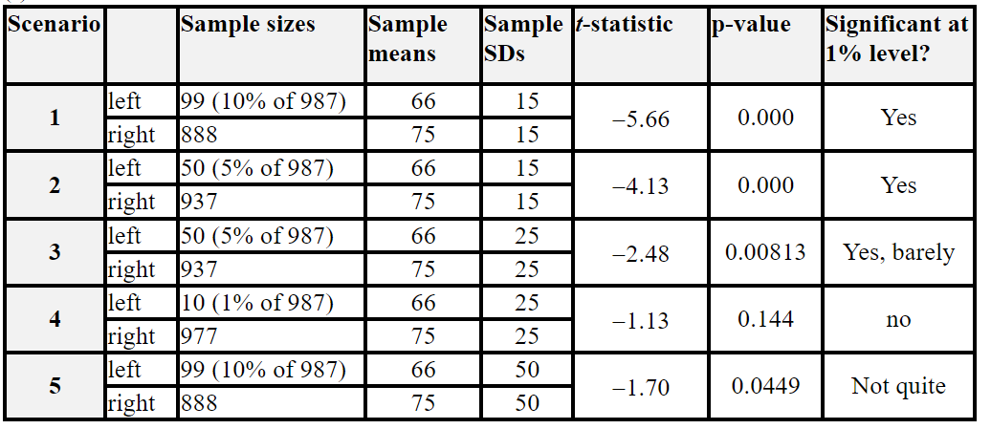
Investigation 4.3

Slide 15
Investigation 4.3
t-statistic = -5.66, p-value < .0001
Less than 1 in 1000 (pairs of) random samples from right/left handed populations would give us a difference in sample means at least this large (> 9 years) if the population means were actually equal
95% CI: (-12.15, -5.85)
I’m 95% confident that the mean age of death for the population of right handers is between 5.85 and 12.15 years larger than the mean age of death for the population of left handers

