Slide 1
Stat 301 – Day 29
Comparing groups on a quantitative response (Ch. 4)

Slide 2
Ch. 4 – Comparing groups on quantitative response
What are appropriate graphs to look at?
What are appropriate statistics for summarizing the data numerically?
  Choice of statistic
How assess statistical significance?
How estimate the corresponding difference in population/ treatment parameter?
Factors that affect p-value, confidence
Scope of conclusions based on study design

Slide 3
Recap: Investigation 4.1
Comparing the groups using graphs with the same scaling
Statistical inference: With small data sets, why not look at all possible arrangements of the observations to groups? Count how many are more extreme than our observed result?
  Models random assignment
  Do need to consider what you mean by “more extreme”
  Not feasible in moderate to large data sets
  Doesn’t give us a confidence interval

Slide 4

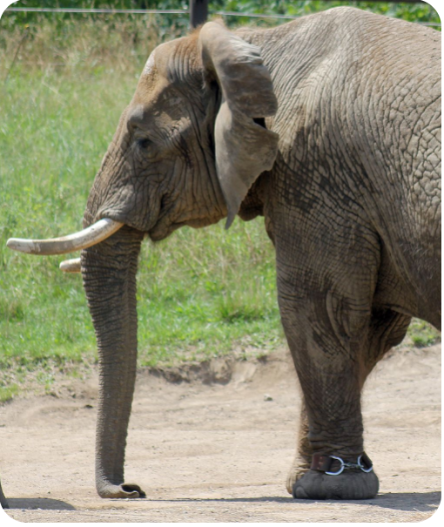
Investigation 4.2
Researchers Holdgate et al. (2016) studied walking behavior of elephants in North American zoos to see whether there is a difference in average distance traveled by African and Asian elephants. They put GPS loggers on 33 randomly selected African elephants and 23 randomly selected Asian elephants and measured the distance (in kilometers) the elephants walked per day.

Slide 5
Inv 4.2
Why might this data be of interest?
  an assumption that elephants are strongly motivated and physiologically adapted to walk long distances, and that the welfare of zoo elephants is therefore compromised when walking distance is constrained
How measure reliably?
  49 zoos, simple random sample of two adult females from each zoo (if > 2 eligible)
  GPS tracking devices, 5 non-consecutive days, at least 20 hours outdoors
  Calculated mean daily walking distance for 56 elephants across 30 zoos

Slide 6
Use R or applet
Graphical and Numerical summaries for comparing two (or more) groups on a quantitative response
  Briefly answer (b) – (h)
  (b) Don’t have to upload but might want to start practicing…
  Ignore comment before Numerical Summaries Tech Detour

Slide 7
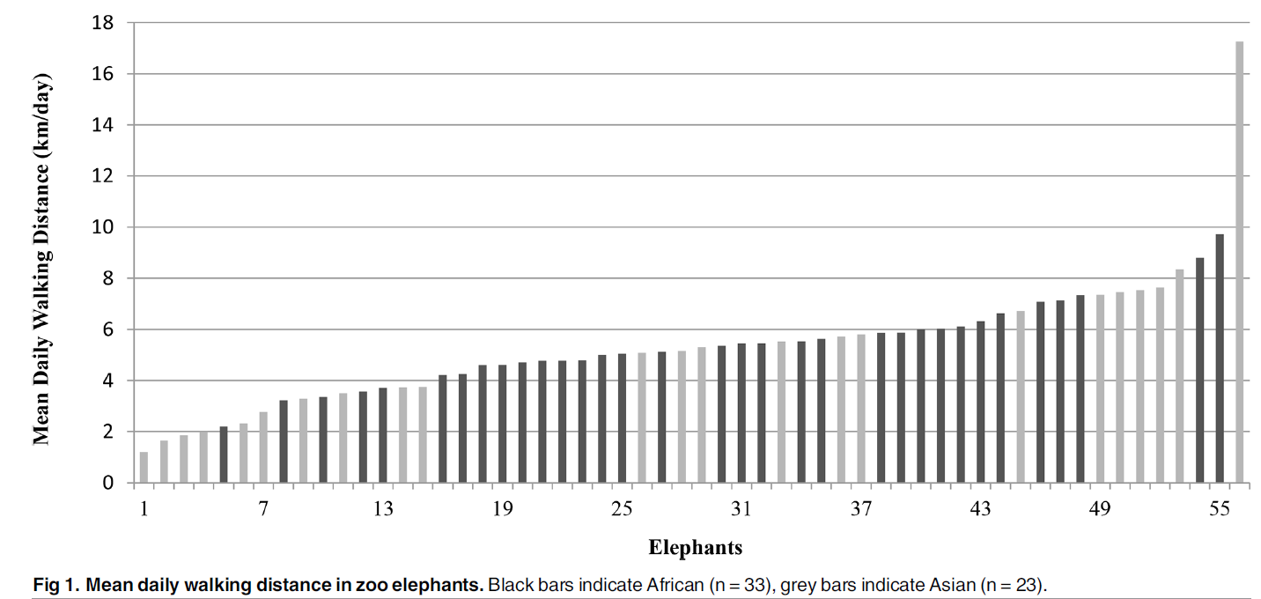
The graph in the paper…

Slide 8
Statistical significance?
Could a difference this large have happened by chance alone?
Need to know how our statistic (difference in sample means) behaves under repeated random samples from two populations
Probability detour
  Salaries (in millions of dollars) of NBA players
  Two Populations applet
    Select NBASalaries2021 from pull-down menu

Slide 9
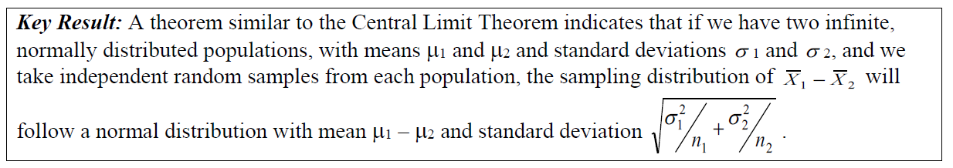
Central Limit Theorem
Does this theorem apply with NBA data?
Did it successfully predict the behavior of the sampling distribution?

Slide 10
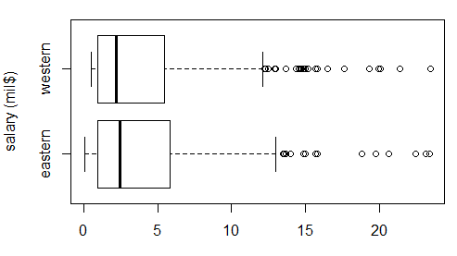
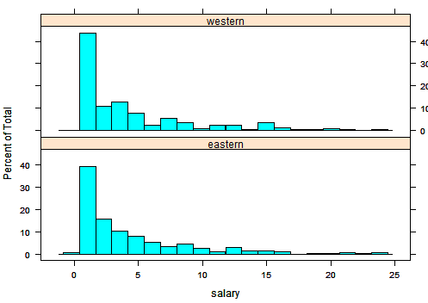
Recap
Overall/on average, not much difference between the two populations
However, taking 20 from each league, might find a difference in the sample means from random sampling error

Slide 11
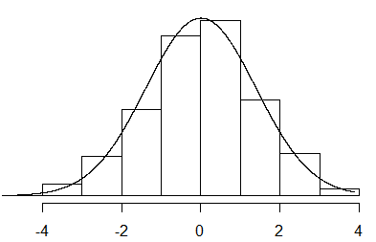

Recap
Luckily, the distribution of the differences in sample means follows a very predictable pattern
Mean: μ₁-μ₂
SD: $\sqrt{\text{s}\text{1}\text{2}\text{/}\text{n}\text{1}\text{ + }\text{s}\text{2}\text{2}\text{/}\text{n}\text{2}}$
Approximately normal as populations not too skewed or samples too small
← Differences in sample means →

Slide 12
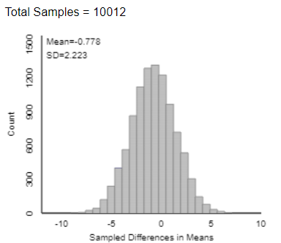
1000 trials – difference in sample means
CLT Prediction
Simulation
Approximately normal
Center: -0.81
SD: 2.33

Slide 13
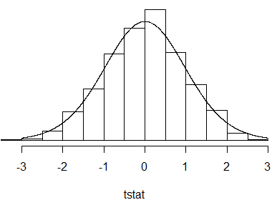
Recap
Which means, when we use the sample standard deviations to calculate the standard error, the standardized statistic will be well-modelled by a t-distribution
The appropriate degrees of freedom are a little complicated, but we’ll let the computer deal with that

Slide 14
Technology Options
Theory-based Inference applet
  Summary data
  Raw data (stacked vs. unstacked)
R
  iscamtwosamplet (summary data)
  t.test(y ~ x, alt = “”, var.equal = FALSE) (raw data)

Slide 15
To Do
Review/Practice Technology Instructions for Two-Sample t-test
Start PP 4.2A and PP 4.2B

