Slide 1
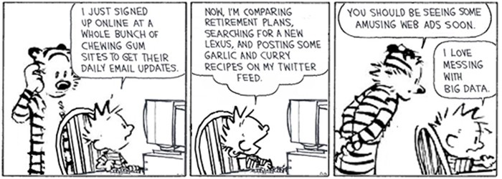
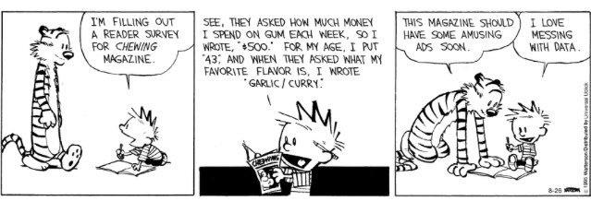
Stat 301 – Day 28
Review

Slide 2
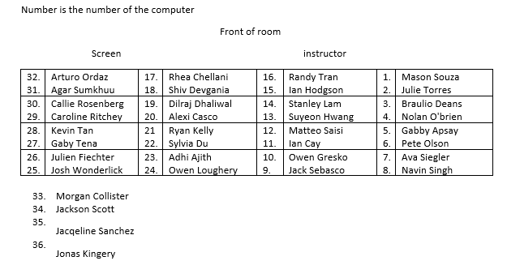
Section 1

Slide 3
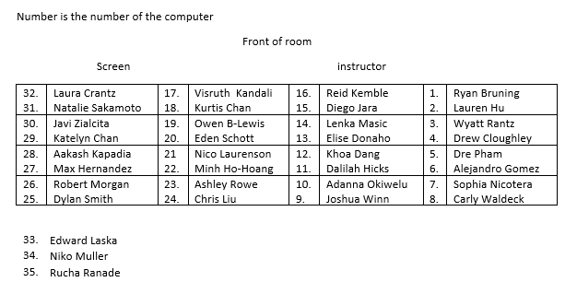
Section 2

Slide 4
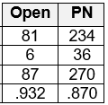
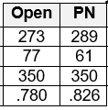
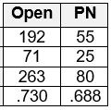
HW 6
Apologies for not “hiding” along the way
Problem 3 – Simpson’s Paradox
.95
.85
.75
.65
Open
PN
Small stones
success
Open
PN
Large stones

Slide 5
Keep in mind: Study Design
Experiment vs. Observational study
Good experiments: ethical, double-blind, random assignment, placebo, Hawthorne effect
Observational studies
Analyze pre-existing groups
Cohort, Case-control, Cross-classified

Slide 6
Recap
Experiment = active imposition of explanatory variable
Observational study = analyze pre-existing groups
Teens in two different
years
People with and without
lung cancer
Kids with different light
conditions and different eye conditions
cohort
case-control
cross-classified

Slide 7
Consequence of case-control studies
We should not estimate the “probability of success” with a case-control study
⇒ Should not use difference in proportions OR relative risk as the statistic
Can we interchange the role of the explanatory variable and the response variable?
Are the chances of smoking higher for lung cancer patients than control patients?
Statistic #3: Odds ratio

Slide 8
Inference: Odds Ratio
Notes:
May need to round down a bit.

Slide 9
Odds Ratio vs. Relative Risk

Slide 10
Format of Exam 2
Similar to Exam 1
May use 2 two-sided 8.5x11 pages of notes
Mixture of short answer, long answer, multiple choice questions
Mixture of “theory” and applications, explanations
How would you set this up?
What if I changed this?
Do this on computer
Interpret this output
Why is this true/does this make sense?
Develop a procedure that…

Slide 11
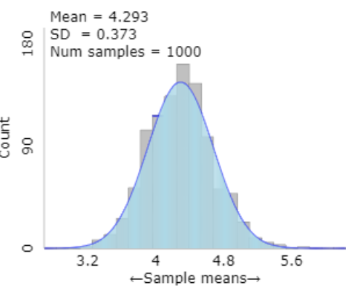
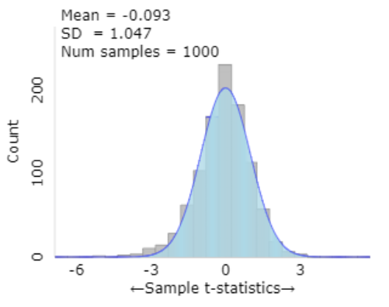
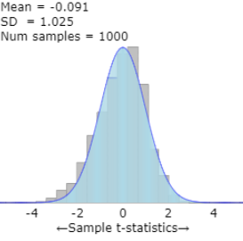
What you have learned – Ch . 2
Analyzing one quantitative response
1) Graphically: dotplots, histograms, stemplots
2) Numerically: mean/SD, median/IQR, FNS boxplot
3) Statistical Significance: p-value using t-distribution (CLT for means) or simulation (finite population) or other alternatives (e.g., median, transformation)
4) Estimation: t-confidence intervals for population mean, prediction interval
5) Draw conclusions: generalizability
t = $\frac{\overline{x}−μ}{s/\sqrt{n}}$

Slide 12
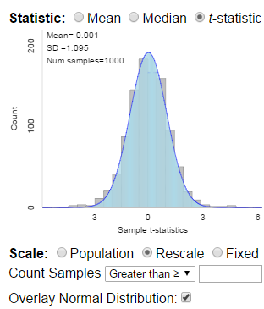
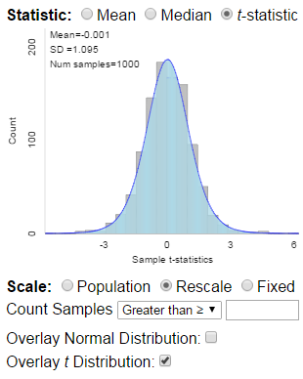
One Sample t test
With quantitative data, we want to calculate
But we don’t usually know σ
But we can calculate the standard error
But then our standardized statistic is better modeled by a t distribution (df = n -1)
p-values more accurate
Confidence intervals have the right coverage rate

Slide 13
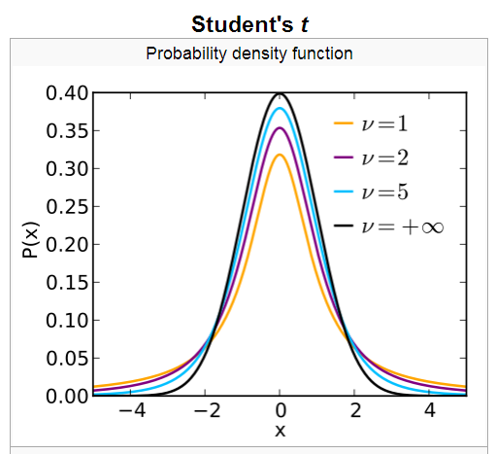
t-distributions
t-distribution has “heavier” tails than normal distribution.
Approaches normal distribution as df → ∞

Slide 14
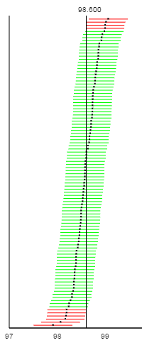
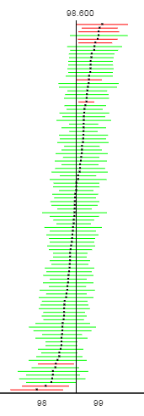
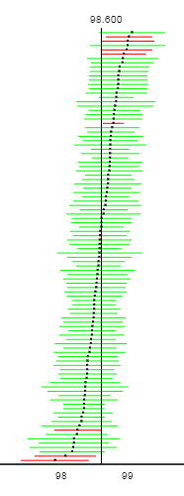
z = 1.96 with σ
z with s
t =2.56 with s

Slide 15
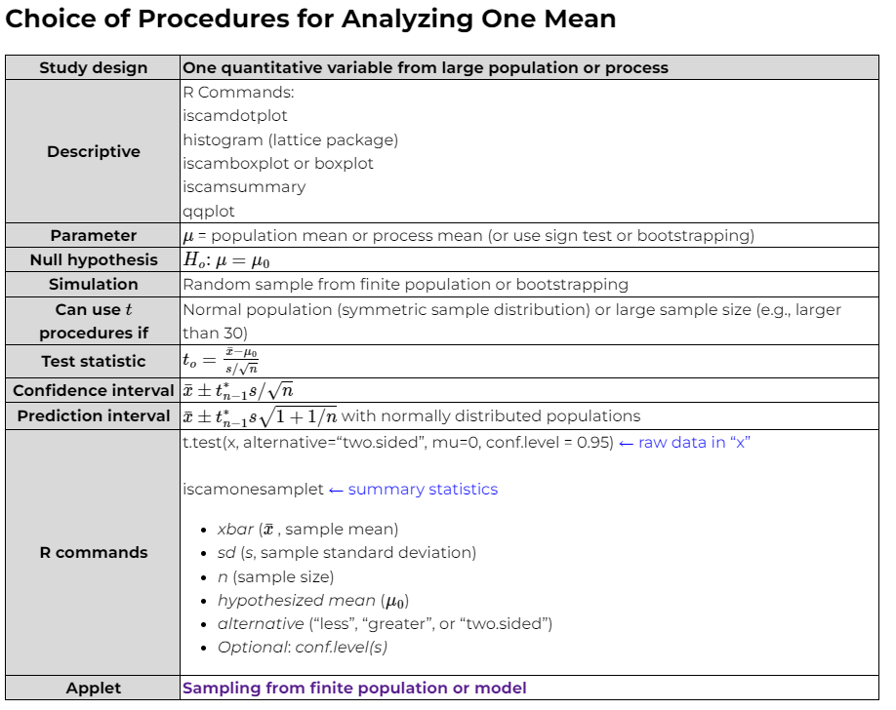
Shape, center,
variability,
outliers
for μ
“validity conditions”
Number of standard errors $\overline{x}$ is from $μ$
On exam, can use t* = 2 for 95% confidence

Slide 16
Confidence vs. Prediction interval
Confidence
Prediction

Slide 17
What you have learned – Ch . 3
Comparing two groups on a categorical response
Organizing data: two-way table of counts
1) Graphically: segmented bar graph, mosaic plot
2) Numerically: difference in conditional proportions, relative risk, odds ratio
3) Statistical Significance: p-value using simulation, Fisher’s Exact test, normal approximation
4) Estimation: confidence intervals for difference in proportions, relative risk, odds ratio
5) Draw conclusions: causation, generalizability
Reject Ho in favor of Ha
Probability vs. Proportion

Slide 18
Study Design
Be able to describe an appropriate design, how you will use randomness, what “controls” you will use
Be able to critique a study design
Be able to draw appropriate conclusions

Slide 19
Study Design → Analysis
Independent random samples (or one random sample with 2 independent subgroups like males vs. females)
Simulation: independent binomial random samples with same value for π (some large number of samples)
FET as an approximation
Normal approximation (all 4 counts > 5) (confidence interval for difference in population proportions or RR or OR)
Randomized experiment
Simulation: Fix successes and failures, randomly shuffle which group they go to (some large number of assignments)
FET exact p-value (examines all possible random assignments)
(Same) Normal approximation (all 4 counts > 5) (confidence interval for difference in treatment probabilities or RR or OR)

Slide 20
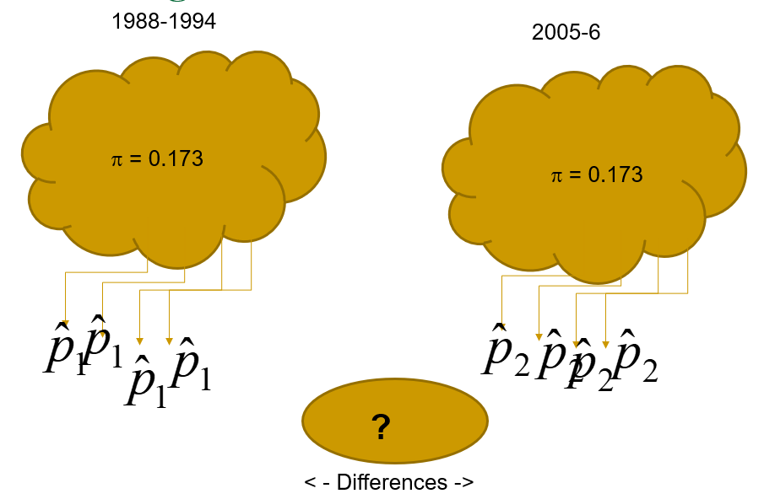
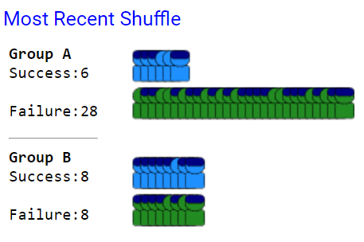
Simulation
Random sampling
Random shuffling

Slide 21
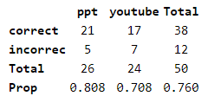
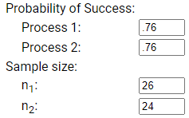
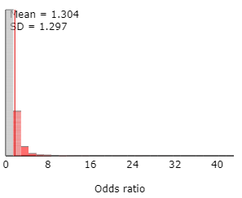
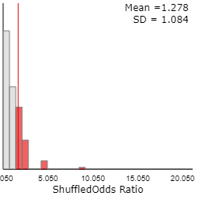
Example

Slide 22
Normal approximation
When the sample sizes are large, can use two-sample z procedures to get the p-value and confidence interval for difference in population proportions/process probabilities
At least 5 successes and at least 5 failures in each group
Helpful with calculations of power, sample size determination etc., test statistic (“z statistic”)
Can improve with continuity correction (p-value), “plus four” adjustment (confidence interval)

Slide 23
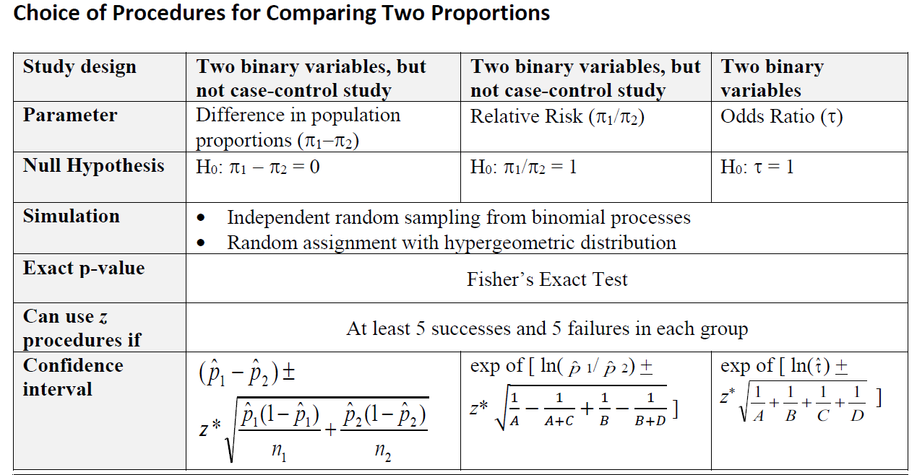
Choice of Procedures (Ch. 3 Summary)
$$z=\frac{{\hat{p}}_{1}−{\hat{p}}_{2}−0}{\sqrt{\hat{p}\left(1−\hat{p}\right)\left(\frac{1}{n_{1}}+\frac{1}{n_{2}}\right)}}$$
Two population proportions applet
Two-way table applet
No “validity conditions” here, but best for randomized experiment (fixed number Ss and Fs)
“theory-based”
“validity conditions”
The ln transformation lets us use these even with pretty small sample sizes

Slide 24
Study Design → Conclusions
Scope of conclusions
Significance: do you have a small p-value
In favor of the alternative hypothesis…
Estimation: interpret the confidence interval
Cause and effect: Random assignment? vs. confounding
Any other obvious differences between the two groups (related to the response variable)
Small p-value
Generalizability: Representative sample? (Look at demographics) Random sampling? vs. sampling bias

Slide 25
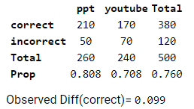
Example
I’m 95% confident that the probability of answering correctly with the ppt treatment is .0245 to .1742 larger than with the youtube treatment
2.5 to 17.4 percentage points

Slide 26
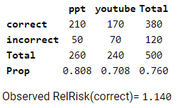
Example
I’m 95% confident that the probability of answering correctly with the ppt treatment is 1.03 to 1.26 times larger than with the youtube treatment
3% to 26% larger
CQ: How would one go about deciding whether this interval procedure is valid?

Slide 27
Example
I’m 95% confident that the probability of answering correctly with the ppt treatment is 1.03 to 1.26 times larger than with the youtube treatment
3% to 26% larger

Slide 28
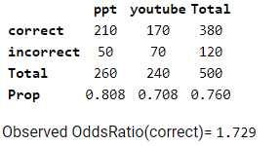
Example
I’m 95% confident that the odds of answering correctly with the ppt treatment are 1.14 to 2.62 times larger than with the youtube treatment
14% to 162% larger

Slide 29
Example
The odds of answering correctly with the ppt treatment are up to .46 times smaller (54% decrease) or up to 6.43 times larger compared to the youtube treatment

Slide 30
Make sure you
Ask follow-up questions (e.g., Discussion board)
Work problems
Focus on calculations and interpretations
Review examples at end of chapters
Review overview of procedures tables
Review solutions to investigations, practice problems, HW, quizzes in Canvas
Think “big picture”

Slide 31
Odds and Odds Ratio
Sheridan’s Odds (“favorites on left”)
Philidelphia 13:10 Los Angeles
Odds = # successes/#failures = 1.3 to 1
P(philidelphia wins) = 13/23 = .565
Boston 3:2 Tampa Bay
P(boston wins) = 3/5 = .60
Relative risk
Boston is .6/.565=1.06 times more likely to win than Phili
Odds ratio
(3/2)/(13/10) = 1.5/1.3 = 1.15
Boston has 1.15 times higher odds of winning than Arizona
Los Angeles .769 to 1
1.5 to 1

Slide 32
Bootstrapping
We want to estimate the expected variation in a statistic by random chance alone
How far might statistic be from parameter (“standard error”)
Don’t have a theory-based approach (e.g., statistic is not the mean or proportion, not transforming)
Depends on sample size, choice of statistic, randomness in study design (e.g., random assignment vs. random sampling)

Slide 33
Bootstrapping
Sampling with replacement from the sample
Gives us an estimate of the sample to sample variation in our statistic
If the bootstrap distribution is roughly symmetric, can find a rough 95% confidence interval by
observed statistic + 2 SD(statistic)
Are “adjustments” that can be made with skewed bootstrap distributions

