Slide 1
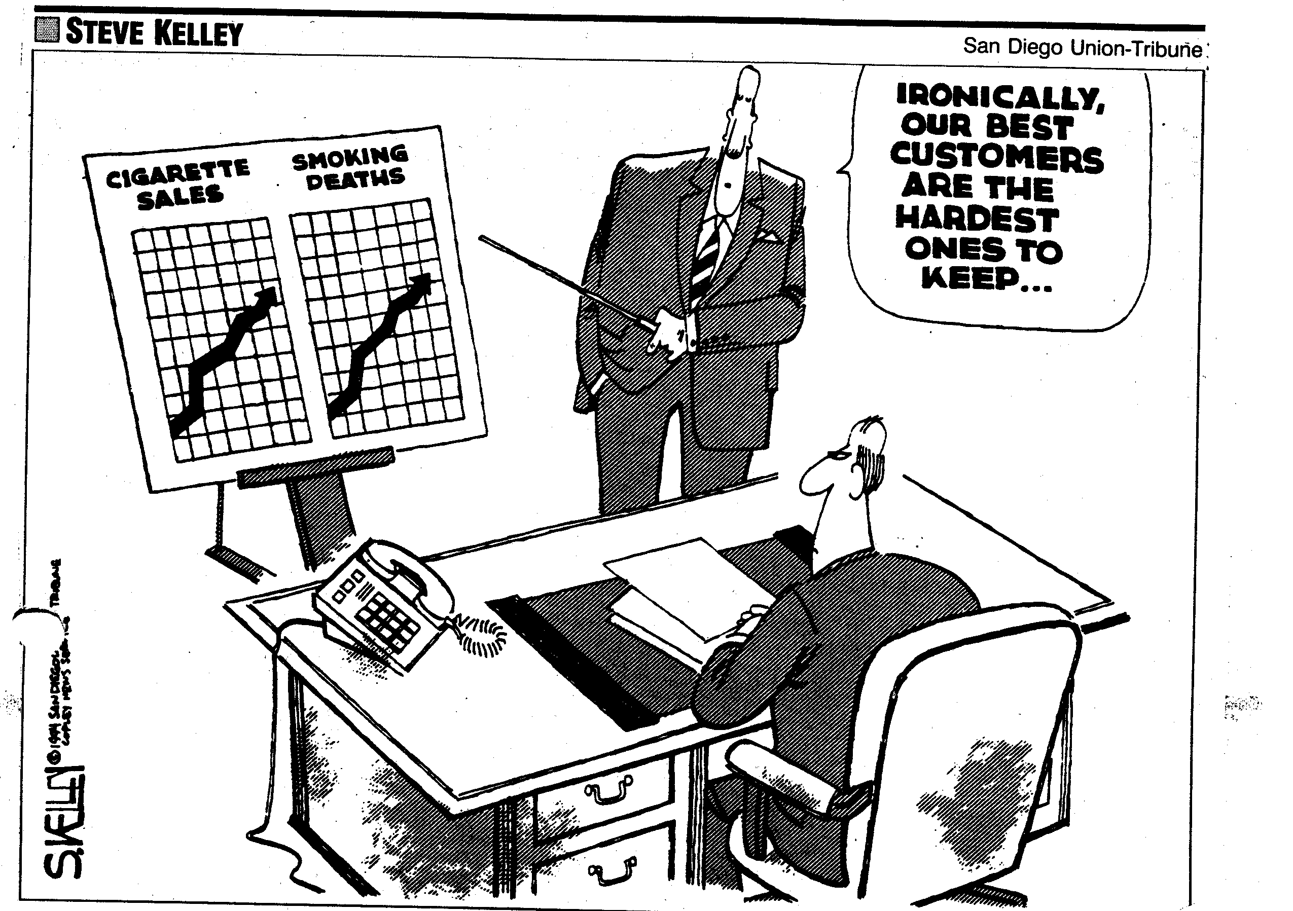
Stat 301 – Day 27
Odds Ratio vs. Relative Risk

Slide 2
Comparing Two Proportions
Statistic 1: Difference in conditional proportions
SD ↓ as sample sizes increase
Can be a bit misleading when the proportions are small
Want to take the “baseline risk” into account
Statistic 2: Relative risk
RR = cond. proportion in group 1 (larger)
cond. proportion in group 2
Group 1’s “risk” (success proportion) is XX times higher or (XX-1)x100% percent higher than Group 2’s risk
If RR < 1, (1-XX)x100% is the percentage decrease
Note: When you say “group,” I hear “sample”
For parameter use “treatment” or “population” instead?

Slide 3
Last Time – Inference with Rel Risk
p-value is exactly the same as with the other statistics
One-to-one correspondence between two-way table and these statistics
The tables that are more extreme than what we observed will be exactly the same for each statistic
(The log transformation does not change the ordering of the values relative to each other)

Slide 4
Last Time - Confidence interval for π₁/π₂
ln(5.86) + 1.96(0.762)
1.768 + 1.4935
(0.275, 3.262)
But that’s for log relative risk
exp(0.275) = 1.32
exp(3.262) = 26.10
We are 95% confident that the “risk” of peanut allergy is 1.32 to 26.10 times larger if avoid rather than consume (6g/week) for all UK infants age 4-11 months similar to the ones in the study
Not assuming the null hypothesis is true
Notes:
How often does this work?

Slide 5
Two small problems
Answer can “change” depending how you set things up
Is not always “valid” to look at relative risk…

Slide 6
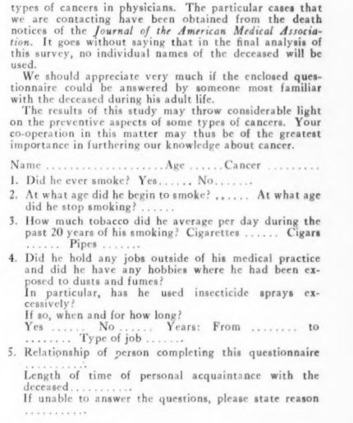
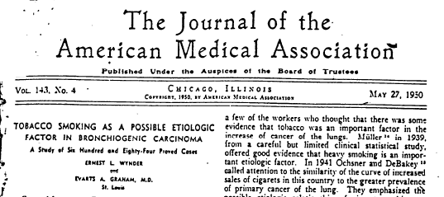
Investigation 3.9
(a)

Slide 7
Investigation 3.9
From these data, can we conclude that about 605/1386 ⇒ 44% of men were lung cancer patients?
We cannot estimate the “probability of success” when we have “controlled” the response variable breakdown

Slide 8
Types of Studies
Experiment = active imposition of explanatory variable
Observational study = analyze pre-existing groups
Teens in two different
years
People with and without
lung cancer
Kids with different light
conditions and different eye conditions
cohort
case-control
cross-classified

Slide 9
Investigation 3.9
Case-control study
Bottom Line: We should not estimate the “probability of success” with a case-control study
Should not use difference in proportions OR relative risk as the statistic
Why choose to do a study this way?

Slide 10
Can we interchange the roles of the explanatory variable and the response variable?
Relative risk of being a heavy smoker (lung cancer compared to controls) =
(583/605)/(576/780) ≈ 1.30
The lung cancer patients were about 1.3 times more likely to be heavy smokers compared to the patients without lung cancer.

Slide 11
Reverse EV and RV?
But research question is really about the “risk” of lung cancer
Relative risk of being in the lung cancer group = (583/1159)/(22/226) ≈ 5.17
The heavy smokers were 5.17 times more likely to have lung cancer compared to the light smokers.

Slide 12
Statistic #3: Odds ratio
For measuring the strength of association between the two variables…
Odds = prop. of success/prob. of failure
Lung cancer: odds of mod/heavy (not light)
(583/605)/(22/605)
(583/22) = 26.5 (or “26.5 to 1”)
Controls: odds of mod/heavy (not light)
576/204 = 2.82 (about “14 to 5”)
The odds are 1:1 or “even” when the proportion is 0.5

Slide 13
Statistic #3: Odds ratio
Odds Ratio
Group 1 odds: successes/failures
Group 2 odds: successes/failures
26.5/2.82 ≈ (583/22)(576/204) = 9.39
Interpretation: How many times higher/lower the odds of “success” are in Group 1 than in Group 2
The odds of heavier smoking were 9.39 times larger for the lung cancer patients than controls

Slide 14
Reverse EV and RV?
Odds of lung cancer for the mod/heavy smokers (numerator) compared to light smokers
= (583/576)/(22/204) ≈ 9.39
The odds of being a lung cancer patient were 9.39 times higher for mod/heavy smokers compared to none/light smokers.

Slide 15
Reverse success and failure?
Odds are not having lung cancer for heavy smokers = (576/583)/(204/22) ≈ 0.106
= 1/9.39
Odds of not hanging lung cancer are 0.106 times smaller for the heavy smokers than the light smokers.

Slide 16
Bottom Line
It’s always ok to use Odds Ratio as the statistic
Just a little harder to interpret: have to say odds, can’t replace with proportion or chance or likelihood etc.
If a case-control study, only use odds ratio
For other studies, can use relative risk and is probably preferred over difference in proportions

Slide 17
HW questions?

Slide 18
But then if we change the statistic…
Parameter: population or long-run odds ratio
Hypotheses: $H_{0}:τ=1$
Simulation?
Random assignment or random sampling
Null hypothesis?
Exact?
Normal approximation?

Slide 19
Inference for Odds Ratio
p-value is exactly the same as other statistics
Confidence interval for “$τ$”
$exp⁡(\ln\left(\hat{τ}\right)±z^{∗}\sqrt{\frac{1}{A}+\frac{1}{B}+\frac{1}{C}+\frac{1}{D}}))$
(this is actually from ‘inverting’ the hypergeometric dist’n)

Slide 20
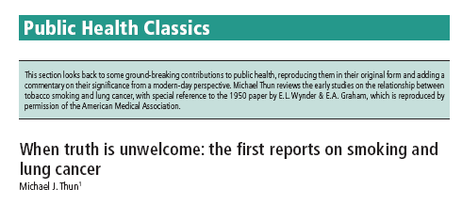
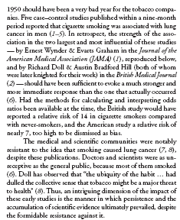
Convincing evidence?
http://www.who.int/bulletin/volumes/83/2/144.pdf

Slide 21
Odds Ratio
Odds Ratio
Group 1 successes/failures
Group 2 successes/failures
Interpretation: How many times higher/lower the odds of “success” are in Group 1 than in Group 2
Equals 1 when probabilities are the same
Invariant to choice of EV, RV, success, failure
Appropriate with case-control studies

Slide 22
To Do
Office hour today: 2:30-3:30
Submit HW 6
Will be a Quiz on HW 6 due Monday night
Finish Inv 3.9 by class Tuesday
Practice question 3.9A?
Start reviewing for Exam 2 (Wed)
Review handout
Review problems
Submit questions on materials and example exam question in Discussion Boards by midnight Monday
Tuesday’s class: review
Optional review zoom session Tuesday 7-8 pm

Slide 23
Odds and Odds Ratio
Sheridan’s Odds (“favorites on left”)
Philidelphia 13:10 Los Angeles
Odds = # successes/#failures = 1.3 to 1
P(philidelphia wins) = 13/23 = .565
Boston 3:2 Tampa Bay
P(boston wins) = 3/5 = .60
Relative risk
Boston is .6/.565=1.06 times more likely to win than Phili
Odds ratio
(3/2)/(13/10) = 1.5/1.3 = 1.15
Boston has 1.15 times higher odds of winning than Arizona
Los Angeles .769 to 1
1.5 to 1

