Slide 1
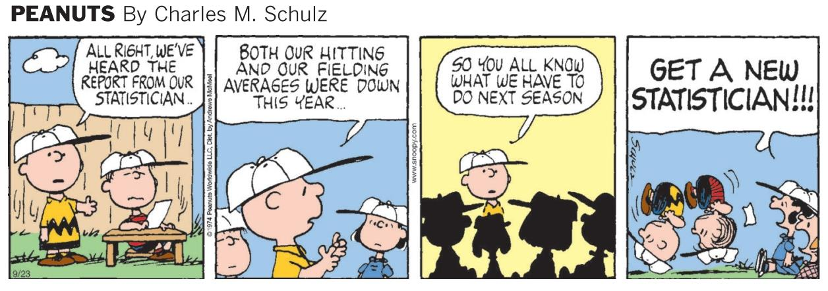
Stat 301 – Day 26
Relative risk

Slide 2
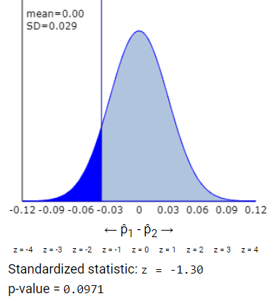
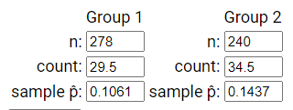
Last Time – Normal approximation to exact p-value
Can safely use if all four cell counts are at least 5
Never a bad idea to apply a continuity correction

Slide 3
Have a two-way table, how going to find p-value?
Ind. random samples (3.1)
Randomized experiment
Small (or large) sample sizes | Simulation (independent binomial processes) Two spinners | Simulation (random shuffling) Shuffle N cards into 2 groups
 |  | Fisher’s Exact Test (Hypergeometric)
Large sample sizes | Normal approximation Continuity correction? | Normal approximation (same) Continuity correction?
$z=({\hat{p}}_{1}−{\hat{p}}_{2}−0)/SE({\hat{p}}_{1}−{\hat{p}}_{2}$)
SE assumes equal probabilities
$$SE\left({\hat{p}}_{1}−{\hat{p}}_{2}\right)=\sqrt{\hat{p}\left(1−\hat{p}\right)\left(\frac{1}{n_{1}}+\frac{1}{n_{2}}\right)}$$

Slide 4
Have a two-way table, how going to find confidence interval?
Ind. random samples (3.1)
Randomized experiment
Small sample sizes
Large sample sizes | Normal approximation Plus Four? (Wilson: add 1 to each cell of table) | Normal approximation Plus Four? (same) (Wilson: add 1 to each cell of table)
$${\hat{p}}_{1}−{\hat{p}}_{2}±z^{∗}SE\left({\hat{p}}_{1}−{\hat{p}}_{2}\right)$$
SE does not assume equal probabilities
$$SE\left({\hat{p}}_{1}−{\hat{p}}_{2}\right)=\sqrt{\left(\frac{{\hat{p}}_{1}\left(1−{\hat{p}}_{1}\right)}{n_{1}}+\frac{{\hat{p}}_{2}\left(1−{\hat{p}}_{2}\right)}{n_{2}}\right)}$$

Slide 5
Investigation 3.8

Slide 6
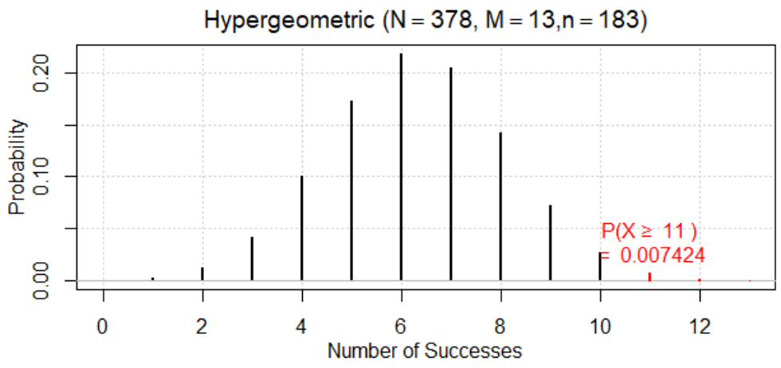
Investigation 3.8
Statistic: 11/183 – 2/195 = .0601 - .0103 = 0.0498
Let X represent the number developing peanut allergy in the avoidance treatment
Strong evidence that the observed difference in the sample proportions did not arise from the random assignment process alone

Slide 7
Relative risk
Definition: Relative risk is the ratio of the conditional proportions
Often set up to be larger than one
RR = (Allergy | avoidance)/(Allergy | consumption) = .060/.010≈ 6.00 (5.86)
Interpretation: Those who avoided peanuts were 6 times more likely to develop an allergy
Percentage change = (5.86 – 1) × 100% = 486%
Suppose RR = 1.2, is a 20% increase…
Suppose RR = 0.80, is a 20% decrease

Slide 8
But now that we’ve changed the statistic…
How find a p-value?
Turns out to be the same!
How to find a confidence interval for $π_{1}/π_{2}$?
estimate + z*× standard error
Need estimate to follow a normal distribution
Need to know the standard deviation of the statistic

Slide 9
Practice Question 3.8

Slide 10
To Do
See Technology Detours for getting CI for relative risk
See Summary boxes
Submit Practice Questions
Complete Investigation 3.9 (a)-(d)
Continue HW 6
Tomorrow:
When ok to use relative risk
How to calculate “odds ratio”

Slide 11
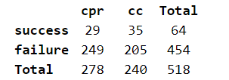
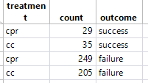
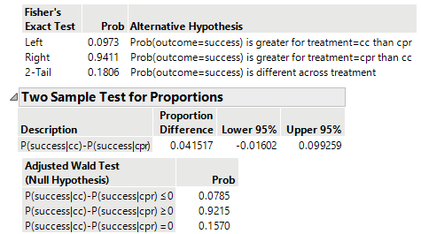
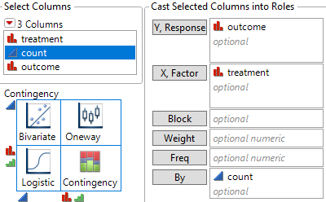
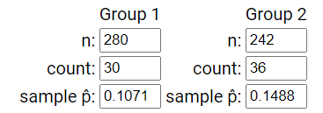
JMP

