Slide 1
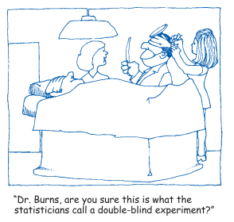
Stat 301 – Day 25
Normal approximation to FET

Slide 2
Last Time: Fisher’s Exact Test
Let X count the number of successes in a sample of n objects selected from a population of N objects consisting of M successes
Two-way table applet*, R

Slide 3
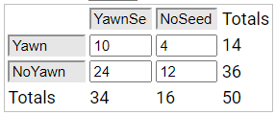
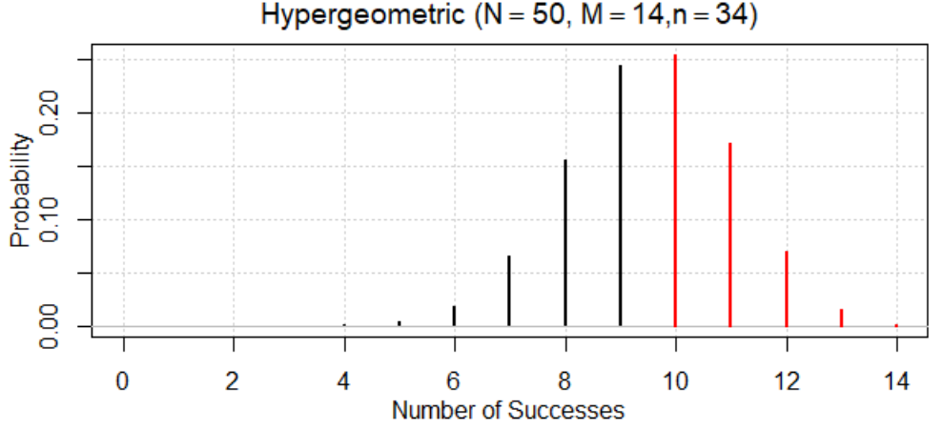
Last Time

Slide 4
Yawning study
(o) Let X represent the number of non-yawners in the no-yawn-seed group
p-value = P(X > 12) with M = 36, n = 16, N = 50
M
N
n

Slide 5
Fisher’s Exact Test
Once have the two-way table, are multiple equivalent ways to calculate the p-value.
Identifying values of M, n, and N and writing out P(X ? ?)…
Include detail on how you carried out the calculation (which inputs, which technology)
Interpretation of p-value: X% of “random shuffles” would have a difference in proportions at least as extreme (larger or smaller?) as XX assuming no treatment effect (null hypothesis is true)

Slide 6
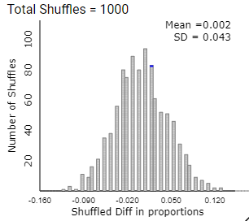
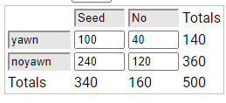
Conclusions
These data do not provide convincing evidence that the presence of a yawn seed increases the probability of a yawn
Can maybe generalize the Flea Market patrons
Large enough sample size?

Slide 7
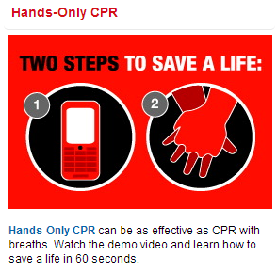
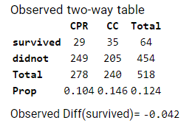
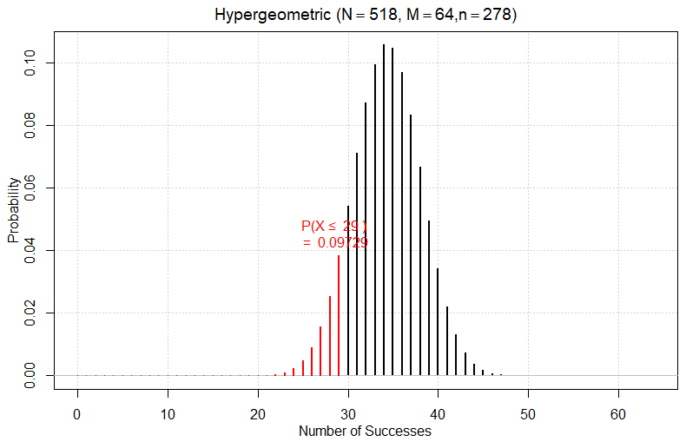
Investigation 3.7
Entering data
Display table
Statistic
p-value = P(X < 29)
Hypergeometric(N = 518, M = 64, n = 278)
=.0973 (9.7% of shuffles if $π_{cpr}=π_{cc}=0$…)

Slide 8
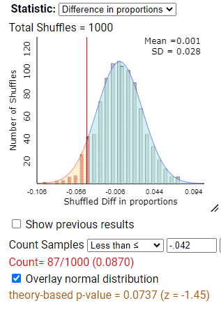
Normal approximation?
Yes! Just need at least 5 in each cell
Use the same formulas/technology
R: iscamtwopropztest
Theory-based inference applet

Slide 9
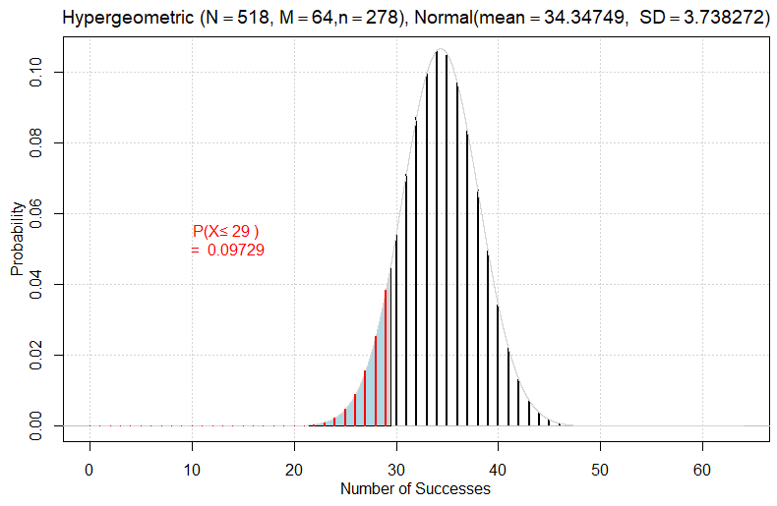
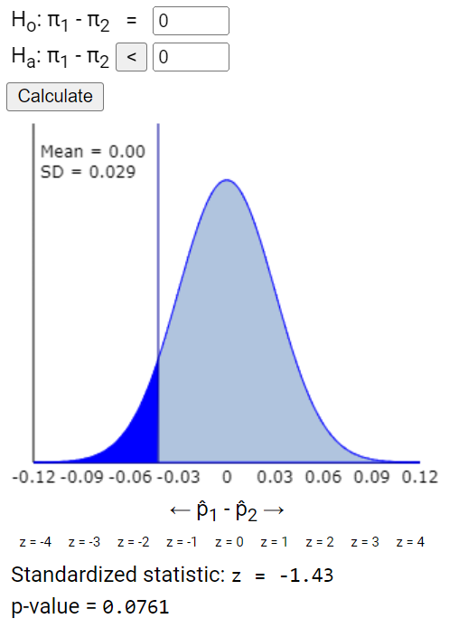
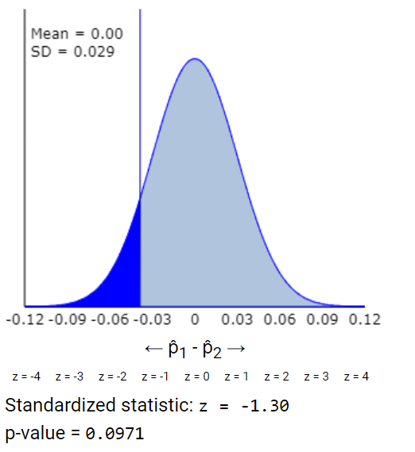
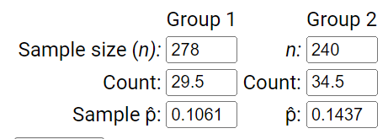
Theory-based inference applet
Underestimates p-value?

Slide 10
Conclusion?
We have convincing evidence at the 10% level (but not the 5% level) that the probability of survival is higher with CC only compared to CPR
Causation?
Population?

Slide 11
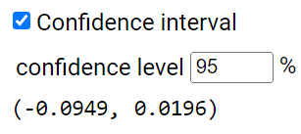
Why bother (already had an exact p-value!)?
Confidence interval!
I’m 95% confident that probability of survival with CC is up to .0949 larger than with CPR, but also plausible that CPR is up to .0196 larger
Why does the interval contain zero?

Slide 12
Practice question 3.7
The 911 dispatcher’s instructions were completely delivered in 62% of episodes assigned to chest compression plus mouth-to-mouth compared to 81% of the episodes assigned to chest compression alone.
Of the 399 combined patients randomly assigned to standard CPR, 44 survived to discharge from the hospital. Of the 351 combined patients randomly assigned to chest compression alone, 47 survived to discharge.

Slide 13
To Do
Office hour today: 2:30-3:30
Continue Week 7 module: Complete Investigation 3.8 (a)-(b), (d), (f), and (g)
HW 6

