Slide 1
Stat 301 – Day 24
Exact p-value for randomized experiments
Notes:
Smokers?

Slide 2
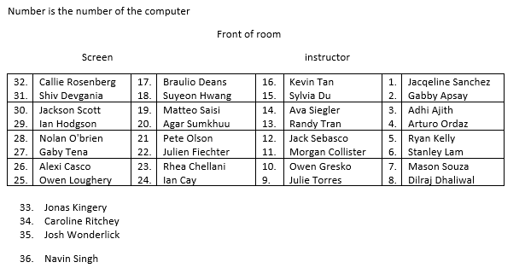
Section 1
You’ve completed Questions (a)-(f) of Investigation 3.6 !

Slide 3
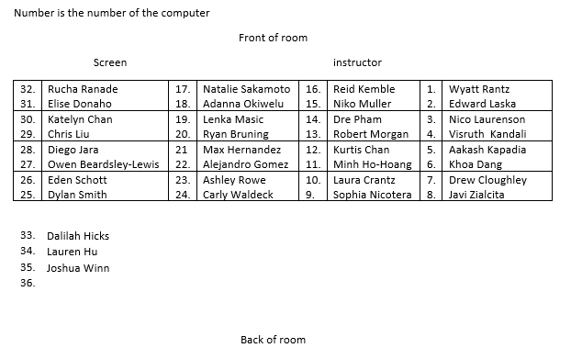
Section 2
You’ve completed Questions (a)-(f) of Investigation 3.6 !

Slide 4
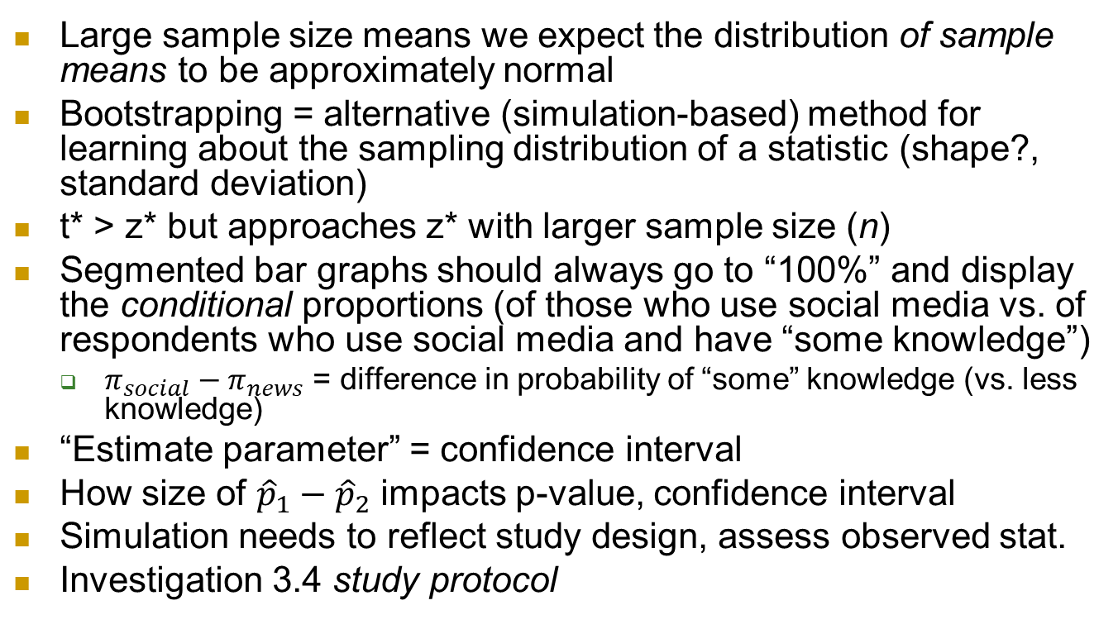
Quiz/HW comments
Large sample size means we expect the distribution of sample means to be approximately normal
Bootstrapping = alternative (simulation-based) method for learning about the sampling distribution of a statistic (shape?, standard deviation)
t* > z* but approaches z* with larger sample size (n)
Segmented bar graphs should always go to “100%” and display the conditional proportions (of those who use social media vs. of respondents who use social media and have “some knowledge”)
  $π_{social}−π_{news}$ = difference in probability of “some” knowledge (vs. less knowledge)
“Estimate parameter” = confidence interval
How size of ${\hat{p}}_{1}−{\hat{p}}_{2}$ impacts p-value, confidence interval
Simulation needs to reflect study design, assess observed stat.
Investigation 3.4 study protocol

Slide 5
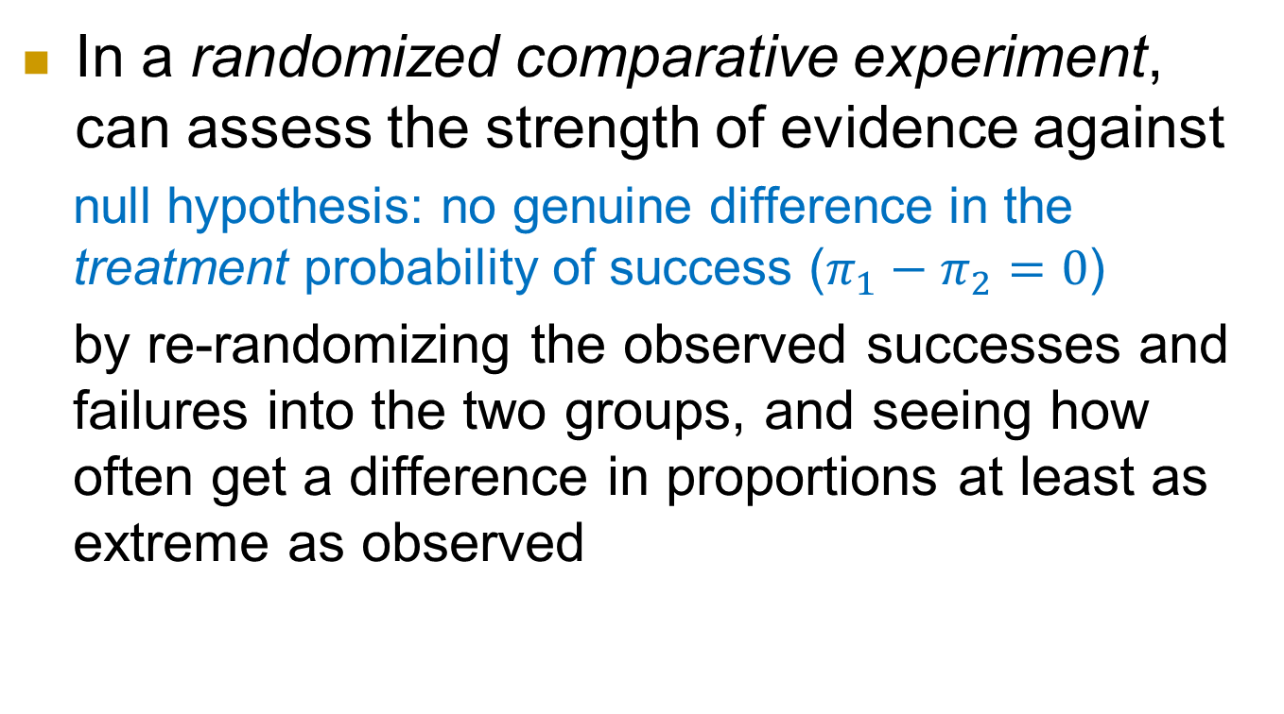
Last Time: Randomization Test
In a randomized comparative experiment, can assess the strength of evidence against
  null hypothesis: no genuine difference in the treatment probability of success ($π_{1}−π_{2}=0$)
  by re-randomizing the observed successes and failures into the two groups, and seeing how often get a difference in proportions at least as extreme as observed

Slide 6
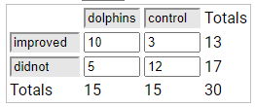
Last Time: Randomization applet
Reshuffle 13 successes and 17 failures into groups of 15 and 15

Slide 7

Control
Dolphin
Therapy
Improve
Improve
Improve
Improve
Improve
Improve
Improve
Improve
Not
Improve
Not
Improve
Improve
Improve
Improve
Improve
Improve
Not
Improve
Not
Improve
Not
Improve
Not
Improve
Not
Improve
Not
Improve
Not
Improve
Not
Improve
Not
Improve
Not
Improve
Not
Improve
Not
Improve
Not
Improve
Not
Improve
Not
Improve
This gives a simulated statistic of 6/15 – 7/15 = −0.067
Shuffled Difference in Proportions

Slide 8
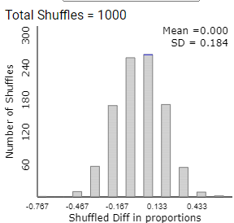
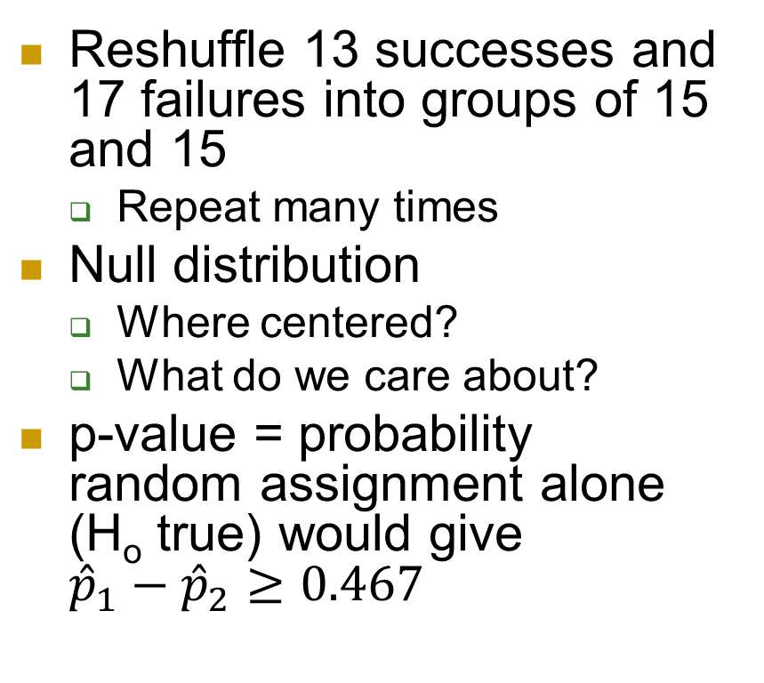
Last Time: Randomization applet
Reshuffle 13 successes and 17 failures into groups of 15 and 15
  Repeat many times
Null distribution
  Where centered?
  What do we care about?
p-value = probability random assignment alone (H_{o} true) would give ${\hat{p}}_{1}−{\hat{p}}_{2}≥0.467$

Slide 9
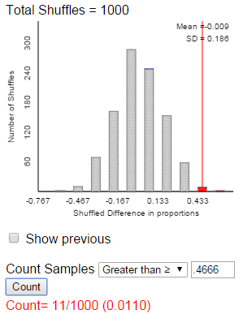
Last Time: Randomization Test
p-value measures how often the random assignment process creates a difference in the conditional proportions at least as extreme by chance alone (assuming the null hypothesis is true)
Small p-value in a randomized experiment is convincing evidence of cause-and-effect relationship (in direction of alternative hypothesis)

Slide 10
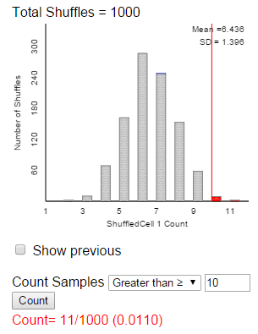
Last Time – Could use # successes in Group A as statistic
.46666 or larger
10 or more successes
Where centered?

Slide 11
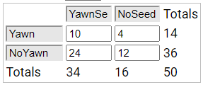
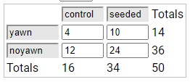
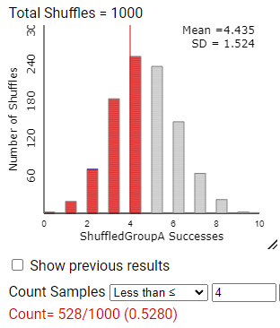
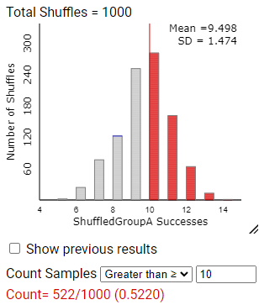
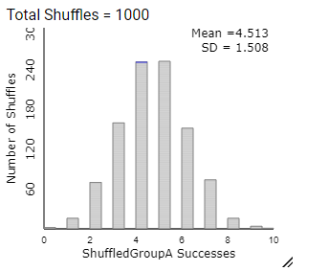
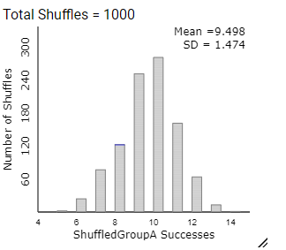
Simulation-based p-value
Inv 3.6: Is yawning contagious
  Parameter: Difference in the probability of yawning with and without a yawn seed
34/50 x 14
= 9.52
16/50 x 14
= 4.48

Slide 12
What about an “exact” p-value
Mathematical model of the shuffling process
Let X represent the number of yawners in the YawnSeed group
p-value = P(X > 10)
= number of ways to have 10 yawners
and 24 non-yawners in GroupA
number of ways to select 34 people
for the Yawnseed group
= C(14, 10) x C(36, 24)
C(50, 34)

Slide 13
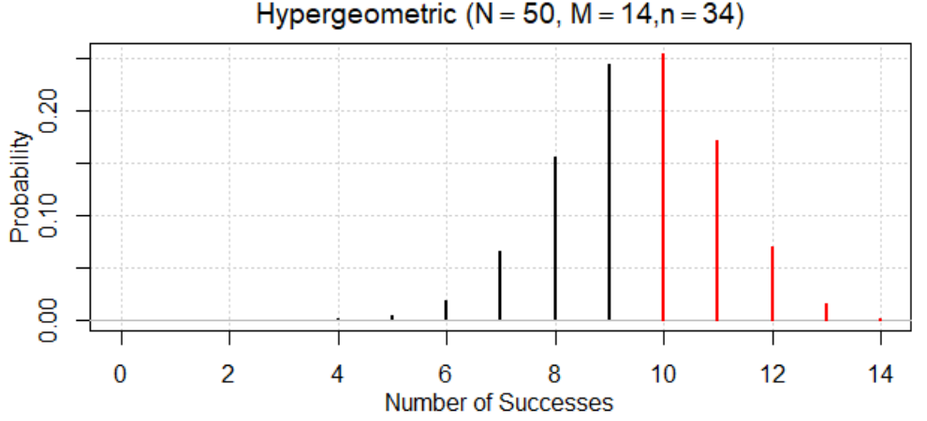

R

Slide 14

Fisher’s Exact Test
Let X count the number of successes in a sample of n objects selected from a population of N objects consisting of M successes
Two-way table applet, JMP, R

Slide 15
Fisher’s Exact Test
Once have the two-way table, are multiple equivalent ways to calculate the p-value.
  Identifying values of M, n, and N and writing out P(X ? ?)…
  Include detail on how you carried out the calculation (which inputs, which technology)
  Interpretation of p-value: X% of “random shuffles” would have a difference in proportions at least as extreme (larger or smaller?) as XX assuming no treatment effect (null hypothesis is true)

Slide 16
To Do
Office hour today 3-4pm
Continue Week 7 module: Complete Investigation 3.7 questions (a)-(e), (i) and (j)
Start HW 6
Notes:
Watch short video for Investigation 3.7

