Slide 1
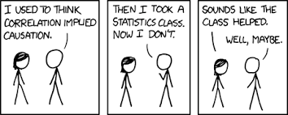
Stat 301 – Day 23
Comparing groups cont.
Notes:
Smokers?

Slide 2
Practice question 2.6
Remember to include context, measurement units
Confidence interval
Prediction interval
Use R or Theory Based Inference applet
Valid if sample size is large (30) or population distribution is normal
Interpretation: I’m 95% confident the population mean …
By hand, get t* from applet or R
Valid if population distribution is normal
Interpretation: I’m 95% confident the next observation…

Slide 3
Practice question 3.1
The proportion of games won by the home team was 0.154 larger in 2019 (with fans) than in 2020
$H_{0}:π_{2019}−π_{2020}=0$ (where $π$ is the probability the home team wins)
Could simulate random samples of 88 and 87 from binomial processes with probability of success = 97/175 or could use Normal distribution (54, 40, 34, 47 > 5)
Do I care that 88 and 87 > 30?
Do I care about “large populations”?
for distribution of differences in sample proportions

Slide 4
Practice question 3.1
I’m 95% confident that the difference in proportions is between .0015 and .047
I’m 95% confident that the probability of the home team winning is 2019 (with fans) was 0.0015 to 0.047 larger than the probability of the home team winning in 2020 (without fans)

Slide 5
Last Time
Explanatory variable vs. Response variable
e.g., EV → RV?
Confounding variables
Related to both explanatory variable and response variable
Provide possible alternative explanation for observed difference in EV groups
So can’t draw any cause-and-effect conclusions when have confounding variables
But still “drawing a conclusion”

Slide 6
Last Time
So how do we “get rid of” confounding variables?
Random assignment!
They are still there but hopefully balanced out across the explanatory variable groups. So no longer provide an alternative explanation for the group differences.

Slide 7
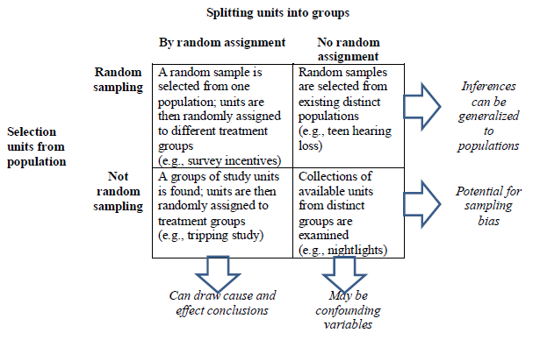
Best Table in Entire Text!

Slide 8
Practice question 3.3
A national sample of 735 households was randomly selected … 368 randomly assigned to receive monetary incentive, other 367 did not
RV = response rate
Experiment because the researchers designed which homes received incentive
Cause and effect?
Yes, due to random assignment and small p-value
Generalize to all households in nation?
Yes, due to random sampling
Do I care that these were large samples?

Slide 9
Investigation 3.4 (for HW)
Well-designed experiments include:
Comparison group(s)
Random assignment
Placebo treatments
Blindness (subjects)
Blindness (evaluator)
Standardized measures
Details of inclusion criterion

Slide 10
Investigation 3.5

Slide 11
Investigation 3.5
Did this study involve random sampling?
No volunteers, clinical depression ⇒ will need some caution in how broadly we generalize our conclusions
Why is it important to know that the subjects were randomly assigned to the two groups?
Have some belief that the groups are similar to each other at the start of the study
Why is it important to know that all other conditions were kept as consistent as possible?
Have some belief that there are no other obvious differences between the treatment groups
Why is it important that all subjects were allowed to swim with dolphins at the conclusion of the study?
Ethical considerations

Slide 12
Investigation 3.5
Overall proportion who improved
13/30 = 0.433
Conditional proportion who improved
Dolphins: 10/15 = 0.667 Control: 3/15 = 0.200
Comparison: 0.667 – 0.200 = 0.467
Any other explanation?

Slide 13
Investigation 3.5
How design a simulation to explore how much the groups could differ from random chance alone?

Slide 14
Investigation 3.5
Simulation plan
Assume the null hypothesis is true: 13 improvers and 17 non-improvers regardless of the treatment
Randomly assign 15 to each group
Calculate the difference in conditional proportions

Slide 15
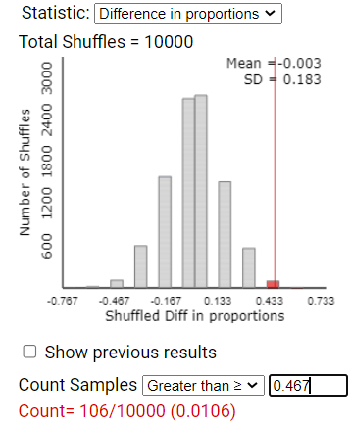
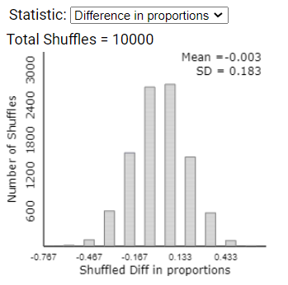
Using technology
We have strong evidence that the difference of 0.467 did not arise “by chance alone”

Slide 16
Randomization Test
p-value measures how often the random assignment process creates a difference in the conditional proportions at least as extreme by chance alone (assuming the null hypothesis is true)
Small p-value in a randomized experiment is convincing evidence of cause-and-effect relationship (in direction of alternative hypothesis)

Slide 17
To Do
Submit HW 5
Remember to include names!
Document your steps (e.g., number of observations after subsetting), include all relevant output
Distribution of what? SD of what?
Review Investigation 3.4
Review HW solutions/prepare for Quiz (Sunday)
Monday night?
Begin Week 7 assignments
Notes:
Watch short video for Investigation 3.7

