Slide 1
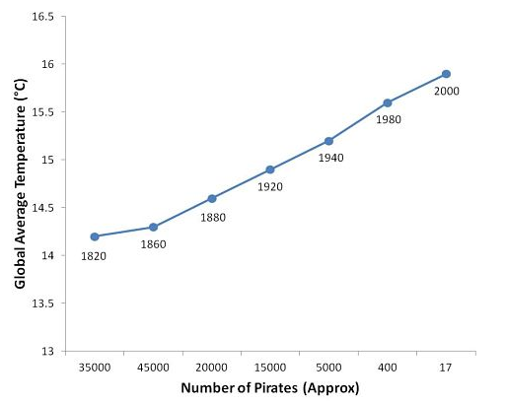
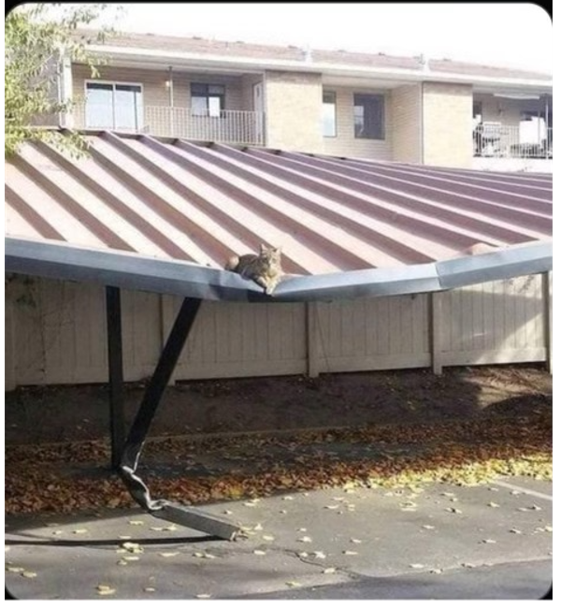
Stat 301 – Day 22
Comparing groups – Study design

Slide 2
Announcements
National Anthem winners!
HW 4 returned
Some inconsistencies with names, groups, versions…
2 pts for water survey
Check HW 5 for updated instructions
Some old videos (working through examples) posted
Have to leave by 3:30 but can zoom tonight!

Slide 3
Last Time – Chapter 3
Have “random” samples from two populations (or random processes), categorical “response” variable
Two-way table
Conditional proportions
Segmented bar graph or Mosaic plot
Inference
Parameter: $π_{1}−π_{2}$
Statistic: ${\hat{p}}_{1}−{\hat{p}}_{2}$
Difference in proportion of all teens with hearing loss
Difference in probability of hearing loss then vs. now

Slide 4
Last Time – Inference for two population proportions

Slide 5
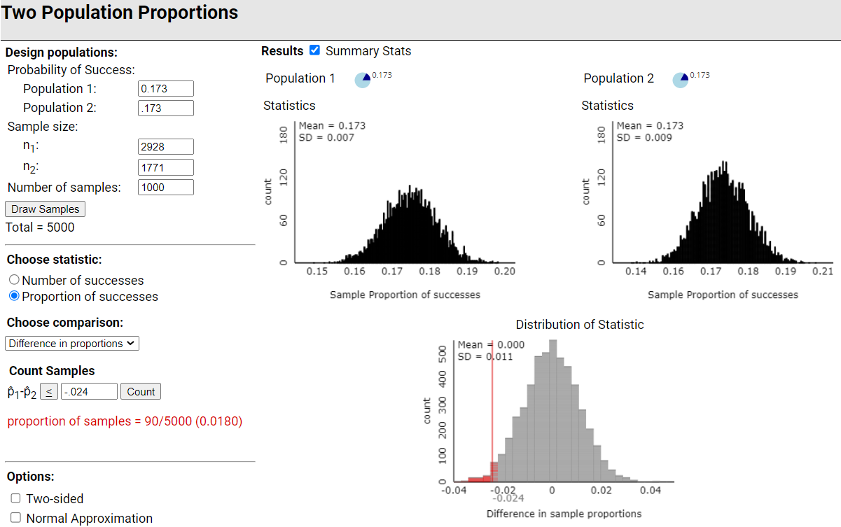
Assuming
Ho true
Binomial processes
Interpret p-value: About 2% of (pairs of) random samples have a difference in conditional proportions of -.024 or less when the two population proportions are equal
Strong evidence that $π_{95}<π_{06}$

Slide 6
We are roughly 95% confident that $π_{94 }−π_{06}$ is between -.024 + 2(0.011) = (-.046, -.002)
that the proportion of teens with some hearing loss in 1988-1994 was .002 to .046 smaller than in 2005-6

Slide 7
Central Limit Theorem

Slide 8
Theory-based approach

Slide 9
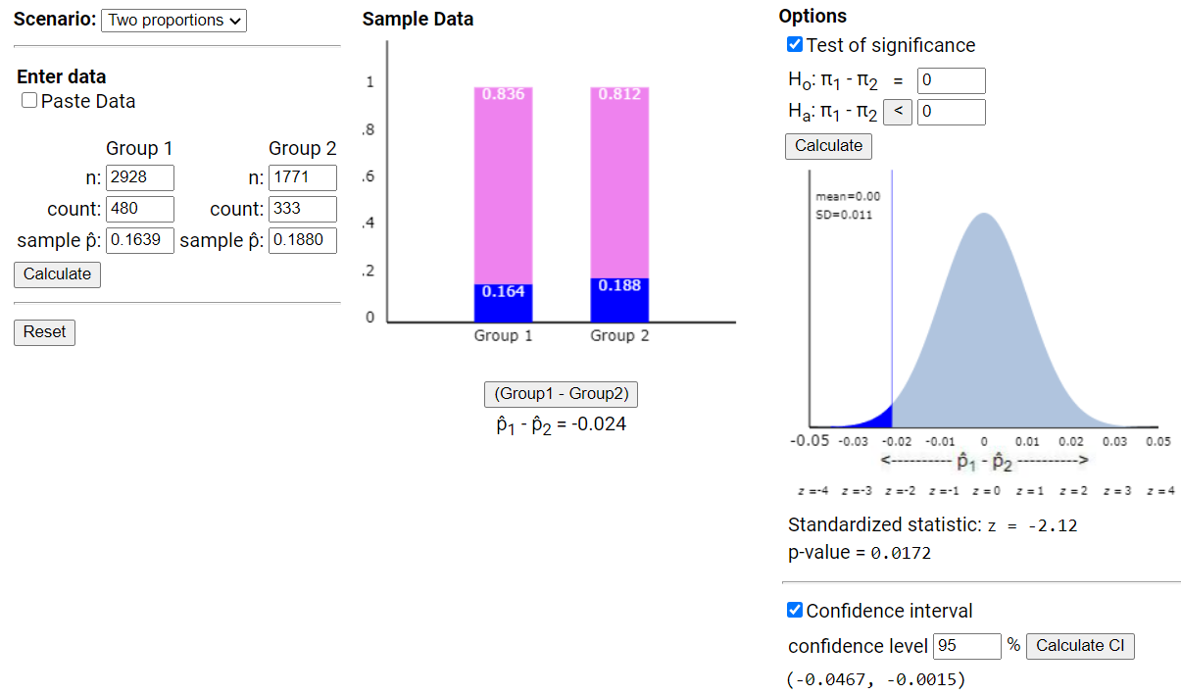
But really will just use technology
“Two-sample z-test”
“Two-sample z-interval”
Are negative values ok in this CI?

Slide 10
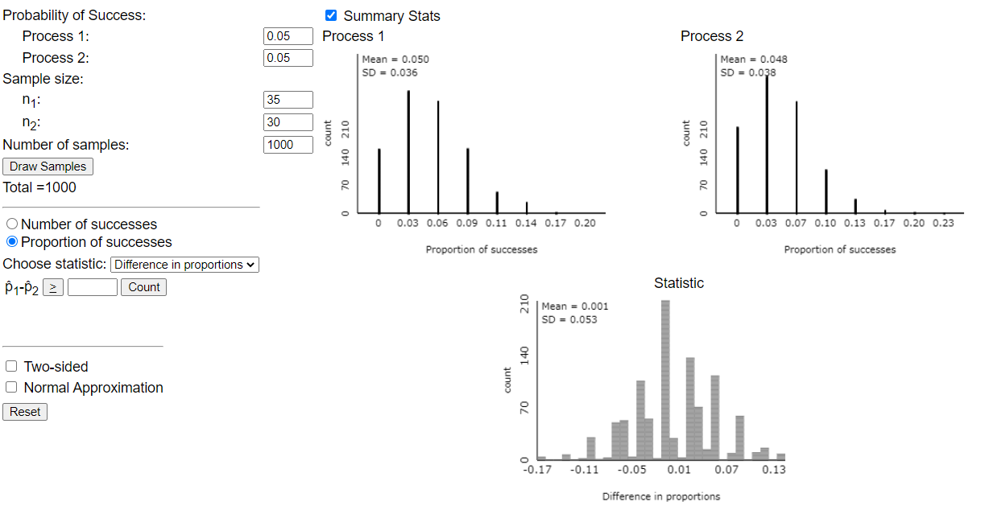
Need at least 5 S/F in each group

Slide 11
Investigations 3.2 and 3.3
Need to consider more options for how the two groups we are comparing arise
Impacts how we carry out the simulation
Spoiler alert: will still end up using two-sample z-procedures
Impacts the “scope of conclusions” we can draw
Investigation 3.2 (a)-(e)
Investigation 3.3 (a)-(f)

Slide 12
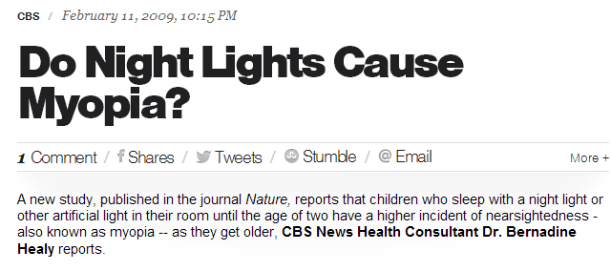
Investigation 3.2
Observational units = children
Variable 1 = type of room light (night light or not)
Variable 2 = eyesight (myopia or not)

Slide 13
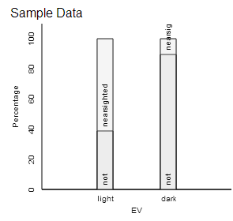
Investigation 3.2
Light: 188/307 = .6124
Without light: 18/172 = .1047

Slide 14
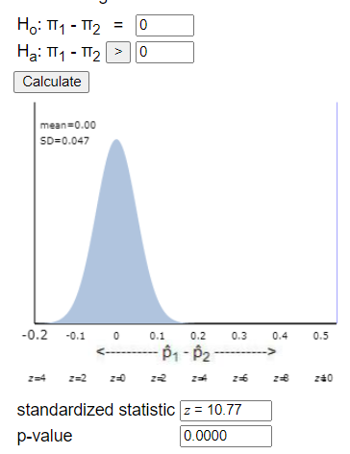

Slide 15
Investigation 3.2
(e) We have a highly statistically significant association between eyesight and type of lighting, can we conclude that using a room light before the age of 2 increases the probability of near-sightedness in children?

Slide 16
Confounding variables
The difference in myopia could be either genetics or light conditions – can’t separate!
Mostly near sighted parents
Night lights
Higher proportion with myopia in night light group
children
Darkness
Few near sighted parents

Slide 17
Confounding variables
(f) Low birth weight?
If born with low birth weight could be more likely to become near-sighted
If born with low birth weight, parents may want to check on them more often with more light
(g) 70% were Caucasian
Not a confounding variable unless the all Caucasians tends to be in only one of the groups and are more/less likely to be near-sighted
But does limit the generalizability of our conclusions!

Slide 18
Big Ideas
Confounding variables
Related to both explanatory variable and response variable
Provide possible alternative explanation for observed difference in EV groups

Slide 19
Investigation 3.3
(a) Classify the variables
EV = writing style (cursive or block)
RV = score on essay
(b) Maybe students from wealthier school districts are more likely to be taught to use cursive and also have better essay writing skills
(c) But what if the same essay and were assigned the different writing styles?

Slide 20
Big Ideas
Confounding variables
Related to both explanatory variable and response variable
Provide possible alternative explanation for observed difference in EV groups
Observational study
Always have to worry about confounding variables
Experimental study
Active imposition of EV to experimental units
Potential to draw cause-and-effect conclusions

Slide 21
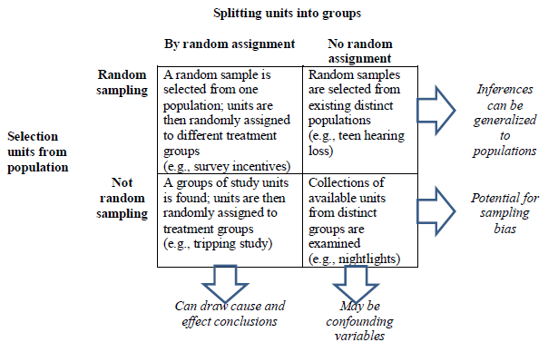
Best Table in Entire Text!

Slide 22
To Do
Submit practice questions tonight
Finish HW 5
Submit separate files
Name(s) in files

