Slide 1
Stat 301 – Day 21
Comparing two sample proportions

Slide 2
Announcements
Did a bit more touch up on Quiz 4 scores
Added applet instructions to HW 5
Added a bit more commentary (in green) to problem 3 in HW 4 solutions
Fixed technology instructions in one sample t-summary page
Note, you can “close” a module on the modules page
Let me know if you think groups are associated with an assignment you’re submitting!

Slide 3
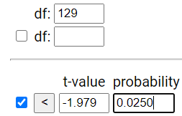
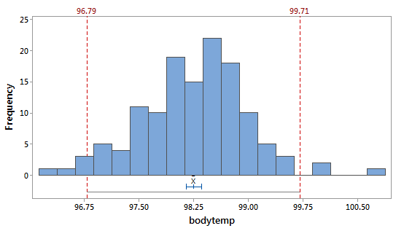
Last Time: Prediction interval
$$\overline{x}±t_{n−1 }^{∗}\sqrt{s^{2}+\frac{s^{2}}{n}}=\overline{x}±t_{n−1}^{∗}×s×\sqrt{1+1/n}$$
97.249 + 1.979 (.733) sqrt(1+ 1/130)
98.249 + 1.457 = (96.79, 99.71)
Accounts for both the sample to sample variability in $\overline{x}$ and the person to person variability in temps

Slide 4
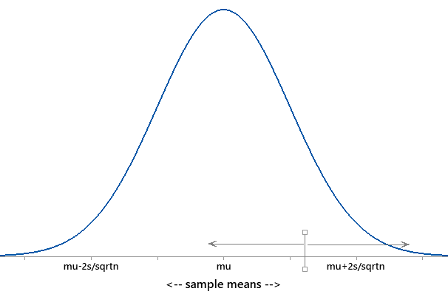
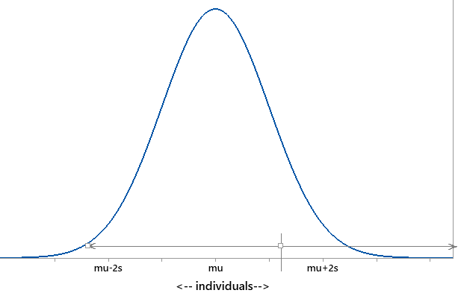
Last Time: Prediction interval
$$\overline{x}±t_{n−1 }^{∗}\sqrt{s^{2}+\frac{s^{2}}{n}}=\overline{x}±t_{n−1}^{∗}×s×\sqrt{1+\frac{1}{n}}$$
I’m 95% confident that the next observation will be between (XX, XX)
IF believe population is normally distributed
μ?
$$\overline{x}$$
98.1 98.4
96.8 99.7

Slide 5
So now
One categorical variable
One quantitative variable

Slide 6
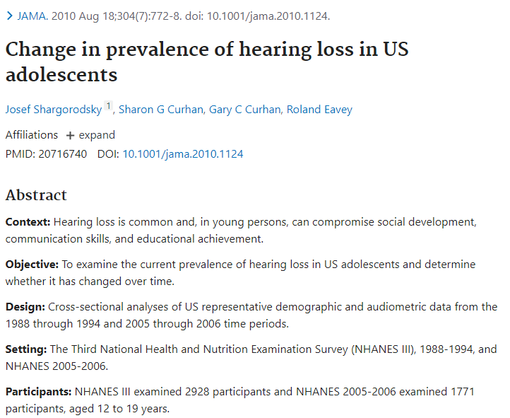
Investigation 3.1
Don’t spend too long on (i)-(k) or (s)-(t)
Technology instructions are at the very bottom of the page.

Slide 7
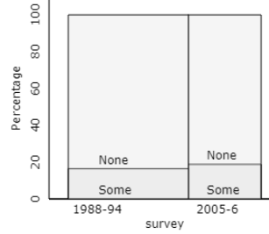
Investigation 3.1
Descriptive statistics
Statistic: Difference in conditional proportions
Graph: Segmented bar graph or mosaic plot
Preliminary evidence
Proportion with some hearing loss higher in more recent sample…

Slide 8
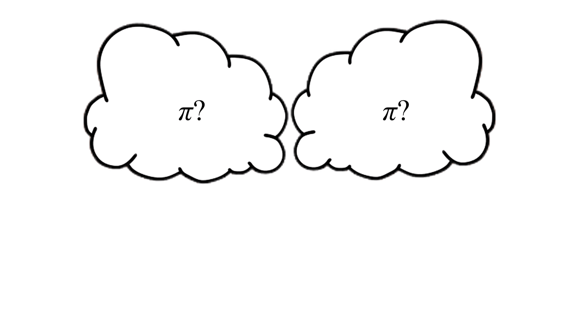
Could this have happened by chance alone?
 | 1988-94 | 2005-6 | Total
Some | 480 | 333 | 813
None | 2448 | 1438 | 3886
Total | 2928 | 1771 | 4699
Proportion | 0.164 | 0.188
Difference | -0.024
Is it possible that the population proportions are the same, and we found a difference in the sample proportions just from random sampling “error”?

Slide 9
How would you design this simulation?
(h) Null hypothesis
Random sampling

Slide 10
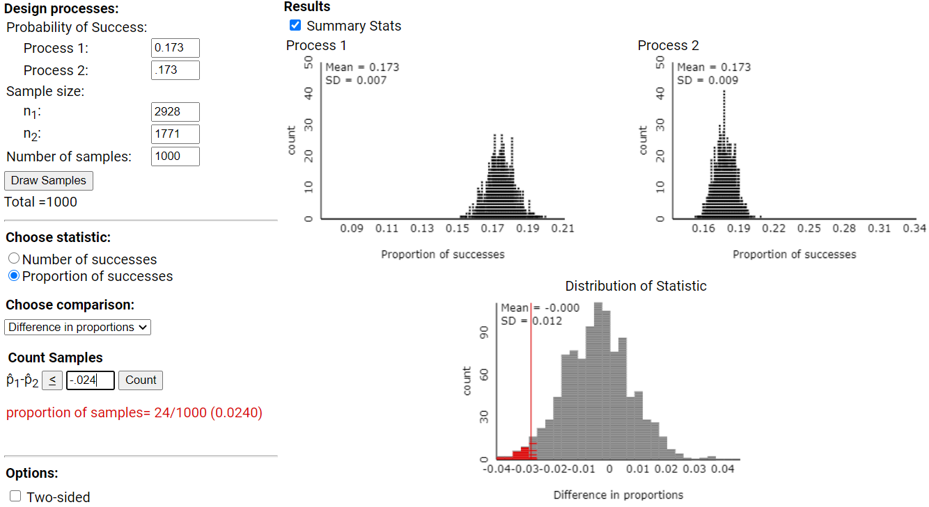

Slide 12
To Do
Verify the two-sample z-procedure calculations using R
Investigation 3.2 (a), (b), (d)
Continue HW 5

